Slide 1
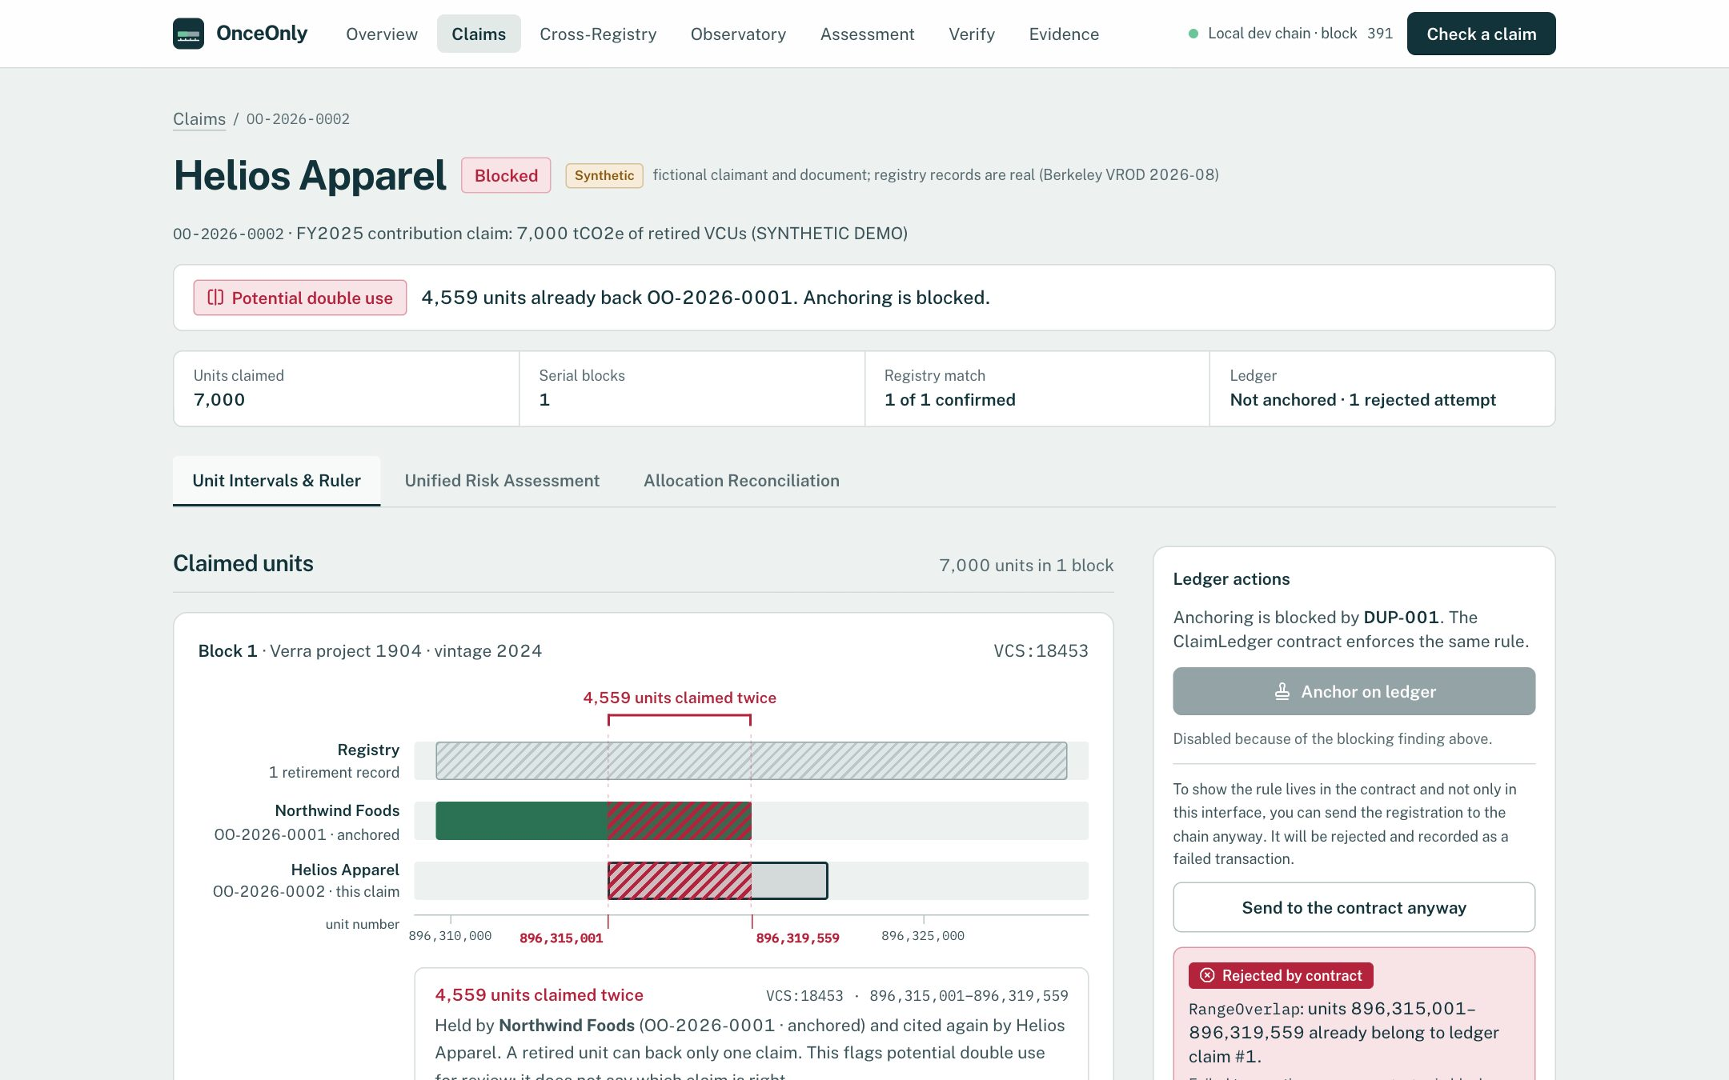
DATANOVA 2026 GLOBAL DATA-THON
OnceOnly
Every retired tonne,
claimed once.
A carbon-credit claim integrity and investigation platform. It reconciles public climate claims with real registry retirements, explains every signal with its evidence and limits, and anchors claims on a contract that refuses to register the same unit twice.
Real Verra retirement (Berkeley VROD 2026-08, batch 18453). Synthetic claimants. Local Hardhat development chain.
Siddhant Patil
github.com/Sidd927/OnceOnly-DataNova

Slide 2
THE PROBLEM
A retirement happens once. Claims about it happen everywhere.
Registries stop a credit being retired twice. Nothing checks whether the same retired units then back two companies' public climate claims.
Brokers split one retirement across many buyers, and claims cite it in reports, labels and websites, each one valid when read alone.
Hashes and string matching miss it: overlapping claims usually cite different serial strings in different documents.
VCS:18453 real Verra retirement · 19,999 units
Registry retirement
Northwind Foods · claim A (anchored)
Helios Apparel · claim B
4,559 units claimed twice
896,315,001 – 896,319,559
The contract reverts claim B: RangeOverlap(…, 896315001, 896319559)
OnceOnly · Every retired tonne, claimed once.
02

Slide 3
WHY SIMPLE CHECKS FAIL
The evidence is fragmented, and the obvious shortcuts break
0.333
159,511
62.7 %
2 roles
recall of exact serial / document-hash matching
spurious overlaps if the batch is ignored
of analysed retirements name no beneficiary
broker vs principal, parent vs subsidiary
It misses every reformatted, partial, contained or superset overlap in the 270-pair evaluation.
Unit numbers restart in every issuance batch (11,631 Verra + 147,880 Gold Standard adjacent pairs). Ranges must be keyed by registry and batch.
Undisclosed is a disclosure fact, not misconduct, but it limits who can be linked to which units.
"Retired on behalf of" and related companies look like conflicts to a naive interval check, and similar names are not legal identity.
Sources: eval/results/latest.json and registry_audit.json (full Berkeley VROD 2026-08: 493,518 rows); beneficiary share from the 37,335-retirement demo subset.
OnceOnly · Every retired tonne, claimed once.
03

Slide 4
OUR SOLUTION
From a claim document to an explained, verifiable result
01
02
03
04
05
06
Read
Reconcile
Allocate
Profile
Assess
Anchor, verify
Deterministic serial parser with provenance on every block; SHA-256 of each document
Serials become unit intervals in (registry, batch) namespaces, matched to real retirements
Interval geometry + entity resolution: split, broker, related parties or conflict
Disclosure, concentration, fragmentation, timing and cross-registry context
16 deterministic rules, 6 scopes; evidence, counterevidence, missing data, next step
ClaimLedger refuses overlapping units; per-check public verification
WHO IT IS FOR
Sustainability auditors
check a client's claim against registry records and other claims
Registry / standards reviewers
see how retirements are split, disclosed and timed
Carbon-market analysts
triage projects, batches and entities with explainable signals
Highlighted steps (Allocate, Assess) are the DATANOVA additions to the original claim-ledger core.
OnceOnly · Every retired tonne, claimed once.
04

Slide 5
ARCHITECTURE
Explainable analytics off-chain; one invariant on-chain
Data
FastAPI backend · Python 3.12
ClaimLedger.sol
· Berkeley VROD 2026-08 (real): 493,518 rows; demo subset 38,004 rows, 22 projects
· Non-destructive normalization: raw values kept
· Synthetic claim documents
· Curated benchmarks (124 + 36 cases)
· Claim pipeline: serials → registry rules → findings → report hash
· 2A entity resolution: normalization, intermediaries, blocking, matching
· 2B allocation reconciliation: interval algebra, 8 allocation classes
· 2C concentration · fragmentation · temporal · cross-registry
· Stage 4 assessment: 16 rules, dependency groups
· Verification: on-chain vs off-chain checks reported separately
· SQLite (claims, read-only registry DB) · content-addressed evidence
· Ranges keyed by keccak(registry:batch)
· O(1) hinted sorted list; RangeOverlap revert
· Local Hardhat chain 31337
React 19 UI
· Overview · Claims · Cross-Registry
· Observatory · Assessment
· Verify · Evidence
· Bespoke SVG charts, no chart library
Deployment: one Docker image (private chain, contract, seeded demo, API serving the UI), about 280 MB of memory; Render blueprint prepared.
OnceOnly · Every retired tonne, claimed once.
05

Slide 6
TECHNICAL DIFFERENTIATION
Intervals, not hashes. Classes, not one red flag.
Allocation-aware reconciliation
Namespace isolation
Defensible statistics
Six geometric and eight allocation classes separate a legitimate split, a broker acting for a disclosed principal, related companies and an unresolved beneficiary from a conflict between unrelated claimants.
Every comparison is inside one (registry, batch). Identical numbers or project IDs across registries are an identifier collision, never the same asset.
HHI and entropy over disclosed volume only; pooled vs within-batch Gini reported separately; leave-one-out MAD bursts; absolute vs relative small allocations.
Explainability by construction
Verification you can redo
A contract that scales
16 versioned deterministic rules; each finding carries thresholds, counterevidence, missing data and a next step; correlated signals grouped so they cannot double-count.
Document, commitment, ranges, network and deployed bytecode checked separately; database lookups never counted as on-chain proof.
Registration gas flat at 301,452 from 10 to 200 active ranges per batch (linear v0: 832,608); a bad hint reverts, it never skips the check.
OnceOnly · Every retired tonne, claimed once.
06

Slide 7
EVIDENCE AND VALIDATION
Measured, and labelled for what each test measures
Double use on 270 synthetic claim pairs citing real Verra ranges
Data and analysis checks
Registry serials → unit ranges (full VROD)
493,518 / 493,518
Overlaps inside one batch (Verra)
0 of 307,416
Entity resolution, 124 curated pairs
P 1.000 · R 0.964
Allocation class, 36 curated scenarios
36 / 36
Serial extraction, 60 synthetic snippets
100 % in-sample
Population metrics, independent SQL re-run
exact match
Software tests (this release)
Ground truth uses the engine's interval definition, so 1.000 verifies the implementation; the finding is what the simpler methods miss. Not real-world accuracy.
274 backend · 24 contract · 45 browser · 13/13 end-to-end
Demo state fingerprint reproduced: c544f589…6483b
OnceOnly · Every retired tonne, claimed once.
07

Slide 8
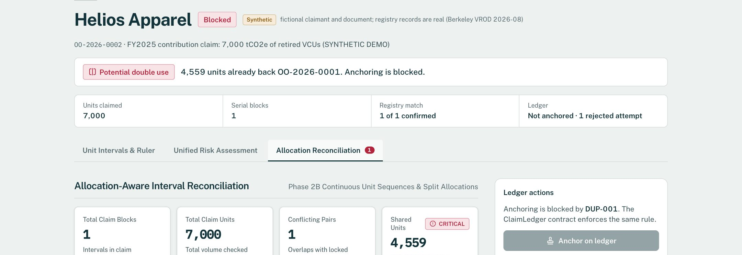
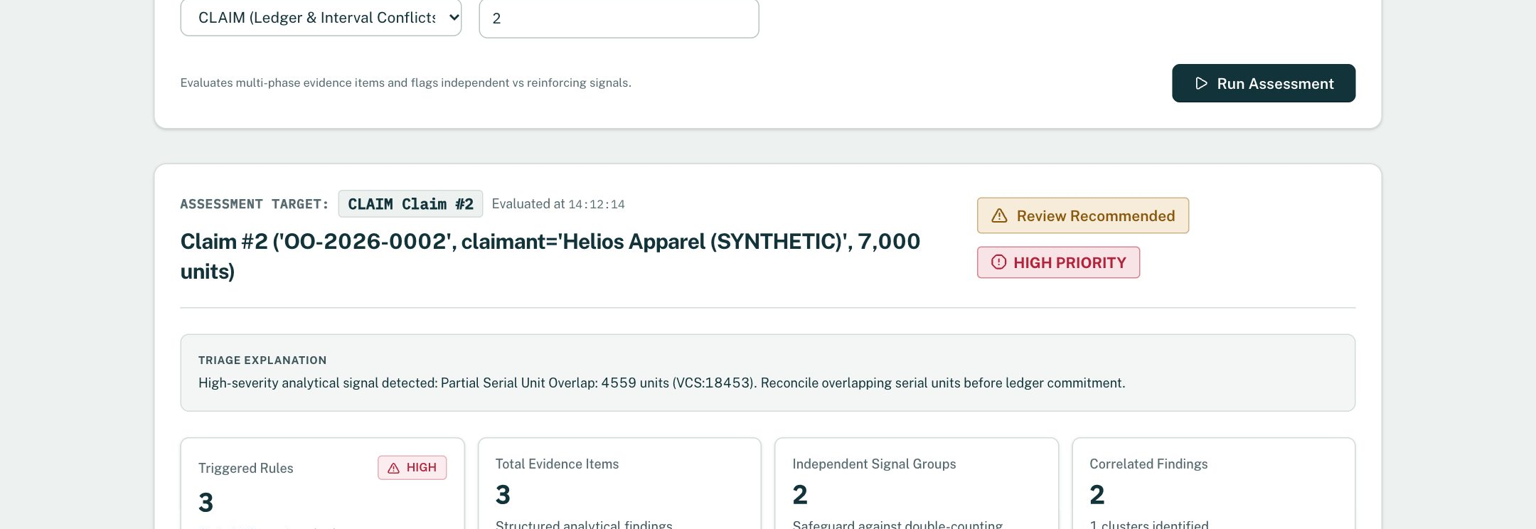
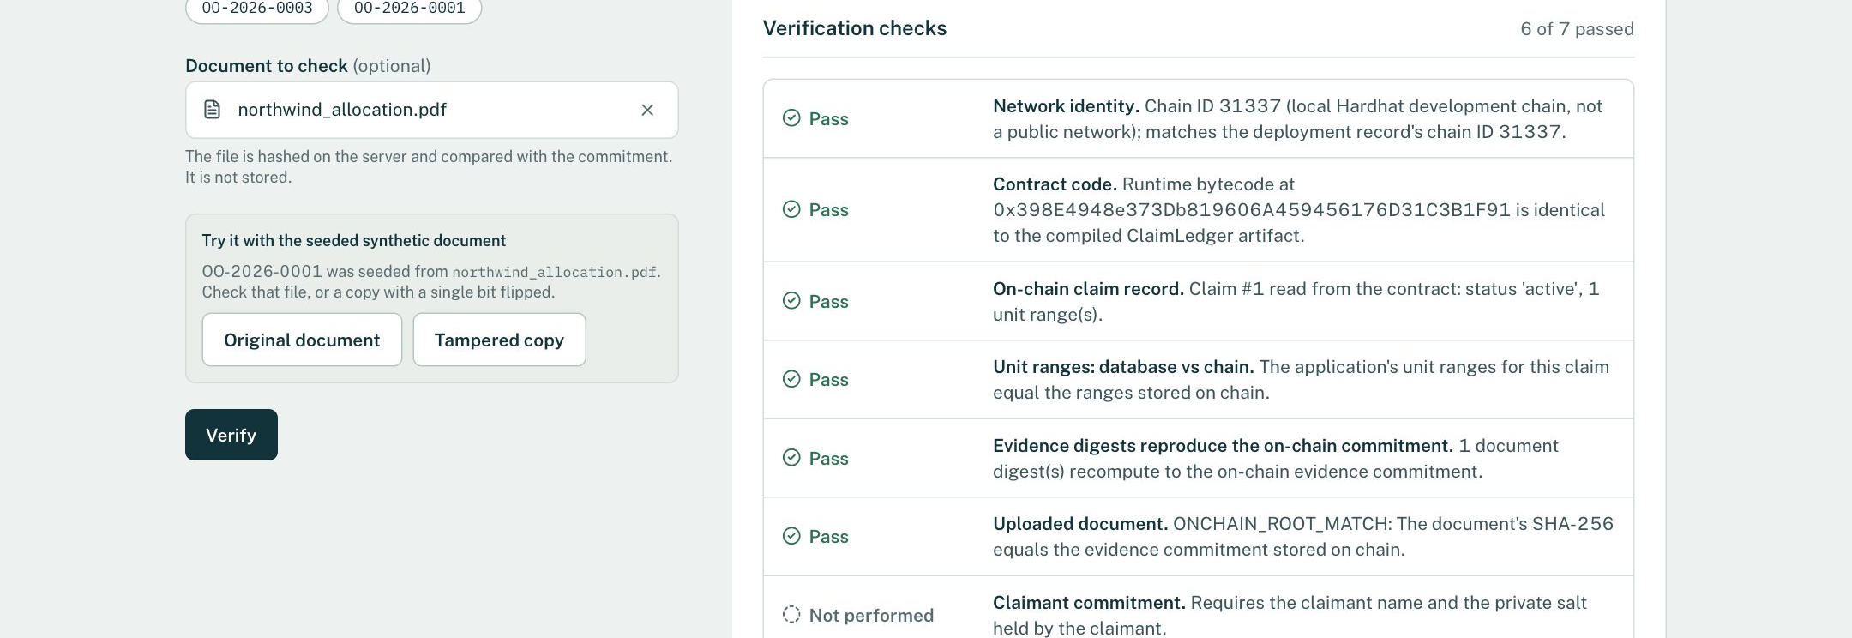
PRODUCT DEMONSTRATION
One real retirement, two synthetic claims, every step explained
1 · The Ruler: 4,559 units already back Northwind's anchored claim; the contract rejects the second registration
2 · Allocation reconciliation: ALLOCATION_CONFLICT between different entities, with a next step
3 · Assessment: RULE-REC-002 with metrics, limitations and grouped concentration signals
4 · Verification: seven separate checks, including deployed bytecode and the document commitment
OnceOnly · Every retired tonne, claimed once.
08

Slide 9
TRUST, LIMITATIONS AND RESPONSIBLE USE
What it verifies, what it flags, what it cannot conclude
VERIFIES
FLAGS FOR REVIEW
CANNOT CONCLUDE
· Serial strings parse into exact unit ranges and match registry retirement records (snapshot 2026-08-31)
· Two claims share specific units in the same registry batch
· A document is byte-identical to what was committed on chain
· The deployed contract code matches the compiled artifact
· Potential double use, classified by allocation type
· Concentration, fragmentation, timing anomalies
· Candidate cross-registry project links
· Missing beneficiary information (reported, never imputed)
· Fraud, intent, or which claim is legitimate
· Legal identity from similar names or parent/subsidiary links
· Credit quality, additionality or permanence
· Anything about the whole market: analytics cover a 22-project subset
Trust boundaries: local Hardhat development chain (31337), not a public network · one trusted registrar key, no claimant signatures · synthetic claimants · static registry snapshot · AI extraction implemented but not measured · benchmarks synthetic or curated, not real-world accuracy.
OnceOnly · Every retired tonne, claimed once.
09

Slide 10
IMPACT AND NEXT STEPS
From a working prototype to a usable integrity check
Practical value
Credible path forward
Catches what document review and hashing miss: partial and reformatted overlaps of the same retired units.
Makes analysis reviewable: every signal shows its rule, threshold, counterevidence and next step, so an auditor can defend or reject it.
Reproducible: public data, open code, one-command container, deterministic demo state.
Neutral ordering: a contract invariant that the operator's own UI cannot bypass.
1
Public testnet deployment with claimant-signed registrations (EIP-712)
2
Per-document Merkle commitments and proofs
3
Registry data beyond the 2026-08 snapshot; more registries
4
Measure AI extraction (accuracy, cost, latency) on real documents
5
Pilot with real published claims, with consent, to measure prevalence
Run it: make docker-build && make docker-run → http://127.0.0.1:7860
Code, data notes and methodology: github.com/Sidd927/OnceOnly-DataNova · Registry data: Berkeley Carbon Trading Project, VROD v2026-08 (CC BY 4.0)
OnceOnly · Every retired tonne, claimed once.
10

