Slide 1
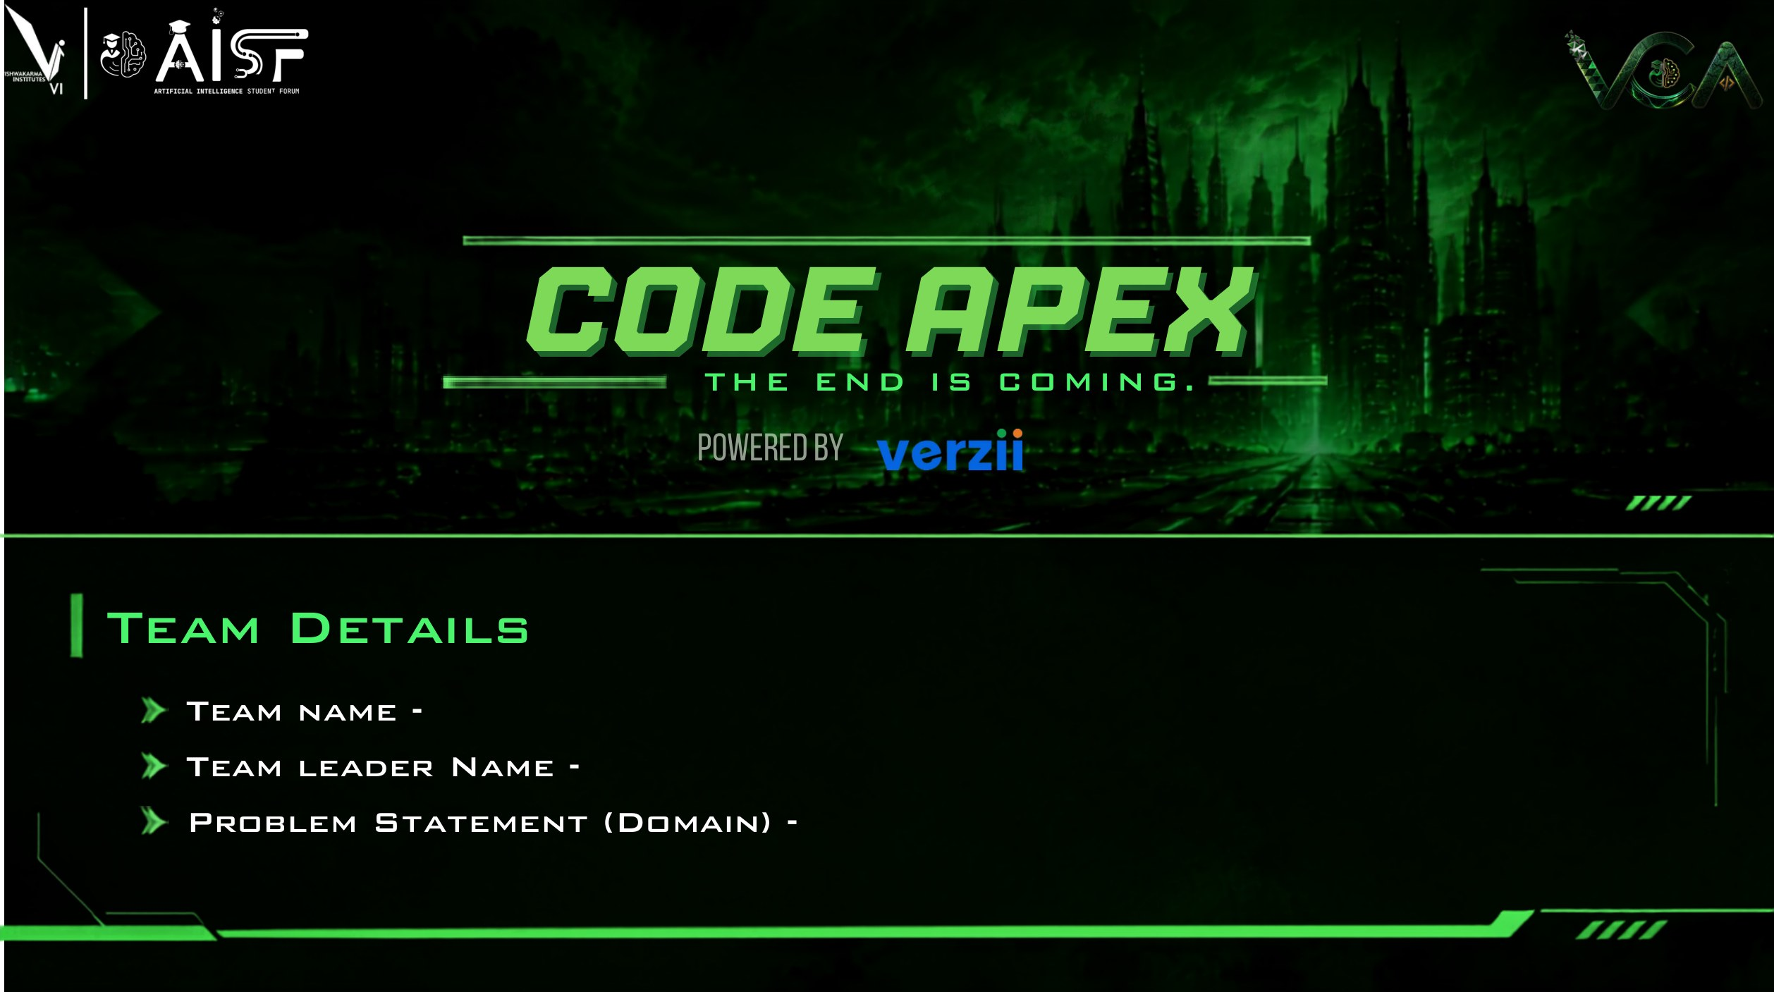
Mac_Enthu
Aayush Aade
Track 1 (Emerson) · PS 1.2 Project IO SIGNAL SUDOKU
SlotSmith · rule-driven, independently checked, revision-aware DeltaV I/O allocation
Notes:
Team Mac_Enthu. Problem statement: Track 1 (Emerson), Project IO SIGNAL SUDOKU (PS #02 in Track_1_PS_description.pdf; registered as PS 1.2). Solution name: SlotSmith.

Slide 2
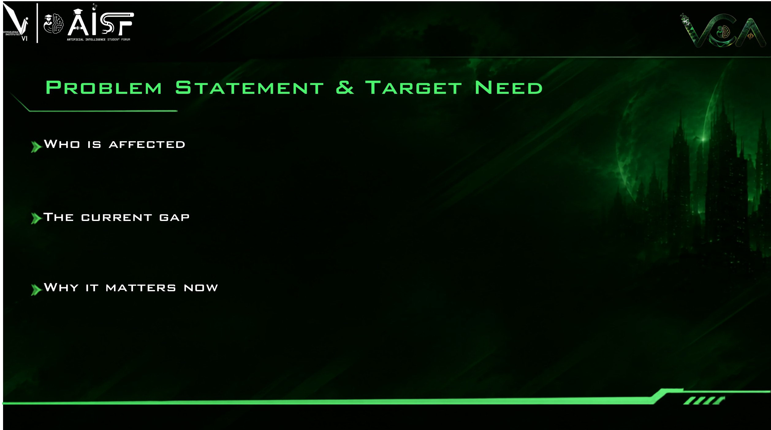
THE PUZZLE, PER EMERSON'S RULEBOOK
Cabinet
≤ 4 CIOCs
CIOC
8 baseplates
Baseplate
12 CHARMs
CHARM
1 signal
DeltaV project and I/O engineers (Emerson and system integrators) who must give every field signal an exact home: cabinet → CIOC → baseplate → CHARM slot. Downstream, panel builders and site teams wire to that allocation.
24-pair cable = 2 full baseplates (22 signals + 2 wired spares)
Emerson's PS: 10,000+ signals are allocated by hand in Excel, and each customer revision means reworking it and tracing the impact again. DeltaV tools automate the steps around it (auto-sense, late binding, Bulk Edit); we found no public tool that places signals from project rules (internal tools may exist).
Smaller cables share a baseplate, in pair order
AI
AO
DI
DO
DO iso+fused
spare
free
Electronic Marshalling makes late changes physically cheap ("without lifting a wire"), but allocation planning and revision tracking remain a manual workflow burden (per the PS). Six interacting rules must hold at once, on every revision, with a technical query (TQ) for each data conflict.
1 Keep IO groups together
2 A and B never share a CIOC
3 Capacity 12 · 8 · 4
4 Cable intact, in pair order
5 ~10% spare per cabinet
6 Right CHARM + terminal block
Sources: Emerson PS #02 p.4; DeltaV Electronic Marshalling PDS (Aug 2026); Smart Commissioning WP (2021) p.5; Bulk Edit WP (2022).
Notes:
Who: DeltaV project/IO engineers. Gap: PS #02 p.4 states allocation is done by hand in Excel for 10,000+ signals and every revision means rework. Emerson-documented automation: auto-sense and drag-and-drop controller assignment (EM PDS Aug 2026 p.2), late binding with manual drag-drop or bulk edit for non-HART signals (Smart Commissioning WP p.5), Bulk Edit TAB-delimited import (Bulk Edit WP). Absence of a public allocation tool is NOT proof that none exists. Hardware facts: 12 CHARMs per baseplate, 8 baseplates (96 channels) per CIOC (EM PDS). 4 CIOCs per cabinet is a PS project rule.

Slide 3
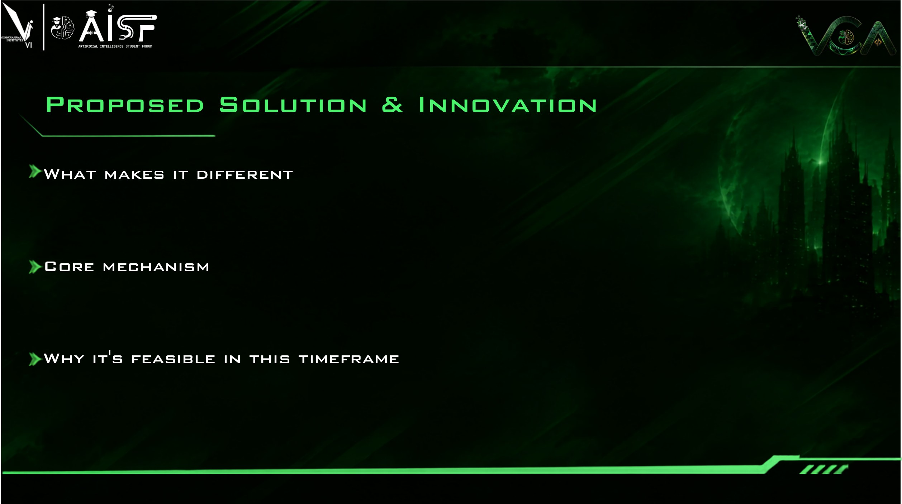
WHERE AI HELPS, AND WHERE IT MUST NOT
AI-assisted, always reviewed
Column auto-mapping for unseen MDBs
Plain-English rule → JSON draft, schema-checked and previewed
Customer-ready TQ wording
Status: planned for Round 2+
Solver + independent verifier
Every placement decision
Rule verification
Excel export and revision diff
Status: built and tested
Independently checked: a separate verifier re-reads the exported workbook (11 rule families).
Revision-aware: unchanged cables stay put; CP-SAT repairs changes locally.
Configurable: existing rule parameters live in JSON; new rule types may need code.
Traceable TQs: every TQ cites a rule ID and the MDB file and row.
Each cable becomes one block of 24/12/6/2 slots (spares included). Blocks are packed per group and A/B side into 12-slot baseplates, then baseplates fill CIOCs (8) and cabinets (4, minus the spare reserve) in group order. Proved: for one A/B side with cable sizes 2/6/12 (24 = two full baseplates), first-fit-decreasing uses the fewest baseplates. Tested, not proved: whole-group totals matched an exact CP-SAT solver in 19,682 exhaustive small cases and 12/12 benchmark runs.
DESIGN PRINCIPLES
Check, don't trust: nothing ships without an independent rule-check report
No AI in placement: a solver places signals; AI only suggests, users confirm
Change locally: a revision keeps unchanged cables in place and reports every move
Surface, don't hide: every unresolved issue becomes a TQ with its rule and source row
Built on Python, OR-Tools CP-SAT and openpyxl, all open source, with a synthetic MDB generator built from the published rulebook. The working prototype already allocates and verifies 20,033 synthetic signals in 6.0 s on a laptop (slide 6).
Notes:
Divisible-size argument: with sizes from a divisible chain and capacity divisible by every size, processing in decreasing order keeps every bin's free space a multiple of the current size, so FFD opens a new bin only when all others are full. Hence #bins = ceil(total/12), the lower bound. Related literature: Coffman, Garey and Johnson, Bin packing with divisible item sizes, J. Complexity 1987. CP-SAT (Google OR-Tools, Apache-2.0) is used for local revision repair (window-local; not always proven optimal). The proof covers one A/B side class; whole-group optimality was tested against exact CP-SAT (artifacts/audit/ffd_exact.json), not proved. AI components are planned and bounded; they never place signals.

Slide 4

DATA FLOW (solid = built; dashed = planned)
Streamlit prototype (built): rule panel, cabinet map, TQs, diff; React + TS later
Customer IO MDB
one or many Excel files
1 · Ingest + map
auto-map columns, keep row provenance
2 · Validate
data + rule conflicts → TQ list
4 · Allocator
cable blocks → baseplates → CIOCs → cabinets
Python 3.12 · pandas · openpyxl · pydantic typed rule sets · CLI
Project files: JSON rule sets, Rev A/B workbooks, run log (SQLite planned)
Deliverable
filled Excel workbook + rule-check report
5 · Independent verifier
re-reads the workbook; shares no code with 4
6 · Exporter
allocation, summary, TQs, impact
OR-Tools CP-SAT (Apache-2.0). Optional LLM for mapping/rule drafts: model declared, never places signals
UI (Streamlit)
built prototype: rule panel, map, TQs, diff
AI helpers
planned: mapping + rule-draft suggestions
3 · Rule set
JSON parameters used by 2 · 4 · 5
7 · Revision engine
Rev A + Rev B: pin unchanged, CP-SAT window repair
Runs offline on a laptop · pytest + Hypothesis · git; Docker for demo (planned)
Row provenance (file:sheet:row) travels with every signal, so each TQ and placement is traceable.
Notes:
Frontend: Streamlit MVP first (fastest path to a usable rule panel), React later if time allows. Backend: Python. Solver: Google OR-Tools CP-SAT, Apache-2.0. The verifier imports nothing from the allocator or exporter; it parses names back into positions using the user's naming patterns and re-derives CHARM/TB from the rule table. LLM use is optional and limited to suggestions a user confirms.

Slide 5

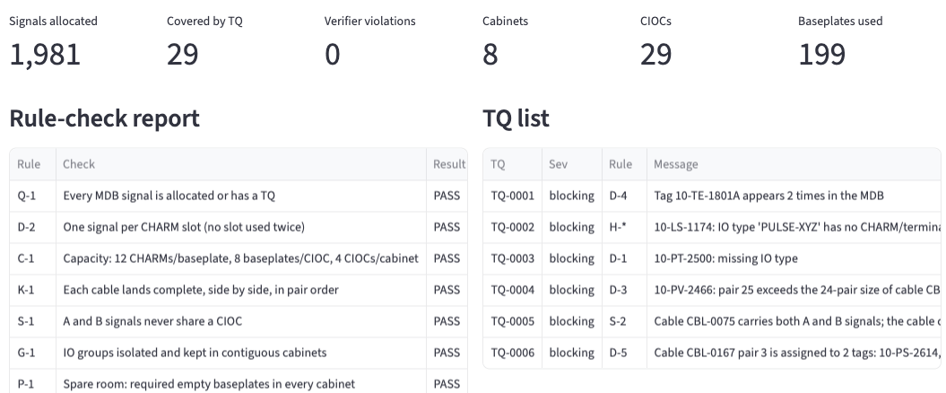
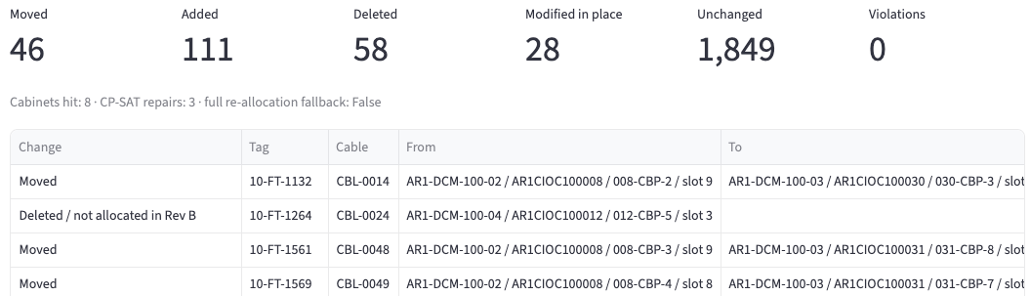
1 · Upload
2 · Set rules
3 · Allocate
4 · Report + TQs
5 · Revise
Excel MDB(s) in; columns auto-mapped with provenance
Rule panel: toggle, edit, save rule sets per project
One click: signal → cabinet, CIOC, baseplate, CHARM
Fill %, spares, rule check, TQ list with sources
Rev B vs Rev A: unchanged stay put; impact report
Built
Built (prototype panel)
Built
Built
Built
ENGINE OUTPUT: CABINET AR1-DCM-100-01 (synthetic 900-signal MDB)
PROTOTYPE UI (real screenshots, post-audit build)
001 · G1 · A
002 · G1 · B
003 · G1 · B
(empty CIOC position)
AI
SYNTHETIC 2,000-signal MDB (6 injected errors) + synthetic Rev B. Top: allocate. Bottom: revise.
AO
DI
DO
DO iso+fused
relay TB
wired spare
free
Notes:
Everything in the lower half is generated by the prototype from synthetic MDBs (seeded), not drawn by hand. Left: cabinet map drawn from the allocator output. Right: screenshots of the Streamlit prototype UI (2,000-signal synthetic MDB with 6 injected errors; Rev B synthetic). The same engine runs from the CLI and produces the workbook (sheets: IO Allocation, Cabinet Summary, TQ List, Rule Check, Revision Impact, Rule Set, Run Info).

Slide 6
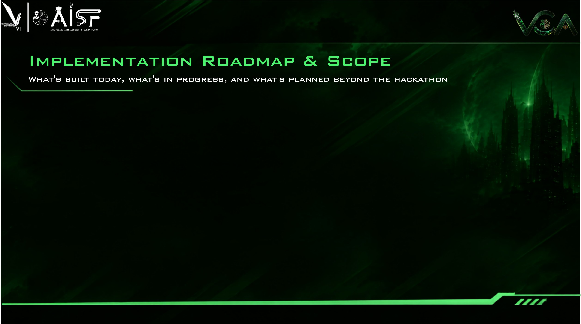
BUILT TODAY · 10 OCT
ROUND 2 · BY 16 OCT
GRAND FINALE · 24 OCT
BEYOND THE HACKATHON
Synthetic MDB + Rev B generator (seeded)
Ingestion: multi-file, header detection, auto-map
Validation → TQs citing rule + source row
Allocator: cable blocks, FFD, groups, A/B, spares, CHARM/TB, names
Independent verifier: 11 rule families
Excel export incl. rule check + impact
Revision engine + CP-SAT window repair
Streamlit prototype UI
31 automated tests incl. property-based
UI polish: mapping review/override, CHARM-table editing, exports
Map to the organiser template once released
Confirm open rule interpretations with mentors
Cut CP-SAT repair time and run-to-run variance
Run on organiser samples + hidden test
AI helpers: column-mapping suggestions, plain-English → rule JSON (previewed)
Demo hardening, offline bundle
Bulk-Edit-style export for DeltaV import (format to be validated)
Other electronic-marshalling platforms (untested)
Cabinet labels and drawings
MEASURED ON SYNTHETIC DATA (prototype, Apple M5) · not evidence about the hidden test
0
100%
81/81
0
5.99 s
429–470 vs 49,805
verifier violations in 12 runs (500–20k signals)
of rows allocated or covered by a TQ
injected data errors raised as TQs
baseplates above the exact per-group minimum (12 runs)
end-to-end for 20,033 signals (median)
moved: SlotSmith vs re-run, 10 Rev B cases, 3 runs; CP-SAT proven exact in 7/11 window repairs
Notes:
All measured figures come from scripts/benchmark.py → artifacts/benchmarks.json (generated 2026-10-10 12:25:40 IST). Synthetic data only. Revision cases: 2k and 10k signals, 5 seeds each, Rev B = 3% deleted, 5% added (half on spare pairs), 2% IO-type changes, 1 cable regrouped. CP-SAT repair was needed in 7 of 10 cases; window repairs proven exact in 7/11, the rest best-found within 10 s. Revision move totals varied across 3 runs (429–470) because CP-SAT runs multi-threaded under a wall-clock limit; allocation results were identical across runs. full-reallocation fallback in 0. Max revision time 53.87 s.

Slide 7

IO / project engineers
Reviewers and QA
Customers and EPCs
Allocation becomes a re-runnable, rule-checked step instead of hand-editing 10,000+ Excel rows.
Every deliverable ships with a rule-check report; every placement and TQ traces to an MDB row.
Specific, traceable TQs and a Rev A → Rev B impact report: added, deleted, moved, cabinets hit.
HOW BIG THE OPPORTUNITY IS (sourced)
HOW IT GROWS BEYOND A DEMO
10,000+
signals per project, allocated by hand today (Emerson PS)
Rule sets saved per customer and project: the next project starts from the last one
Designed to complement DeltaV and SPI: an export adapter to their import formats is planned (not yet validated)
Block-packing engine could be adapted to other electronic-marshalling I/O families (untested)
Near-linear runtime measured: 0.6 s at 2k, 3.0 s at 10k, 6.0 s at 20k signals (synthetic)
≤ 300
CIOCs per DeltaV system (spec maximum) → at most 28,800 CHARM channels (EM PDS)
Every
customer revision means rework and impact tracing (Emerson PS)
HONEST LIMITS TODAY
Synthetic data only: the organiser's sample MDB and template are not yet released, so no official-template compatibility is claimed. Rule interpretations (straddling, spare rounding, controller mapping) await mentors. Rules are parameters; new rule types still need code. CP-SAT repair is window-local. No time savings claimed. Complements DeltaV tools; does not replace them.
Notes:
Impact statements are expected, not measured. Sources: PS #02 p.4 (10,000+ signals, manual Excel, revisions); DeltaV Electronic Marshalling PDS Aug 2026 p.10 ('Number of CIOCs per System: 300', a specification maximum; 96 channels per CIOC). Positioning: complementary pre-configuration engineering assistant; see docs/emerson_product_analysis.md.

Slide 8

Team Mac_Enthu · Aayush Aade (lead) · Siddhant Patil · Gaurang Bagwe
Notes:
Thank you. Repository, rule register, source register and benchmark logs are available on request.

