Slide 1
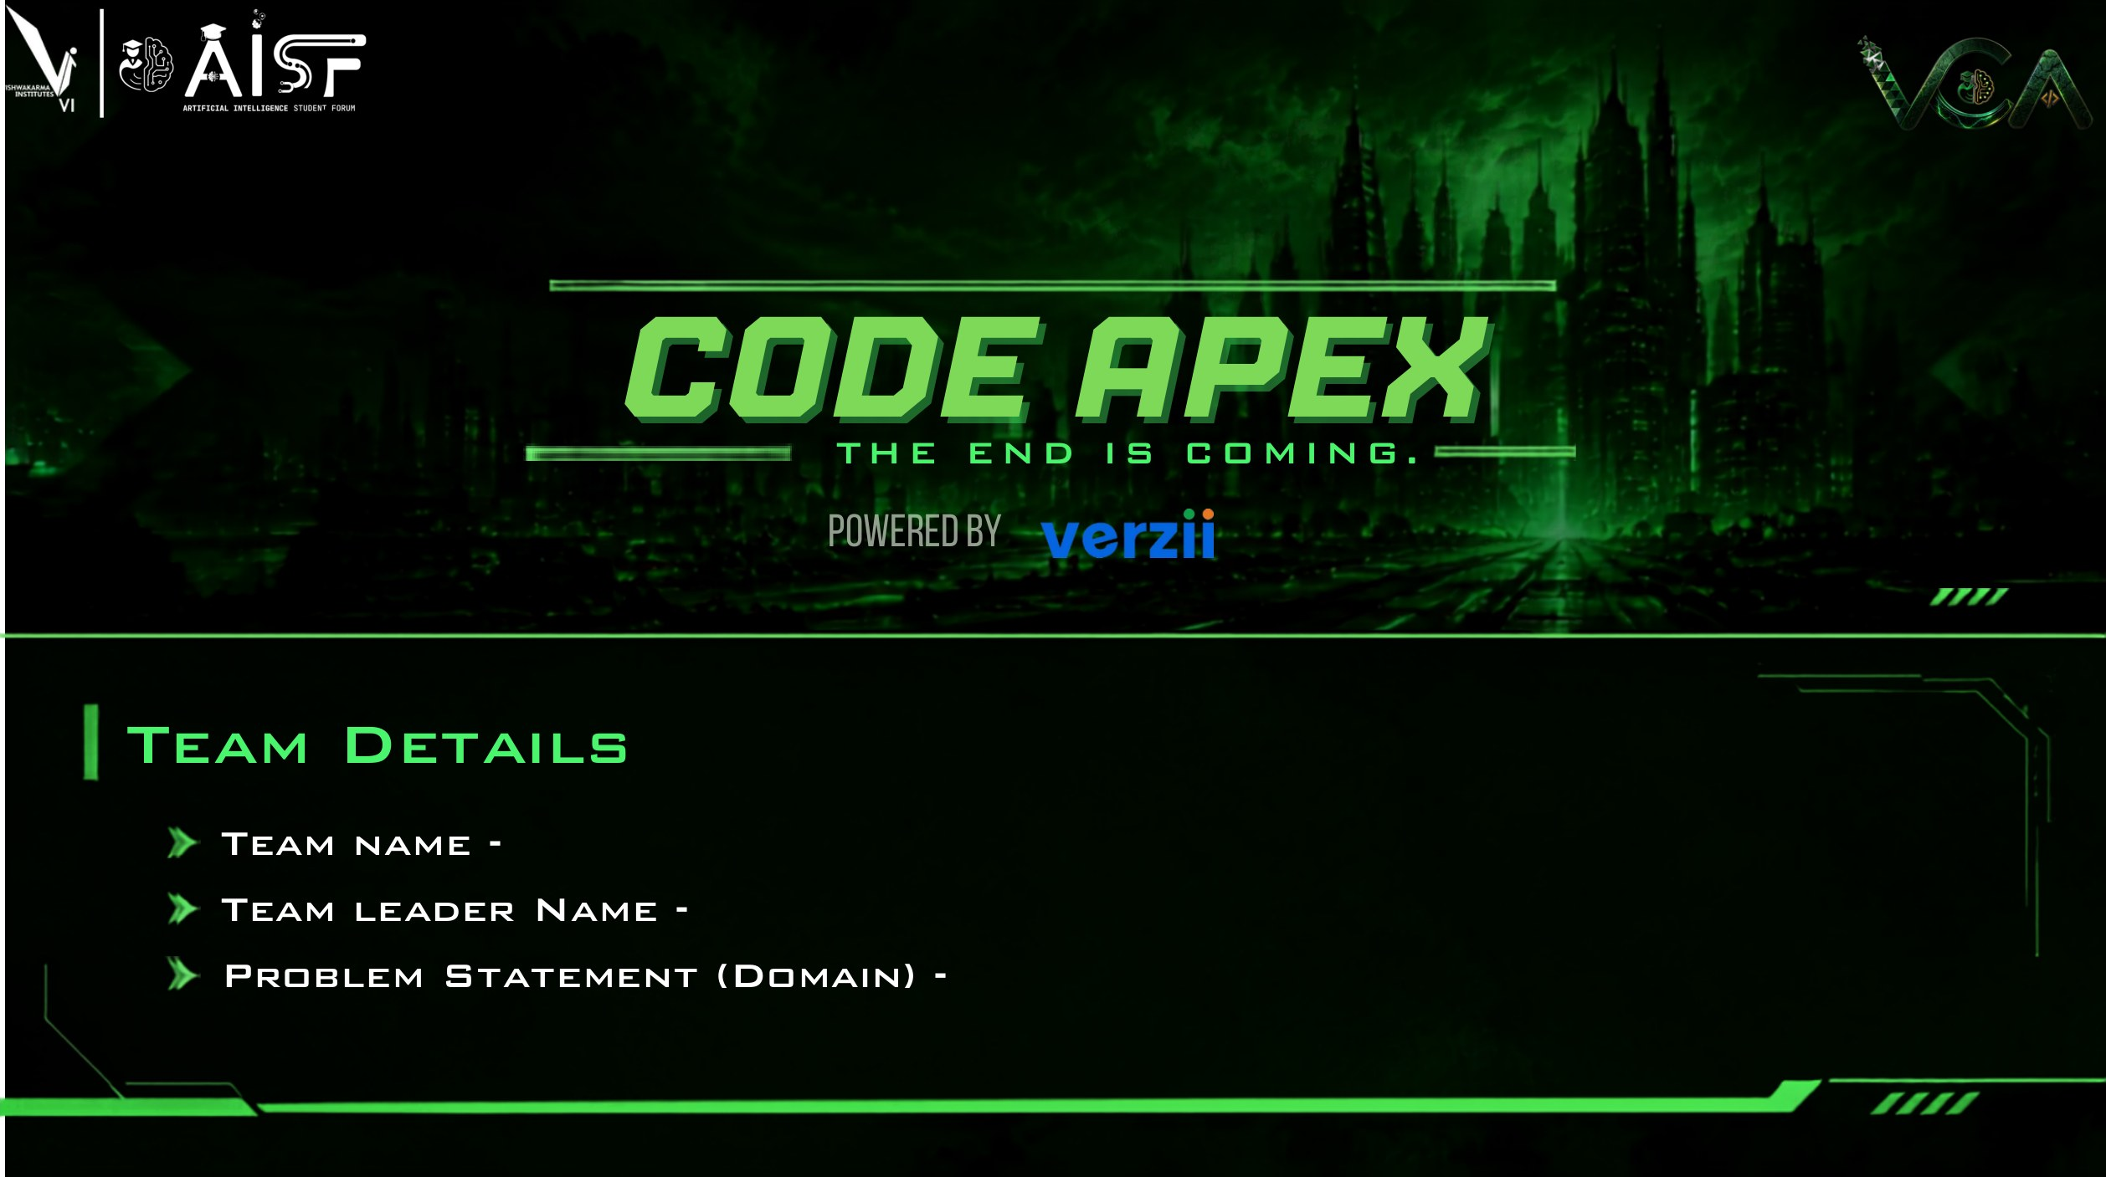
Mac_Enthu
Aayush Aade
Track 1 (Emerson) · PS 1.2 Project IO SIGNAL SUDOKU
SlotSmith · rule-driven, independently checked, revision-aware DeltaV I/O allocation
Places each signal in cabinet → CIOC → baseplate → CHARM under project rules and re-checks the export independently. Prototype, synthetic data.
Notes:
Team Mac_Enthu. Track 1 (Emerson), PS 1.2 Project IO SIGNAL SUDOKU. SlotSmith is a working prototype tested on synthetic data only; no organiser sample data or template had been released when this deck was prepared.

Slide 2
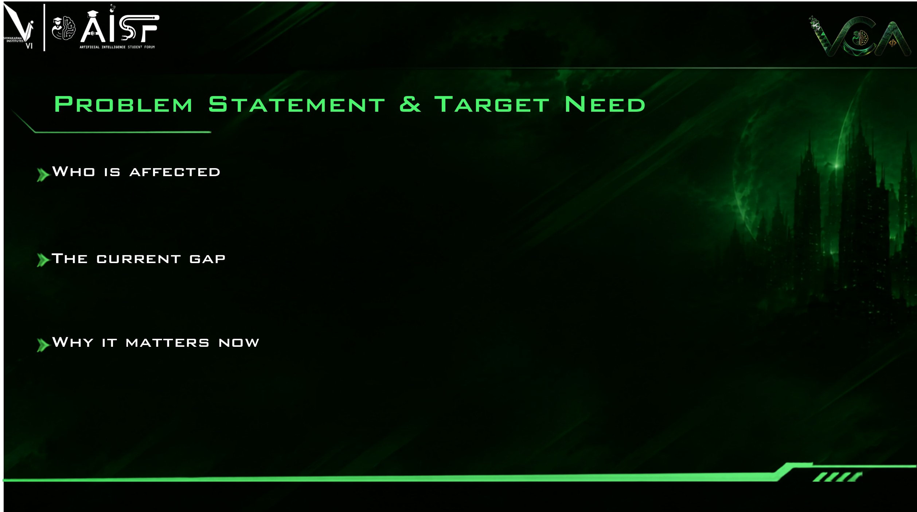
THE PUZZLE, PER EMERSON'S RULEBOOK
Cabinet
≤ 4 CIOCs
CIOC
8 baseplates
Baseplate
12 CHARMs
CHARM
1 signal
DeltaV project and I/O engineers must give every field signal an exact home: cabinet → CIOC → baseplate → CHARM slot. Panel builders and site teams then wire to that allocation.
ONE INTERACTION two 6-pair cables, one on side A, one on side B
Would fit one baseplate…
…so each gets its own CIOC
A
A
A
A
A
A
B
B
B
B
B
B
A
A
A
A
A
A
Emerson's PS: 10,000+ signals are allocated by hand in Excel, and each customer revision means reworking it and tracing the impact again. DeltaV tools automate the steps around it (auto-sense, late binding, Bulk Edit); we found no public tool that places signals from project rules (internal tools may exist).
✕ A and B never share a CIOC
B
B
B
B
B
B
Rule 4 keeps each cable whole, in pair order, so both baseplates stay half empty. Capacity (rule 3) and the spare reserve (rule 5) must absorb that.
SIX RULES, ELEVEN INDEPENDENT CHECKS
Electronic Marshalling makes late changes physically cheap ("without lifting a wire"), but allocation planning and revision tracking remain a manual workflow burden (per the PS). Six interacting rules must hold at once, on every revision, with a technical query (TQ) for each data conflict.
1 Groups together G-1
2 A and B apart S-1
3 Capacity 12·8·4 C-1
4 Cable intact K-1
5 ~10% spare P-1
6 CHARM + block H-1..6
+5 checks on data and output: Q-1 every signal placed or queried · D-2 one signal per slot · N-1..6 names · C-2 controllers · M-1 rows match the MDB
Sources: Emerson PS #02 p.4; DeltaV Electronic Marshalling PDS (Aug 2026); Smart Commissioning WP (2021) p.5; Bulk Edit WP (2022).
Notes:
Sources: Emerson PS #02 p.4-5 (six rules, 10,000+ signals by hand, revisions); DeltaV Electronic Marshalling PDS (12 CHARMs per baseplate, 8 baseplates per CIOC; 4 CIOCs per cabinet is a PS project rule); Smart Commissioning and Bulk Edit white papers. The interaction example uses PS rule 2 (A and B never share a CIOC) and rule 4 (cable whole, in pair order); in the engine a cable that mixes A and B becomes a TQ (S-2). The six PS rules map to six verifier families (G-1, S-1, C-1, K-1, P-1, H-1..6); the verifier has five more (Q-1, D-2, N-1..6, C-2, M-1), 11 in total (src/slotsmith/verifier.py CHECKS). 'We found no public tool' reflects the sources reviewed, not proof of absence.

Slide 3
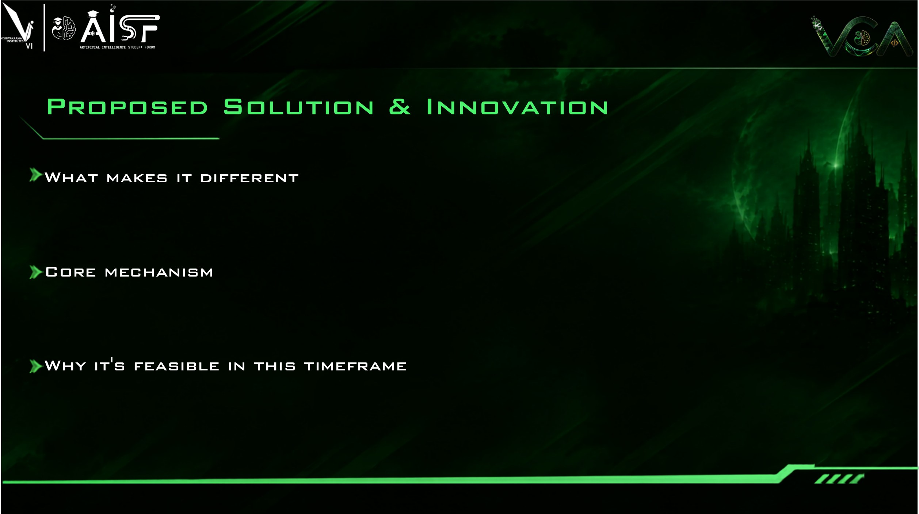
WORKFLOW
1 Input
Excel or CSV lists; columns auto-mapped; file · sheet · row kept
Independently checked: a separate module re-reads the exported file (11 checks).
Revision-aware: unchanged cables stay put; CP-SAT repairs a local window.
Configurable: rule parameters live in JSON; new rule types may need code.
Traceable: every TQ cites a rule ID and the file, sheet and row.
2 Validate
Missing, duplicate or conflicting data → TQs with rule ID
3 Allocate
Constructive first-fit-decreasing packing, no solver
4 Verify
Separate module re-reads the exported file; 11 checks
Baseline allocation is constructive, with no solver: each cable becomes one block of 24/12/6/2 slots and first-fit-decreasing (FFD) packs blocks per group and A/B side into baseplates, CIOCs and cabinets. CP-SAT enters only to repair a revision (10 s limit per window) and reports each window as proven exact or best found.
5 Revise
Pin unchanged, CP-SAT window repair, impact sheet
PROVED
First-fit-decreasing uses the fewest baseplates for one A/B side with cable sizes 2/6/12.
Open-source Python, OR-Tools and openpyxl; 122 automated tests pass. The prototype allocates and verifies 20,033 synthetic signals in about 6 s on a laptop (slide 6). AI helpers are planned and would only suggest; none runs today.
Group baseplate totals matched exact CP-SAT optima in all 19,682 small cases and 148 of 150 larger groups (2 unproven, none worse).
TESTED
NOT CLAIMED
Minimum CIOCs, cabinets or revision moves; global optimality; results on organiser data.
Notes:
Allocation is constructive (per-class first-fit-decreasing); CP-SAT is used only to repair revisions inside a window of cabinets. Proof: docs/architecture.md section 4 (divisible item sizes 2, 6, 12 with capacity 12: free space is always a multiple of the current size, so FFD opens a new bin only when all others are full). Exhaustive audit: artifacts/audit/ffd_exact.json (19,682 group cases against CP-SAT, all solved to OPTIMAL, 0 worse), artifacts/audit/lb_gap.json (150 random larger groups, 148 OPTIMAL / 2 FEASIBLE, 0 worse). The audit compares baseplate counts per group under the same A/B and group-isolation rules; it does not cover CIOC or cabinet counts. Verifier: src/slotsmith/verifier.py imports only rules.py; pipeline.py re-reads the exported workbook before verifying. 122 tests = 31 engine (25 + 6 audit regressions) + 91 UI.

Slide 4
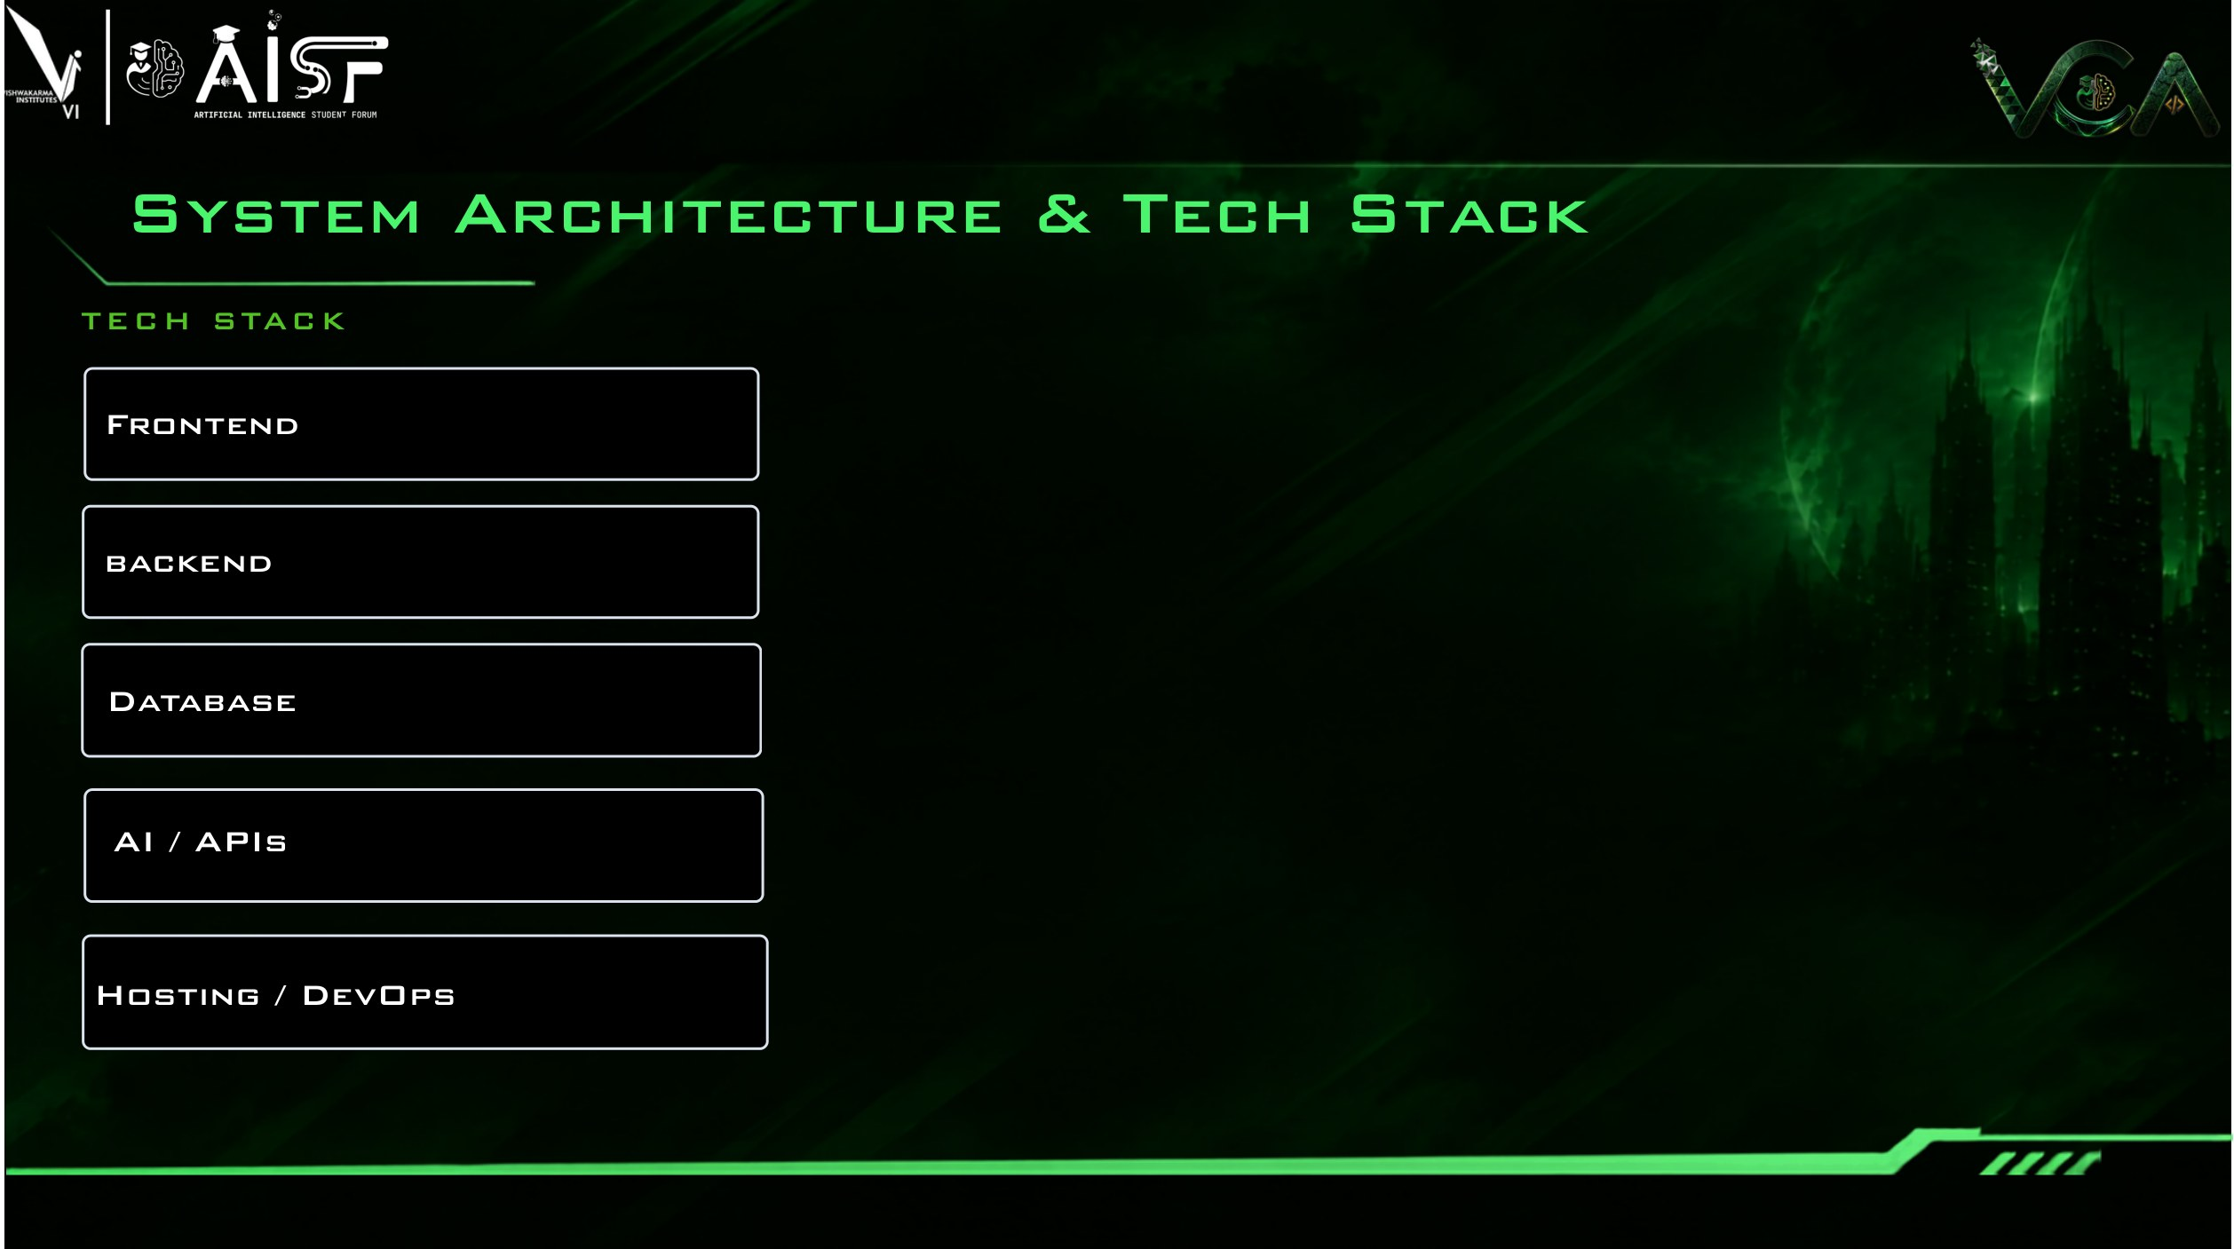




DATA FLOW solid = built · amber = verification · dashed = planned
Streamlit workbench (built): 7 stages, cabinet map, TQs, revision diff
Rule set JSON, typed with pydantic · read by validate, allocate, revise and verify
Rev A list
xlsx or csv, one or many files
Ingest
map columns, keep file·sheet·row
Validate
rules + data → TQs
Allocate
FFD packing → baseplates, CIOCs, cabinets
Export
writes the workbook sheets
Workbook
sheets: allocation, summary, TQs, rule check
Python 3.12 · pandas · openpyxl · pydantic typed rule sets · CLI
No database: xlsx / csv in, JSON rule sets, xlsx workbooks out
Revisions add a Revision Impact sheet: added, deleted, moved, modified.
Rev B list
xlsx or csv
Revision engine
pin unchanged → greedy fill → CP-SAT window repair → full re-run only as fallback
Verify
11 checks on the exported file
OR-Tools CP-SAT for revision repair only. No LLM runs today; an optional helper is planned
SURFACES, TESTS AND STORAGE
Local run · pytest + Hypothesis · Docker bundle planned
Streamlit
7-stage workbench
CLI
slotsmith run / revise
pytest
122 tests
Files only
no database
LLM helper
planned
Docker
planned
The verifier imports only the rule set and parses exported names back into positions.
Notes:
Follows src/slotsmith: ingest.py, validate.py, rules.py, allocator.py, export.py, verifier.py, revision.py + repair_cpsat.py, pipeline.py, cli.py; UI in app/. Verifier imports only rules.py. pipeline.run re-reads the exported workbook for verification. Planned items per docs/technology_decisions.md: optional LLM for mapping suggestions and rule drafts (never in the placement path), Docker deferred, React optional later. A SQLite run log appeared in the earlier deck but is not in the code or docs, so it is no longer shown. Technology logos: Simple Icons (CC0 data), see docs/pitch_deck/research_notes.md; openpyxl and OR-Tools have no logo here and are text.

Slide 5

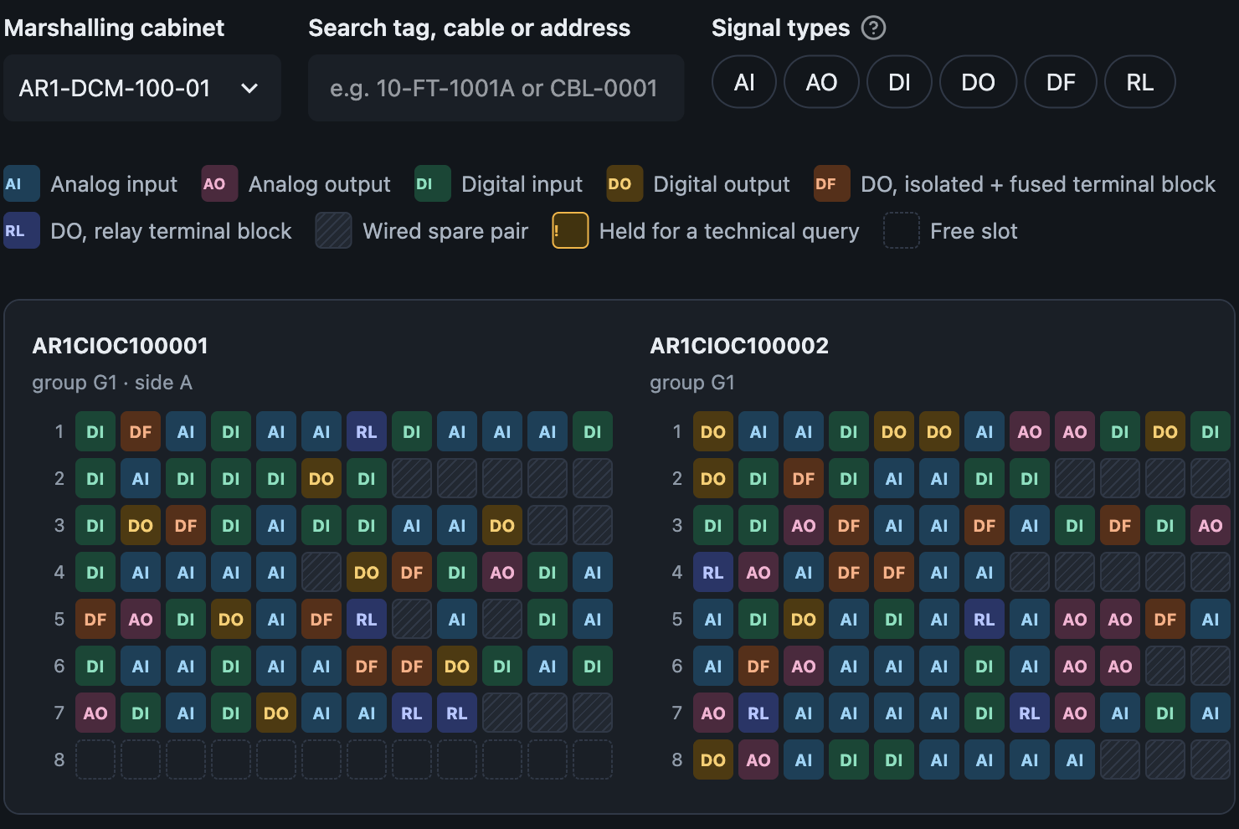
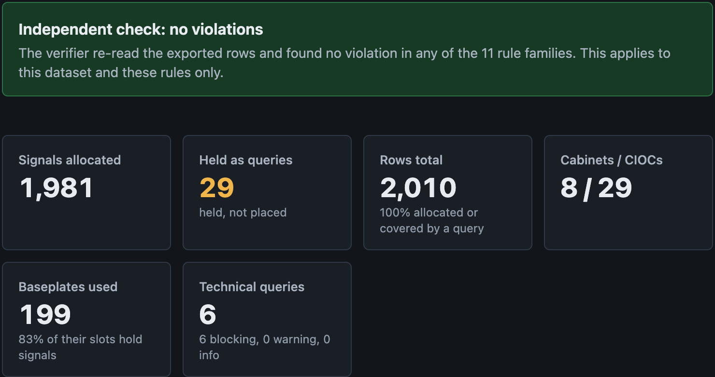
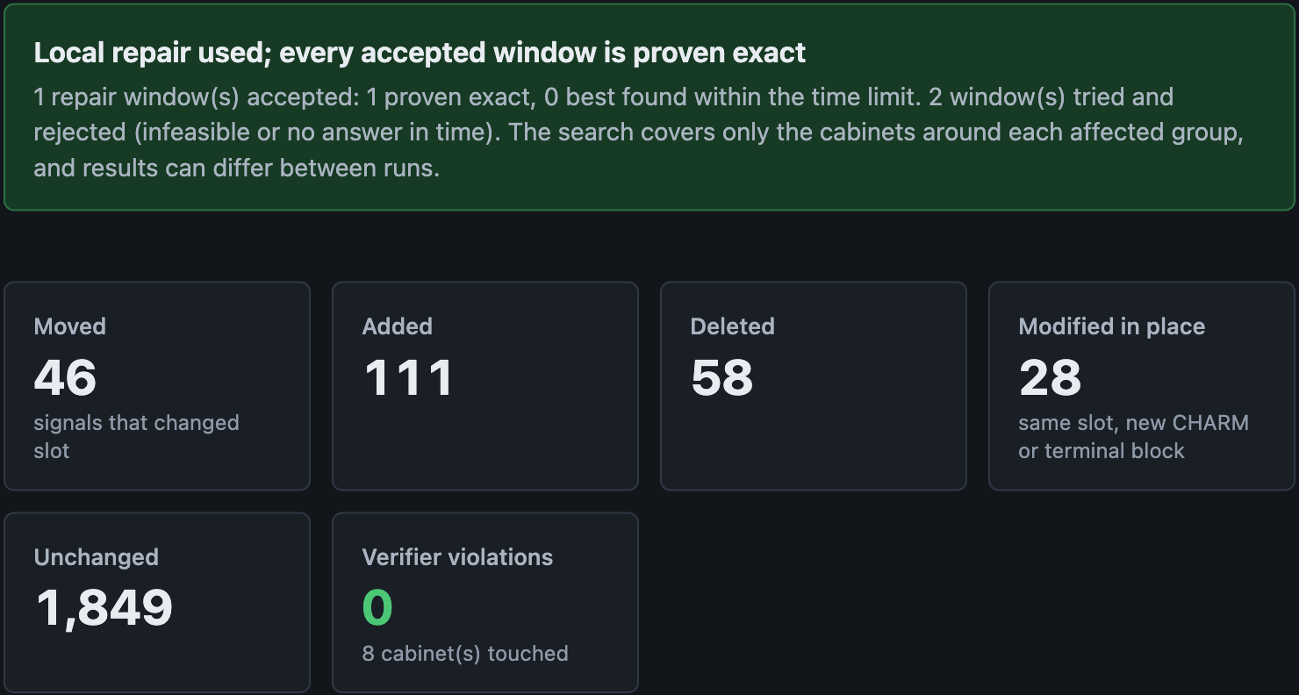
WORKBENCH · 7 STAGES BUILT
1 · Input
2 · Review
3 · Allocate
4 · Results
5 · Cabinets
6 · Revise (Rev B)
7 · Deliverables
RESULTS
0 violations
Verifier re-read the exported rows: all 11 rule families pass, for this dataset and these rules only.
29 rows held under 6 blocking TQs; every row placed or queried.
REVISE (REV B)
46 moved
of 1,981 allocated signals; 111 added, 58 deleted, 28 modified in place, 0 violations.
Repair window proven exact in this run; runs can differ.
Cabinet inspector. Every slot shows its signal type; hatched = wired spare, ! = held for a TQ. 2 of 4 CIOCs of cabinet AR1-DCM-100-01.
Real screenshots of the current build, captured 11 Oct 2026. Data is SYNTHETIC: 2,000-signal MDB with 6 injected errors plus a synthetic Rev B. Not customer data.
Notes:
Crops of the running Streamlit workbench (app/), dark theme, synthetic demo dataset (seed 7, 2,000 signals, 6 injected errors). Screens: Cabinets, Results, Revise (Rev B). Capture method and raw files: docs/pitch_deck/visual_qa_report.md and deliverables/pitch_deck/assets/screens/raw. Numbers on the slide are read from those screenshots. Repair-window status and move counts vary between runs (CP-SAT, multi-threaded, wall-clock limit).

Slide 6
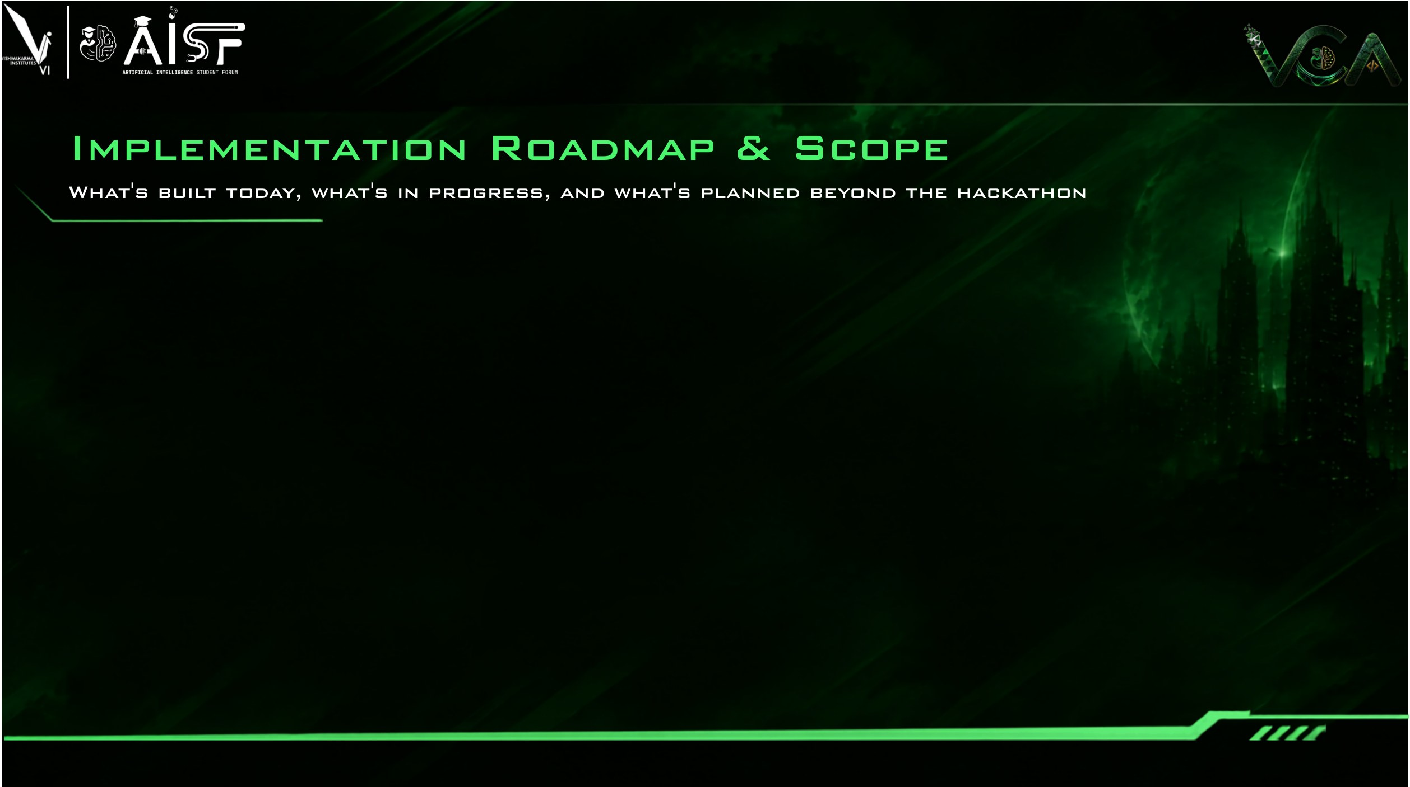
BUILT · AS OF 11 OCT
Built
ROUND 2 · 15–18 OCT
Planned
GRAND FINALE · 24 OCT
Planned
BEYOND
Idea, untested
Engine: ingest to verified export
Revision engine + CP-SAT repair
Streamlit workbench, 7 stages
122 automated tests pass
Map export to organiser template, if released
Confirm open rule readings with mentors
Reduce CP-SAT run-to-run variance
UI: mapping review and override
Run on organiser samples + hidden test
AI mapping suggestions, user-reviewed
Demo hardening, offline bundle
Bulk-Edit-style export (format unvalidated)
Other electronic-marshalling platforms
Cabinet labels and drawings
EVIDENCE · SYNTHETIC DATA ONLY Apple M5 laptop, 16 GB · not evidence about the hidden test
Revision cost: signals moved per case, log scale total 429–575 over 4 runs vs 49,805 for a full re-run
0
81/81
10,000
verifier violations
injected errors raised as TQs
1,000
12 allocation runs, 10 revisions, 500 to 20,033 signals
3 synthetic MDBs, 27 errors each
100
10
0
7 of 11
1
2k·1
2k·2
2k·3
2k·4
2k·5
10k·1
10k·2
10k·3
10k·4
10k·5
baseplates over the exact minimum
repair windows proven exact
53
11
4
50–218
66
50
9
93–156
44
27
closed form, sizes 2/6/12, 12 runs
4 best-found; 7 of 10 revisions used CP-SAT
SlotSmith: median; green figures = min–max of 4 runs
Full re-run of Rev B (same in all 4 runs)
Event dates from the Code Apex 3.0 handbook (subject to change); roadmap items are intentions, not commitments. The re-run baseline re-allocates Rev B from scratch with the same engine; it is a naive reference, not an optimum.
Notes:
Revision metric: 10 synthetic revision cases (5 at 2,000 signals, 5 at 10,000), Rev B = about 3% deleted, 5% added, 2% type changes, 1 cable regrouped. Moves are counted identically for both methods with revision.impact_report: a tag present in both revisions whose cabinet/CIOC/baseplate/slot differs. SlotSmith total moved over the 10 cases in 4 independent runs: 429, 446, 470, 575; the full re-run total is 49,805 in every run (deterministic). The difference between runs comes from CP-SAT repair (multi-threaded under a wall-clock limit). One run overlapped with other CPU load and gave a worse result for one case; the cause was not isolated. 'Cases' vs 'windows': 7 of the 10 revisions needed CP-SAT; across those, 11 repair windows were accepted (7 proven exact, 4 best-found within 10 s); further windows were tried and rejected as infeasible or unanswered. 'Exact per-group minimum' is the closed-form minimum from the divisible-size lemma (allocator.exact_group_baseplates), validated against CP-SAT in the exhaustive audit. All 12 allocation runs: 0 violations, 100% of rows placed or covered by a TQ. Sources: artifacts/benchmarks.json, artifacts/repro/benchmarks_clean_run2.json, artifacts/pitch_deck_repro/benchmarks_rerun.json, artifacts/audit/revision_status.json. Dates: HANDBOOK_CODEAPEX_3.0.pdf timeline (Round 2 15-18 Oct, Grand Finale 24 Oct).

Slide 7

MEASURED TODAY · SYNTHETIC end-to-end time vs signals
EXPECTED BENEFITS · NOT MEASURED
9 s
IO / project engineers
6 s
Allocation becomes a re-runnable, rule-checked step instead of hand-editing 10,000+ rows.
3 s
Reviewers and QA
Every export carries a rule-check report; every placement and TQ traces to a file, sheet and row.
0 s
500
5,000
10,000
15,000
20,000
Customers and EPCs
Dots: every allocation run in 3 batches (3 per size); line: medians. 20,033 signals took about 6 s on one laptop (batch medians 6.0, 6.0, 6.3 s; one 8.7 s outlier). Observed, not a complexity proof. Allocation alone is about 0.01 s; the rest is Excel I/O, validation and verification.
Specific, traceable TQs and a Rev A → Rev B impact list.
No time or cost saving has been measured, so none is claimed.
SCALE CONTEXT · SOURCED
WHERE IT FITS
LIMITS · NEXT VALIDATION
10,000+
DeltaV tools
auto-sense, late binding, Bulk Edit
SlotSmith
allocation planning, checking, Rev B impact
Next dependency: the organiser's sample MDB and allocation template (not released).
Synthetic data only; no official-template compatibility claimed.
Rule readings (straddling, spare rounding, controller mapping) await mentors.
New rule types need code; CP-SAT repair is window-local and varies between runs.
signals per project, allocated by hand today (Emerson PS)
≤ 28,800
Complements DeltaV tools; it does not replace them. Export adapters to their import formats and other marshalling platforms are untested ideas.
CHARM channels per DeltaV system (300 CIOCs × 96): a spec maximum, not a typical project
Notes:
Measured today: runtime points are every allocation run in three benchmark batches (about 500, 2,000, 10,000 and 20,000 signals, three seeds each) on an Apple M5, synthetic data. Wall time covers ingest, validate, allocate, export and verification. Observed scaling only; no asymptotic claim. One 20k run took 8.7 s while other work was running on the machine. Scale context: PS #02 p.4 (10,000+ signals); DeltaV Electronic Marshalling PDS 'Number of CIOCs per System: 300' and 96 channels per CIOC = 28,800 (specification maximum). Benefits are expected, not measured. Complement-not-replace: DeltaV auto-sense, late binding and Bulk Edit are documented by Emerson; SlotSmith plans the allocation before them.

Slide 8

LINKS
GitHub
https://github.com/Sidd927/SlotSmith
Allocation you can re-run, check independently, and revise without starting over.
Demo video
{{YOUTUBE_DEMO_URL}}
Documentation
{{DOCUMENTATION_URL}}
Team Mac_Enthu · Aayush Aade (lead) · Siddhant Patil · Gaurang Bagwe
Notes:
Links: the GitHub address is the team repository. The YouTube demo and documentation links are placeholders ({{YOUTUBE_DEMO_URL}}, {{DOCUMENTATION_URL}}) to be replaced before submission. Check that the repository is public or shared with the judges.

