Slide 1


Team Details
c. Problem Statement
Retail & Commerce – consumer intelligence
Retail and e-commerce brands talk to customers all day, in support calls, sales calls, WhatsApp and chat, but listen to almost none of it. Teams read a small sample by hand, so why customers buy, return, complain or churn, which products they ask for, and how agents handle them stays buried in transcripts and recordings. aftercall turns every conversation into structured consumer intelligence that teams act on once the call is done.
a. Team name: Koffee after KitKat
b. Team leader name: Siddharth Bhardwaj
Product: aftercall
You keep your conversations, we handle the rest.
Notes:
Hi, I'm Siddharth from Koffee after KitKat. This is aftercall: you keep your conversations, we handle the rest. We built it on Google Cloud for the Retail & Commerce theme, with a consumer-intelligence angle. Retail and e-commerce brands talk to customers all day but listen to almost none of it. aftercall turns every conversation into structured insight. [~0:00-0:15]

Slide 2
Brief about the idea
aftercall asks every conversation the same questions
Who it's for
You define trackers: groups of signals, each a Choice, a Yes/No or a Score.
Upload transcripts (CSV, JSON, JSONL, TXT, VTT, SRT, any layout) or call recordings (mp3, wav, m4a, ogg, webm, flac, up to 30 MB).
TypeSafe Jev answers every signal on every call with a confidence score; low-confidence answers go to human review.
Ask alteria (Gemini) answers questions across all analysed calls, with cited calls.
1
D2C and e-commerce brands
2
Marketplaces
3
Retail chains
4
Quick-commerce support teams
5
AI voice agents for retail
100%
Any tool
Hindi · Hinglish · English
of conversations read, not a sample
not tied to a call or chat product
transcribed in the original language
Notes:
In retail, why customers buy, return, complain or churn is said out loud, in support calls, sales calls, WhatsApp and chat. Teams read a small sample, and AI voice agents push volume higher. aftercall asks every conversation the same questions. You group signals under trackers: a choice, a yes or no, or a score. Upload transcripts or recordings from any tool, and TypeSafe Jev answers each signal with a confidence score, so people only review the calls it is unsure about. It is built for D2C and e-commerce brands, marketplaces, retail chains, quick-commerce support teams and AI voice agents. [~0:15-0:45]

Slide 3
Opportunities
1
How is it different?
2
How does it solve the problem?
3
USP
Works on transcripts and recordings from any tool; no call platform to adopt
You write the questions; there is no fixed taxonomy
A confidence score on every answer, not a black-box summary
Reads 100% of conversations instead of a hand-read sample
Structured answers show trends by channel, agent or campaign
Low-confidence answers go to people; Ask alteria explains the why with cited calls
The same questions on every call, at a fraction of an LLM's cost
Jev routes each request to the cheapest Gemini tier that is enough
Cost is shown before anything runs; over-limit calls are flagged, not run
You keep your conversations, we handle the rest.
Notes:
How is it different? Most tools sit inside one call platform and use a fixed list of topics. aftercall is not tied to any call or chat tool, you write the questions, and every answer carries a confidence score. How does it solve the problem? It reads every conversation, turns them into structured answers you can trend by channel, agent or campaign, and sends only the uncertain ones to people. The USP: the same questions on every conversation, at a fraction of the cost of running an LLM on each call, and the cost is shown before anything runs. [~0:45-1:05]

Slide 4
List of features offered by the solution
1
Trackers and signals
2
Any transcript or recording
3
Jev answers + confidence
Choice, Yes/No or Score questions, grouped by topic
Any layout; Gemini transcribes audio with speakers labelled
Every call, every signal; low confidence goes to review
4
Conditional trackers
5
Insights across uploads
6
Ask alteria
Run a tracker only if another answer matches
Trends, breakdowns by channel, agent or metadata, movers
Gemini answers across all calls with cited calls; drafts trackers
7
Dashboards and CSV export
8
People, roles, projects
9
Cost shown first
Charts you check every week, shareable and exportable
Workspaces with owners, members and viewers
Estimate before any run; calls over 30k tokens flagged
Notes:
Nine things in the product. Trackers and signals. Any transcript or recording, transcribed by Gemini in the original language. Jev answers with confidence. Conditional trackers that only run when another answer matches. Insights across uploads: trends, breakdowns, movers. Ask alteria, aftercall's built-in AI, for plain-English questions with cited calls. Dashboards and CSV export, people and roles, projects, and the cost shown before anything runs. [~1:05-1:15]

Slide 5
Process flow diagram
1
2
3
4
5
Define trackers
Upload
See the cost
Jev answers
Act on it
signals: Choice, Yes/No, Score
transcripts or recordings
calls over 30k tokens are flagged
every signal, with confidence
insights, Ask alteria, CSV
Recording: Gemini transcribes, speakers labelled
Low confidence: routed to human review
Illustrative retail signals a tracker could ask on every conversation
return / refund reason
purchase intent
product interest
competitor mentioned
price objection
delivery complaint
churn risk
sentiment / frustration
right resolution offered
upsell attempted
policy misstated
asked for a human
Notes:
The flow is five steps. One: define trackers. Two: upload a transcript or a recording; recordings are transcribed by Gemini with speakers labelled, in the original language. Three: aftercall shows the token cost before anything runs, and a call over 30 thousand tokens is flagged rather than run. Four: Jev answers every signal with a confidence score, and low-confidence answers go to human review. Five: act on it with insights, Ask alteria and CSV export. The chips at the bottom are illustrative retail signals, not a fixed list. [~1:15-1:30]

Slide 6
Wireframes / mock diagrams of the proposed solution
Ask alteria
illustrative
Results
illustrative
Why are customers returning the X?
call 0412 · chat
94% sure
Return reason: Size too small
Most returns mention size and fit; delivery delays come second. (example answer)
call 0977 · voice
71% sure
Delivery complaint: Yes
to review
call 0412
call 0977
call 1031
call 1031 · WhatsApp
97% sure
Purchase intent: High
Ask about the conversations in this project…
Ask in plain English; answers cite the calls behind them
Every answer shows its confidence; uncertain ones are flagged
Notes:
Two wireframes of the core experience. On the left, Ask alteria: you ask a plain-English question such as why customers return a product, and Gemini answers across every analysed call with the calls it used cited. On the right, the results view: each answer shows a confidence bar, and anything Jev is unsure about is flagged for review. These are illustrative wireframes; real screenshots of the build are on the snapshots slide. [part of 1:30-2:05 live demo]

Slide 7
Architecture diagram of the proposed solution
Google Cloud + Firebase
Firestore
all records
Firebase Auth
Google sign-in
Cloud Tasks
one task per call, OIDC-verified
Web app
React 19 · Vite
Firebase Hosting
/api rewritten to Cloud Run
Cloud Run
FastAPI API · asia-south1 · scales to zero, max 5
Cloud Storage
call recordings
Vertex AI Gemini
transcription, Ask, 3 tiers
Flow: upload → Cloud Storage → Cloud Tasks queues one task per call → Cloud Run worker calls Gemini (transcribe) and Jev (answer) → results in Firestore.
TypeSafe Jev
external · jev-1.13.0 signals
Secret Manager
keys and secrets
Notes:
Under the hood, everything is on Google Cloud. The React web app is on Firebase Hosting, which rewrites slash API to Cloud Run, where a FastAPI service runs in asia-south1, scaling to zero. Firebase Authentication handles Google sign-in. Recordings go to Cloud Storage; Cloud Tasks runs one OIDC-verified task per call; Gemini on Vertex AI transcribes and powers Ask alteria; TypeSafe Jev, the one external service, answers the signals. Firestore holds every record and Secret Manager holds the keys. [~2:30-2:50]

Slide 8
Technologies used in the solution
Google Cloud
Models
TypeSafe Jev (jev-1.13.0): signals. Gemini 3.8 Flash: standard + transcription; 3.5 Flash-Lite: simple; 3.1 Pro preview: complex
Gemini on Vertex AI
Cloud Run
Firestore
Cloud Tasks
Web app
Cloud Storage
Firebase Authentication
React 19 · Vite · Tailwind · TypeScript
Firebase Hosting
Secret Manager
Backend
Python 3.12 · FastAPI · pydantic
Notes:
The stack. On Google Cloud: Gemini on Vertex AI, Cloud Run, Firestore, Cloud Tasks, Cloud Storage, Firebase Authentication, Firebase Hosting and Secret Manager. For models, TypeSafe Jev for the signals, and three Gemini tiers: 3.8 Flash as standard and for transcription, 3.5 Flash-Lite for simple requests, and 3.1 Pro preview for complex ones. The web app is React 19 with Vite, Tailwind and TypeScript; the backend is Python 3.12 with FastAPI and pydantic.

Slide 9
Estimated implementation cost
Analysing 1,000 calls, 5 signals each (est.)
≈ $0.00005
per 5-signal call on Jev (~1,100 input tokens)
≈ $0.02
to transcribe a 10-minute recording on Gemini 3.8 Flash
≈ $0
Google Cloud infra at demo scale (free tiers)
Same ~1,100-token call with ~150 output tokens on Gemini. List prices; estimates.
Notes:
Estimated from list prices per million tokens; these are estimates, not billed figures.
Jev: $0.042 per 1M input tokens. A typical call with 5 signals is about 1,100 billed input tokens: 1,100 x $0.042 / 1,000,000 = $0.0000462, about $0.00005 per call, or $0.046 per 1,000 calls.
Same call sent to Gemini (assume ~150 output tokens for 5 answers, no thinking): 3.8 Flash ($0.75 in / $3.75 out): 1,100 x 0.75 = 825 + 150 x 3.75 = 562.5, so $0.00139 per call, $1.39 per 1,000 (about 30x Jev). 3.5 Flash-Lite ($0.30 / $2.50): 330 + 375 = $0.000705 per call, $0.71 per 1,000. 3.1 Pro preview ($2 / $12): 2,200 + 1,800 = $0.0040 per call, $4.00 per 1,000.
Recording: Gemini audio is about 32 tokens per second. A 10-minute recording is 600 s x 32 = 19,200 tokens x $0.75 / 1M = $0.0144 input on 3.8 Flash, plus roughly 2,000 transcript output tokens x $3.75 / 1M = $0.0075, about $0.022 per recording. Answering its signals on Jev adds well under $0.0001.
Google Cloud infrastructure for the prototype stays within free tiers: Cloud Run scales to zero, Cloud Tasks has 1M free operations a month, Firestore has a free daily quota, so about $0 at demo scale.

Slide 10
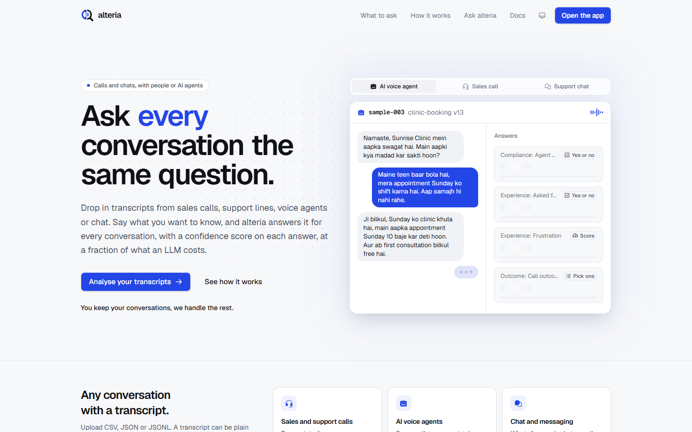
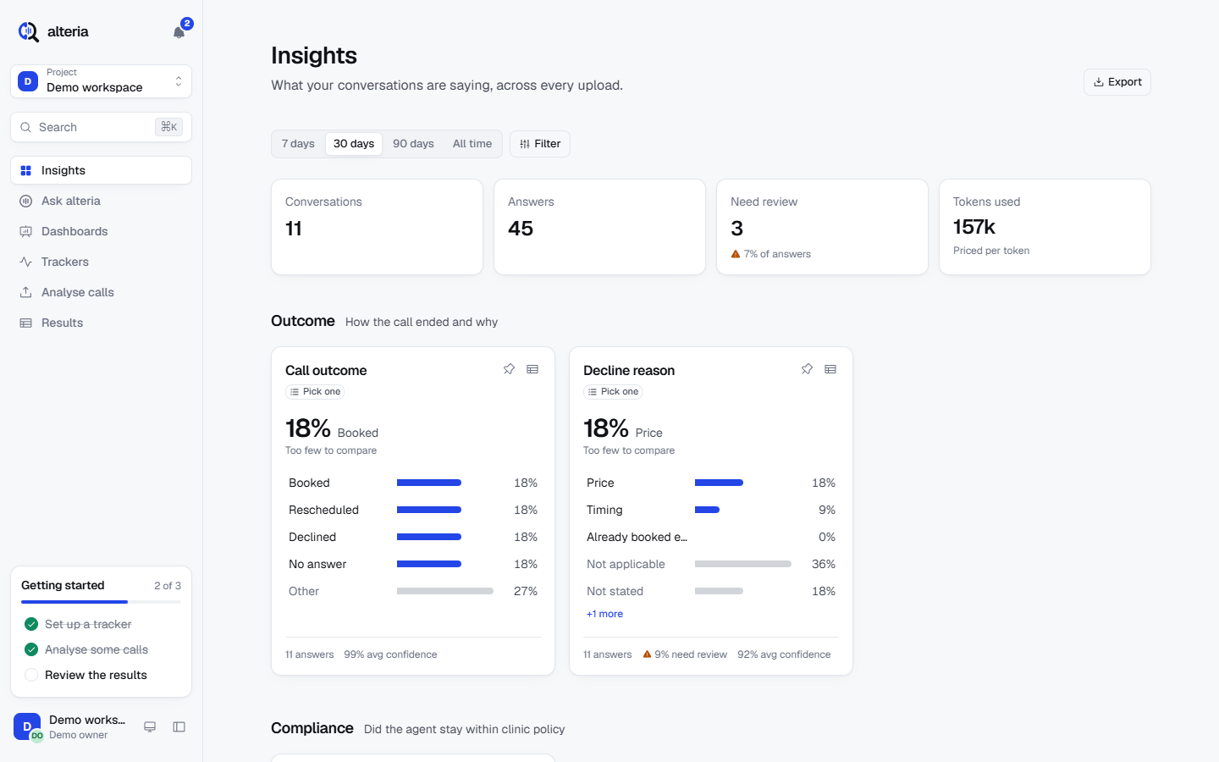
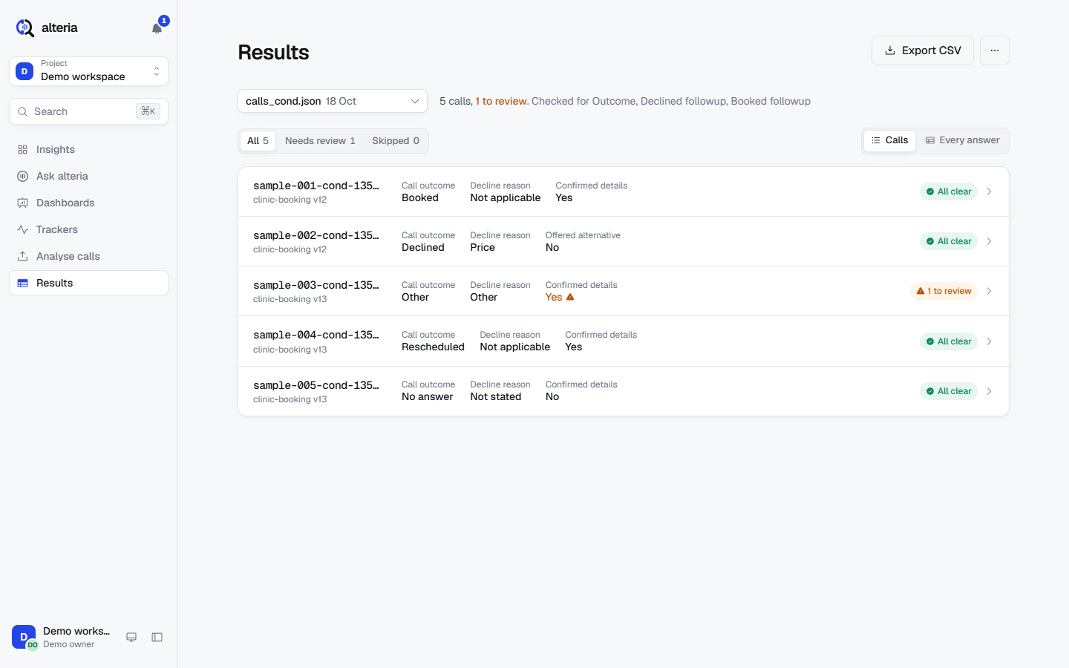
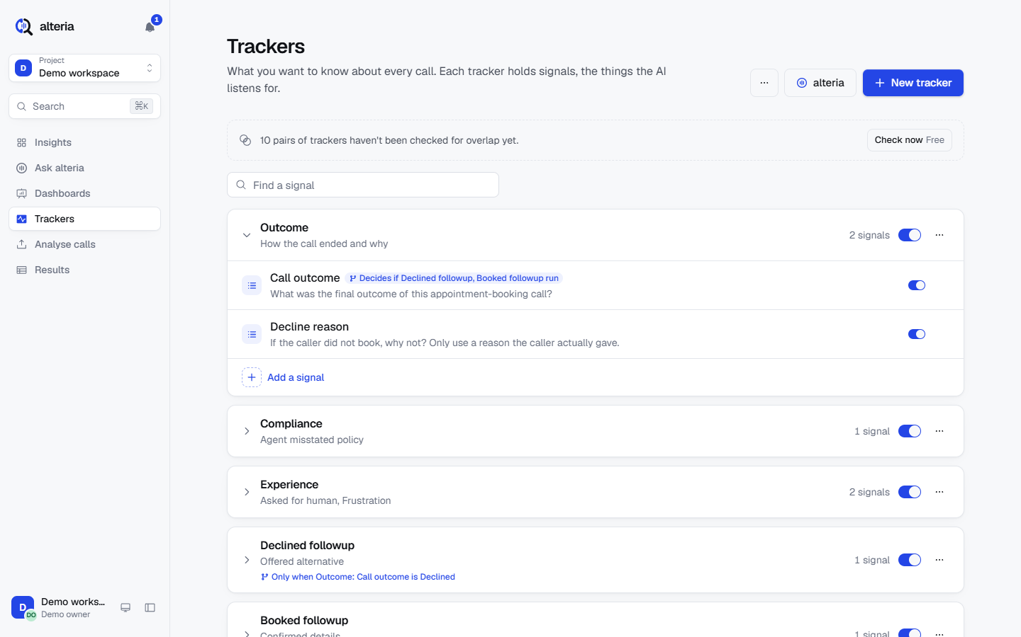
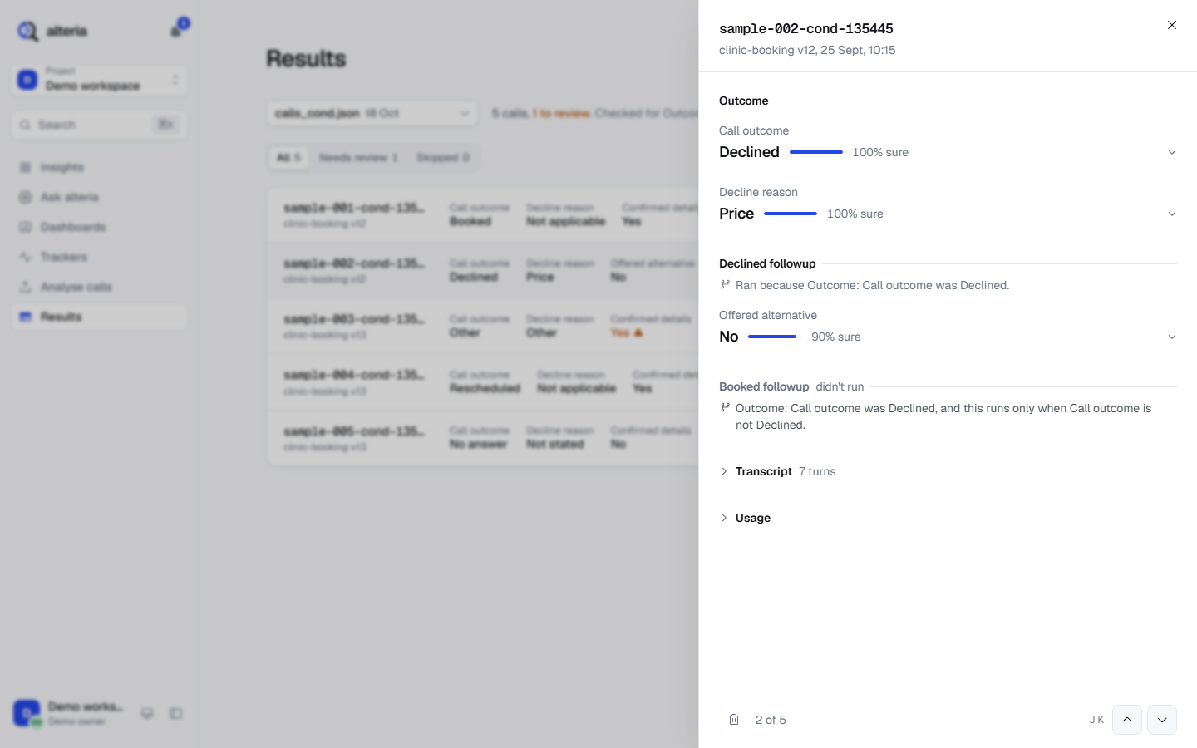
Snapshots of the prototype
Landing page
Insights
Results
Real screens from the running build
Shown on a sample dataset (clinic appointment-booking calls). The same trackers carry over to retail signals such as returns, delivery and churn.
Trackers
Call detail
Notes:
These are real screenshots from the running build, on a sample dataset of clinic appointment-booking calls. The landing page, Insights across uploads, the Results table with confidence and a review flag, the Trackers screen with a conditional tracker, and a single call open with each answer and its confidence. For retail, the same screens would show return reasons, delivery complaints or churn risk. [live demo ~1:30-2:30]

Slide 11
Prototype performance report / benchmarking
25/25
~6 s
254
answers matched hand labels (100%): 5 sample calls × 5 signals, live Jev
to analyse 6 calls end to end
passing backend tests
5/5
~1,100
29.6k → 5
conditional trackers routed correctly
billed input tokens for a typical call, 5 signals
a ~29.6k-token call auto-split into 5 Jev requests; a 32k call flagged, not sent
Efficiency: Insights read only call documents with a 30 s shared cache, about 20× fewer Firestore reads per view (≈600k → ≈10–30k at 10k calls × 10 signals). Low Gemini thinking on simple tiers and transcription.
Confidence: sample answers mostly 0.84–1.00; low-confidence ones routed to review.
Notes:
Real numbers from the live smoke test against live Jev, on a sample dataset. Five sample calls with five signals each: 25 of 25 answers matched the hand labels. Six calls analysed in about six seconds end to end. A call of about 29.6 thousand tokens was split automatically into five Jev requests and answered; a 32 thousand token call was flagged over the limit and not sent. Conditional trackers routed correctly five out of five. A typical call is about 1,100 billed input tokens for five signals, and the backend has 254 passing tests. On efficiency, Insights reads only call documents with a 30 second shared cache, about 20 times fewer Firestore reads. Confidence is mostly 0.84 to 1.00, with low-confidence answers going to review. [~2:50-3:00]

Slide 12
Additional details / future development
1
2
3
4
Long calls
Live analysis
Connectors
Regional languages
Beyond the 30k-token limit
Streaming, mid-call signals
Twilio, Exotel, Genesys, WhatsApp, CRM
Hindi and regional-language benchmarks
5
6
7
8
Cheaper transcription
Billing
Alerts
Multi-region
Flash-Lite after quality tests
Per-token prepaid credits, Pro plan back on
On red-flag signals, e.g. churn risk, policy misstated
Run closer to customers
Notes:
What is next: handling calls over 30 thousand tokens, live analysis of calls as they happen, connectors for Twilio, Exotel, Genesys, WhatsApp and CRMs, Hindi and regional-language benchmarks, cheaper Flash-Lite transcription once quality tests pass, billing with prepaid credits and a Pro plan, alerts on red-flag signals such as churn risk or a misstated policy, and multi-region deployment.

Slide 13
Links to our GitHub repository, demo video and final product
GitHub public repository
1
[GitHub link]
Demo video (3 minutes)
2
[Demo video link]
Final product
3
https://gen-lang-client-0902222994.web.app
You keep your conversations, we handle the rest.
Notes:
Our links: the public GitHub repository, the three-minute demo video, and the live final product at gen-lang-client-0902222994.web.app on Firebase Hosting. [Placeholders: GitHub link and demo video link are filled in by the team lead before submission.]

Slide 14
You keep your conversations, we handle the rest.
1
Every conversation
2
Every answer
3
Every insight
asked the same questions
with a confidence score
from trends to Ask alteria
aftercall · Koffee after KitKat · gen-lang-client-0902222994.web.app
Notes:
Same questions on every conversation, each answer with a confidence score, cheap enough to run on all of them. You keep your conversations, we handle the rest. Thank you. [~2:55-3:00]

Slide 15

Notes:
Thank you.

