Slide 1

Classification of Amazon Reviews based on Sentiment Analysis using Machine Learning Techniques
Presented by
Siddanth jagdish (18213376)
Under the guidance of
Dr. Liam Tuohey
Dublin City University

Slide 2
Research Question???
To Find the most suitable methodology to conduct Sentiment Analysis on Amazon Reviews Dataset

Slide 3
Introduction
Nowadays, as we all know that the online shopping is at it’s peak and the rapid growth of which has offered people excellent convenience in sitting at home and buying the product of their choice.
On each E-Commerce site there are enormous number of reviews for products which makes it difficult for the clients to go through each review.
By Using sentiment analysis, it would be possible to analyze huge number of reviews and predict whether a product is good or not.

Slide 4
Block Diagram

Slide 5
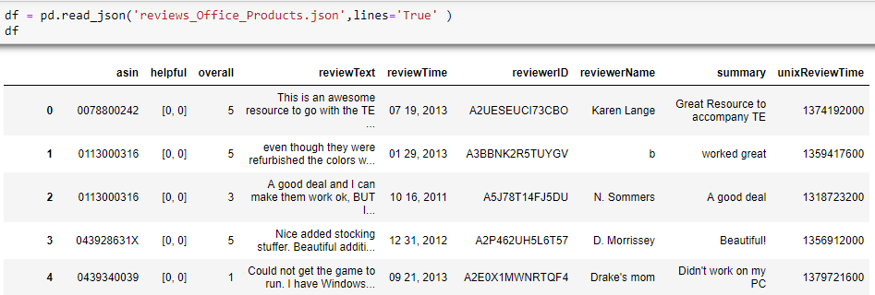
Data
The data was available from www.jmcauley.ucsd.edu/data/amazon and the data has been accessed under prior permission of the holder.
The data consists of 9 fields and the analysis is mainly based on two fields that is review text and overall(rating).
The data comprises of 1.2 million rows X 9 columns.

Slide 6

Data Pre-Processing
As the data we have used did not required much of cleaning, we have adopted some steps to clean the data before analysis and they are:
Converting the text into a standard form. That is converting all the letters in a word to lower case.
Removal of punctuations, accent marks and diacritics.
Removal of stopwords.
removing white spaces: To remove leading and ending spaces, the strip function is used on white spaces.

Slide 7
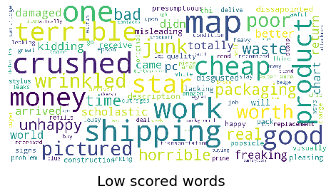
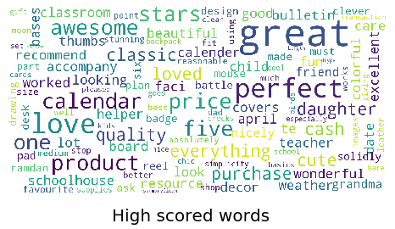
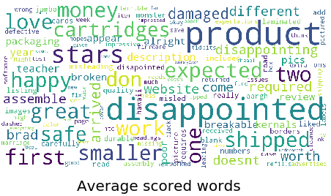
Visualization
The pre-processed data is then used for the purpose of visualization.
Here we can see three different wordcloud plots for all low scored words, high scored words and average scored words respectively.

Slide 8
Machine Learning Algorithms for Classification
Bernoulli Naïve Bayes
Multinomial Naïve Bayes
Logistic Regression
Support Vector Machine
Decision Trees
K-Nearest Neighbors

Slide 9
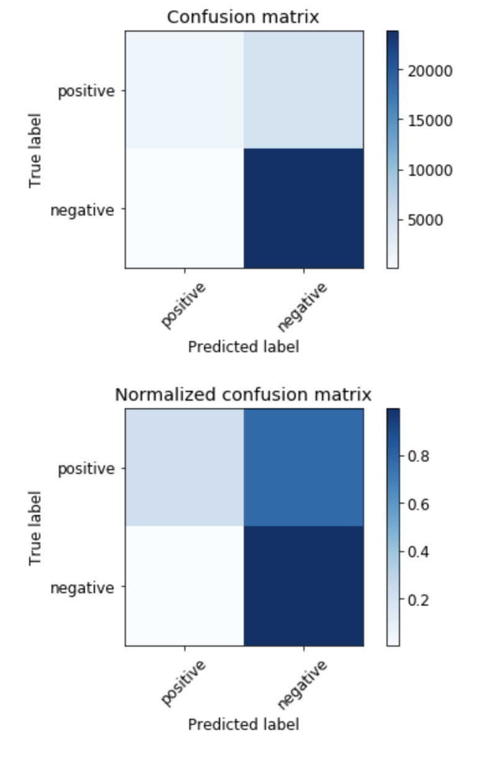
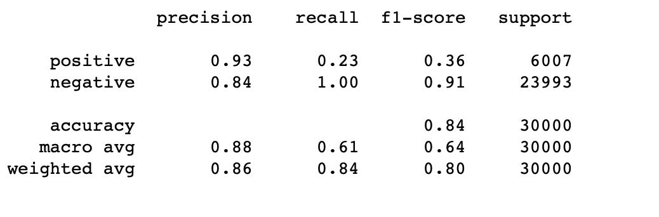
Bernoulli Naïve Bayes
Notes:
It is a classification technique based on Bayes’ Theorem with an assumption of independence among predictors. In simple terms, a Naive Bayes classifier assumes that the presence of a particular feature in a class is unrelated to the presence of any other feature.
Bernoulli NB cares about counts for a single feature that do occur and counts for the same feature that do not occur. Bernoulli NB can only focus on a single keyword, but will also count how many times that keyword does not occur in the document. But if you only have a single feature to worry about, then you can make a Bernoulli naïve bayes modelling choice.

Slide 10
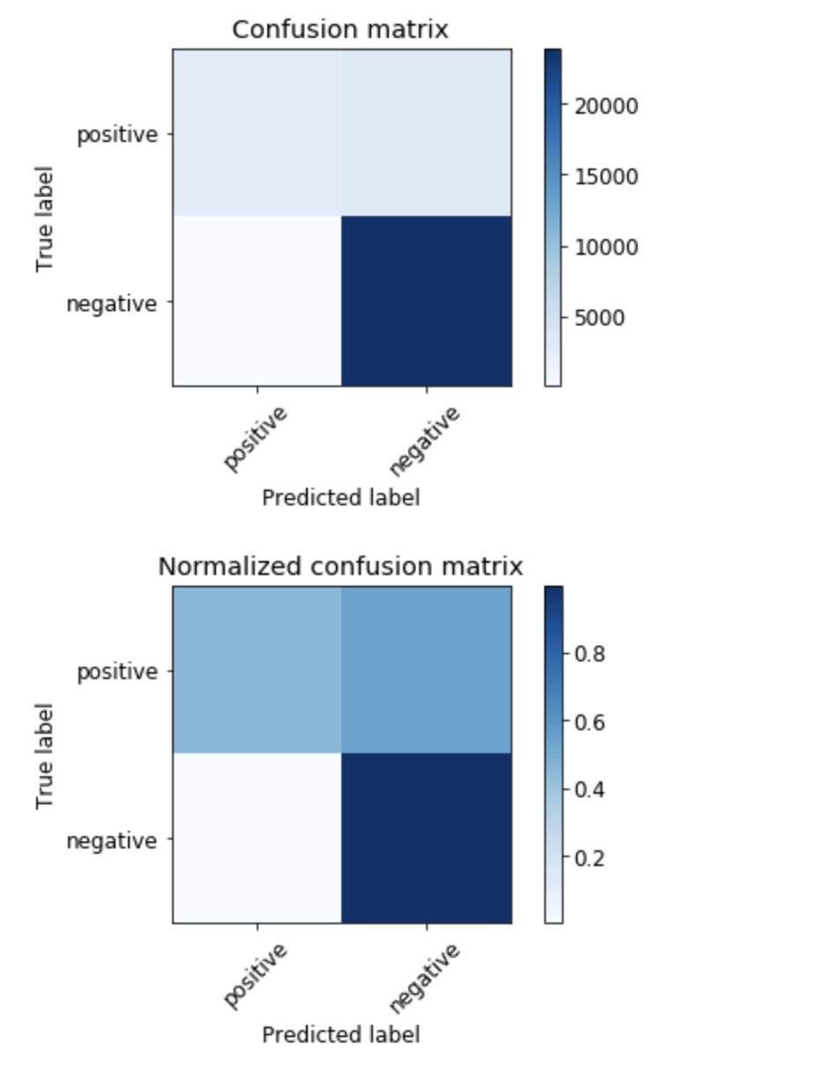
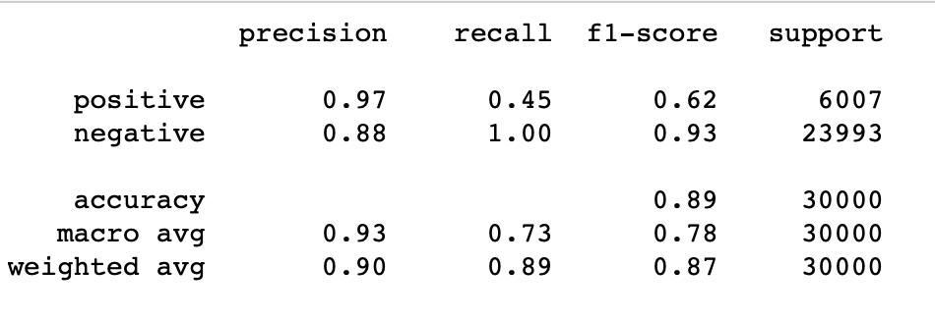
Multinomial Naïve Bayes
Notes:
Multinomial NB cares about counts for multiple features that do occur. Multinomial NB will classify a document based on the counts it finds of multiple keywords.

Slide 11
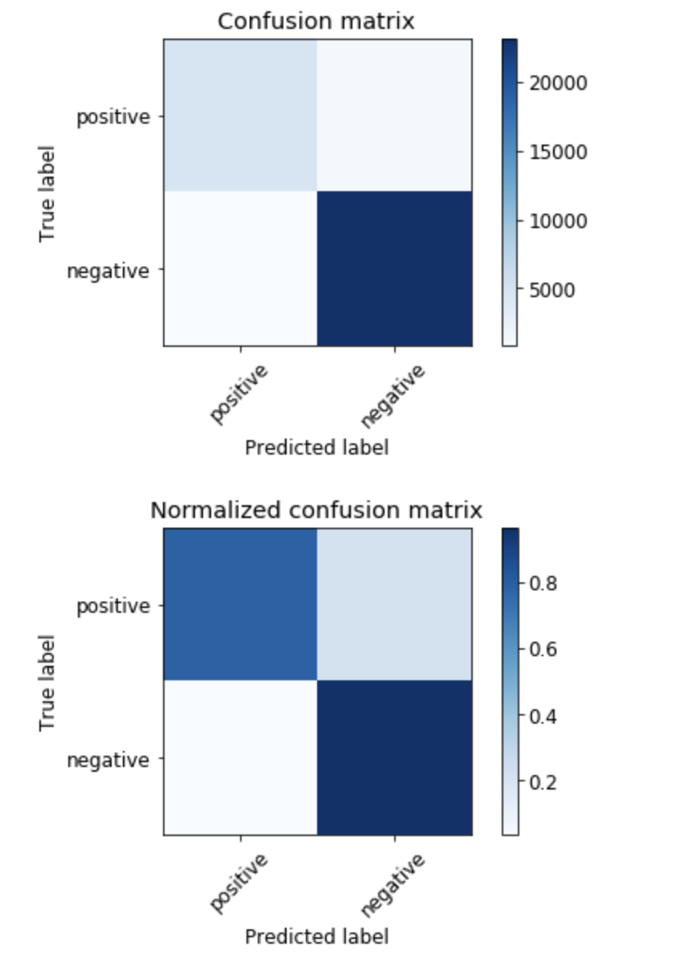
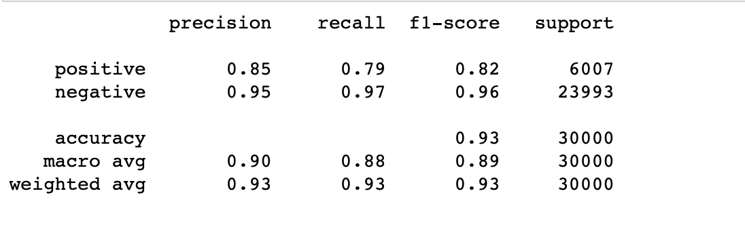
Logistic Regression
Notes:
The goal of logistic regression is to find the best fitting model to describe the relationship between the dependent variable (outcome variable) and a set of independent (predictor) variables.

Slide 12
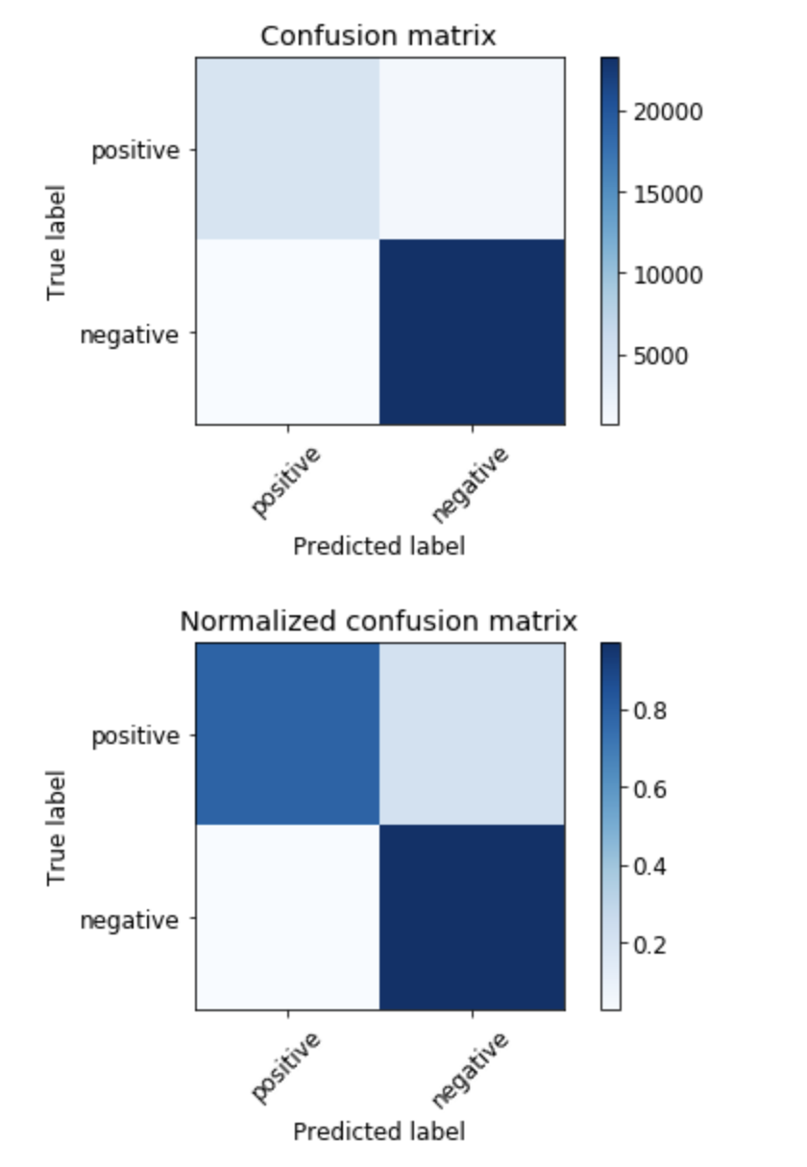
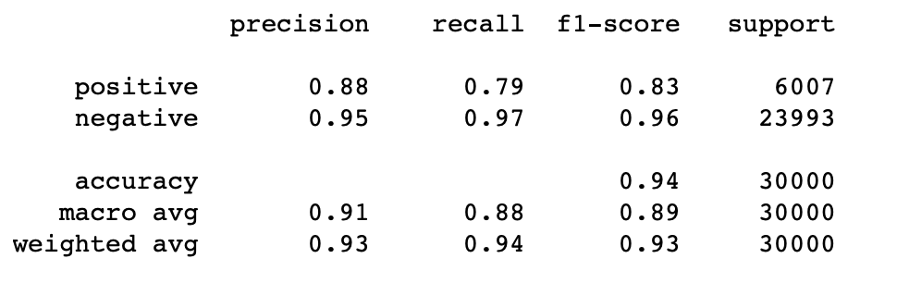
Support Vector Machine
Notes:
SVM Algorithm is a supervised learning algorithm, and the way it works is by classifying data sets into different classes through a hyperplane. It marginalizes the classes and maximizes the distances between them to provide unique distinctions. We can use this algorithm for classification tasks that require more accuracy and efficiency of data.

Slide 13

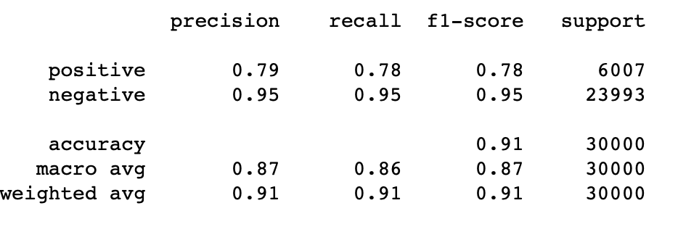
Decision Trees
Notes:
The decision tree is used to build both classification and regression model in a form of trees structure. It breaks the data into smaller and smaller subsets in the mean time an associated decision tree is incrementally developed. The result of the tree is either decision node or a leaf node. Where a decision node has two or more branches and a leaf node represents a classification or a decision. The top most decision node in a decision tree is the best predictor called root node.

Slide 14
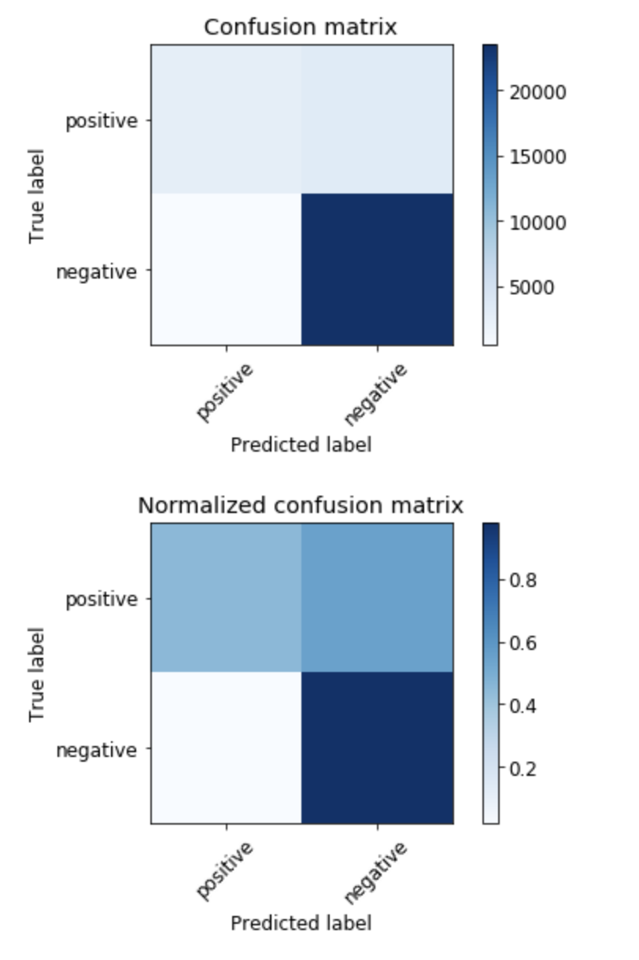
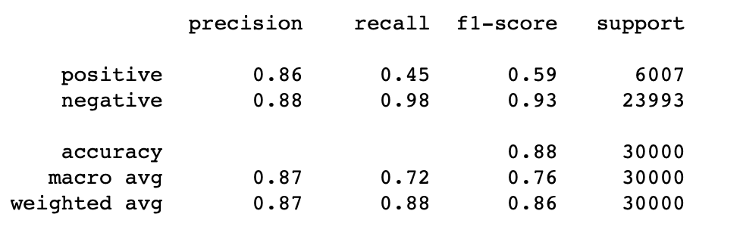
K-Nearest Neighbors
Notes:
K-Nearest neighbors is the supervised classification algorithm which takes a bunch of labelled points and uses them to learn on how to label other points. To label a new point it looks at labelled points closest to the new point and its neighbors votes.

Slide 15
Comparison Based on Accuracy
MODELS | ACCURACY
Bernoulli Naïve Bayes | 0.841834
Multinomial Naïve Bayes | 0.8889
Logistic Regression | 0.930634
Support Vector Machine | 0.935134
Decision Trees | 0.913934
K-Nearest Neighbors | 0.875334

Slide 16
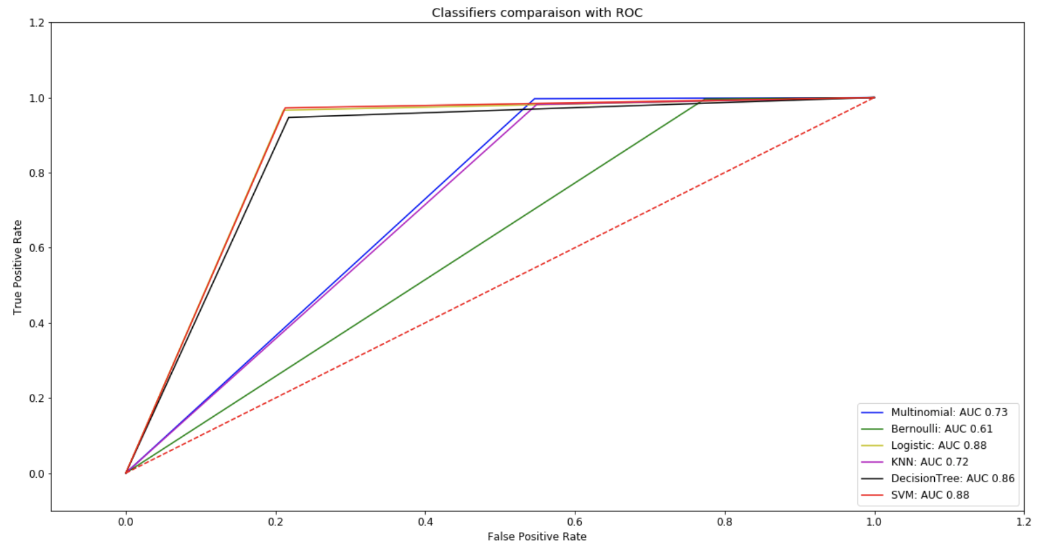
Performance Evaluation
AUC-ROC CURVE
Notes:
ROC curves typically feature true positive rate on the Y axis, and false positive rate on the X axis. This means that the top left corner of the plot is the “ideal” point - a false positive rate of zero, and a true positive rate of one. This is not very realistic, but it does mean that a larger area under the curve (AUC) is usually better.
The “steepness” of ROC curves is also important, since it is ideal to maximize the true positive rate while minimizing the false positive rate.
ROC curves are typically used in binary classification to study the output of a classifier. In order to extend the ROC curve and ROC area to multi-class or multi-label classification, it is necessary to binarize the output. One ROC curve can be drawn per label, but one can also draw a ROC curve by considering each element of the label indicator matrix as a binary prediction (micro-averaging).

Slide 17
Conclusion
This analysis here considers six machine learning algorithms for sentiment analysis on product reviews and we are able to figure out the performance measure of each of them.
In the six machine learning algorithms it can be seen that Bernoulli naïve bayes has achieved the least accuracy score of 83%. Logistic regression and Support Vector machine have achieved relatively the highest accuracy score of 93%.
The analysis solely based on how well the classification algorithms work when it comes to sentiment analysis of product reviews data.

Slide 18
Thank You

