Slide 1
ORAL CANCER DETECTION USING DEEP LEARNING
Presented By: Shreyas S (DS21CS112) Minor Project Department of Computer Science and Engineering Under the Supervision: Dr. <Guide Name> 2024-25
Presented By: Shreyas S (DS21CS112) Minor Project Department of Computer Science and Engineering Under the Supervision: Dr. <Guide Name> 2024-25
Presented By: Shreyas S (DS21CS112) Minor Project Department of Computer Science and Engineering Under the Supervision: Dr. <Guide Name> 2024-25
Presented By: Shreyas S (DS21CS112) Minor Project Department of Computer Science and Engineering Under the Supervision: Dr. <Guide Name> 2024-25
Presented By: Shreyas S (DS21CS112) Minor Project Department of Computer Science and Engineering Under the Supervision: Dr. <Guide Name> 2024-25
Presented By: Shreyas S (DS21CS112) Minor Project Department of Computer Science and Engineering Under the Supervision: Dr. <Guide Name> 2024-25

Slide 2
Abstract
This project aims to build a deep learning-based solution for early oral cancer detection using image processing. We utilized the EfficientNetB0 CNN architecture with transfer learning and Grad-CAM for interpretability. The model was trained on a curated dataset of 1081 oral cavity images categorized as cancerous or non-cancerous. The solution includes a Streamlit web app for real-time predictions with user-friendly UI and Grad-CAM heatmaps. Implementation tools include TensorFlow, Keras, OpenCV, and Streamlit.

Slide 3
Problem Statement
Patients lack accessible tools for early detection of oral cancer, especially in remote areas. Goal: Build a reliable, interpretable, and deployable system to classify oral cavity images as cancerous or non-cancerous using deep learning.

Slide 4
Introduction
Current Status: Manual inspection by doctors is time-consuming and subjective. Planned Work: Create an image classification model with Grad-CAM visualization. Scope: Real-time oral cancer detection with high accuracy (>95%). Assumptions: Sufficient labeled data and consistent image input.

Slide 5
Social/Environmental Impact
This system can help in early diagnosis of cancer and reduce mortality, especially in rural and underprivileged areas with limited access to healthcare.

Slide 6
Social/Environmental Impact
State in one or two sentences if any else skip the slide
Can use pics/images to explain

Slide 7
State of the Art-work
Literature survey
Do not copy paragraphs from papers or your report
Can include a table like below( this is in general: include or exclude columns as per guide instructions)
Research Gaps
Author’s Name/ Paper Title | Conference/Journal Name and year | Technology/ Design | Results shared by author | What you infer

Slide 8
Design
A high-level design will include data flows, flowcharts, data structures:
System architecture
Database design
Brief mention of all the platforms, systems, services, and processes the product would depend on
Brief description of relationships between the modules and system features

Slide 9
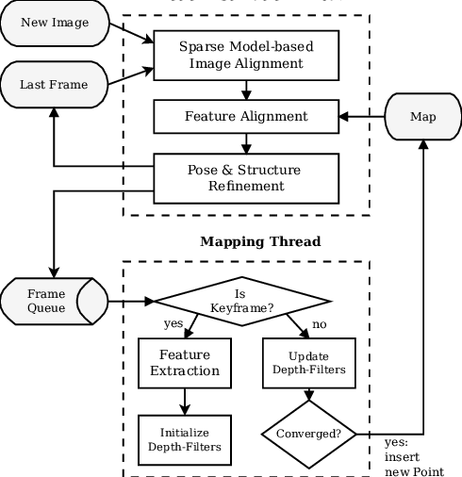
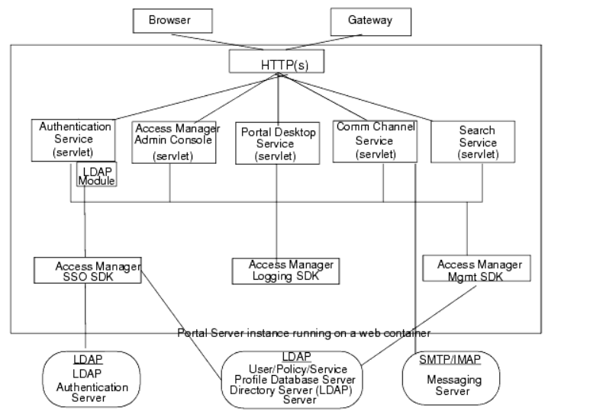
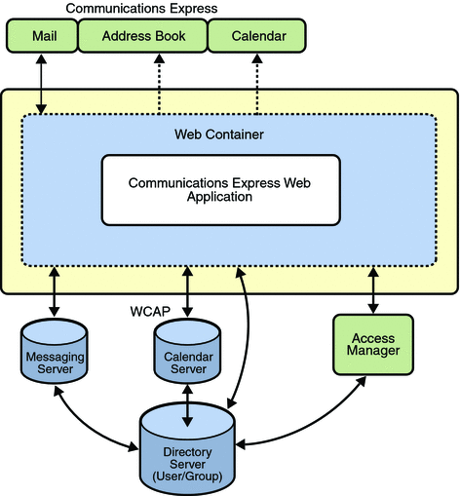
Design- few examples

Slide 10
Design- Screen design

Slide 11
Implementation Algorithm/ pseudocode

Slide 12
Results
Discuss the final results with the help of graphs and tables

Slide 13
Conclusion

Slide 14
References
List of all the papers that were referred as per the Report template(IEEE format)

