Slide 1

Car sales and service management
Presented by
WAZID MUNAVALLI (2BU21CS188)
SIDDARATH MAMADAPUR(2BU21CS147)

Slide 2

Overview
Abstract
Objectives​
Requirements
ER diagram​
Schema Diagram
Implementation
Summary​

Slide 3
ABSTRACT
The Car Sales and Management Application is designed to streamline and automate the process of managing car sales operations for both customers and dealership staff. The purpose of this project is to create a user-friendly platform that enables efficient management of car inventory, sales transactions, customer information, and employee tasks.
The application features a comprehensive database system that stores and organizes information related to cars, customers, dealerships, and employees. It allows users to easily search for cars based on various criteria such as make, model, year, and price range. Customers can browse available cars, view detailed information, and initiate the purchase process online.
For dealership staff, the application provides tools for managing inventory, tracking sales, generating reports, and communicating with customers. It also includes features for scheduling appointments, managing test drives, and processing payments.
Overall, the Car Sales and Management Application aims to improve the efficiency and effectiveness of car sales operations, enhance the customer experience, and increase sales revenue for dealerships.

Slide 4
Objectives
The main objective of the project is to design and develop a user friendly system
Easy to use and an efficient computerized system.
To develop an accurate and flexible system, it will eliminate data redundancy.
zTo make a software fast in processing, with good user interface.
Provides Security to the data by using login and password method.
To provide immediate storage and retrieval of data and information.

Slide 5
REQUIREMENTS
Hardware Requirements
Software Requirements
Operating System: windows 10 and above
Front-end: tailwind , reactjs
Backend: MySQL, Express, NodeJS, XAMPP server
Google Chrome/Internet Explorer
XAMPP
Editor: Microsoft visual studio code
Computer with a 1.1 GHz or faster processor
Minimum 2GB of RAM or more
2.5 GB of available hard-disk space
5400 RPM hard drive
1366 × 768 or higher-resolution display

Slide 6
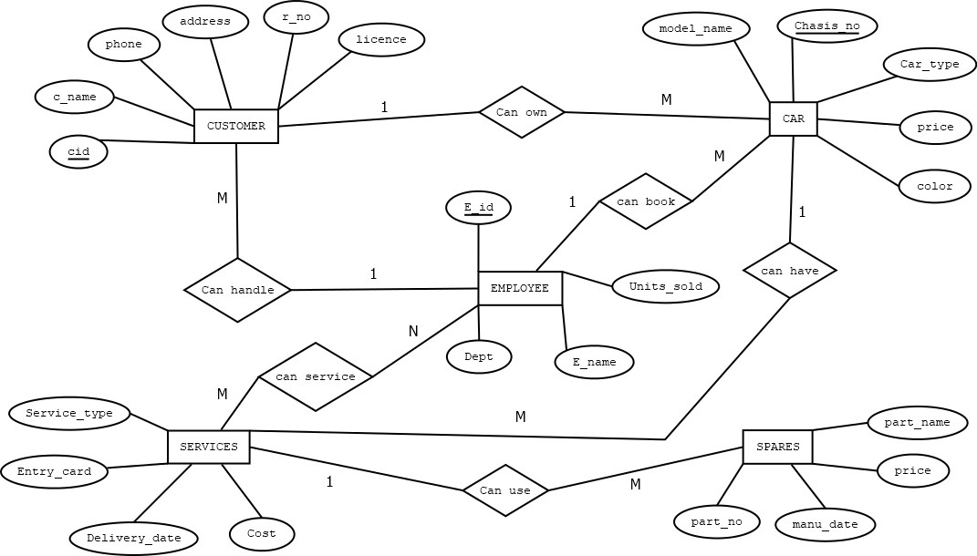
ER Diagram

Slide 7
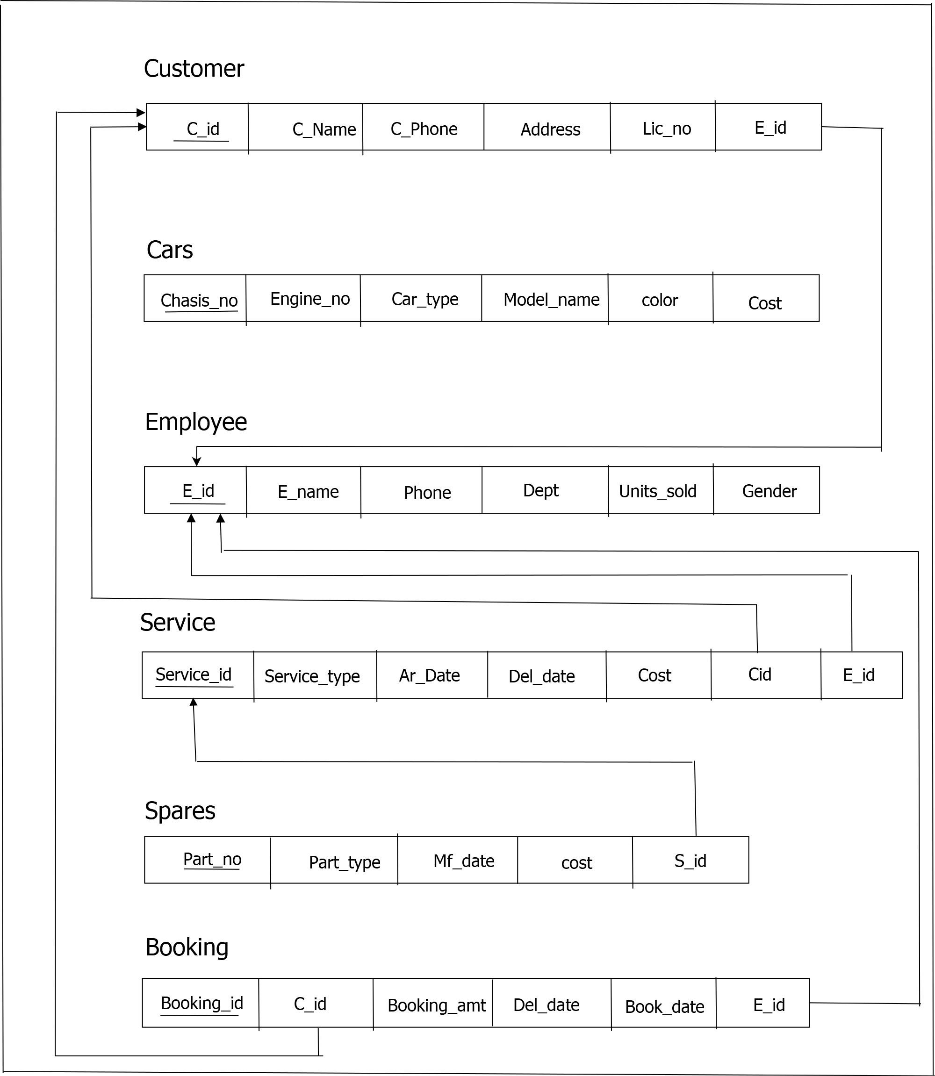
SCHEMA

Slide 8

CONCLUSION
In conclusion, our car sales and service management system represents a significant step forward in streamlining operations within the automotive industry. By leveraging robust database management principles and modern technology, we have created a comprehensive solution that addresses the complexities of both sales and service aspects.

Slide 9


Thank you

