Slide 1
TEAM QUANTIVEX · OPERATIONAL INCIDENT RESPONSE
INC-1042
orders-api · v2.8.1
IncidentIQ
DEP-882
linked via the version number
Evidence-aware incident investigation for explainable operational decisions.
PM-211
an earlier, similar incident
Turn scattered operational evidence into a verifiable investigation.
“Why did the Order API become slow on September 16?”

Slide 2
THE PROBLEM
Deployment notes
Incident reports
The answer is rarely
in one document
Troubleshooting guides
Architecture docs
Postmortems
Incident reports, deployment notes, troubleshooting guides, architecture docs, and postmortems live in different places.
Engineers must connect services, versions, dates, history, and conflicting guidance under pressure.
WHAT WE ARE SOLVING
1
Retrieval finds documents, but does not by itself investigate.
2
Similar incidents can inform a search without being exact matches.
CORE TENSION
Information exists, but relationships between evidence are hard to see.
3
Temporal relationship is not proof of causation.
4
Insufficient evidence must remain a valid outcome.
IncidentIQ · Team Quantivex
2 / 8

Slide 3
THE SOLUTION
IncidentIQ turns retrieval into investigation
5
4
3
2
Explain
1
Compare
Follow up
Show source IDs, investigation trace, and uncertainty—not unsupported certainty.
Discover
Compare dates, versions, contradictions, and historical similarity before concluding.
Ask
Newly discovered clues trigger bounded follow-up searches.
Find evidence across incidents, deployments, guides, and postmortems.
Ask a natural-language operational question.
Question → Evidence → Investigation → Reasoning → Explainable conclusion
IncidentIQ · Team Quantivex
3 / 8

Slide 4
WHAT MAKES INCIDENTIQ UNIQUE
Investigation is
a loop, not a
single search
01
Analyze
02
Retrieve
Service, symptom, date, version, and subquestions.
Semantic search plus metadata filters and lexical fallback.
03
Extract
04
Update state
Facts, claims, relationships, contradictions, and open questions.
What was learned and what remains unknown.
The first result informs the next search.
05
Follow up
06
Reason
A discovered version or deployment ID becomes the next search clue.
Temporal context, applicability, historical similarity, and evidence sufficiency.
IncidentIQ · Team Quantivex
4 / 8

Slide 5
TECHNICAL APPROACH
Hybrid retrieval
Evidence-aware reasoning
From question
to explainable
answer
Investigation state
Semantic search plus service, date, version, and type filters.
Distinguishes temporal from causal, similar from exact, and supports insufficient-evidence outcomes.
Tracks facts, sources, relationships, contradictions, and open questions.
Evidence-aware engineering by design
React receives the user question.
FastAPI routes the request to the investigation orchestrator.
THE PATH
Hybrid retrieval combines semantic search, metadata filters, and lexical fallback.
User question → React → FastAPI → Investigation Orchestrator → Hybrid Retrieval → Evidence & Reasoning → Explainable Output
The evidence and reasoning layer keeps sources, relationships, contradictions, and uncertainty visible.
Retrieval supplies evidence; investigation connects and tests it.
Similar is not exact. Temporal relationship is not causation. Insufficient evidence is a valid result.
5 / 8

Slide 6
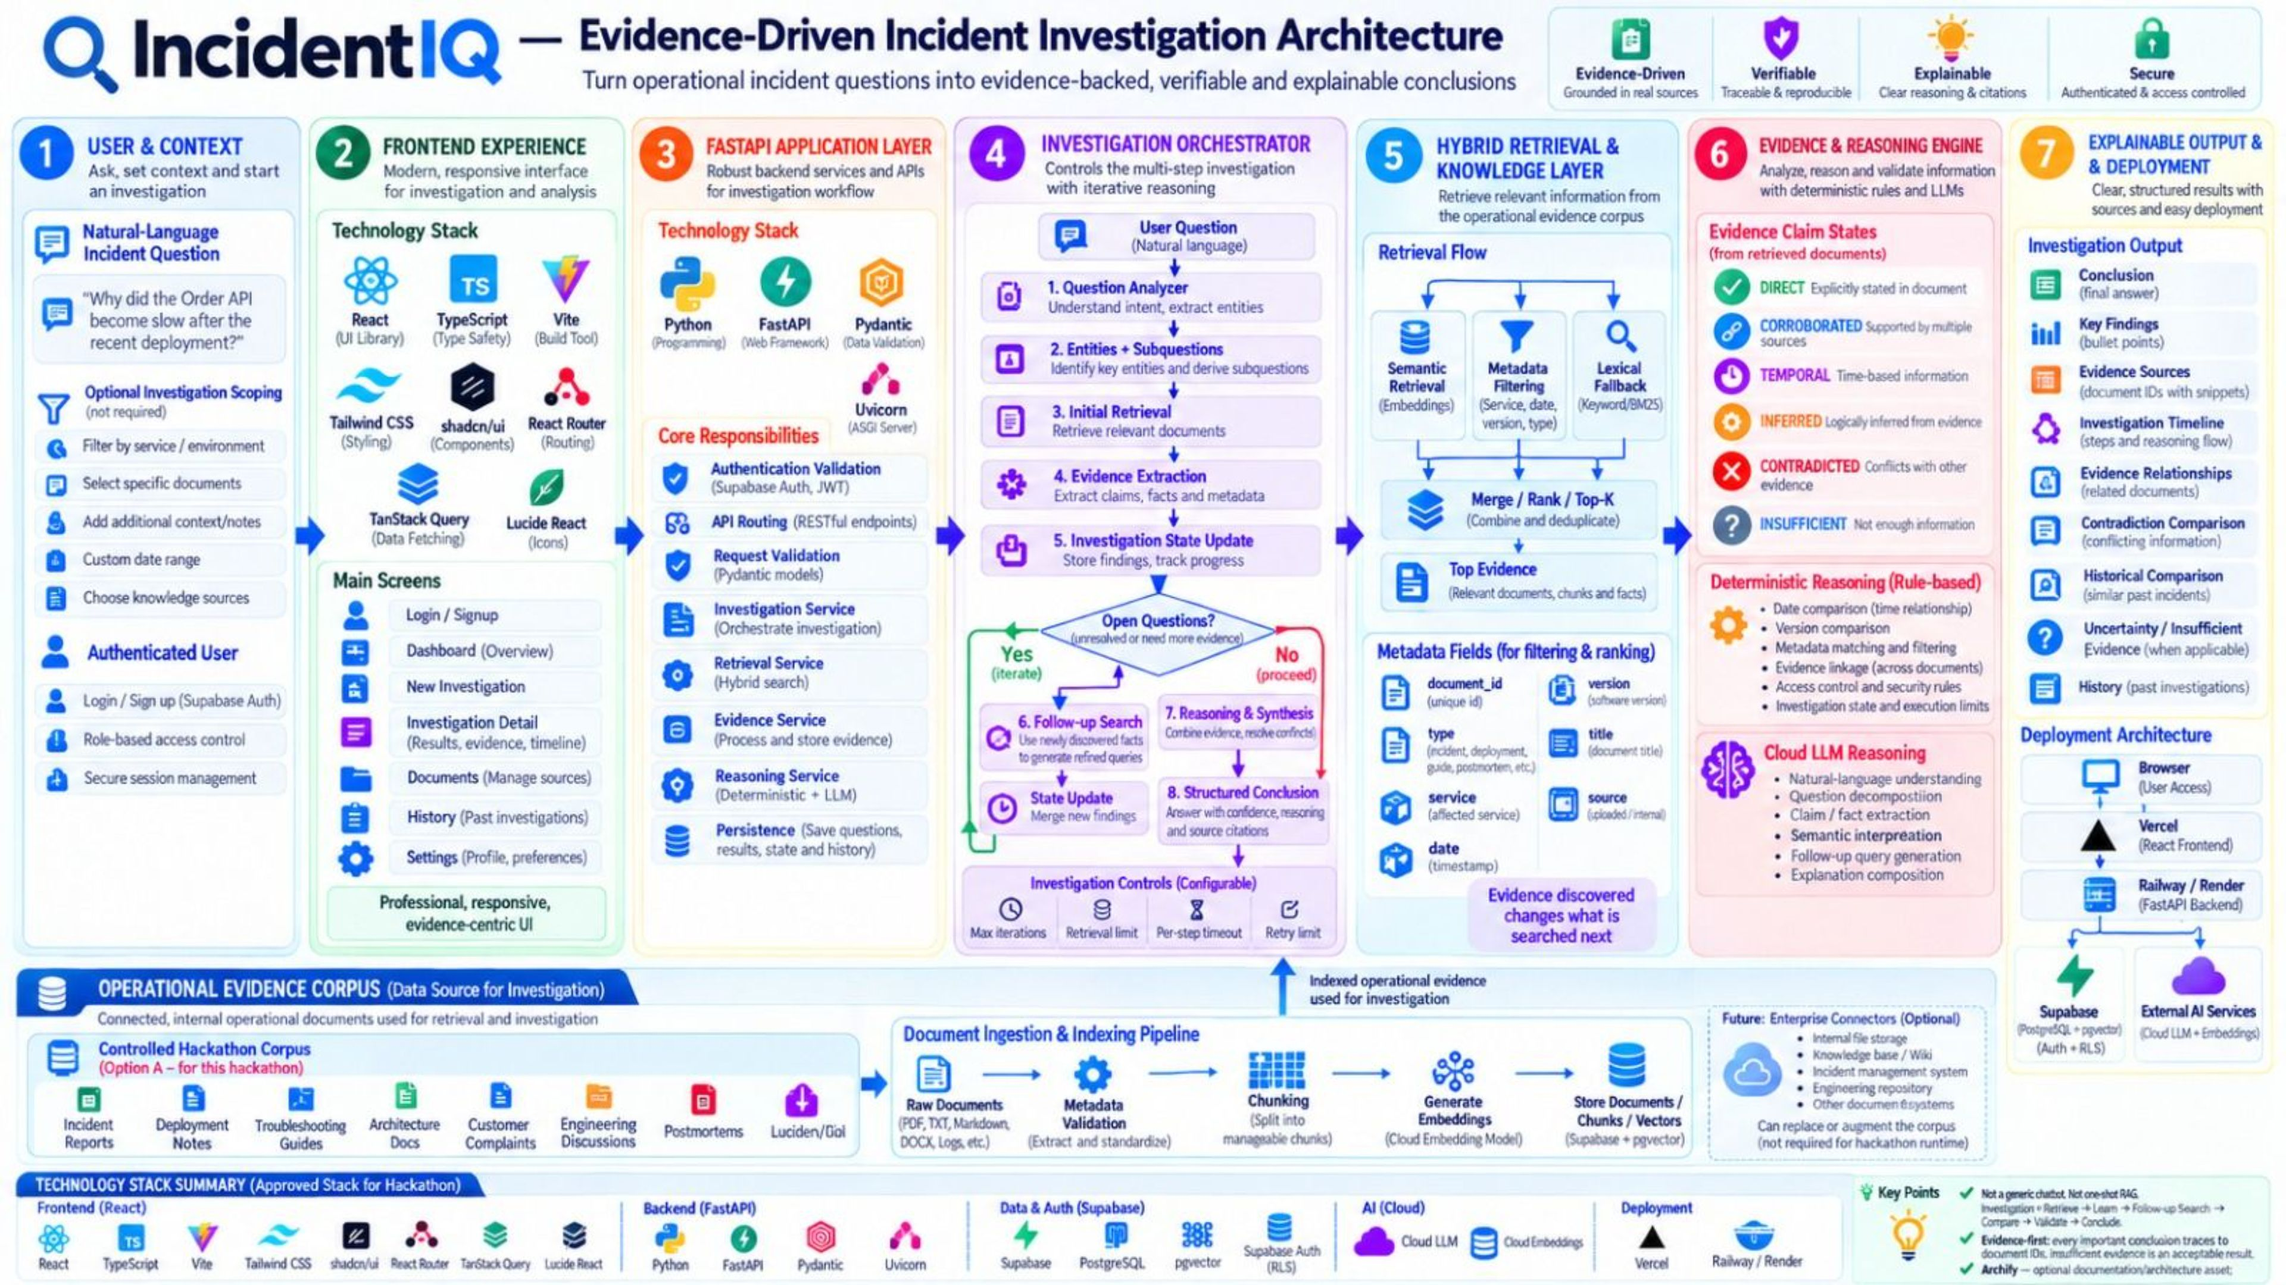
SYSTEM ARCHITECTURE
Evidence-driven architecture, end to end
Not a chatbot
Not a generic chatbot. Not one-shot RAG.
Evidence-first
Every important conclusion traces to document IDs.
Honest outcomes
Insufficient evidence is an acceptable result.
IncidentIQ · Team Quantivex
6 / 8

Slide 7
FEASIBILITY, VIABILITY & BENEFITS
Proof: from incident question to evidence chain
“
Why did the Order API become slow on September 16, was a deployment related, and have we seen this before?
STEP 01
INC-1042
Incident report reveals orders-api and version v2.8.1.
STEP 02
DEP-882
Follow-up search connects the discovered version to a deployment record.
STEP 03
PM-211
Historical search finds an earlier incident for comparison.
✓
Feasible
✓
Viable and beneficial
Built from a focused investigation loop over existing operational evidence.
Helps teams investigate fragmented knowledge with visible evidence links and uncertainty.
IncidentIQ · Team Quantivex
7 / 8
Notes:
Reminder from the original deck: demo evidence and final A/B/C test outcomes must be verified before presentation.

Slide 8
DEMO PATH & CLOSING IMPACT
Make the evidence chain
visible
IncidentIQ turns scattered operational evidence into a verifiable incident investigation.
01 Ask
02 Trace
03 Decide responsibly
Start with a real operational question.
Follow evidence links across incidents, deployments, and history.
Temporal ≠ causal. Similar ≠ exact. Missing evidence ≠ guess.
Built for SRE, DevOps, platform engineering, incident response, and support escalation.
Next horizon Enterprise connectors, service/dependency knowledge graphs, and continuous incident intelligence.

