Slide 1
OPERATING SYSTEMS
Resource Management, System Calls and User–Kernel Interaction in a Multi-User Linux Server
Users / Applications
Linux Kernel
Student: Galla Sai Siddartha
Register No: 192425093
Faculty: GEETHA P
Course: Operating Systems
CPU · Memory · Disk
Linux server stack

Slide 2
Multi-User Linux Server Environment
Multi-user: many users work at once via SSH and terminals
Every user has a unique UID; processes run with that identity
The Kernel shares CPU, Memory, disks and I/O among users
Users never touch hardware directly; they use System Calls
Shared files and devices are protected by Permissions
User A
User B
User C
Applications (shell, editor, DB)
System calls
Linux Kernel
Scheduler · Memory Mgr · VFS · Drivers
CPU
RAM
Disk
NIC
Users submit work through applications; only the Kernel controls CPU, Memory, disk and network, so no user can interfere with another user's resources.
Operating Systems | Galla Sai Siddartha | 192425093
2
Notes:
A multi-user Linux server lets many users work at the same time, usually through SSH or terminals. Each user has a unique UID, and every process runs with that identity. The diagram shows the layers. Users run applications, applications never touch hardware directly, and the kernel sits between them and the CPU, RAM, disk and network card. The kernel shares these resources fairly among users. The only legal way for an application to ask the kernel for a service is a system call, and shared files and devices are protected by permissions.

Slide 3
OS Functions in Resource Management
Process Mgmt
CPU scheduling (CFS)
fork · exec · signals
Memory Mgmt
Virtual memory, paging
mmap · swap
File Mgmt
VFS, inodes, ext4
page cache
Linux Kernel: Resource Manager (allocation · scheduling · protection)
Device Mgmt
Drivers, interrupts, DMA
access via /dev
Security & Protection
UID/GID, permission bits
isolation between users
Goals: fairness · efficiency · isolation · protection
Each function allocates and protects a shared resource: the Kernel schedules the CPU, maps virtual Memory, mediates files and devices, and enforces Permissions.
Operating Systems | Galla Sai Siddartha | 192425093
3
Notes:
The operating system acts as a resource manager, and this slide shows its five main functions. Process management handles CPU scheduling, using the Completely Fair Scheduler in Linux, along with fork, exec and signals. Memory management provides virtual memory, paging and swapping, so each process gets its own address space. File management uses the Virtual File System, inodes and the page cache. Device management uses drivers, interrupts and DMA, and exposes devices through /dev. Security and protection use UID, GID and permission bits to isolate users from each other. Together these goals are fairness, efficiency, isolation and protection.

Slide 4
File System Calls
System Call | Purpose
open(path, flags) | Returns a file descriptor
read(fd, buf, n) | Copy data into buffer
write(fd, buf, n) | Write buffer to file
close(fd) | Release the descriptor
lseek(fd, off, whence) | Move file offset
stat(path, &st) | Read inode metadata
unlink(path) | Remove directory entry
Application
open() / read() / write()
System Call Interface
trap into kernel
Kernel (VFS)
permission + fd lookup
File System
ext4 / xfs
Storage
HDD / SSD
An application never reads the disk itself; each call crosses into the Kernel, and the File System translates file names and offsets into disk blocks.
Operating Systems | Galla Sai Siddartha | 192425093
4
Notes:
Linux provides a small set of system calls for working with files. open takes a path and flags and returns a file descriptor, which is a small integer used for all later operations. read and write move data between the file and a user buffer. close releases the descriptor. lseek moves the file offset, stat reads inode metadata such as size, owner and permissions, and unlink removes a directory entry. The flow on the right shows the path of a request: the application issues the call, the system call interface traps into the kernel, the VFS checks permissions and looks up the descriptor, the file system such as ext4 maps the file to disk blocks, and finally the storage device is accessed.

Slide 5
Device System Calls
User Process
read(fd, buf, n)
Kernel
VFS + syscall layer
Device Driver
char / block driver
Hardware
disk · NIC · terminal
Device files live in /dev (/dev/sda, /dev/tty)
Character devices: byte streams
Block devices: fixed-size blocks
Identified by major / minor numbers
Device Driver hides hardware details
Call | Role on a device
open | Get fd for /dev node
read / write | Transfer data
ioctl | Device-specific control
close | Release the device
A device is used like a file: the Kernel forwards the request to the Device Driver, which converts it into hardware commands; ioctl handles special controls.
Operating Systems | Galla Sai Siddartha | 192425093
5
Notes:
In Linux, devices are treated as files. Each device has a special file under /dev, for example /dev/sda for a disk or /dev/tty for a terminal. Character devices transfer a stream of bytes, like a terminal. Block devices transfer fixed-size blocks, like a disk. Each device is identified by a major number, which selects the driver, and a minor number, which selects the specific device. The same calls, open, read, write and close, work on devices. For operations that do not fit read and write, such as setting the baud rate of a serial port, Linux provides ioctl. The flow at the top shows the request passing from the process through the kernel to the device driver and then to the hardware, with the driver hiding hardware details.

Slide 6
User Processes and Kernel Interaction
1 User Mode
app calls open()
2 System Call
libc wrapper, trap
3 Kernel Mode
validate + serve
4 Hardware
disk / device / RAM
5 Return
result or errno
Return value / errno, CPU switches back to User Mode
User Mode (Ring 3)
Kernel Mode (Ring 0)
Restricted instructions
Own virtual address space
No direct hardware access
Full privileged access
Controls memory and devices
Entered by syscall, interrupt, exception
A System Call is the controlled gateway from User Mode to Kernel Mode; the kernel validates the request, performs it, and returns control to the process.
Operating Systems | Galla Sai Siddartha | 192425093
6
Notes:
This is the core of the topic. The CPU runs in two modes. User Mode, or Ring 3, has restricted instructions and no direct hardware access. Kernel Mode, or Ring 0, has full privilege. Follow the flow: step 1, the application calls a function such as open. Step 2, the C library wrapper places the system call number and arguments in registers and executes the trap instruction. Step 3, the CPU switches to Kernel Mode, and the kernel validates the arguments and performs the service. Step 4, the kernel accesses the disk, device or memory. Step 5, the result or an error code, errno, is returned and the CPU switches back to User Mode. This design protects the system, because a faulty user program cannot damage the kernel or other users.

Slide 7
File Sharing in a Multi-User Linux Server
alice (UID 1001)
process P1
Linux Kernel
Permission check: UID/GID vs rwx
/srv/shared/report.txt
-rw-rw-r--
owner alice : group dev
File descriptor → open file table
bob (UID 1002)
process P2
Inode + page cache
Ownership
UID + GID in inode
Permissions
rwx for user, group, other
Concurrent Access
flock() / fcntl() locks
File Descriptors
per-process fd table
The Kernel checks Permissions on every open(), gives each process its own file descriptor, and lets users share one inode safely, with locks for concurrent writes.
Operating Systems | Galla Sai Siddartha | 192425093
7
Notes:
Here is a practical scenario. Alice and Bob are in the group dev, and both use the file /srv/shared/report.txt, which is owned by alice with group dev and permissions rw-rw-r--. When either process calls open, the kernel first runs the permission check, comparing the process UID and GID with the file's owner, group and mode bits. If allowed, the kernel creates an entry in the open file table and returns a file descriptor from that process's own descriptor table. Both users can access the same inode, and the page cache keeps their view consistent. For concurrent writes, processes can coordinate using advisory locks such as flock and fcntl. So ownership, permissions, locking and file descriptors together make shared access safe.

Slide 8
Summary and Conclusion
User Processes
System Calls
Linux Kernel
System Resources
Resource Management
File / Device Calls
User–Kernel Interaction
Process, memory, file, device
Security and protection
open, read, write, close
lseek, stat, unlink, ioctl
User Mode ↔ Kernel Mode
Trap, service, return
The Kernel manages shared CPU, Memory, files and devices, and System Calls give users safe, controlled access.
Operating Systems | Galla Sai Siddartha | 192425093
8
Notes:
To summarize: first, the OS manages processes, memory, files, devices and security as shared resources. Second, file and device operations use a small set of system calls, namely open, read, write, close, lseek, stat, unlink and ioctl. Third, user processes and the kernel interact through the system call interface, switching between User Mode and Kernel Mode. The bottom line is this: user processes make system calls, the Linux kernel checks and performs the request, and the system resources are used safely. This is how a multi-user Linux server provides controlled file sharing and device access. Thank you. I am happy to answer questions.

Slide 9
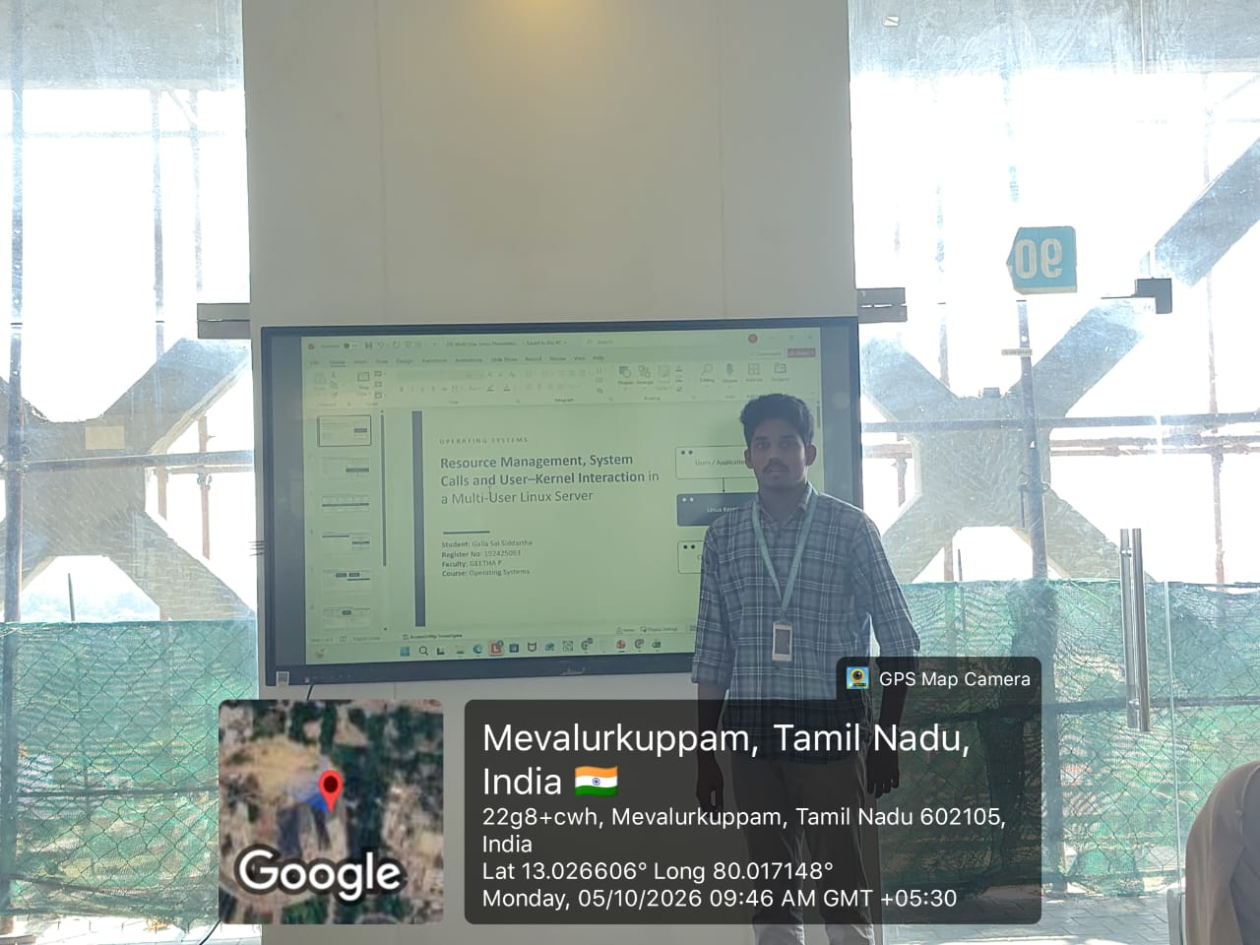
Geotag Photo
Notes:
To summarize: first, the OS manages processes, memory, files, devices and security as shared resources. Second, file and device operations use a small set of system calls, namely open, read, write, close, lseek, stat, unlink and ioctl. Third, user processes and the kernel interact through the system call interface, switching between User Mode and Kernel Mode. The bottom line is this: user processes make system calls, the Linux kernel checks and performs the request, and the system resources are used safely. This is how a multi-user Linux server provides controlled file sharing and device access. Thank you. I am happy to answer questions.

