Slide 1

Wireless Ad Hoc Network Visualizer & Emergency Messaging App
Presented by : Galla Sai Siddartha (192425093)
    : Charan Teja (192424167)
Subject code : ITA0329
Subject : MOBILE COMPUTING
Guide name : Saravanan.M.S
Date : 27/10/2026

Slide 2


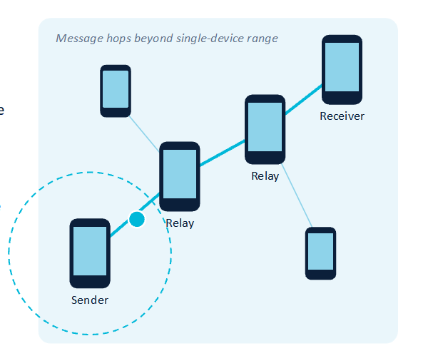
INTRODUCTION
A wireless ad hoc network connects devices directly, with no central access point
Devices communicate through nearby peers
Multi-hop routing carries messages beyond the range of a single connection
Emergency messaging supports communication during outages and disasters
The Android app visualizes connectivity and message delivery

Slide 3
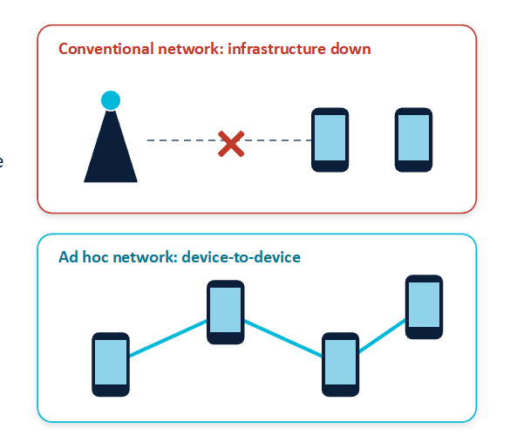
PROBLEM STATEMENT
Conventional messaging depends on available infrastructure
Network outages can interrupt emergency communication
Limited wireless range restricts direct device-to-device messaging
Device movement can break communication paths
A lightweight system is needed to visualize connectivity and support multi-hop emergency messaging

Slide 4
PROBLEM STATEMENT
Conventional messaging depends on available infrastructure
Network outages can interrupt emergency communication
Limited wireless range restricts direct device-to-device messaging
Device movement can break communication paths
A lightweight system is needed to visualize connectivity and support multi-hop emergency messaging

Slide 5
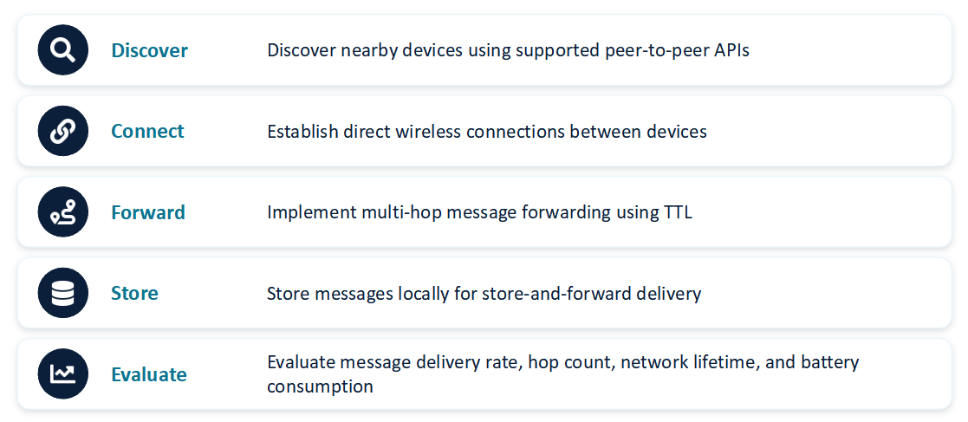
OBJECTIVE

Slide 6
PROPOSED SYSTEM
Android Application
Messaging UI and network visualization
Peer Discovery
Wi-Fi P2P and Nearby Connections APIs
Routing Layer
Selects forwarding paths and manages TTL
Connected Devices
Nearby peers over supported links
message handling
network monitoring
Wi-Fi Direct and Nearby Connections are alternative or complementary link mechanisms. Multi-hop routing is implemented at the application layer; Android does not route messages across arbitrary peers.
Room Database
Stores messages awaiting delivery
Analytics Dashboard
Delivery rate, hop count, battery, network status

Slide 7
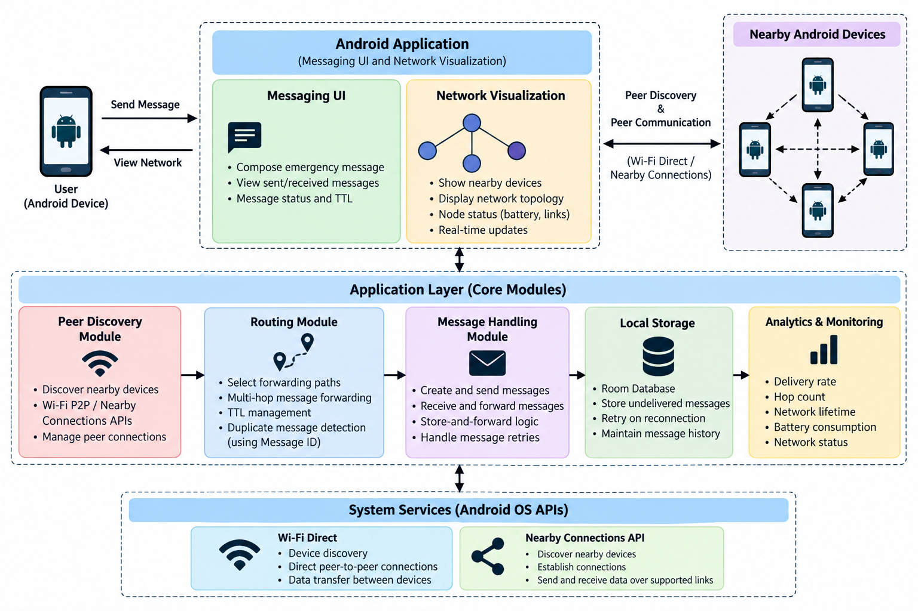
ARCHITECTURE DIAGRAM

Slide 8
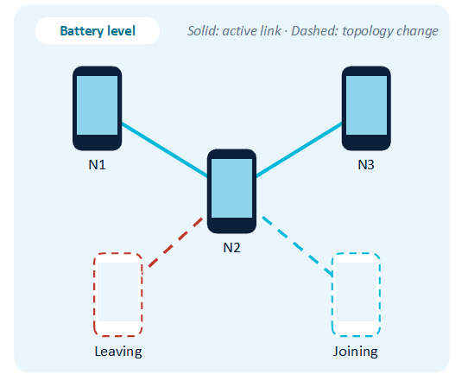
Module 1 : Peer Discovery & Visualization
Discover nearby devices via Wi-Fi P2P or Nearby Connections
Establish and monitor supported peer connections
Nodes represent devices; edges represent wireless links
Update the graph when devices connect or disconnect
Display configurable node count, connection range, battery level, and topology changes

Slide 9
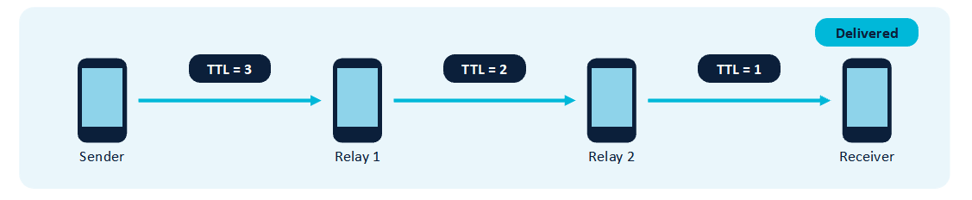
Module 2 : Multi-Hop Emergency Messaging
Create emergency messages and send to connected peers
Relay through a custom routing layer; TTL limits propagation
Message IDs enable duplicate detection and stop repeat forwarding
Undelivered messages are stored in Room and retried on reconnection, if the app is permitted to run
Evaluate delivery rate, hop count, delay, network lifetime, and battery use

Slide 10
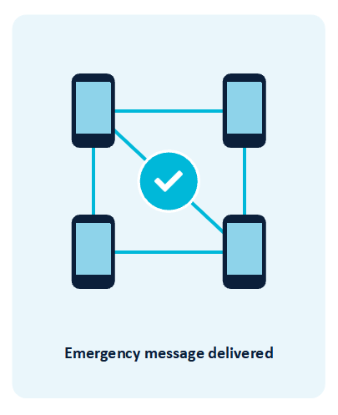
CONCLUSION
Infrastructure-independent communication between supported nearby Android devices
Combines discovery, visualization, multi-hop forwarding, and local storage
Provides measurable metrics for network reliability and resource usage
Enables emergency communication between nearby Android devices without relying on network infrastructure.

Slide 11


