Slide 1

ATLIQ Hardware AD-HOC Insights
Consumer Goods
Created By: SIDDESH PARDESHI

Slide 2
Problem Statement
Atliq Hardware (imaginary company), a top player in the computer hardware industry both in India and internationally, has hit a roadblock.
The management has noticed that they’re not getting the insights they need to make quick and smart decisions based on data.
This lack of timely information is holding them back from responding effectively to market demands and competition.
To tackle this challenge, Atliq Hardware has decided to launch an SQL challenge aimed at digging into their sales, product, and customer data.
The goal? To uncover valuable insights that will help management make informed decisions, adapt their strategies, and ultimately drive the business forward.

Slide 3
Objectives
Address Specific Requests: Fulfill 10 specific data requests using SQL for extraction and analysis.
Utilize Power BI: Leverage Power BI for effective data visualization.
Generate Actionable Insights: Produce insights that can directly inform and enhance decision-making.
Support Strategic Goals: Aid Atliq Hardware in achieving its strategic objectives through informed data analysis.
Enhance Operational Efficiency: Contribute to the overall growth and operational efficiency of the company.

Slide 4
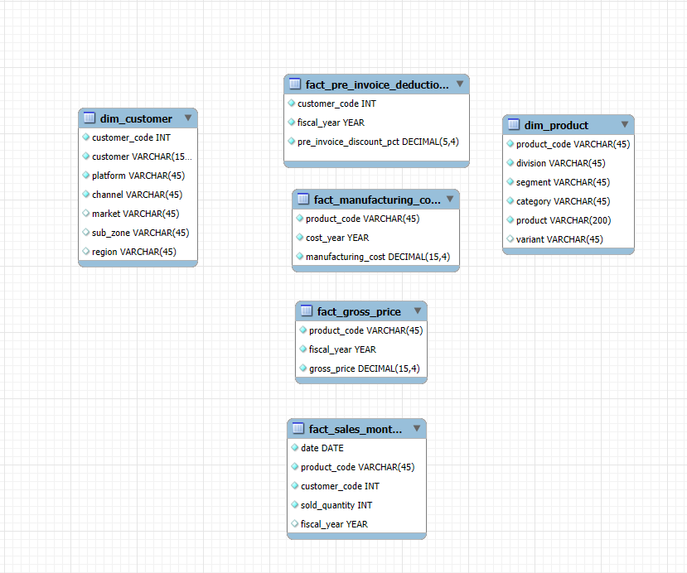
Database Overview

Slide 5
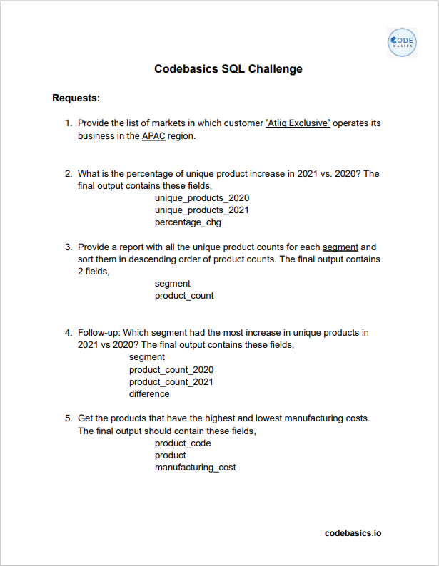
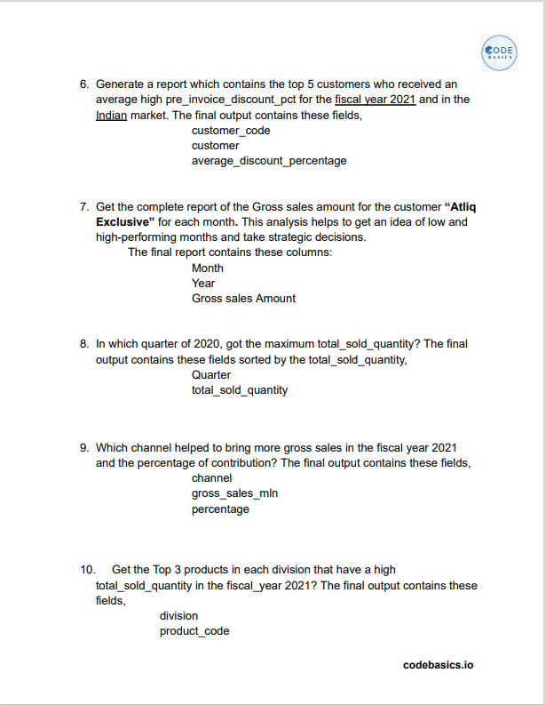


Requests and Analytical Tools
Tools Used:

Slide 6

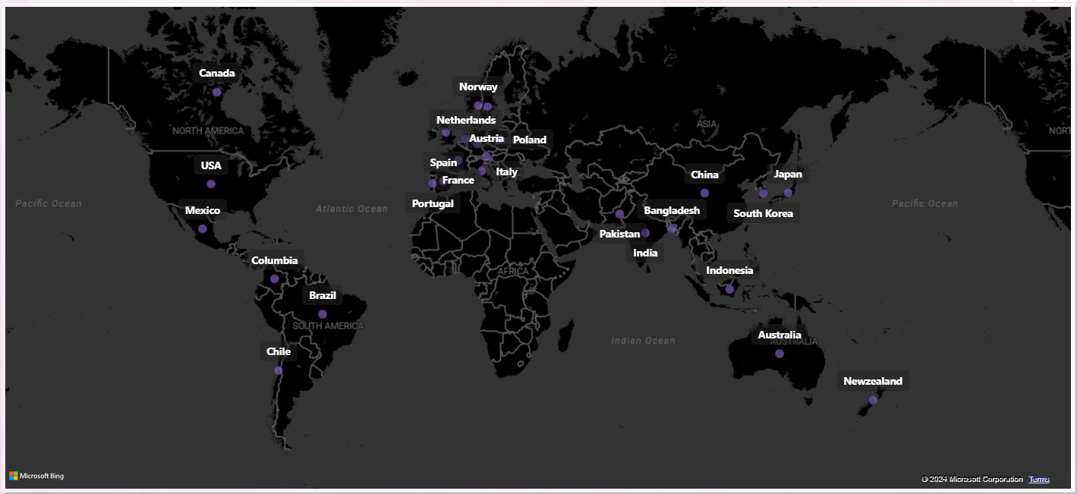
AtliQ’s Market

Slide 7
AD-HOC requests, insights & query results

Slide 8
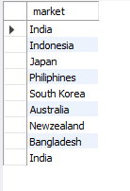

Request 1: Provide the list of markets in which customer "Atliq Exclusive" operates its business in the APAC region.
Query
Output

Slide 9
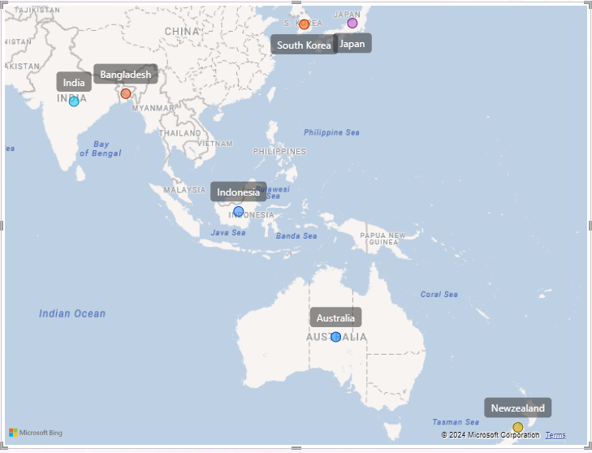
Insights
Our Atliq Exclusive store is now available in 8 important markets across the APAC region.

Slide 10
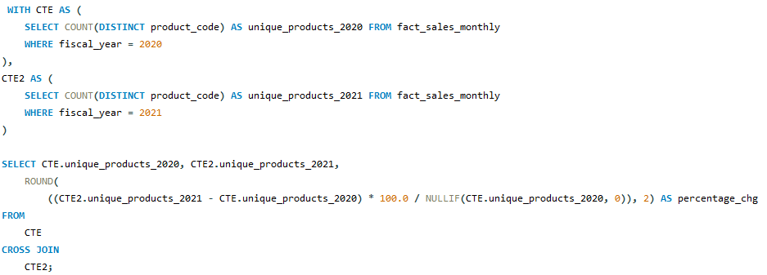

Request 2: What is the percentage of unique product increase in 2021 vs. 2020? The final output contains these fields, unique_products_2020, unique_products_2021, percentage_chg
Query
Output

Slide 11
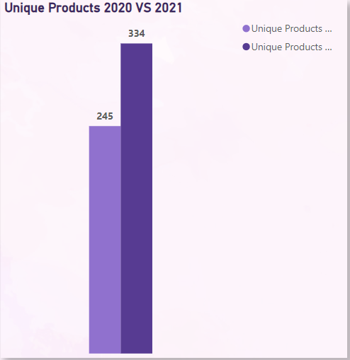

Insights
Percentage Chg
36.33%
The number of unique products went up from 245 in 2020 to 334 in 2021, a 36.33% increase. This growth shows how the company is focused on new ideas and meeting different customer needs.

Slide 12
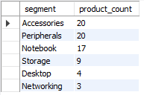

Request 3: Provide a report with all the unique product counts for each segment and sort them in descending order of product counts. The final output contains 2 fields, segment, product_count
Query
Output

Slide 13
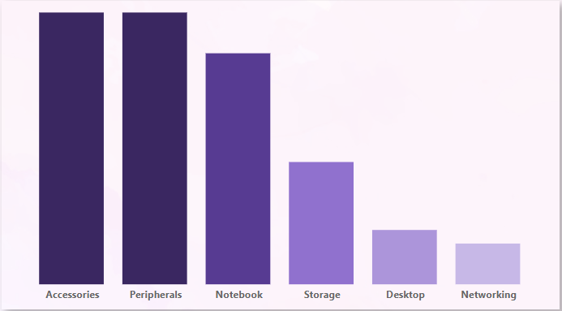
Insights
AtliQ's main products are Notebooks, Accessories, and Peripherals, making up 82.87% of the lineup.
The rest, 17.13%, includes Desktops, Storage, and Networking. To grow, AtliQ should focus more on the bigger category and create products that match what’s popular in the market right now.

Slide 14
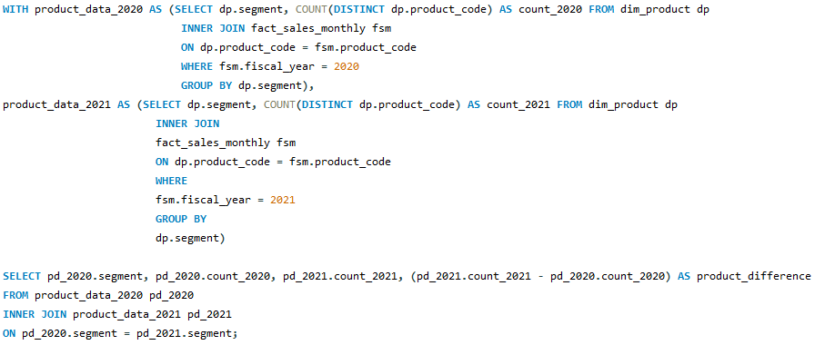
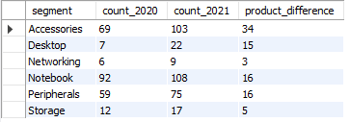
Request 4: Follow-up: Which segment had the most increase in unique products in 2021 vs 2020? The final output contains these fields, segment, product_count_2020, product_count_2021, difference
Query
Output

Slide 15
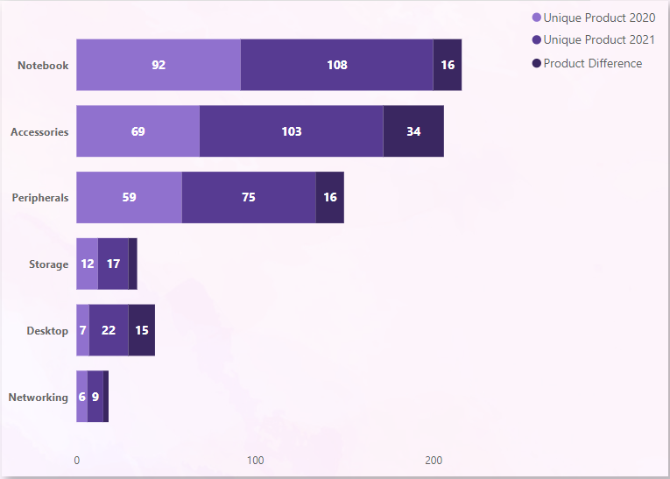
Insights
From 2020 to 2021, every division has expanded its range of unique products, showing growth and variety in all categories. Accessories saw the biggest jump, adding 34 new products during this period.

Slide 16
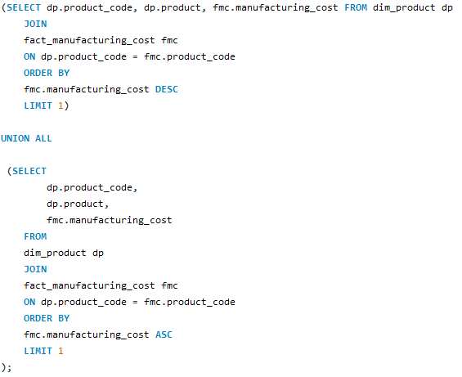

Request 5: Get the products that have the highest and lowest manufacturing costs. The final output should contain these fields, product_code product manufacturing_cost
Query
Output

Slide 17

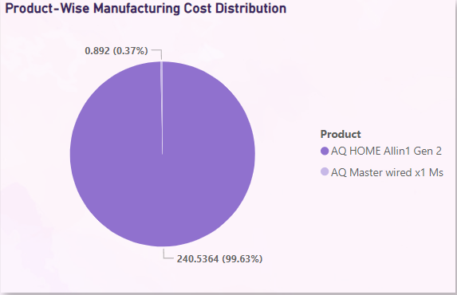

Insights
Highest Manufacturing Cost
AQ Home Allin1 Gen2
Lowest Manufacturing Cost
AQ Master wired x1 Ms
The AQ Home Allin1 Gen2 (Plus3 variant) personal desktop has the highest manufacturing cost, while the AQ Master wired x1 Ms (Standard1 variant) mouse comes in with the lowest manufacturing cost.

Slide 18
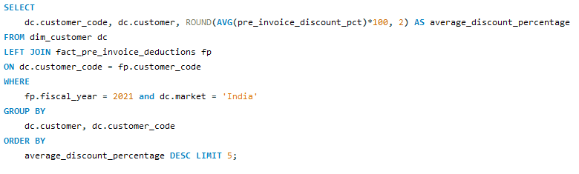
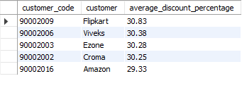
Request 6: Generate a report which contains the top 5 customers who received an average high pre_invoice_discount_pct for the fiscal year 2021 and in the Indian market. The final output contains these fields, customer_code, customer, average_discount_percentage
Query
Output

Slide 19
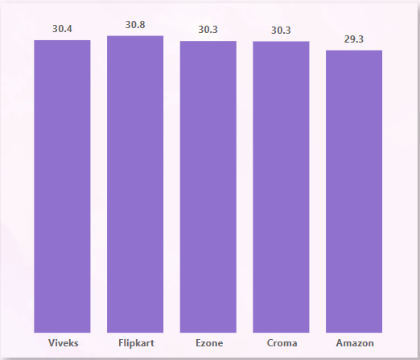
Insights
Flipkart gets the biggest discount in the Indian market, with a pre-invoice discount of 30.63%.
Amazon, on the other hand, received the lowest average discount at 29.33%.

Slide 20
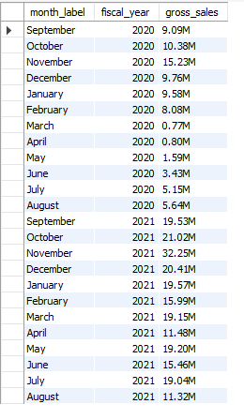
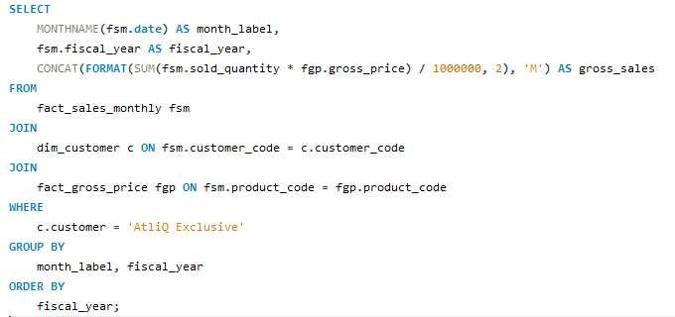
Request 7: Get the complete report of the Gross sales amount for the customer “Atliq Exclusive” for each month. This analysis helps to get an idea of low and high-performing months and take strategic decisions. The final report contains these columns: Month, Year, Gross sales Amount
Query
Output

Slide 21
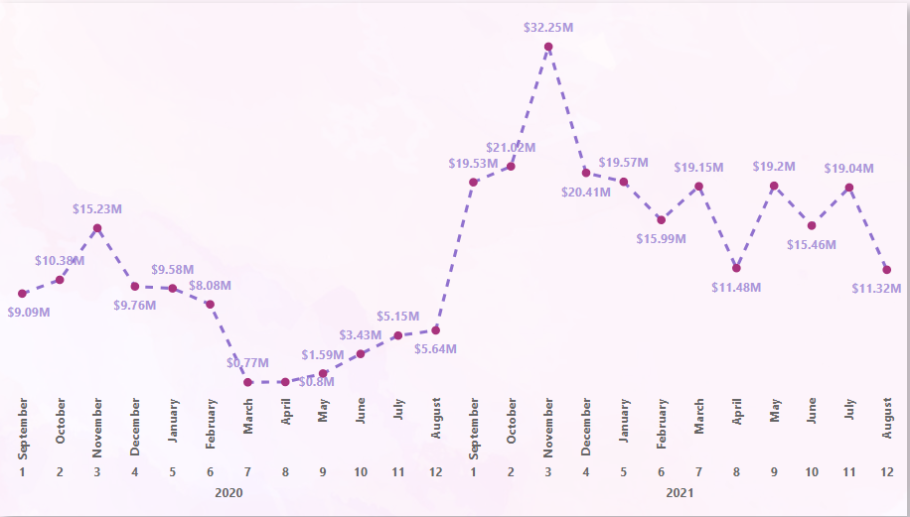

Insights
Highest Gross Sales 32.25M
Lowest Gross Sales 0.8M
The drop in sales from March to August was mainly due to the effects of COVID-19.
However, it's great to see that sales have been gradually increasing since then and are performing well compared to 2020.

Slide 22
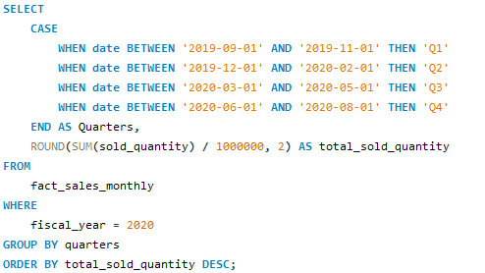
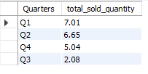
Request 8: In which quarter of 2020, got the maximum total_sold_quantity? The final output contains these fields sorted by the total_sold_quantity, Quarter total_sold_quantity
Query
Output

Slide 23
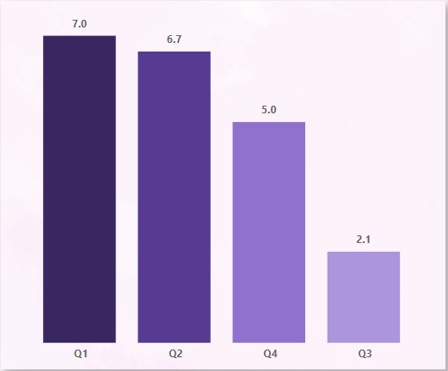
Insights
Highest total Sold Quantity
Lowest total Sold Quantity
The first quarter (Q1) of FY 2020 was a standout period for sales, showing strong performance at the beginning of the financial year.
However, in the third quarter (Q3) (March, April, May), AtliQ faced a notable drop in sales, likely linked to the COVID-19 pandemic, which highlighted tough market conditions and changing consumer habits.

Slide 24
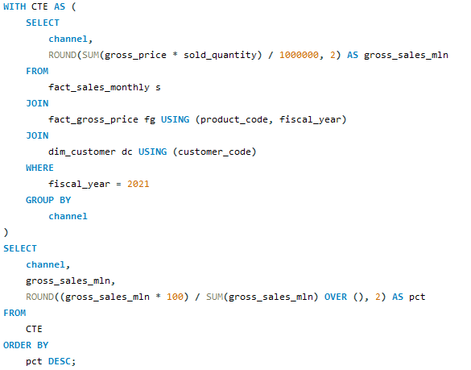

Request 9: Which channel helped to bring more gross sales in the fiscal year 2021 and the percentage of contribution? The final output contains these fields, channel, gross_sales_mln, percentage
Query
Output

Slide 25
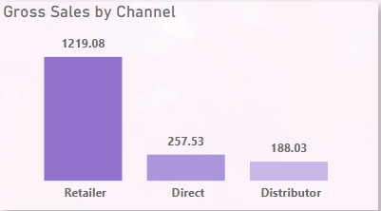
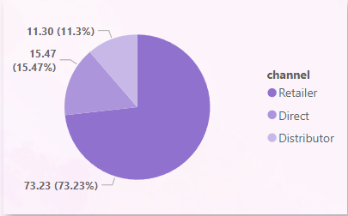
Insights
Most of our sales, about 73.22%, came from retailers. In comparison, only a tiny portion of our sales was made through direct and distributor channels.

Slide 26
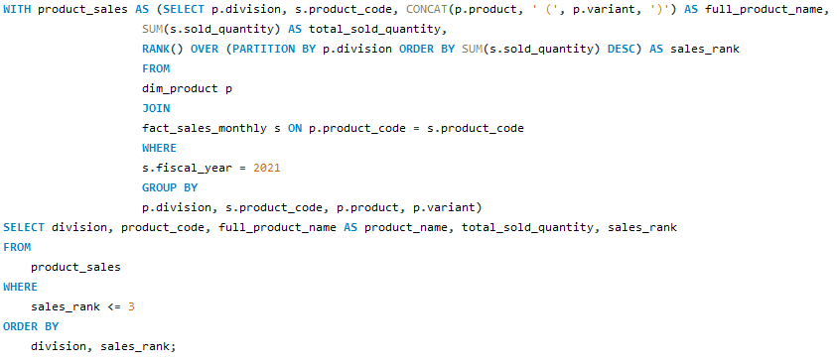
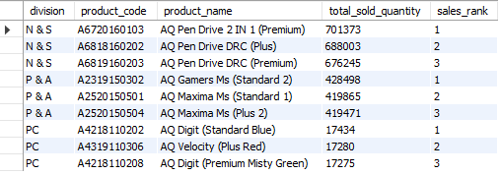
Request 10: Get the Top 3 products in each division that have a high total_sold_quantity in the fiscal_year 2021? The final output contains these fields, division, product_code, product, total_sold_quantity, rank_order
Query
Output

Slide 27
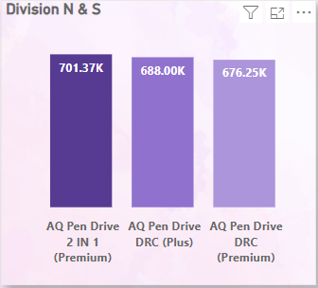
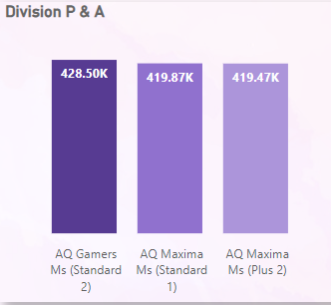
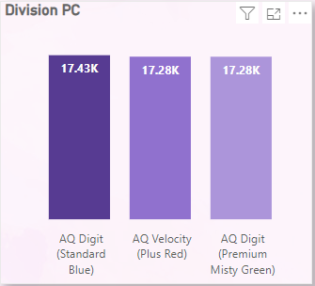
Insights
The three best-selling products in N&S were pen drives, with sales reaching approximately 700,000 units.
The three highest-selling products in P&A were mice, totaling about 400,000 units sold.
The three best-selling products in PC were personal laptops, with sales around 17,000 units.

Slide 28
THANK YOU!

