Slide 1
Event extraction from news articles
Siddhant Agarwal
IIT2020228

Slide 2
Introduction to Event Extraction
Event extraction involves identifying and extracting relevant information about events from text data.
It utilizes techniques such as pattern matching, syntactic parsing, named entity recognition, and semantic role labeling.
Event extraction can be used for applications like information retrieval, knowledge base construction, and event tracking.
Evaluation metrics such as precision, recall, F1-score, and accuracy are used to assess the performance of event extraction systems.
Ongoing research aims to improve the accuracy and efficiency of event extraction methods, addressing challenges like ambiguous language and coreference resolution.

Slide 3
Literature Review
Paper No. | Author | Title | Methodology | Performance | Dataset | Year
1 | Felix Hamborg, Corinna Breitinger, Bela Gipp | Giveme5W1H | The Giveme5W1H system preprocesses news articles using Stanford CoreNLP, converts named entities into canonical form, and then performs four independent extraction chains to identify the main event components. Finally, it selects the most appropriate candidates for each of the 5W1H questions through individual and combined scoring methods. | Dataset divided into Bus, Ent, Pol, Spo, Tec categories; average accuracy: Bus=.72, Ent=.72, Pol=.75, Spo=.73, Tec=.71; overall=.73. | NYTAC, Europarl Corpus, Sina News, Gigaword for evaluation. | 2019

Slide 4
Literature Review
Paper No. | Author | Title | Methodology | Performance | Dataset | Year
2 | Jin Zhang, Tao Li, and Wei Xu | Event Detection and Clustering Using Maximum Entropy Based on Semantic and Temporal Features | It uses a maximum entropy model to classify news articles and extract features from a dataset of around 10,000 articles from various sources. The method combines N-gram and latent semantic analysis for semantic features and employs a sliding window approach for temporal features. The maximum entropy model handles high-dimensional data and captures complex relationships between the features. | The proposed method's performance is evaluated using precision, recall, and F1-score metrics. The results demonstrate superior performance compared to state-of-the-art methods in event detection and clustering accuracy. | Chinese news agencies' articles dataset: 2,000 articles, 19,880 sentences, collected over 3 months. | 2015

Slide 5
Literature Review
Paper No. | Author | Title | Methodology | Performance | Dataset | Year
3 | Pengda Qin, Weiran Xu, William Yang Wang, and William W. Cohen | Unsupervised Event Extraction and Representation Learning from News Articles | The authors proposed an unsupervised event extraction and representation learning method, called Unsupervised Event Embedding (UEE). Their approach aimed to capture event-specific information and generate event representations for downstream tasks | UEE method outperformed baselines in event extraction and representation learning on both datasets. Qualitative analysis evaluated event quality. | UEE method evaluated on English and Chinese Gigaword datasets with millions of news articles. English Gigaword: 9+ million articles. Chinese Gigaword: 10+ million articles. | 2018

Slide 6
Methodology

Slide 7
Preprocessing
Tokenization: The input text is split into individual words or tokens using the word_tokenize() function from the nltk package.
Lowercasing: All words are converted to lowercase using a list comprehension.
Removing punctuation: Punctuation marks are removed from each word using the string.punctuation string and the str.translate() method.
Removing non-alphabetic characters: Words that contain non-alphabetic characters (such as numbers or symbols) are removed using a list comprehension and the str.isalpha() method.
Removing stop words: Common stop words (such as "the", "and", "a") are removed using the stopwords.words() method from the nltk package and another list comprehension.

Slide 8
Event Extraction
Loading the Spacy NLP model: The 'en_core_web_sm' model is loaded to perform part-of-speech tagging, dependency parsing, and named entity recognition on the pre-processed text.
Generating sentence vectors: The Spacy model is used to generate sentence vectors for each pre-processed news article description. The sentence vectors capture the meaning of each sentence in the text.
Storing sentence vectors: The generated sentence vectors are stored in a dictionary where the keys represent the index of the sentence vector and the values represent the vector itself.
Converting sentence vectors to a numpy array: The generated sentence vectors are converted to a numpy array to be used as input for the DBSCAN algorithm.

Slide 9
How to apply DBSCAN?
Determine the minimum number of points (minPts) and the distance within which points should be considered neighbors (epsilon or eps) for clustering.
Choose a data point at random that has not yet been assigned to a cluster, and determine whether it has at least minPts neighbors within the distance of eps.
If the point has at least minPts neighbors, create a new cluster and add the point and its neighbors to the cluster. If the point has fewer than minPts neighbors, mark it as a noise point.
For each neighbor of the point, check whether it has at least minPts neighbors within eps. If so, add it and its neighbors to the current cluster.
Repeat the process until all points have been assigned to a cluster or marked as noise points.
Points that are not assigned to any cluster are considered as noise points.
If a point belongs to more than one cluster, merge the clusters.
Compute the centroids of each cluster, which represent the center of the cluster.

Slide 10
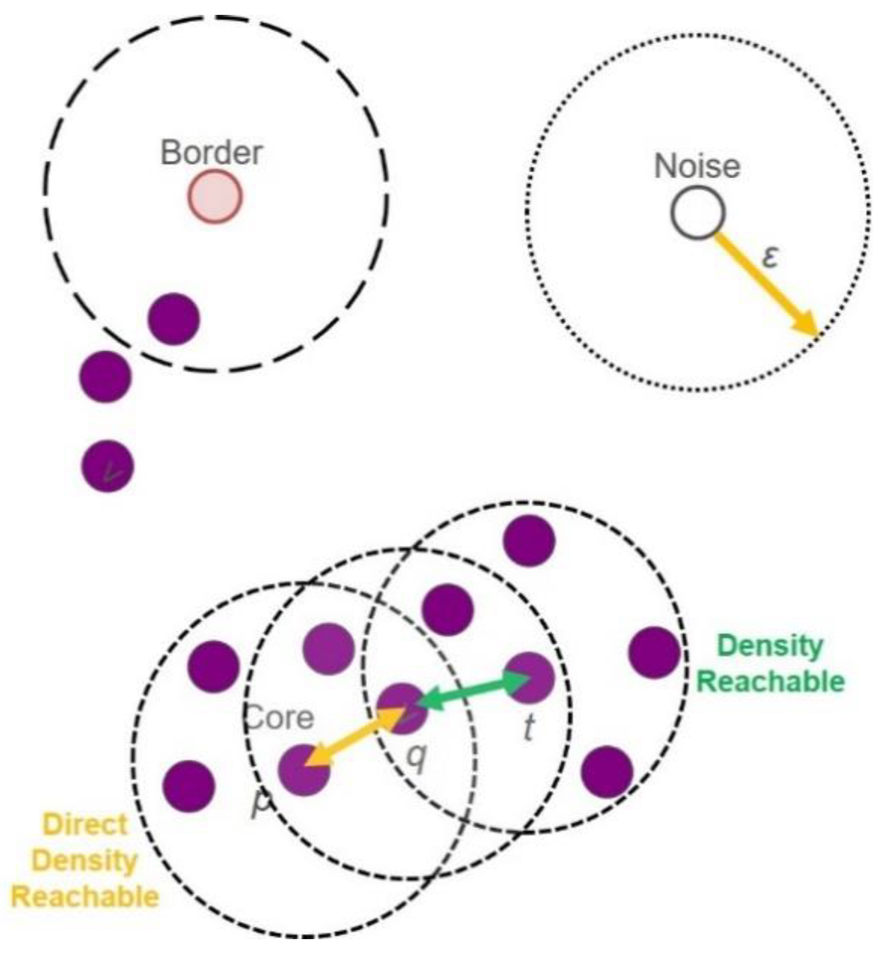
How to apply DBSCAN?

Slide 11
How I have applied DBSCAN?
Perform a grid search over a range of values for the eps parameter in DBSCAN clustering.
Count the number of clusters formed for each eps value.
Determine the optimal eps value as the one resulting in the highest number of clusters.
Run the DBSCAN algorithm using the optimal eps value and a min samples value of 5.
Cluster the event vectors using DBSCAN.
Assign a label to each event phrase based on the cluster it belongs to.
Store the labeled event phrases and their corresponding news articles in a Pandas dataframe.
Print out the number of events in each cluster.
Display a few examples of events from a selected cluster.

Slide 12
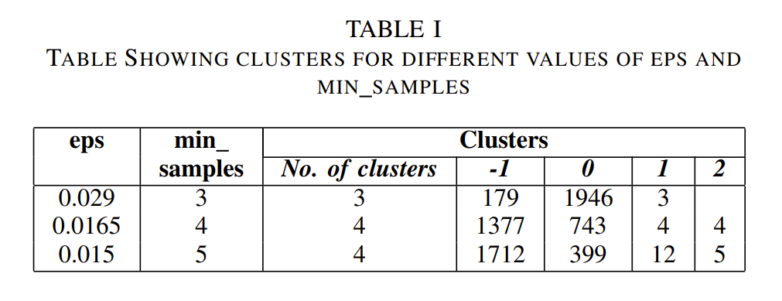
Results

Slide 13
Results
The DBSCAN algorithm was applied to the event vectors with an epsilon value of 0.015 and a minimum number of samples of 5. Also I experimented with different values of epsilon and minimum number of samples. These have been shown in the above table.
In case of eps=0.015 and minimum number of samples=5, I got 4 clusters.
Here cluster number -1 represents noisy data.
The descriptions that were clustered together share similar topics and content. Some of the topics include sports, politics, health, and technology.
The algorithm was able to group together similar news articles and identify topics and themes in the dataset.

Slide 14
References
Felix Hamborg, Corinna Breitinger and Bela Gipp, Giveme5W1H: A Universal System for Extracting Main Events from News Articles, 2019.
Jin Zhang, Tao Li and Wei Xu, Event Detection and Clustering Using Maximum Entropy Based on Semantic and Temporal Features, 2015.
Pengda Qin, Weiran Xu, William Yang Wang, and William W. Cohen, Unsupervised Event Extraction and Representation Learning from News Articles, 2018.
https://paperswithcode.com/paper/giveme5w1h-a-universal-system-for-extracting
https://github.com/fhamborg/Giveme5W1H
https://github.com/daniel-aracquine/event-extraction-nlp

Slide 15
Thank You

