Slide 1

Sarcasm Detection
Presented By: Ravi Utsav (IIT2020504) Siddhant Agrawal (IIT2020228) Shreyans Jain (IIT2020238) Department of IT IIIT Allahabad, India | Supervised By: Dr. Naveen Saini

Slide 2
Talk Flow
Objective/Introduction
Related Work
Methodology
Outcomes
Application
Appendix

Slide 3
Objective/Introduction
Sarcasm detection has emerged as a critical task in natural language processing, especially in the context of news headlines where subtle nuances can significantly impact interpretation.
We present a meticulously curated dataset comprising of sarcastic and non-sarcastic news headlines.
We conduct experiments employing state-of-the-art models including DistilBERT, BERT, GPT-2, SetFit and RoBERTa each renowned for their prowess in natural language understanding tasks.
By shedding light on the comparative effectiveness of deep learning models in detecting sarcasm within news headlines, our study paves the way for more robust and accurate sarcasm detection systems in real-world applications.

Slide 4
Related Works
Aditya Joshi & Pushpak Bhattacharyya (2017). Automatic Sarcasm Detection: A Survey
Jacob Devlin & Ming-Wei Chang (2018). BERT: Pre-training of Deep Bidirectional Transformers for Language Understanding
Yinhan Liu & Myle Ott (2019). RoBERTa: A Robustly Optimized BERT Pretraining Approach
Alec Radford & Jeffrey Wu (2019). Language Models are Unsupervised Multitask Learners (GPT2)
Rishabh Misra & Prahal Arora (2022). Sarcasm Detection using Hybrid Neural Network
Victor SANH & Lysandre DEBUT (2020). DistilBERT, a distilled version of BERT: smaller, faster, cheaper and lighter
Lewis Tunstall & Nils Reimers (2022). Efficient Few-Shot Learning Without Prompts (SetFit)

Slide 5
Methodology (Proposed)
Data Collection
Model Selection
Model Training
Experimental Setup
Results Analysis
Discussion

Slide 6
Data Set Collection
We created this high-quality datasets featuring sarcastic news headlines within an Indian context, this database aims to bridge the gap by providing a structured and reliable dataset.
Leveraging two primary sources renowned for their satirical news headlines in India, namely The Fauxy and The Unreal Times
This dataset has total 2128 headlines from The Fauxy website and 1919 headlines from archived snapshots of The Unreal Times on the Wayback Machine.
To balance the sarcastic headlines we added equal number of news headlines written in formal sense.
We put the dataset on kaggle for other researchers to use.
Kaggle Dataset Link

Slide 7
Data Set Collection
Dataset Sample
Text | Is sarcastic?
Diesel costlier by 3 as Bihar government withdraws VAT rebate. | 0
Yogendra Yadav Beaten Up At Immigration For Applying ‘Protester Visa’ To Travel To Canada. | 1
Salman Khan's lawyer: No evidence produced that actor drove the car | 0
Arvind Kejriwal To Inaugurate Covid 3rd Wave. | 1

Slide 8
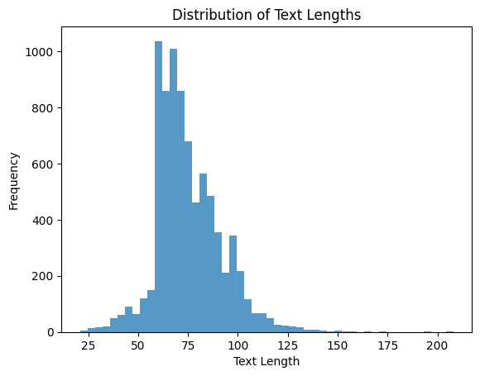
Data Set Collection
Most of the headlines length is around 60 - 80 characters length

Slide 9
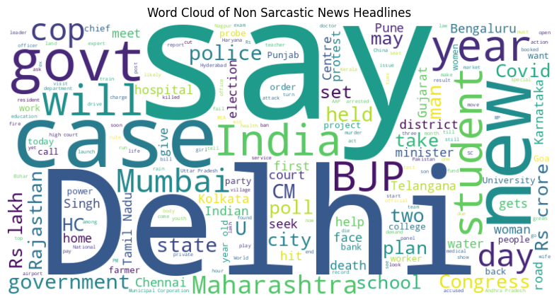
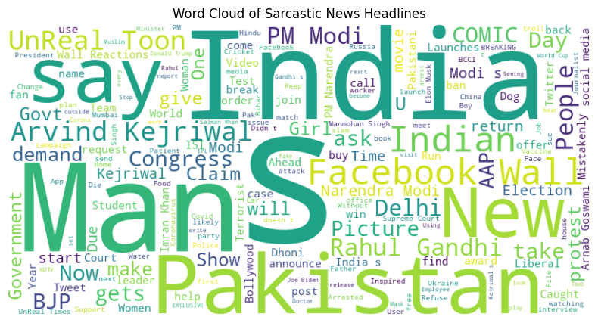
Data Set Collection
Word Cloud of the news headlines

Slide 10
MACHINE LEARNING MODELS USED

Slide 11
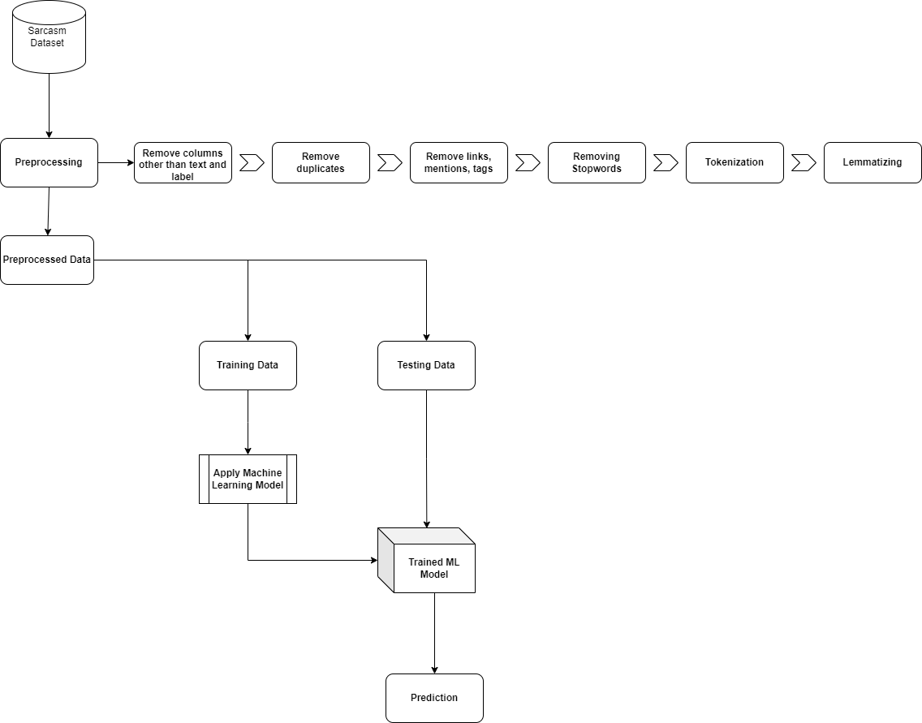

Slide 12
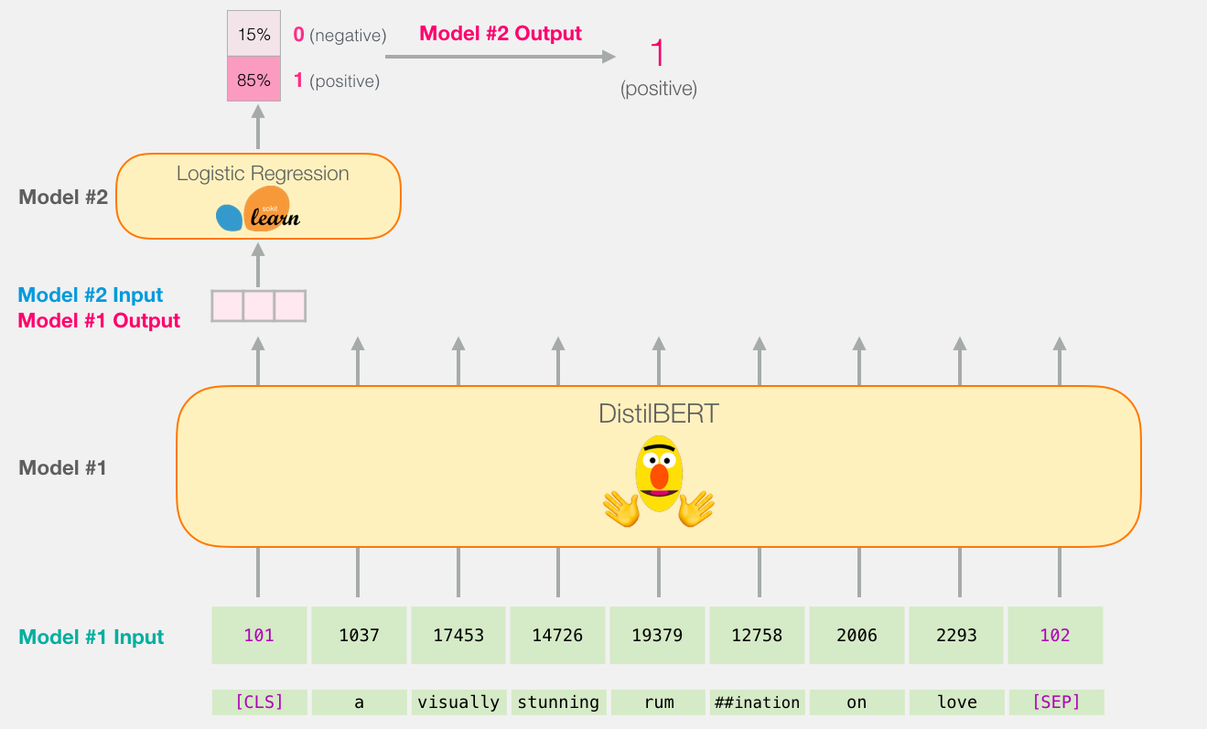
Using DistilBERT as word embedding
image ref

Slide 13
Using DistilBERT word embedding and then applying classical machine learning algorithms gives following results.
Model | Accuracy
Logistic Regression | 87.25
Random Forest | 86.36
Naive Bayes | 81.32
Support Vector Machine | 87.75

Slide 14
2) Adding classification head over distillbert and only tuning the classification head.
Input text is fed into DistilBERT.
DistilBERT acts as a feature extractor, generating high-level representations of the input text.
A classification head, typically consisting of one or more fully connected layers, is added on top of DistilBERT.
The classification head maps the extracted features to the desired output classes for the classification task.
During training, only the parameters of the classification head are updated, keeping the DistilBERT parameters fixed.
This architecture allows for efficient adaptation of pre-trained language understanding to specific classification tasks with minimal computational resources and training time.

Slide 15
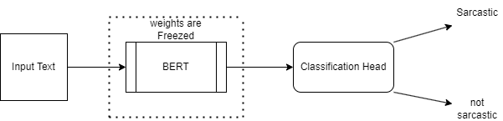
Architecture Diagram

Slide 16
3) Fine tune BERT with classification head on.
BERT as base model: Utilizes pre-trained transformer architecture for contextual understanding.
Classification head: Added atop BERT for task-specific mapping of features.
Fine-tuning process: Adjusts both BERT and classification head parameters simultaneously.
Input → BERT → Classification Head → Output: Captures contextual embeddings and maps to output classes.
Benefits: Leveraging pre-trained knowledge for improved task performance with minimal data.

Slide 17
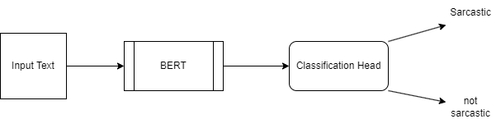
Architecture Diagram

Slide 18
4. SetFit (Sentence Transformers Finetuning)

Slide 19
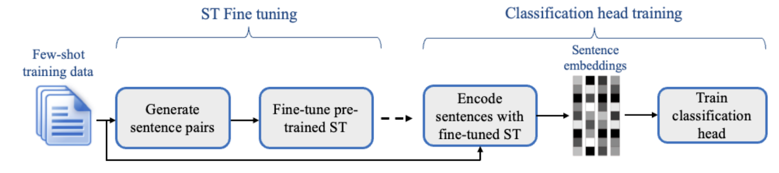
SetFit
SETFIT uses a two-step training approach
An ST is fine-tuned on the input data in a contrastive manner on sentence pairs. In the second step, a text classification head is trained using the encoded training data generated by the fine-tuned ST from the first step.
A text classification head is trained using the encoded training data generated by the fine-tuned ST from the first step
Lewis Tunstall & Nils Reimers (2022). Efficient Few-Shot Learning Without Prompts

Slide 20
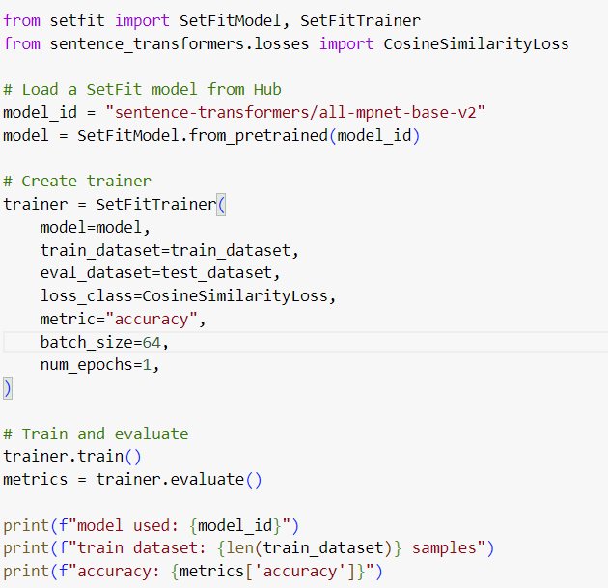
SetFit

Slide 21

SetFit

Slide 22
4. GPT2

Slide 23
GPT2
GPT2 is a model made by stacking decoder part of transformers.
GPT2 is an autoregressive model meaning that the current token is taken as an input for the future generation.
GPT-2 model has a total of 1.5 Billion parameters.
It is trained on a much larger unlabeled dataset as compared to GPT1.

Slide 24
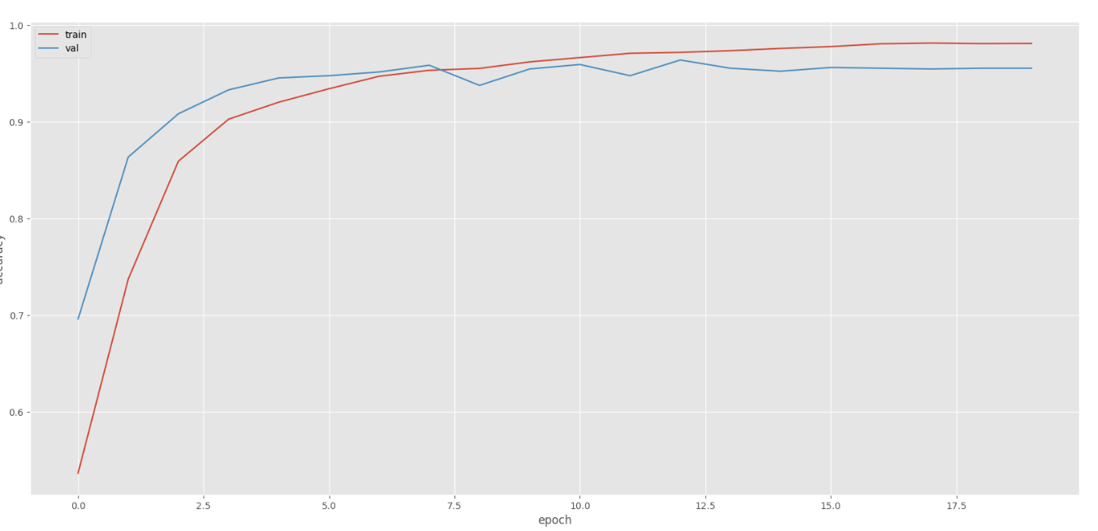
GPT2

Slide 25
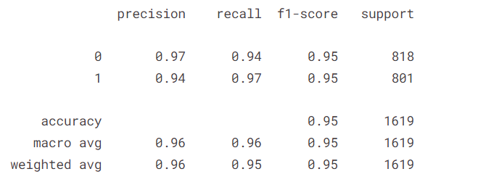
GPT2

Slide 26
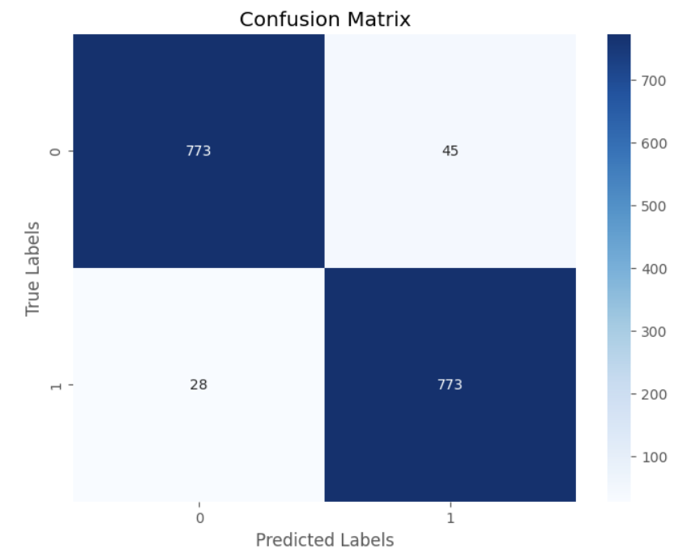
GPT2

Slide 27
6. RoBERTa

Slide 28
RoBERTa
Modifications from BERT:
RoBERTa was trained on a dataset of 160GB of text, which is more than 10 times larger than the dataset used to train BERT
Removed the Next Sentence Prediction (NSP) objective. Only trained of MLM (Masked Language Modelling)
Trained with Bigger Batch Sizes
In the Masked Language Model (MLM) training objective, RoBERTa employs dynamic masking to generate the masking pattern every time a sequence is fed to the model.

Slide 29
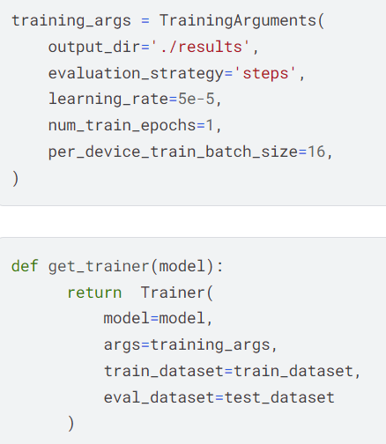
RoBERTa

Slide 30
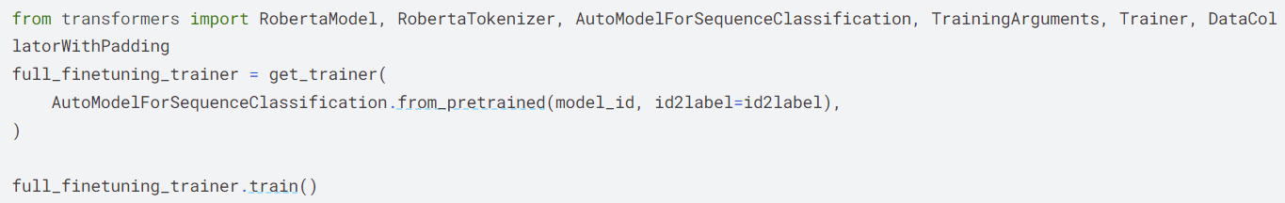
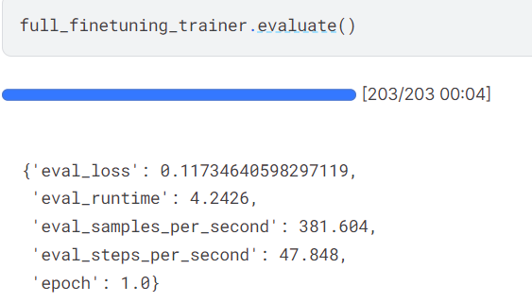
RoBERTa

Slide 31
Outcomes
MODEL | ACCURACY
Word embedding from distillbert and then applying classical machine learning algorithm like Logistic Regression, SVM, Random Forest. | Logistic Regression : 87.25 Random Forest : 86.36 Naive Bayes : 81.32 SVM : 87.75
Adding classification head over distillbert and only tuning the classification head. | 85.8
Fine tune BERT with classification head on. | 94.5
ROBERTa | 88.7
SetFit | 96.4
GPT2 | 95

Slide 32
Error Analysis
Text | Correct Classification | Predicted Classification | Reason
West Indian Cricket Board approaches Mel McLaughlin to coach team. | Sarcastic | Not Sarcastic | Mel McLaughlin is a cricket news reporter, West Indies made this remark because their current coach is not delivering as expected. So they are comparing their current coach with a reporter.
SpiceJet cancels Kabul flights following spate of attacks at airport there. | Non Sarcastic | Sarcastic | There is no sarcasm in this news headline.
Taj Hotels to buy 53% of stakes of Tihar. | Sarcastic | Non Sarcastic | This headline is sarcastic because Tihar is a Jail and it doesn’t make sense for a hotel to buy a jail.

Slide 33
Code
GPT2 on EMOFF_MEME dataset: https://www.kaggle.com/code/siddhantagarwal4583/fork-of-gpt2-fine-tuning/edit
RoBERTa on sarcasm-detection-dataset: https://www.kaggle.com/code/siddhantagarwal4583/roberta-fine-tuning-3
GPT2 on sarcasm-detection-dataset: https://www.kaggle.com/code/siddhantagarwal4583/gpt2-fine-tuning
SetFit on sarcasm-detection-dataset: https://colab.research.google.com/drive/1FLnP5KQVmU9fer1hekkw41A7e_5ZJOID
DistilBERT with classification head on: https://colab.research.google.com/drive/1GtnuA-1VTyn5kKrTAjjPntI9oX1r2qT_?usp=sharing
BERT fine Tuned: https://colab.research.google.com/drive/1_fE-CiLerV_Gp8dQmWriHlCEIRTq7zca?usp=sharing
DistilBERT as embedding: https://colab.research.google.com/drive/1uU9VM4W7_WZeS5b2KbaGK1rZz9rSCPvk?usp=sharing
Llama 2 on sarcasm-detection-dataset:
https://colab.research.google.com/drive/1LT9lxKAoQcH538xTfYwkZem0bl8Aijgw?usp=sharing

Slide 34
Application(s)
Social Media Monitoring: Sarcasm detection can be used to analyze social media posts and comments to understand the sentiment behind them more accurately.
Sentiment Analysis in Reviews: Sarcasm detection can enhance sentiment analysis algorithms, especially when analyzing product or service reviews. It can help businesses accurately gauge the true sentiment of customers, even when it's expressed sarcastically.
Detecting Cyberbullying and Hate Speech: Sarcasm detection can aid in identifying instances of cyberbullying and hate speech online. By flagging sarcastic remarks that contain harmful or offensive content, social media platforms and online communities can take appropriate action to prevent harassment and maintain a safe environment.

Slide 35
Future Work
Fine-tuning for specific domains: Develop sarcasm detection models that are fine-tuned for specific domains such as social media, news articles, customer reviews, or online forums. Each domain may have its own unique patterns of sarcasm, and tailoring models to these specific contexts could improve detection accuracy.
Multimodal sarcasm detection: Explore sarcasm detection using multiple modalities such as text, images, and audio. Combining information from different modalities could provide richer context for detecting sarcasm, especially in platforms like social media where users often incorporate various types of media in their posts.
Cross-lingual sarcasm detection: Extend sarcasm detection to multiple languages to make it applicable in diverse linguistic contexts. This could involve adapting existing models to different languages or developing language-agnostic approaches that can detect sarcasm across multiple languages.

Slide 36
Thank You
Suggestions / Questions

Slide 37
Sentence Transformers
Sentence transformers are used for getting semantic meaning and context of the input sentence. rather than just words which was done by BERT
Sentence Transformers involves 3 tasks:
Natural Language Inference (NLI): The task typically requires the model to classify the relationship between the premise and hypothesis into one of three categories: entailment, contradiction, or neutral.
Sentence Text Similarity (STS): Sentence text similarity refers to the degree of likeness or resemblance between two sentences in terms of their meaning, context, or semantic content.
Triplet dataset: A triplet dataset consists of triplets of data points, typically comprising an anchor sample, a positive sample, and a negative sample, used for training models in tasks such as similarity learning or contrastive learning.

Slide 38
Novelty
We created high-quality datasets featuring sarcastic news headlines within an Indian context, this database aims to bridge the gap by providing a structured and reliable dataset.
Dataset Link - https://www.kaggle.com/datasets/raviutsavk/indian-news-sarcastic-headline-dataset
We fine tuned 6 models on this dataset.
Also we are trying to extend these models on a new dataset named EMOFF_MEMES provided by IIT Patna. in paper Zombies Eat Brains, You are Safe: A Knowledge Infusion-based Multitasking System for Sarcasm Detection in Meme

