Slide 1
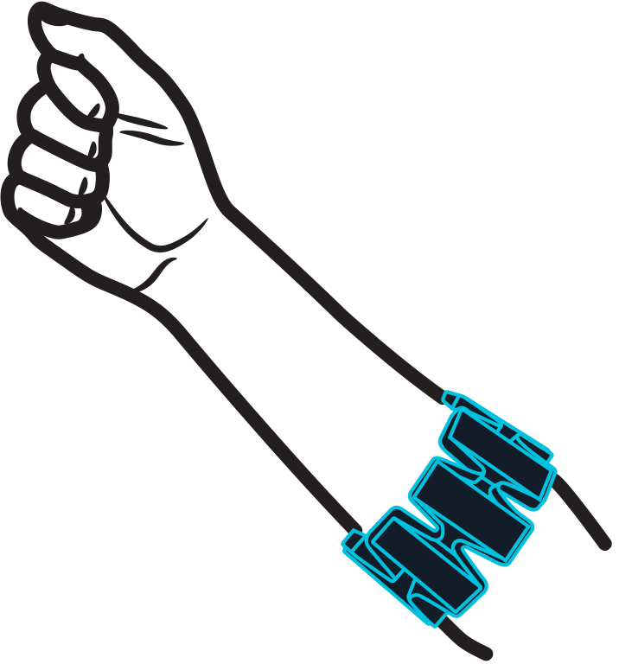
Ubiquitous Project – Spring 16
Project Goal:
To control Camera using Hand gestures with the help of (MYO) to click pictures and use other Camera features
Group Members
Siddhant Jaiswal
Saurabh Bindal

Slide 2
Project Progress
Researched, Studied, You-tubed, the working and scope of MYO armband . Conclusion : Need to Install MYO SDK-kit for Android
Looked into the SDK’s need to develop Applications which sync with MYO
Conclusion : As MYO is fairly new tech , less support available online, only support is on offical site (MYO.com)

Slide 3
Conclusion from Researching on MYO
The MYO armband reads the electrical activity of your muscles and the motion of your arm to let you wirelessly control technology with hand gestures.
Best way to control camera with MYO is to use the camera on the phone .
Need to build an app (using Android Studio) i.e a camera app on android which is compatible with MYO gestures and SDK.

Slide 4
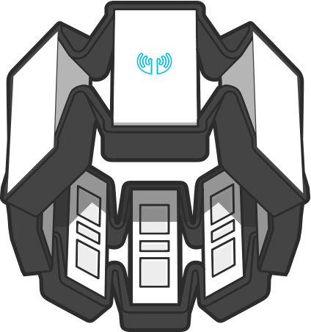
Actual Progress with MYO
MYO Armband Activated –
Installed MYO Drivers in Laptop (Windows) from MYO.com
Activated MYO after charging it overnight,
After several attempts, MYO was successfully connected with Laptop via bluetooth

Slide 5

C. Tests with MYO
After syncing MYO with Laptop it was used to test hand gestures and proper control

Slide 6
Controlling cursor with MYO

Slide 7
Conclusion of Gesture Controls
Double tap and finger spread gesture were difficult to read for the sensors in MYO
MYO takes some time to warm up to hand gestures (after switching it ON)

Slide 8
Work to be done over coming weeks
Learn Android Development on Android Studio. -Any help provided is appreciated
Sync SDK of MYO with Android Studio
Build a Picture Gallery on Android and successfully control it with MYO -Thank You

