Slide 1
SlideEZ
Team Mavericks

Slide 2
test
this is a survey on 8051 microcontroller
it ha 32 prince it ha a timer .

Slide 3
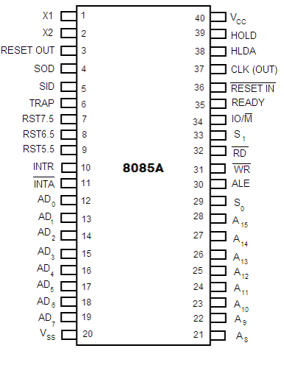
the 8085 is a microprocessor show
i an image of the 8085 processor .

Slide 4
this is our internet and web programming class
it is use in html and css client side script language javascript .

Slide 5
Mavericks
10,000 internet and web programming class 11 about html and css email to also javascript .

Slide 6
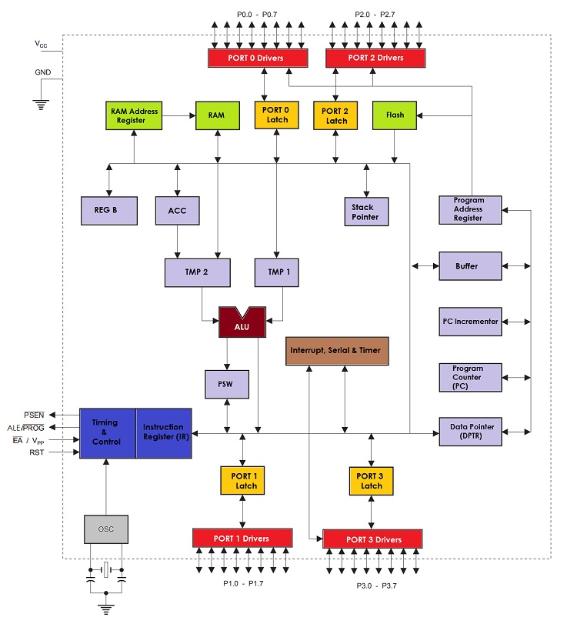
image of 8051 microcontroller .

Slide 7
jetson microcontroller .

Slide 8
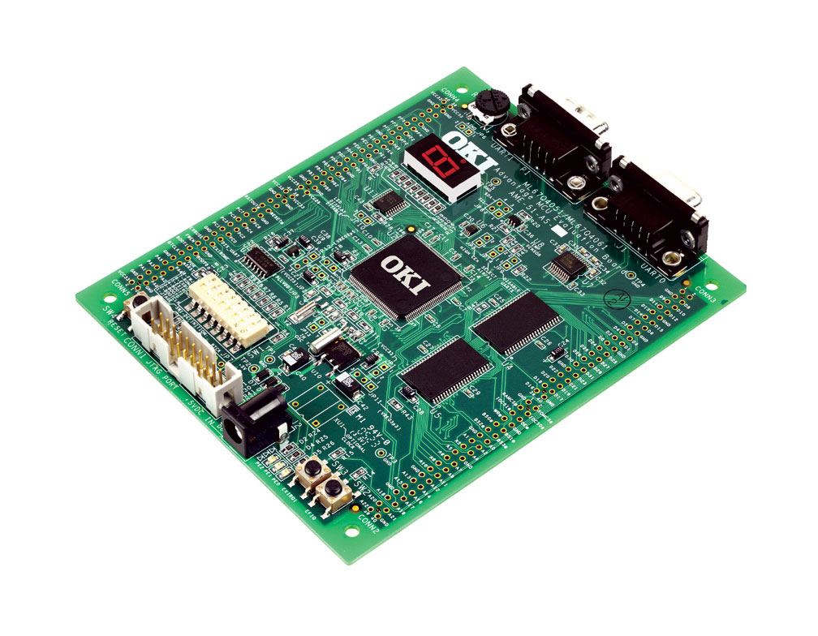
image of a microcontroller .

Slide 9
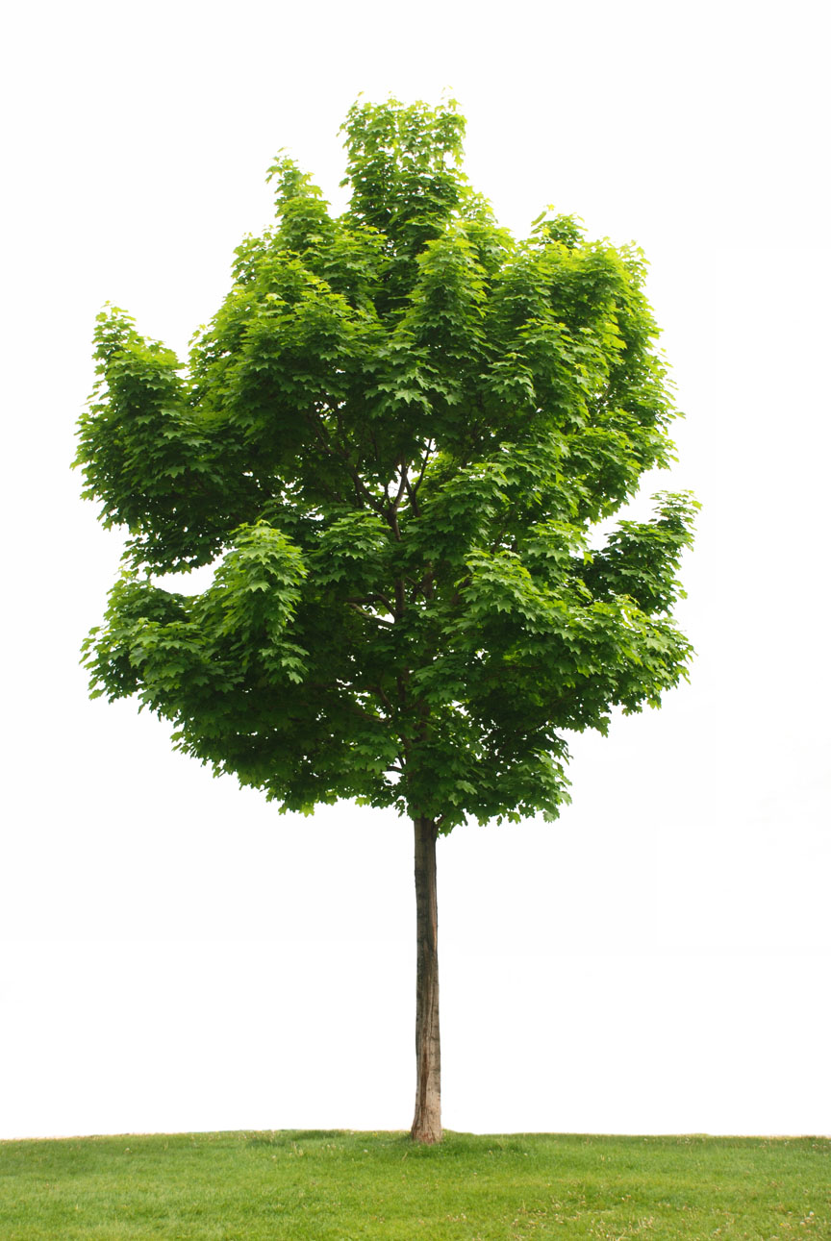
image of a tree .

Slide 10
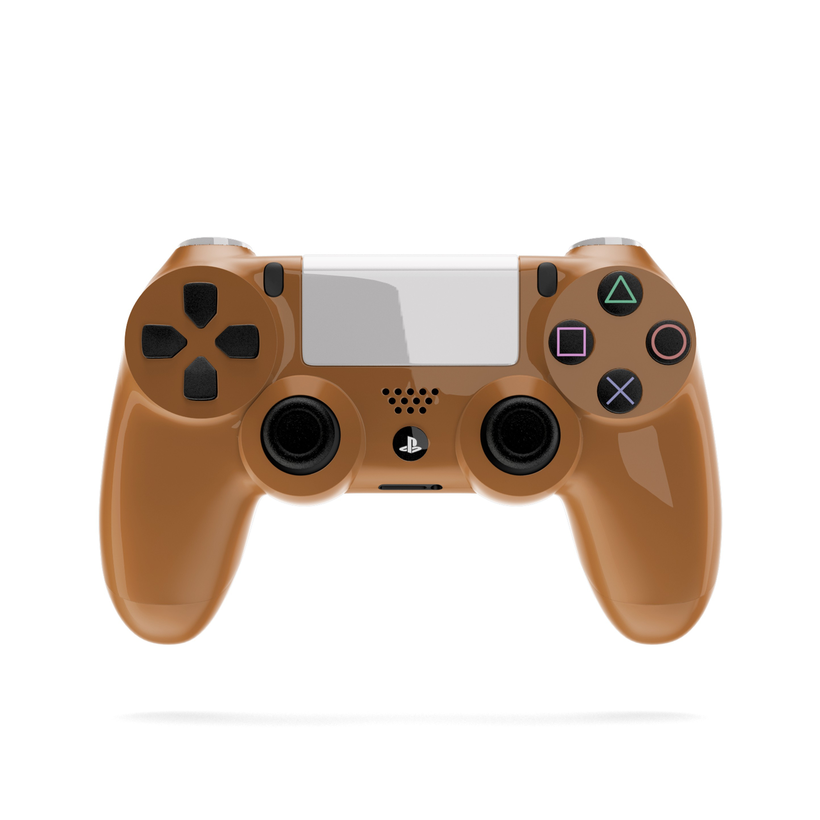
talk about the 8051 microcontroller show i an image of the controller .

Slide 11
Keywords
image microcontroller cow boom

Slide 12
image of a tree .

Slide 13
study about the 8051 microcontroller it ha 32 prince it ha two timer register .

Slide 14
Microcontroller
microcontroller .

Slide 15
Keywords
microcontroller image ha 8051

Slide 16
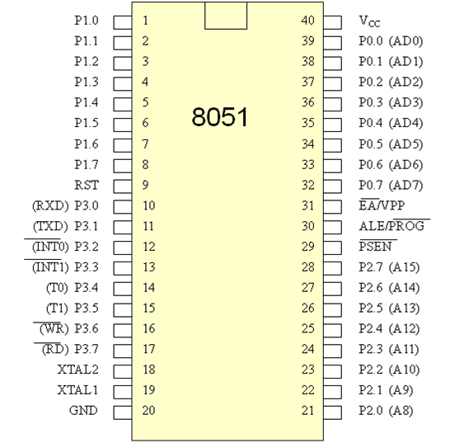
image of 8051 microcontroller .

Slide 17
get i an image of a microcontroller .

Slide 18
Keywords
microcontroller image 8051 ha

Slide 19
get i the image of an 8051 microcontroller .

Slide 20
Differential
neural network is the deep learning model
it work on partial differential equation .

Slide 21
Keywords
image microcontroller 8051 ha

