Slide 1

SwiftQueue: Optimizing Low-Latency Applications with Swift Packet Queuing (NINeS’26)
Siddhant Ray, Xi Jiang, Jack Luo, Nick Feamster, Junchen Jiang

Slide 2
Low Latency Queuing Models
Latency sensitive applications need low-latency queuing models
Cloud gaming, VoIP etc.
L4S Dual-Queue is one such popular technique
Dual queue separation for TCP traffic
Queue 1: Classic traffic
Queue 2: Low latency traffic
Notes:
Let’s start with low latency queuing models.
Latency sensitive applications have latency needs < 10-20 ms
else difference affects user QoE L4S dual queue is an popular new queue management technique
Separation for TCP Traffic

Slide 3
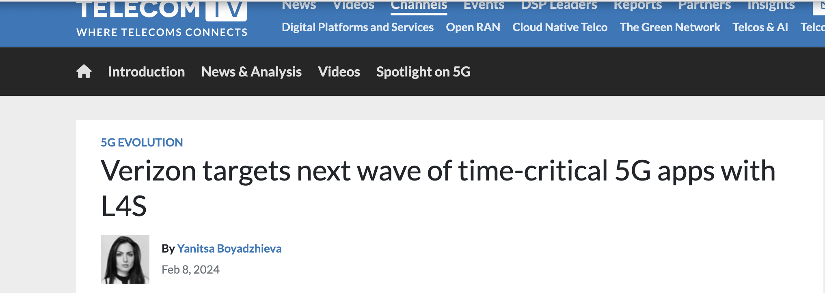
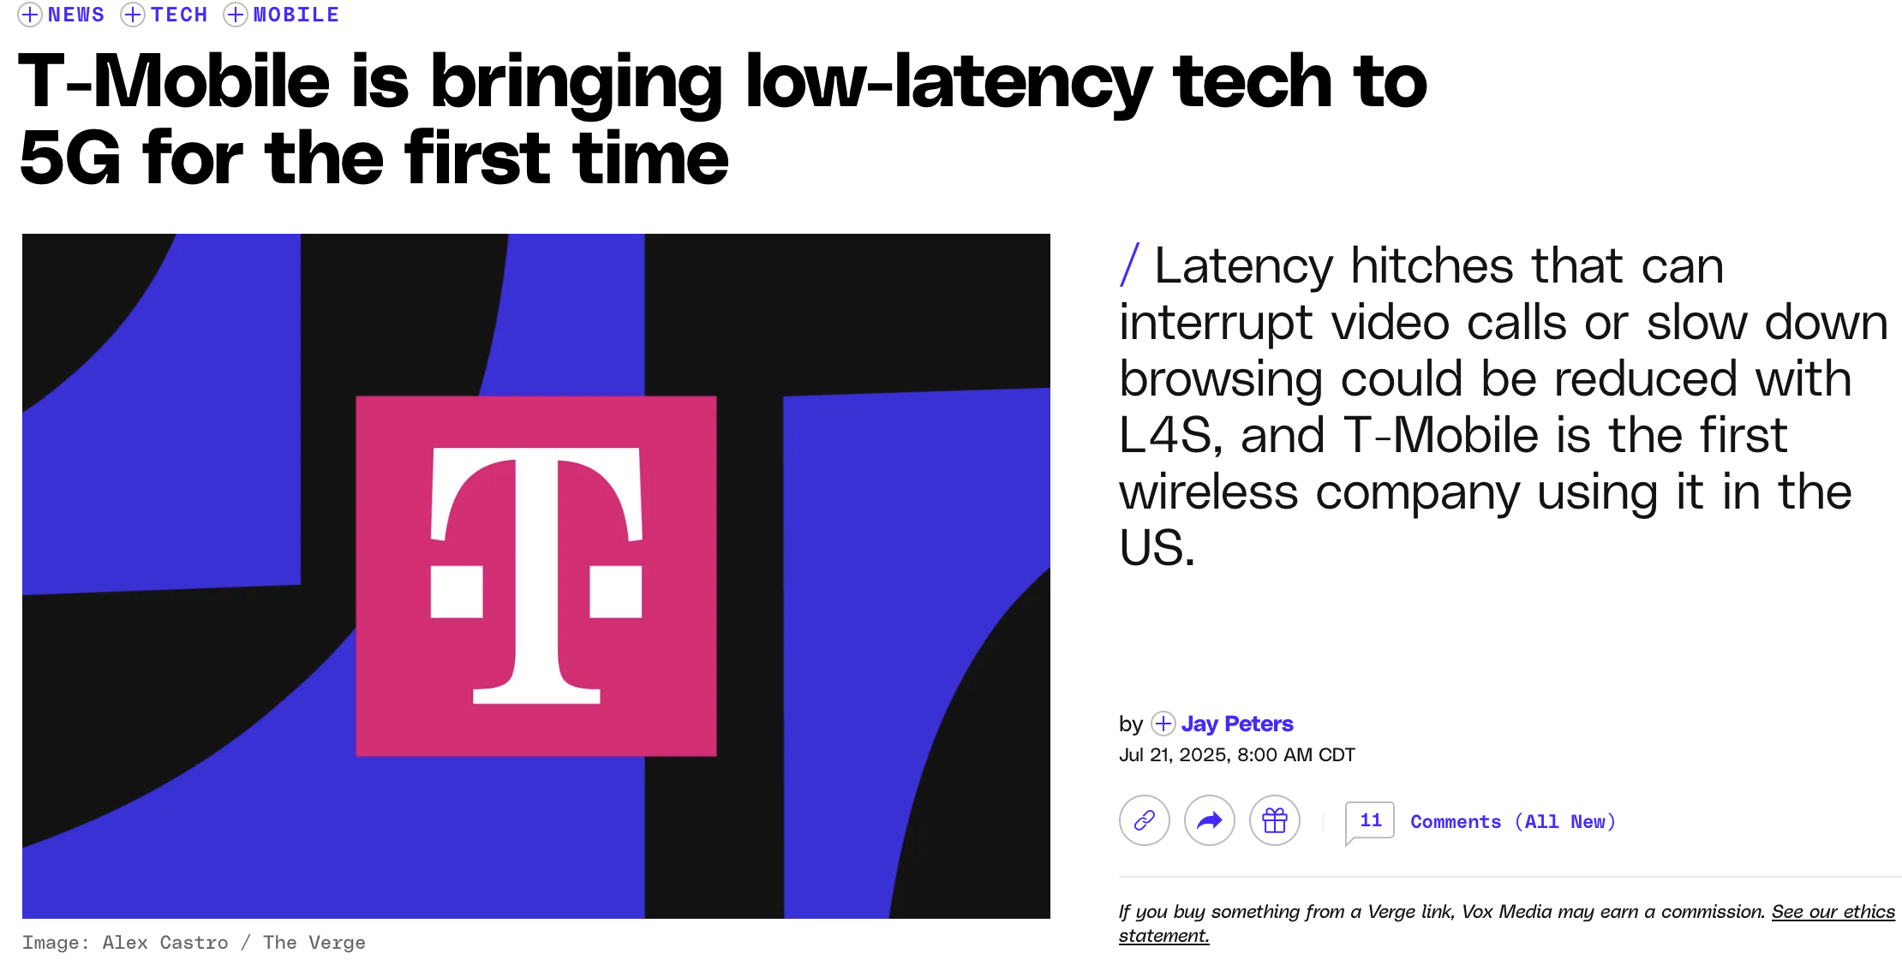


L4S is being rolled out across Telecom vendors!
Notes:
L4S deployments being rolled out across several leading Telecom vendors
Promising case of L4S in production networks

Slide 4
L4S piggybacks on ECN (Explicit Congestion Notification)
ECN field in IP header is used to choose queue (non-ECT vs ECT)
Non-ECT traffic -> classic queue
ECT (1) traffic -> L4S queue
L4S packets marked as CE (Congestion Experienced) instead of being dropped
Notes:
Let me give a quick background on L4S
L4S uses the ECN bit in the IP header to decide the queue.

Slide 5
Packets from same flows are always put in the same queue!
Notes:
Let’s look at the a classic L4S setup.
Orange packets always in Queue 1.
Blue packets always in Queue 2.
These decisions are made at the sender and are static.

Slide 6
Can we make smarter queuing decisions at the packet-level by accurately predicting the latency of the next packet(s)?

Slide 7
(a) Standard L4S
Latency-prediction
model
(b) Per Packet L4S
If next packet latency can be predicted, we can assign queues at the packet-level!
Notes:
Consider the following case – In standard L4S, all packets of the flow have the same marking. All orange packets will be sent to Queue 1 and can cause queueing delays.
We don’t directly see the queue but what if we could predict the latency before sending the packet?
In that case, we indirectly know if the packet will experience high latency in a queue.
Now, we can choose to put it in the other queue.

Slide 8
How can we leverage the sequence of recent packet history to make packet latency prediction?
Notes:
If we have a model to predict latency reliably, we can make queuing decisions at the packet level at the sender.

Slide 9
Packet-level latency prediction is challenging
Packet interactions across flows and joint queue buildup patterns need to be learnt from past packet history.
Need to predict sharp latency spikes not values!
Simpler time-series (e.g., ARIMA) models fail to learn such interactions, we need more expressive models!
Notes:
Combination of packets from TCP streams, which react to other TCP streams.
Interaction of packets across flows
We care about predicting tail events (latency spike or drop) to reduce latency, not the average case value of the latency. Prediction of the average latency value does not help.
ARIMA models and classic ML models have both failed at predicting localized sharp changes

Slide 10
Value to predict
Value to predict
Predictor input
Predictor input
Transformer maps different latency inputs to different positions in the feature’s latent space
Transformer Model
Latent features of
high-latency prediction
Latent features of
low-latency prediction
t-SNE 2D visualization of
model’s intermediate layer
Notes:
So how do we learn to predict packet latency values? Let us look at an example and consider a packet sequence. Two values to predict in a TCP flow, one with a spike, one without, using past history.
We feed it into a model which could learn this. Now we look at the tSNE visualization of the outputs by the model's intermediate layer! We see that the latent features of the high-latency prediction is very well separated from the features of the low-latency prediction. So there is a model which can learn this, can you guess which model? <Pause here> It is a Transformer!

Slide 11
Gamechanger: Transformer model
Transformers are expressive models for time-series predictions
Uses Attention mechanism to capture complex temporal patterns
The Attention mechanism enables greater memorization from past learnt interactions
Other deep learning models (e.g., LSTMs) suffer from vanishing gradients
Attention can be parallelized (no need to process in sequence)
Reduces training and inference time while maintaining accuracy
Notes:
Attention is weighted dot product with positional information , over the sequence
Transformer can learn temporal patterns based on embedded signals
What are vanishing gradients? Time derivative over sequences leads to forgetting of past values. Attention is very efficient for parallelizing the learning.

Slide 12
Packet latency values have learnable signals
Learnable network signals embedded in the past packet latencies
Packet interaction from flows using certain CC logic can result in learnable latency patterns (e.g., queue buildup and back-off in TCP Cubic).
Some latency variations are unpredictable (exogeneous factors)
E.g. User clicks, link failures
No model can learn these, so we don’t focus on those
Notes:
What kind of signals are present for learning?
Some latency spikes are random and unpredictable (start of new flows)

Slide 13




SwiftQueue: Queue selection with packet level latency prediction
Latency Prediction
Transformer
Queue selection logic
L4S-enabled router
Sender
Notes:
We introduce SwiftQueue
a) Transformer based latency predictor b) Queue selection logic using predicted values I am going to talk about these two parts one by one.

Slide 14

SwiftQueue: Training a Custom Transformer for latency prediction
Transformer
Model
Fast Fine-tuning
Change-focused loss function
Model training or fine-tuning
Expressive input features
Recent measurements for model fine-tuning
Notes:
We train and fine-tune the model on recent packet histories.
Custom transformer has several components
1) Change focused loss function
2) Fast Fine Tuning 3) Expressive Input Features I will present two of them in this talk.

Slide 15
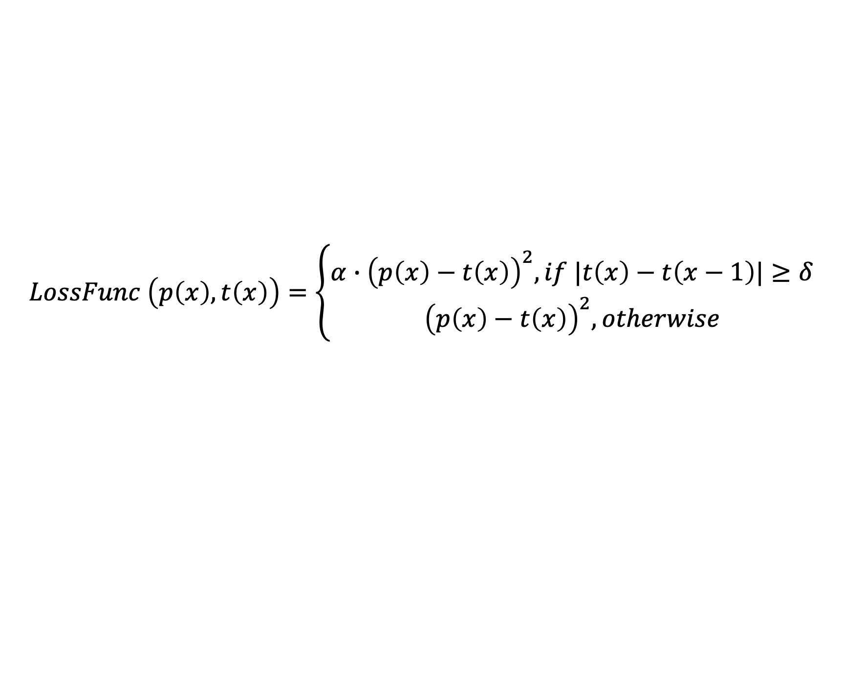

Change-focused loss function
Mean Squared Error (MSE) doesn’t focus enough on sharp changes
$$p\left(x\right)=predicted value$$
$$t\left(x\right)=target value$$
$$LossFunc \left(p\left(x\right), t\left(x\right)\right)=\left\{\begin{aligned}α∙{\left(p\left(x\right)−t\left(x\right)\right)}^{2}, if |t\left(x\right)−t\left(x−1\right)|≥δ \\ {\left(p\left(x\right)−t\left(x\right)\right)}^{2}, otherwise\end{aligned}\right.$$
$$δ=±20 ms and 20\% change; α=10$$
Change focused loss functions sharp change prediction.
Notes:
Change focused loss function , which penalizes sharp changes more.
20 ms becomes significant for low latency applications (VoIP and gaming) as it is becomes noticeable in user QoE.
At higher values of latency, relative % also becomes important and we want to compare that. We combine learning both absolute and relative latency changes for spike prediction.

Slide 16
Online Model Fine-Tuning
Fast fine-tuning needed for changing network conditions
Redesigned smaller Transformer with ~100K parameters
Layers pre-trained and
fine-tuned
Layers only pre-trained
Fine-tuning on reduced parameters after learning initial features.
Notes:
We redesign a smaller transformer (compare with BERT and Llama)
During the pre-training, we pretrain both the transformer layers and the linear layers. During fine-tuning, we only fine-tune the linear layers. Fine-tuning the linear layers is much faster and can be done frequently.

Slide 17
Expressive Input Features
Every packet in the history context
window is this set of features
History context window size is set to match 1-2X BDP (number of recent inflight packets)
Expressive models learn packet interactions with smaller feature sets!
Notes:
Context window cannot grow unbounded as attention scales quadratic with input size (in terms of inference time)
Look at recent history Acknowledge looking at even further history can be helpful

Slide 18
SwiftQueue: Per-Packet L4S Queue Selection
Mark ECN bit
Fast prediction
with batching
Packets with prediction values
L4S Queue
Selector
Prevent queue oscillation
Notes:
1: Based on the predicted latency, mark the ECN bit to use the classic or L4S queue.
2: Make prediction in time to ensure packets are sent out in time.
3: Prevent queue oscillation while selecting if packet ACKs are not received.

Slide 19
Batching for faster inference
Prediction needs to be made ‘in time’
Make prediction for the future batch of packets
Notes:
Predicting latency for the next packet is ideal
Prediction may not be made in time Make prediction for the future batch of packets
There is a trade-off : Batch size vs quality, highest quality at BS = 1 but slow we can predict within 200−400 µs which allows us to support link speeds upto 200Mbps If we predict packet 9, 10 with packets upto 8, might not be fast enough

Slide 20
Batching for faster inference
Prediction needs to be made ‘in time’
Make prediction for the future batch of packets
Latency for packets
12, 13 and 14 are in predicted batch
Notes:
Predicting latency for the next packet is ideal
Prediction may not be made in time Make prediction for the future batch of packets
There is a trade-off : Batch size vs quality, highest quality at BS = 1 but slow we can predict within 200−400 µs which allows us to support link speeds upto 200Mbps

Slide 21
Preventing queue oscillation
UnACKed packets may cause unstable queue selection
Use selected queue for past UnACKed packets
Packets 6,7, 8 are also used for queue decision
Notes:
If SwiftQueue has not received enough recent acknowledgments (ACKs) for the previously sent out packets, it may not select the queue correctly
as it does not have the most recent network state information. Use UnACKed packets which have their queue selection decided in order to decide if the next packet is in which queue Use packets 6,7,8 to predict future

Slide 22
Evaluation
4 real world traces collected to evaluate prediction performance
Trace | Description | Median Latency (ms)
video_wifi | Netflix traffic on WiFi endpoint | 70
web_wifi | Facebook traffic on WiFi endpoint | 66
video_eth | Netflix traffic on Ethernet endpoint | 74
web_eth | Facebook traffic on Ethernet endpoint | 57
Notes:
We collect traces from two endpoints , wifi and web, across two applications of video and browser. Train on 5 min, evaluate on every next 5 min
At every 5 min interval, fine-tune on the previous 1 minute of data.

Slide 23
L4S simulation setup (NS3)
Simulation by replaying video_eth, web_eth, video_wifi and web_wifi in NS-3 L4S simulator
Notes:
To evaluate the L4S set, we use an NS3 simulation.
6 L4S, 4 Classic, 10 L4S cross traffic at Router
100 M bps link, 20 ms link delay
Classic flows run TCP Cubic
SwiftQueue’s Transformer sees all flows at Sender 1, focuses on reducing tail latency for those L4S flows

Slide 24
SwiftQueue latency prediction on video_wifi
45-65% higher latency change prediction
Notes:
Result on video_wifi trace, more results in the paper. Precision and recall for predicting sharp latency changes
Introduce axis and baselines. Takeway

Slide 25
SwiftQueue tail-latency reduction on video_wifi
36-45% better P99 latency reduction
Notes:
Tail latency reduction based on per-packet queue selection

Slide 26
Tuning prediction batch size for fast inference
Improve prediction speed with larger batch up to tolerable quality drop
Notes:
Batch size reduces performance but increases prediction speed, hence it is a tradeoff Best prediction quality is at batch size 1 but that is slow. We found 8 to be optimal across our workloads.

Slide 27
More results in the paper
Sensitivity analysis stressing predictor performance
Changing # flows
Changing link delay
Changing queue sizes
Ablation studies on loss function, TCP-CC algorithms
Analysis of varying fine-tuning intervals on performance
Notes:
Do this very quickly if pressed for time.

Slide 28
Conclusion
First Transformer based packet-level sharp latency change predictor.
Packet-level queue selection for L4S to mitigate high tail latency for latency sensitive flows.
Result: 45-65% better latency change prediction and 36-45% better P99 latency reduction.

