Slide 1
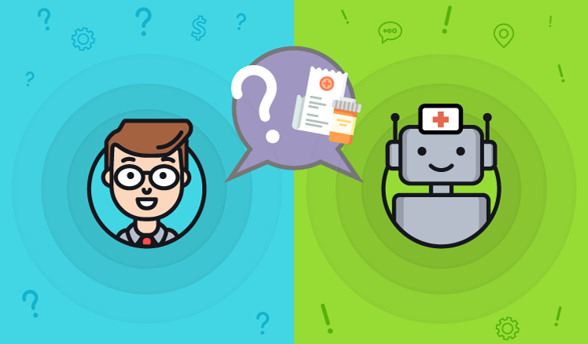
Medical chatbot using LLAMA2
Transfer learning chat-med
-Siddhant Saini(210962160)

Slide 2
Abstract
Chat-Med is an innovative medical chatbot designed to deliver personalized and sophisticated medical consultation through natural language interaction. By harnessing transfer learning techniques and the state-of-the-art Llama 2 model, Chat-Med offers users access to reliable healthcare information. Trained on the extensive GALE ENCYCLOPEDIA of MEDICINE dataset, Chat-Med empowers individuals to make informed decisions about their health and well-being.

Slide 3
Introduction
In the realm of healthcare, Chat-Med emerges as a pioneering solution, blending artificial intelligence with medical expertise to provide accessible and reliable medical consultation. By leveraging transfer learning and the advanced capabilities of the Llama 2 model, Chat-Med offers users a seamless and intuitive interface for interacting with medical information. With its foundation built on the extensive GALE ENCYCLOPEDIA of MEDICINE dataset, Chat-Med stands as a beacon of innovation, empowering individuals to take charge of their health journey.

Slide 4
LITERATURE REVIEW
Previous studies have explored the utilization of transfer learning in medical chatbots, highlighting its potential to enhance performance and adaptability across diverse medical domains {Oh, K.-J. et al. (2017). A chatbot for psychiatric counselling in mental healthcare service based on emotional dialogue analysis and sentence generation}. Transfer learning techniques enable chatbots to leverage pre-existing knowledge from large datasets, facilitating the understanding of medical terminologies and nuances.
The integration of advanced language models, such as Llama 2, has emerged as a promising avenue for enhancing the conversational capabilities of medical chatbots {Kowatsch, T., M. Nißen, C.-H. I. Shih, D. Rüegger, D. Volland, A. Filler, F. Künzler, F. Barata, D. Büchter, B. Brogle, et al. (2017). Text-based healthcare chatbots supporting patient and health professional teams: preliminary results of a randomized controlled trial on childhood obesity}. These models exhibit remarkable proficiency in understanding context and generating human-like responses, thereby enhancing the user experience.
Studies exploring the utilization of domain-specific datasets, such as the GALE ENCYCLOPEDIA of MEDICINE, have shed light on the importance of tailored knowledge sources in improving the accuracy and reliability of medical chatbots {Divya, S., V. Indumathi, S. Ishwarya, M. Priyasankari, and S. K. Devi (2018). A self-diagnosis medical chatbot using artificial intelligence. Journal of Web Development and Web Designing, 3(1), 1–7}. While such datasets provide a wealth of domain-specific information, challenges related to data bias, scalability, and coverage of diverse medical topics remain significant hurdles to overcome.

Slide 5
LITERATURE REVIEW
Cascaded diffusion models have demonstrated potential in enhancing the quality and diversity of responses generated by medical chatbots {A. F. Ur Rahman Khilji, S. R. Laskar, P. Pakray, R. A. Kadir, M. S. Lydia and S. Bandy-opadhyay, "HealFavor: Dataset and A Prototype System for Healthcare ChatBot," } These models leverage hierarchical dependencies and conditioning augmentation techniques to refine the synthesis of medical information, thereby enriching the user experience.
Despite advancements, significant limitations persist, hampering the widespread adoption of medical chatbots {A. Kaya, A. S. Keceli, C. Catal, H. Y. Yalic, H. Temucin, and B. Tekinerdogan, ‘‘Analysis of transfer learning for deep neural network-based plant classification models,’}. Computational efficiency remains a key concern, particularly in resource-constrained environments where chatbots must operate with limited processing power and memory.
Ethical considerations, including patient privacy and algorithmic transparency, are essential for the ethical development and deployment of medical chatbots {Hiba Hussain1, Komal Aswani2, Mahima Gupta3, Dr. G.T. Thampi4, Implementation of Disease Prediction Chatbot and Report Analyzer using the Concepts of NLP, Machine Learning and OCR.}
). Ensuring adherence to ethical guidelines and addressing potential biases in chatbot algorithms are paramount to safeguarding patient trust and autonomy.

Slide 6
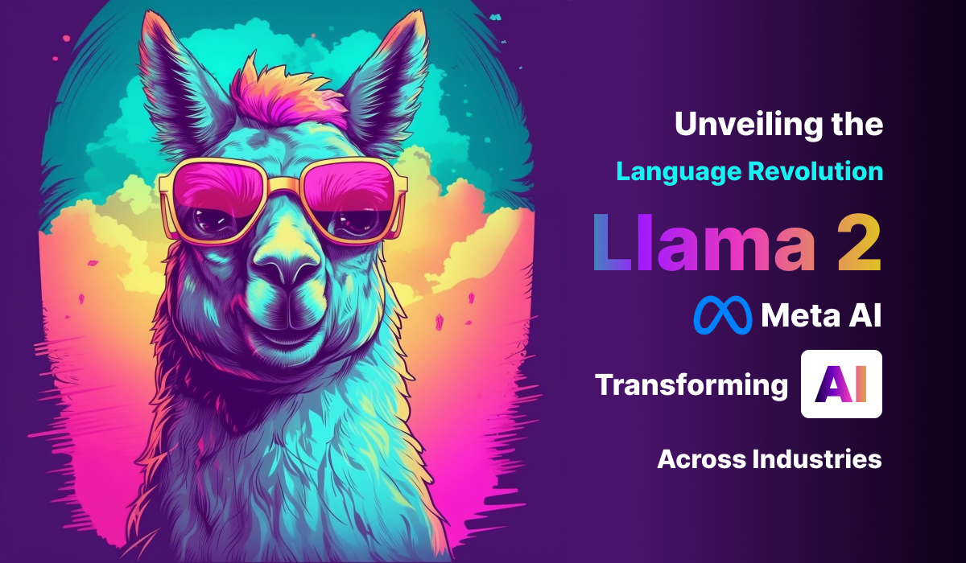
Llama 2
Llama 2: Advanced language model with top-notch text understanding and generation. It's a go-to for tasks like text completion, question answering, and translation. Widely used in chatbots and virtual assistants, it's a game-changer in natural language processing.

Slide 7
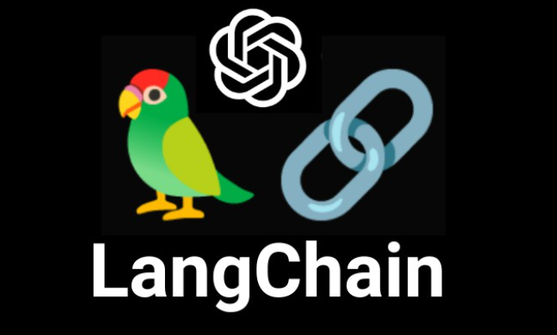
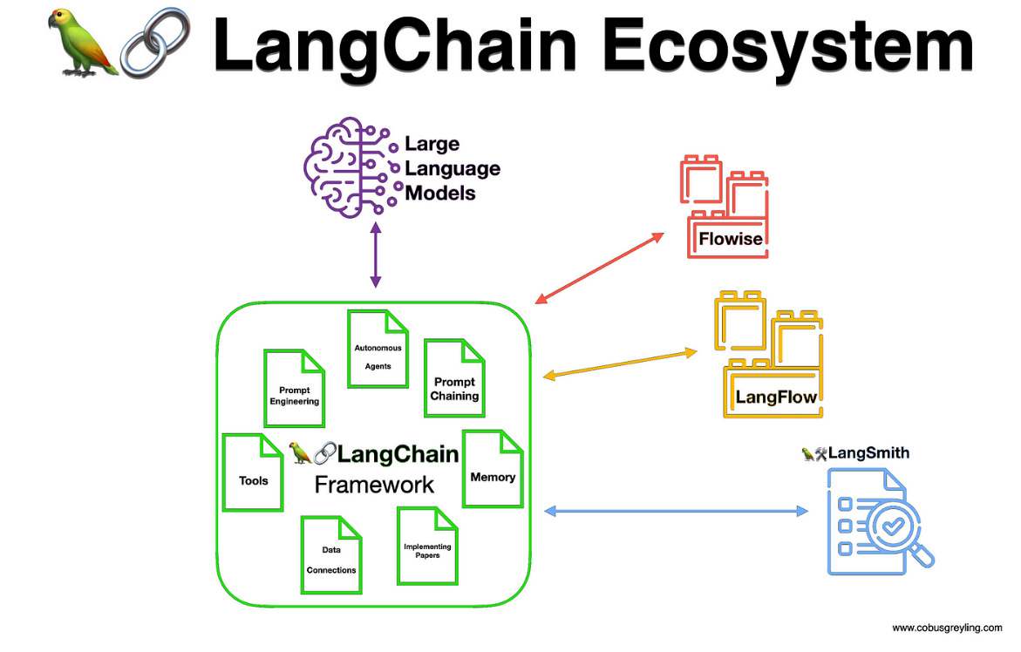
LLM AND LANGCHAIN
LLM (Large Language Model):
LLMs are advanced AI models that understand and generate human-like text.
They're trained on massive datasets to learn language patterns for tasks like text completion and translation.
LLMs are versatile tools used in chatbots, virtual assistants, and content creation.
LangChain:
LangChain is a blockchain platform for language services.
It decentralizes language-related transactions like translation and learning.
It ensures transparency, security, and direct connections between language professionals and clients.
LangChain revolutionizes the language industry by creating a decentralized marketplace for language services.

Slide 8
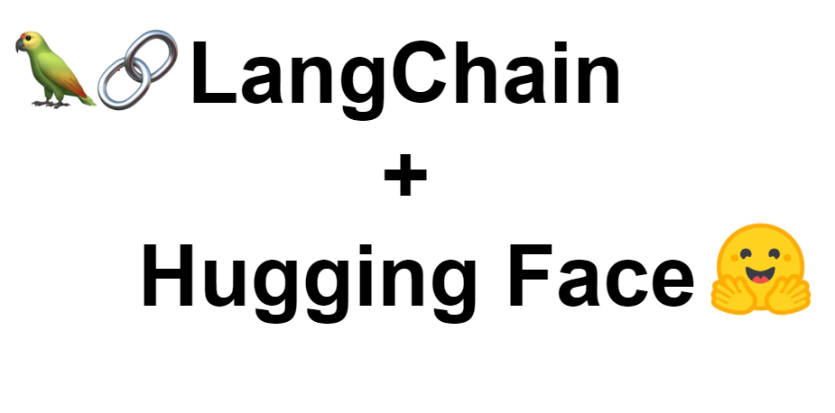
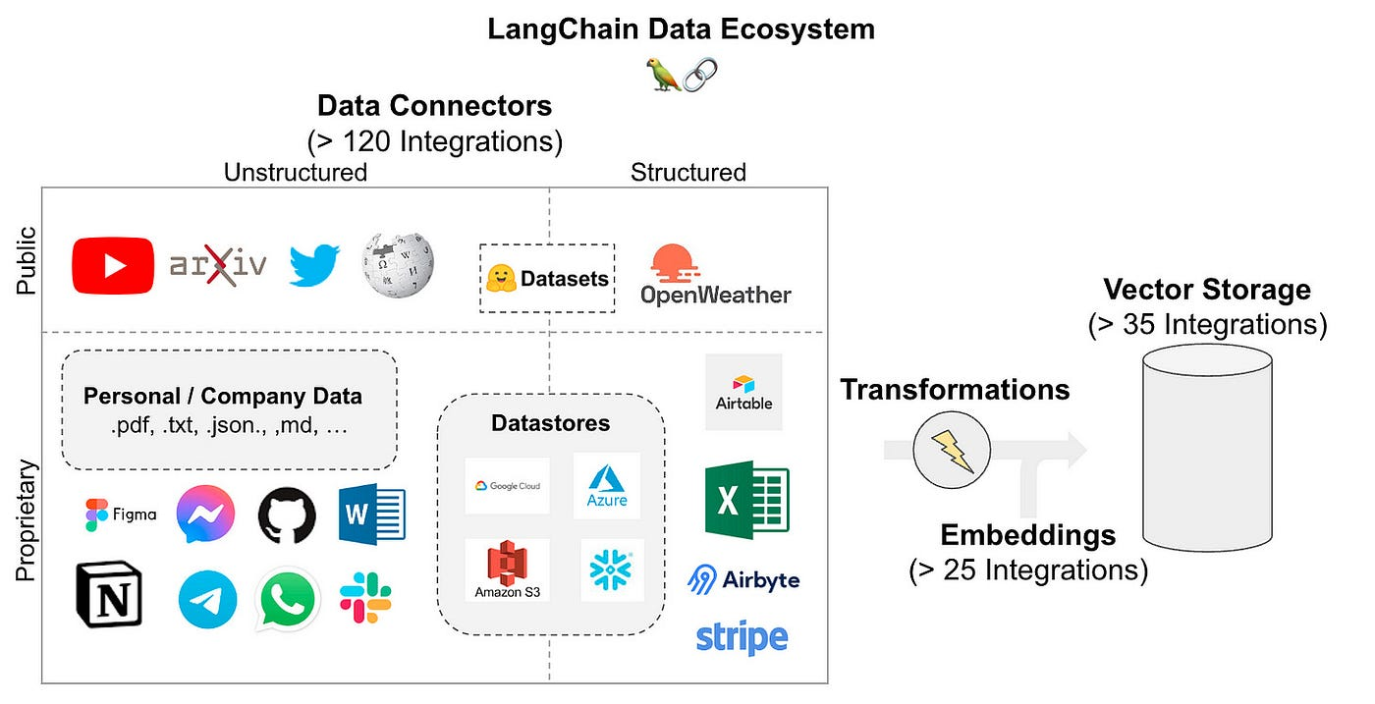
HuggingFaceEmbedding and Fiass Vector Score
HuggingFace Embedding:
HuggingFace Embedding is a technique in natural language processing (NLP) that converts words and sentences into dense numerical vectors. These vectors capture the contextual meaning of the text, facilitating tasks such as sentiment analysis and text classification.
Fiass Vector Score:
The Fiass Vector Score assesses the similarity between two texts by measuring the distance between their embeddings in a high-dimensional vector space. A lower score indicates greater similarity, making it valuable for tasks like information retrieval and recommendation systems

Slide 9
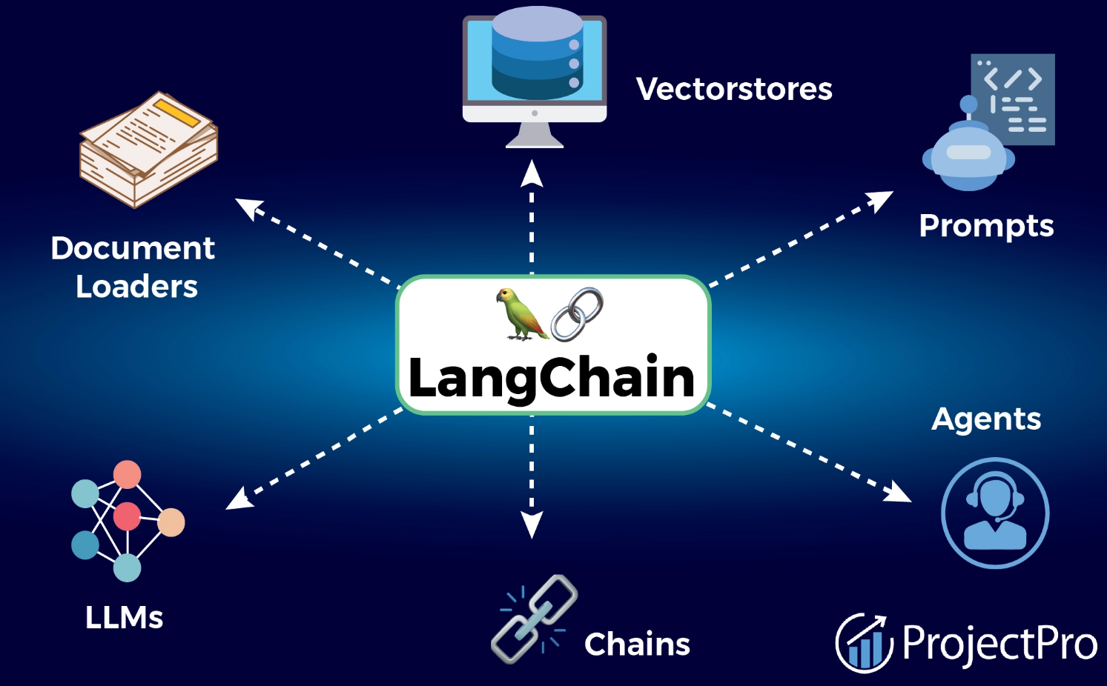
Methodology
Data ingestion and preprocessing
Model Initialization and Configuration
Query Processing and Response Generation
Handling User Interaction
Output Formatting and Presentation
Deployment and Testing

Slide 10
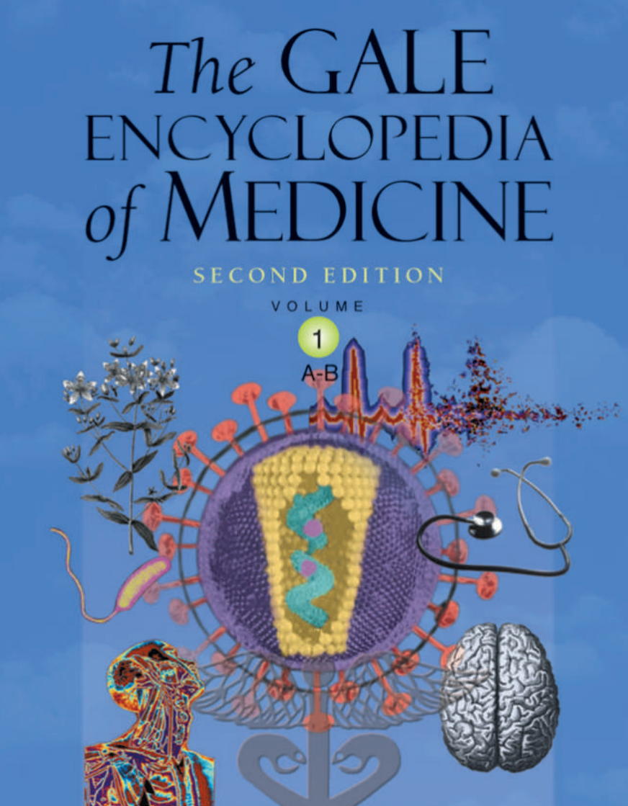
1. Data Ingestion and preprocessing
We start by ingesting medical documents stored in PDF format using the `PyPDFLoader`. These documents are then processed using the `RecursiveCharacterTextSplitter` to split the text into manageable chunks for further analysis. Next, we obtain embeddings for each text chunk using `HuggingFaceEmbeddings`, capturing semantic information about the text. These embeddings are efficiently stored in a vector database such as `FAISS`, enabling fast and effective retrieval during the question-answering process.
Dataset -Medicine Encyclopedia

Slide 11
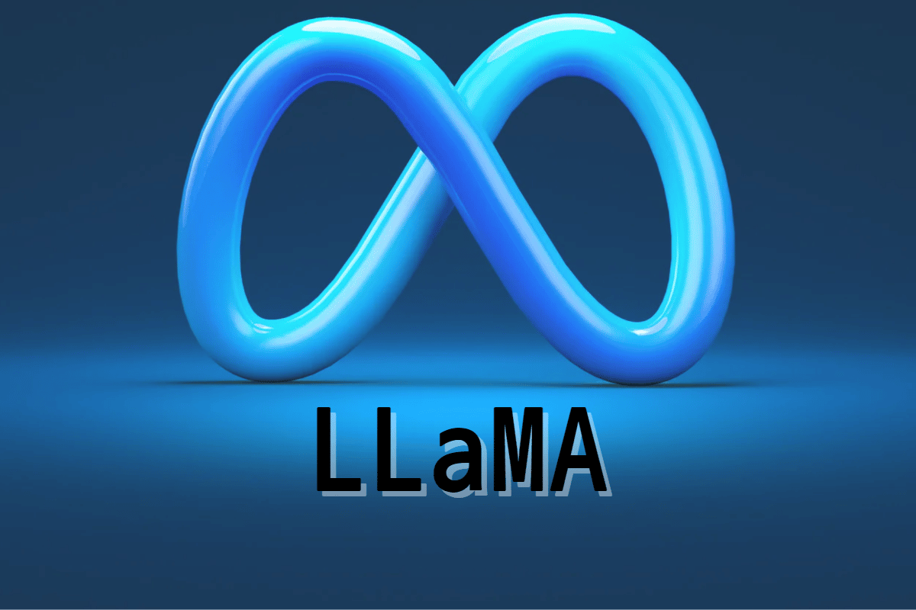
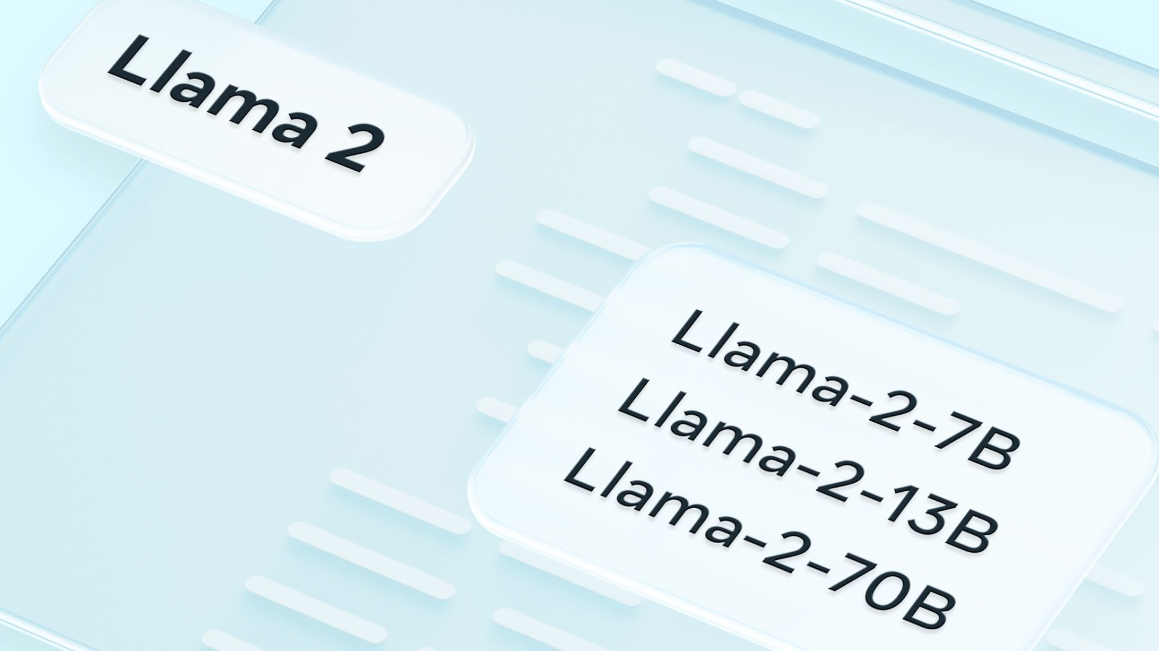
2. Model Initialization and Configuration:
We define a custom prompt template tailored for question-answering (QA) retrieval, specifying necessary context and question components. The pre-trained LLAMA-2 model is loaded using `CTransformers`, facilitating transfer learning and fine-tuning capabilities. Subsequently, we configure the retrieval QA chain using the loaded LLAMA model, custom prompt, and the vector database obtained in the previous step, setting up the foundation for accurate response generation.

Slide 12
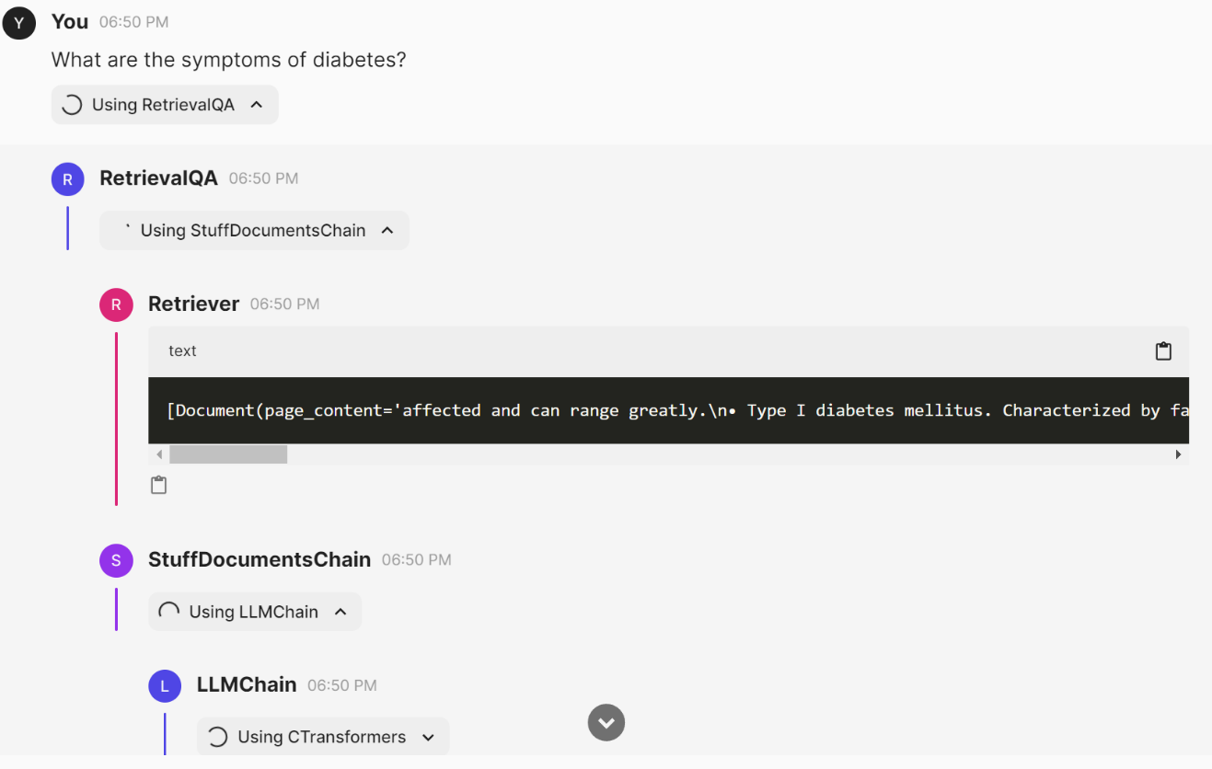
3. Query Processing and Response Generation:
The `qa_bot()`function is implemented to orchestrate the question-answering process. This function initializes embeddings, loads the FAISS vector store, configures the LLAMA model, and sets up the retrieval QA chain. Upon receiving a user query, the QA chain retrieves relevant answers based on the provided context and question, ensuring accurate and informative responses.

Slide 13
4. Handling User Interaction (5 Steps):
RetrievalQA: This term likely refers to a system or process related to information retrieval and question answering. It could involve techniques such as natural language processing (NLP) to understand questions and retrieve relevant information from a database or corpus.
Retriever: In the context of information retrieval or search systems, a retriever is a component or module responsible for fetching relevant documents or data based on a query or search request. It plays a crucial role in returning accurate and useful results to users.
StuffDocumentsChain: This term seems to be related to a chain or sequence of documents or data items. It might refer to a linked list or a series of documents processed or handled in a specific order within a document processing or retrieval system.
LLMChain:"LLM" could stand for Large Language Model, and "Chain" might imply a sequence or series of processes or actions. Therefore, LLMChain could refer to a sequence of operations or tasks performed using a large language model, such as processing text, generating responses, or analyzing language data.
CTransformers:This term likely refers to models or systems based on transformer architectures, which are widely used in natural language processing tasks. Transformers are known for their effectiveness in tasks like machine translation, text generation, and language understanding.

Slide 14
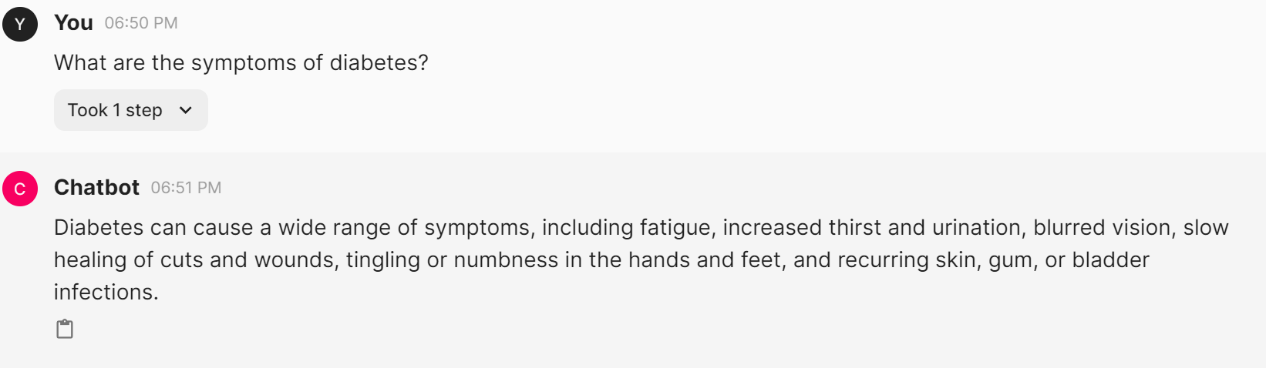
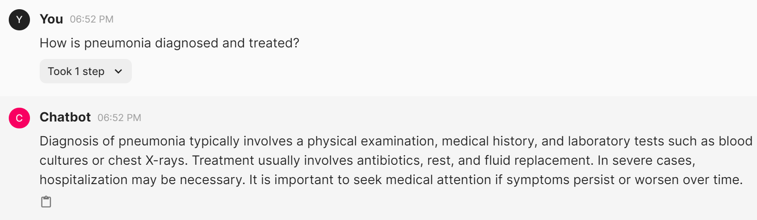
5. Output Formatting and Presentation:
The final response generated by the chatbot is formatted to include the retrieved answer from the QA chain. Additionally, we may optionally include information about the sources or documents from which the answer was retrieved, providing transparency and credibility to the response.
Prompt 1:
What are the symptoms of diabetes?
Prompt 2:
How is pneumonia diagnosed and treated?

Slide 15
6. Deployment and Testing:
The chatbot is deployed in the desired environment for user interaction, ensuring accessibility and usability. Thorough testing is conducted with various medical queries to validate the model's accuracy and effectiveness, addressing any potential issues or shortcomings. Continuous monitoring of the chatbot's performance is essential, accompanied by gathering user feedback for continuous improvement. Periodic fine-tuning of the model using additional data or retraining techniques enhances its capabilities over time. Additionally, keeping the model up to date with the latest medical knowledge and advancements through regular updates and maintenance ensures its relevance and effectiveness in addressing user queries and concerns

Slide 16
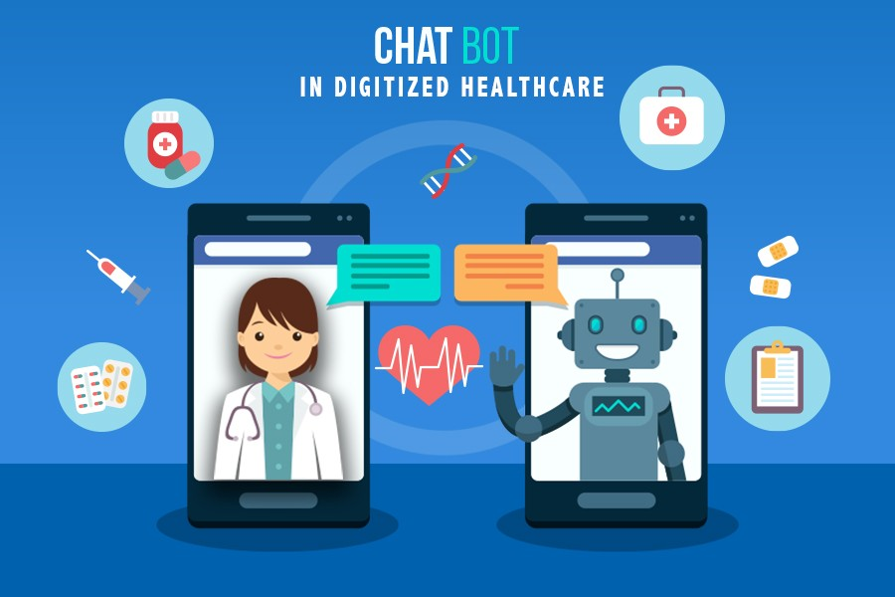
Conclusion
In conclusion, The developed medical chatbot model holds promise as a valuable tool in healthcare. Its efficient data processing and storage, accurate responses, seamless user interaction, transparency, and credibility contribute to its effectiveness. Real-world deployment, testing, continuous improvement, and user feedback are key for its relevance and impact in improving healthcare outcomes.

Slide 17

Future work
Enhanced Model Performance: Invest in further research and experimentation to improve the performance of the medical chatbot model. This could involve fine-tuning hyperparameters, exploring alternative architectures, or incorporating ensemble learning techniques to boost accuracy and robustness.
Real-Time Interaction: Investigate methods for enabling real-time interaction and feedback mechanisms within the chatbot interface. This could include integrating natural language understanding models with real-time data streams to provide immediate responses to user queries or updates on medical conditions.
Scalability and Deployment: Develop strategies for scaling the deployment of the medical chatbot across diverse healthcare settings and populations. This could involve optimizing the model architecture for efficient resource utilization, implementing cloud-based solutions for scalability, and partnering with healthcare organizations for widespread adoption and integration into clinical workflows

Slide 18
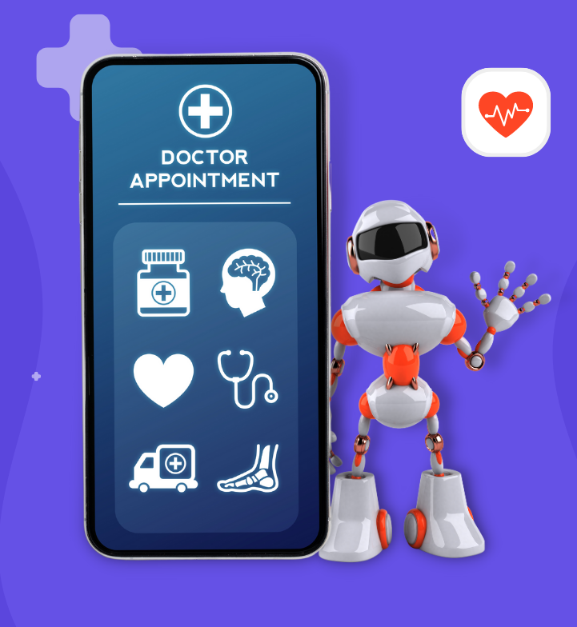
Applications
Health Information and Education: LLM-powered chatbots can provide accurate and up-to-date health information on various topics, such as common illnesses, medications, treatment options, preventive care, and healthy lifestyle practices.
Follow-up and Post-Discharge Support: After a medical visit or hospital discharge, the chatbot can follow up with patients to monitor their progress.
Mental Health Support: They can guide users to appropriate mental health services or crisis hotlines if needed and maintain confidentiality and sensitivity in handling sensitive topics.
Healthcare Resource Navigation: The chatbot can help users navigate healthcare resources and services, such as finding nearby clinics, hospitals, pharmacies, specialists.

