Slide 1
Visualization of the effects of covid 19 in hospitalization in new York state

Slide 2
AGENDA
Data Cleaning
Hypothesis
Hypothesis 1
Hypothesis 2
Hypothesis 3
Conclusion

Slide 3
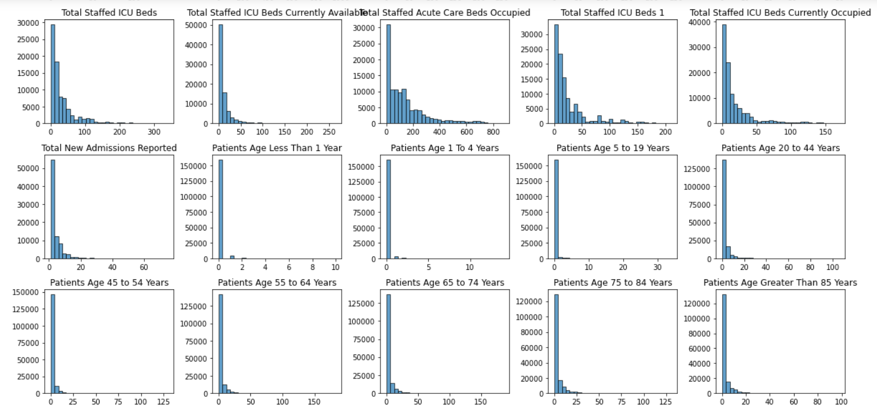
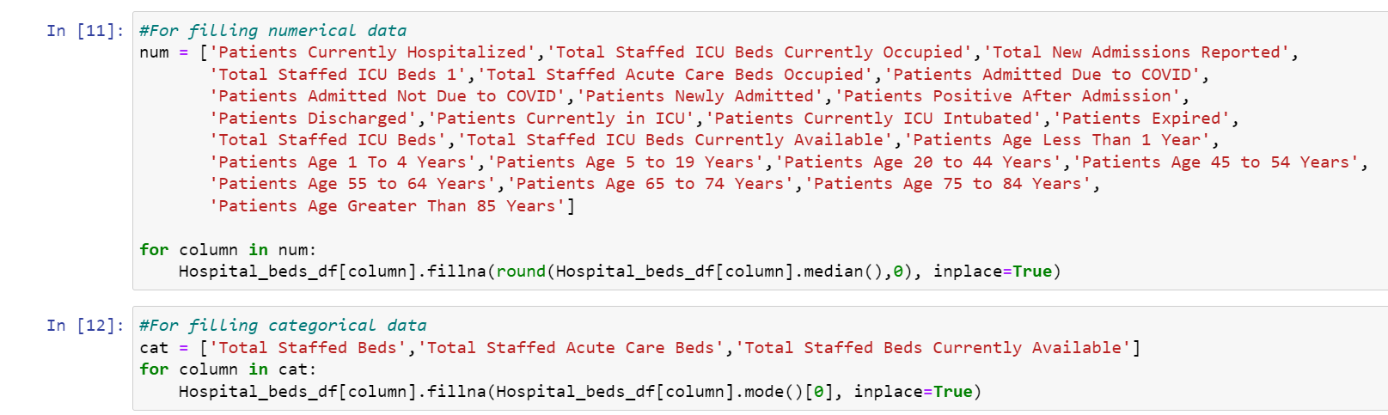
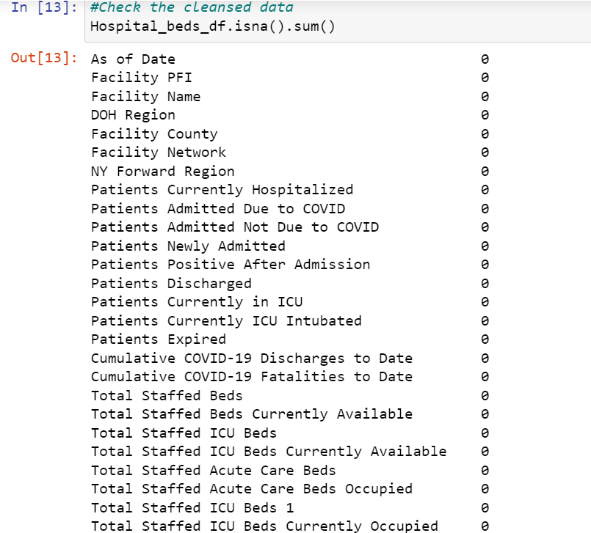
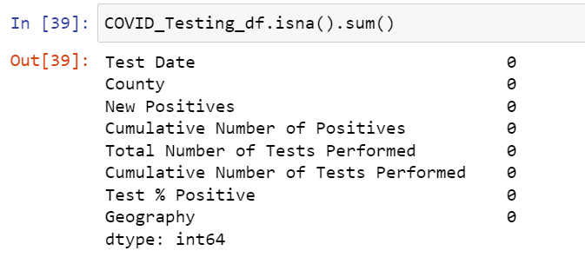
Data Cleansing
Data Cleansing
Data Distribution
Cleansed Primary Dataset Values
Cleansed Secondary Dataset Values

Slide 4
Hypothesis
1. Whether the People in Bronx County are less likely to get affected by COVID-19 than People in Erie County.
2. Whether people of age group 20-44 are hospitalized less as compared to the age group of 55-64 because of younger age.
3. Whether INDEPENDENT hospital network in Erie County have less treatment scale than CATHOLIC HEALTH network and KALEIDA HEALTH network.
4. Does less hospitalization happening in second quarter in Bronx County as compared to first quarter because better prevention measures have been taken.
5. Whether the increase in ICU patients leads to an increase in the mortality rate of patients in Erie and Bronx counties

Slide 5
Hypothesis 1
Whether the People in Bronx County are less likely to get affected by COVID-19 than People in Erie County.

Slide 6
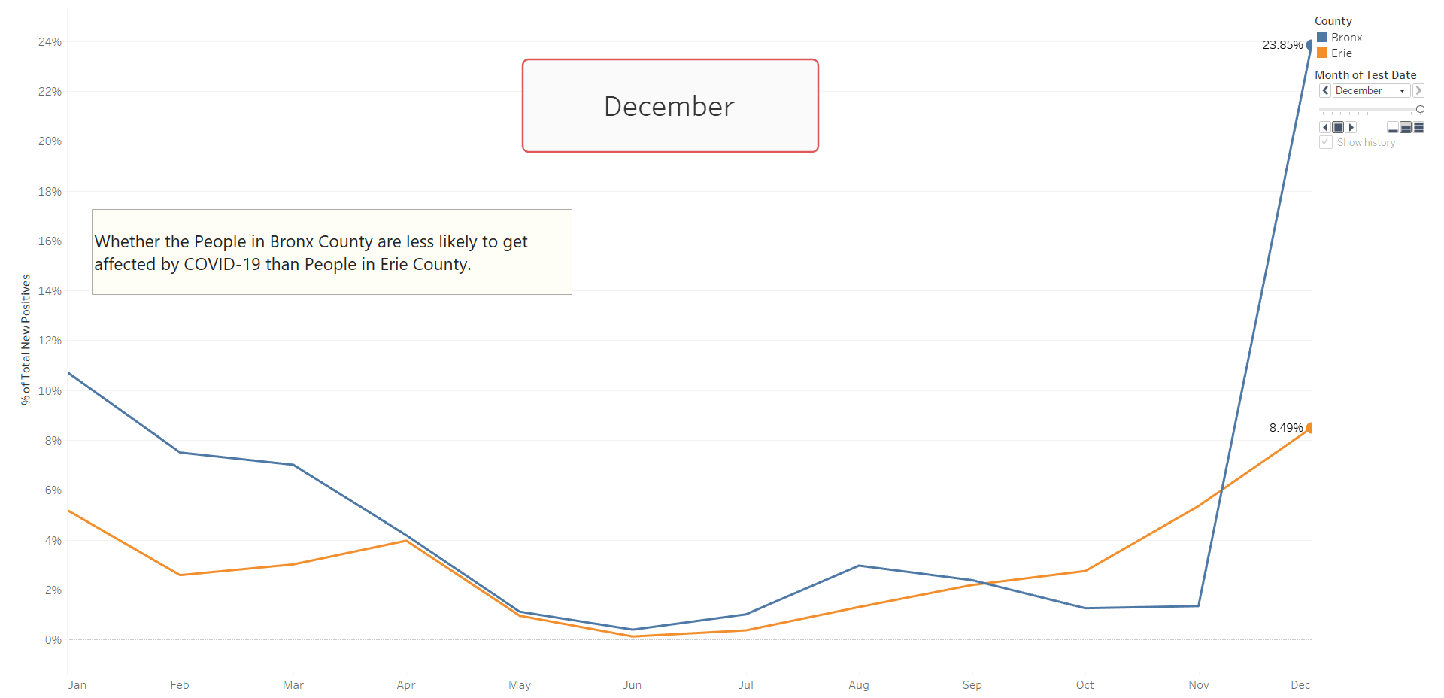

Slide 7
Hypothesis 2
Whether people of age group 20-44 are hospitalized less as compared to the age group of 55-64 because of younger age.

Slide 8
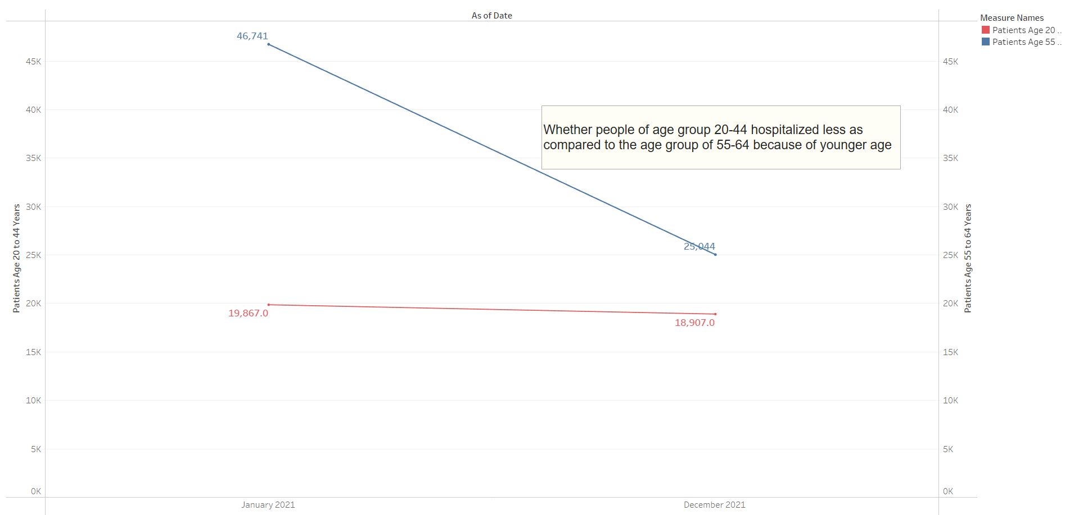

Slide 9
Hypothesis 3
Whether INDEPENDENT hospital network in Erie County have less treatment scale than CATHOLIC HEALTH network and KALEIDA HEALTH network.

Slide 10
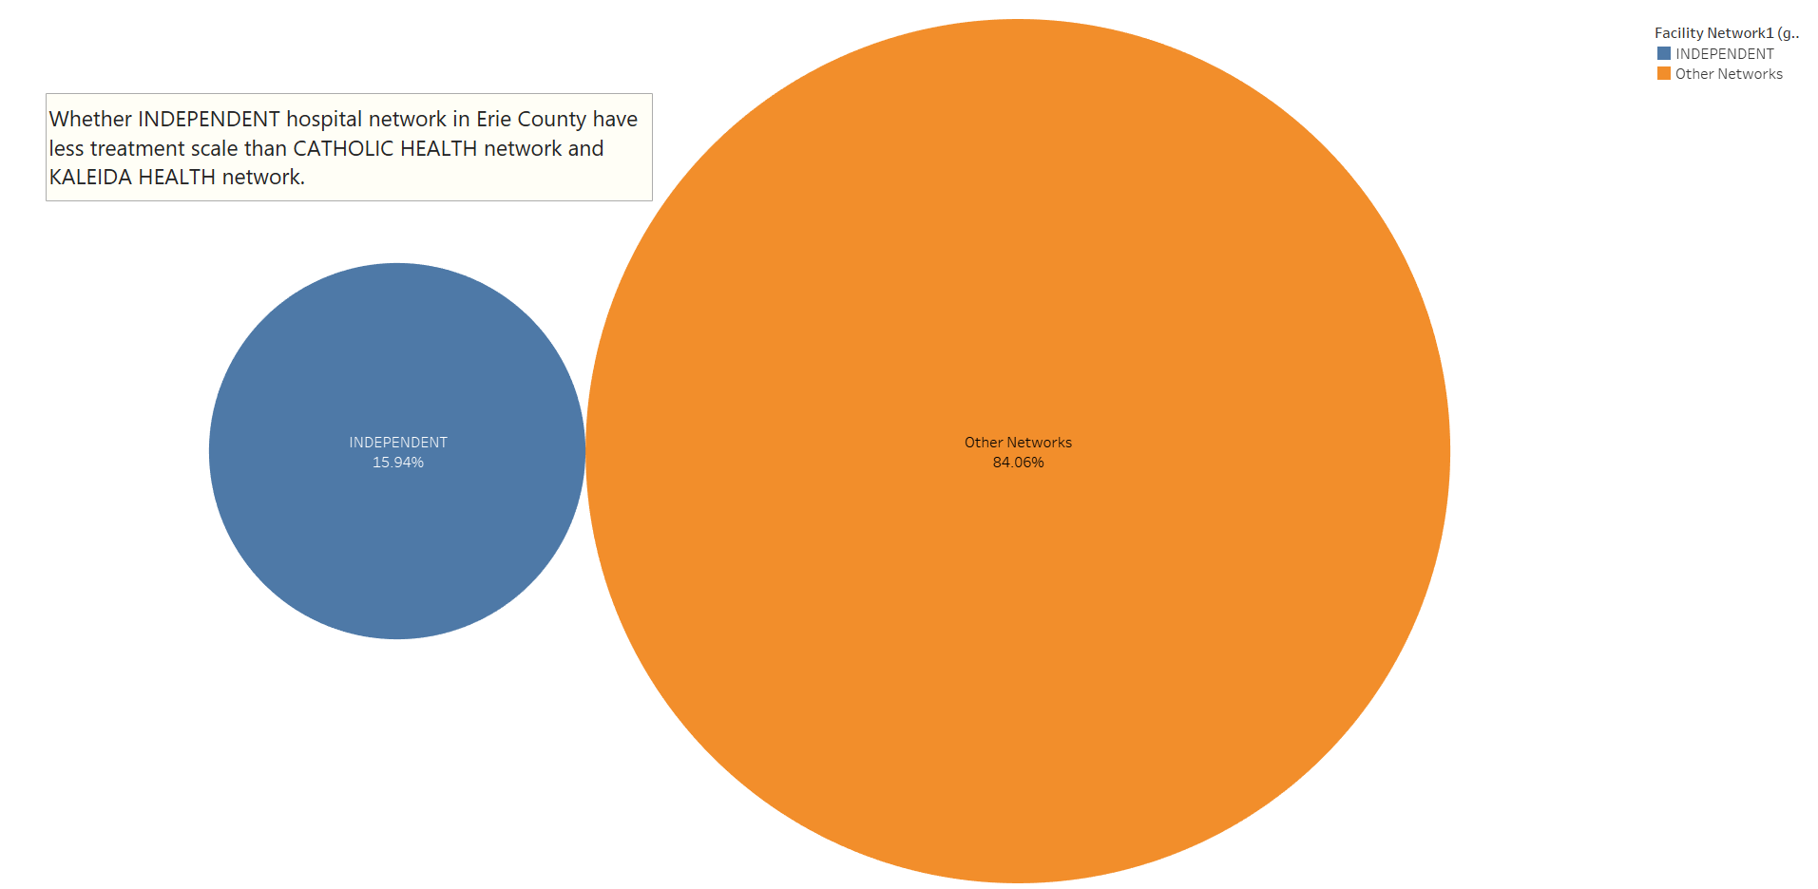

Slide 11
Hypothesis 4
Does less hospitalization happening in second quarter in Bronx County as compared to first quarter because better prevention measures have been taken.

Slide 12
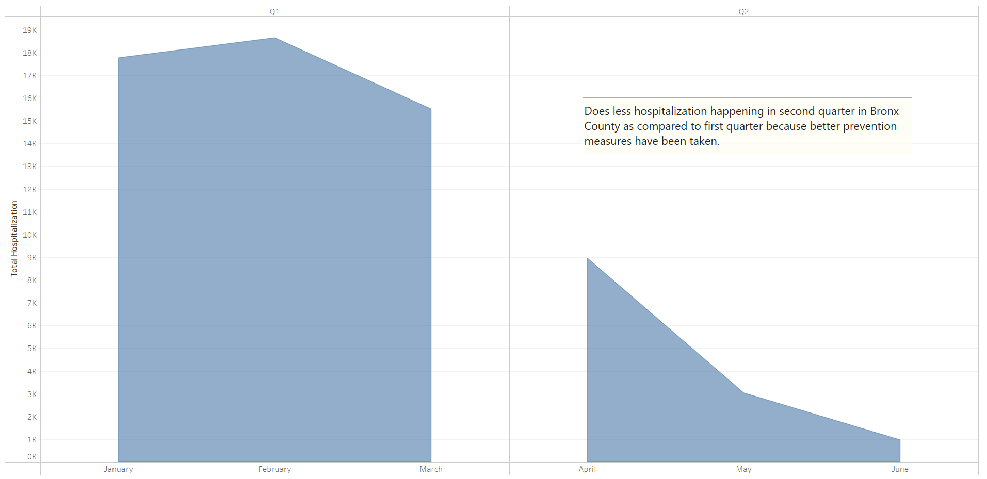

Slide 13
Hypothesis 5
Whether the increase in ICU patients leads to an increase in the mortality rate of patients in Erie and Bronx counties

Slide 14
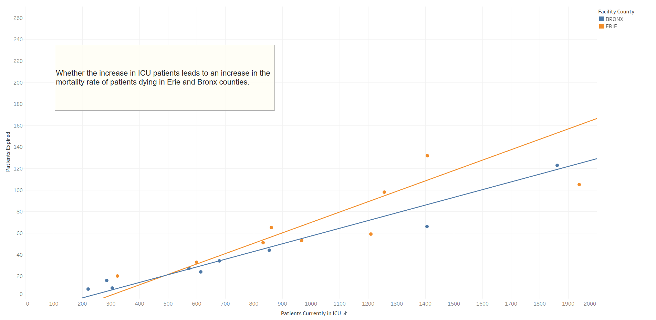

Slide 15
Conclusion
1. Unpredictable future
2. Preventive measures
3. With the number of patients in hospitals, we can observe that older people are more prone to Covid 19 when compared to younger people.
4. People in ERIE county trust CATHOLIC HEALTH NETWORK and KALEIDA HEALTH network than INDEPENDENT NETWORKS.
5. Services provided by hospitals in Bronx is better than that provided in Erie County, as proved by hypothesis 1 and 5.

Slide 16
THANK YOU

