Slide 1
Customization to Reduce User “Churn”
Group 5
Liya Zhou, Siyun Ding, Renjie Yin,
Haolin Liu, Siddhant Prashant Bandiwadekar
Notes:
© Copyright Showeet.com – Creative & Free PowerPoint Templates

Slide 2
Outline
01
Background and Data
04
Flights analysis
Siyun
Haolin
02
Partner analysis
05
Feedback analysis
Siddhant
Renjie
03
Customer analysis
06
Recommendation
Liya
Siyun
Notes:
© Copyright Showeet.com – Creative & Free PowerPoint Templates

Slide 3
Background and Data
01
Figuring out and analyzing relations between recommendation score and other possible factors
Get insights on how to improve customer experience of taking flights
31 variables and 10,282 samples
Notes:
© Copyright Showeet.com – Creative & Free PowerPoint Templates

Slide 4



Data
Day.of.Month, Partner.Name, Scheduled.Departure.Hour, Departure.Delay.in.Minutes, Arrival.Delay.in.Minutes, Flight.cancelled, Flight.time.in.minutes, Flight.Distance, Flight.Month
Age, Gender, Price.Sensitive, Flights.Per.Year, Type of Travel, Shopping.Amount.at.Airport, Eating.and.Drinking.at.Airport, Class, Year.Length, Airline.Status, Free Text
Destination.City, Origin.City, Origin.State, Destination.State, olong, olat, dlong, dlat
Airline
Customer
Place
Notes:
© Copyright Showeet.com – Creative & Free PowerPoint Templates

Slide 5
Partner Analysis
02
Notes:
© Copyright Showeet.com – Creative & Free PowerPoint Templates

Slide 6

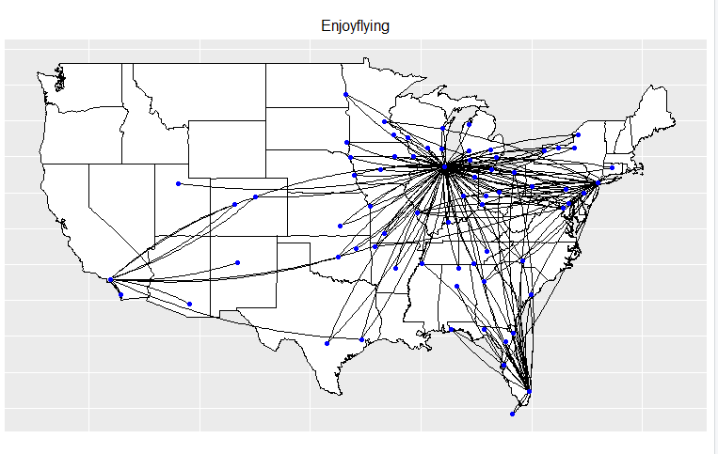

Slide 7
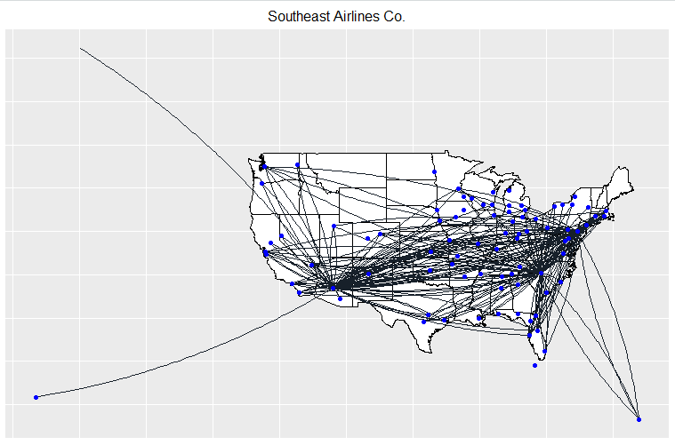

Slide 8
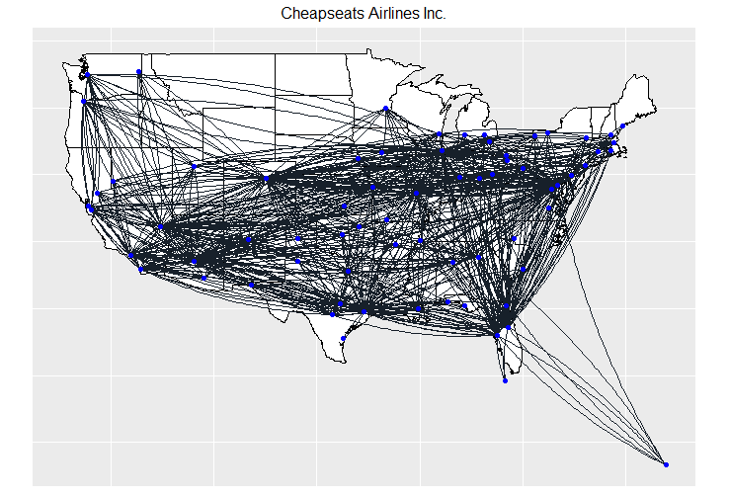

Slide 9
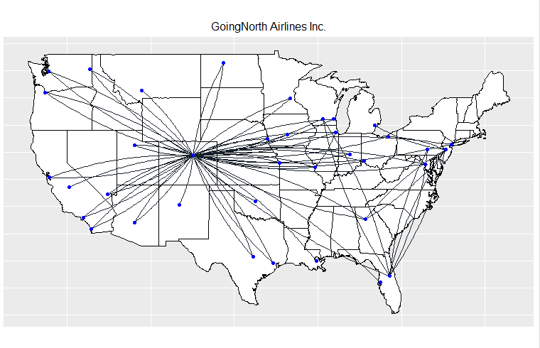

Slide 10
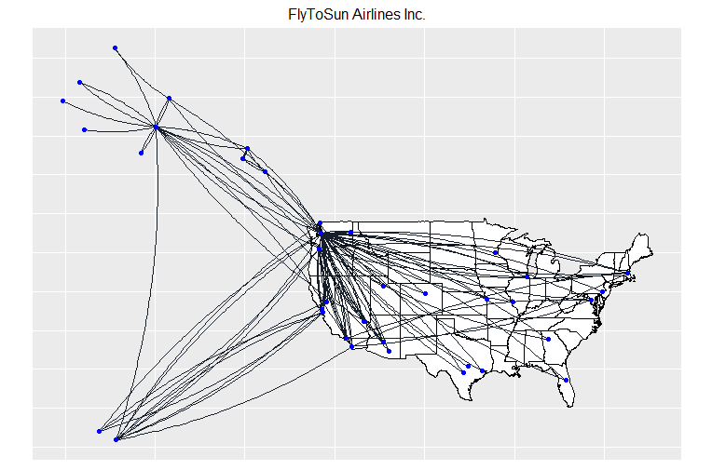

Slide 11
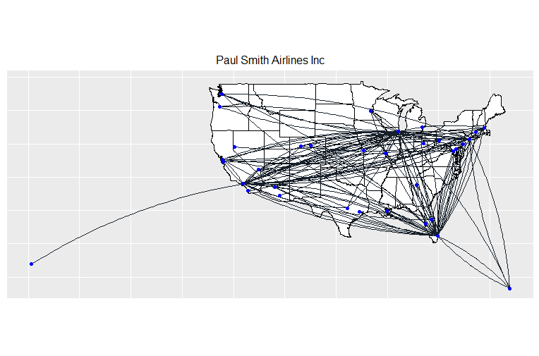

Slide 12
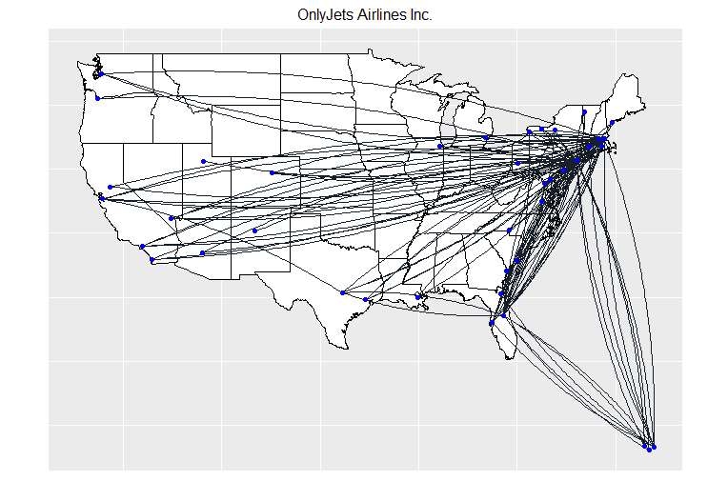

Slide 13
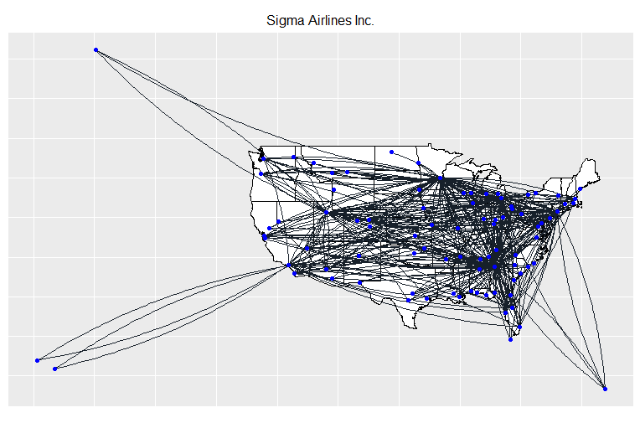

Slide 14
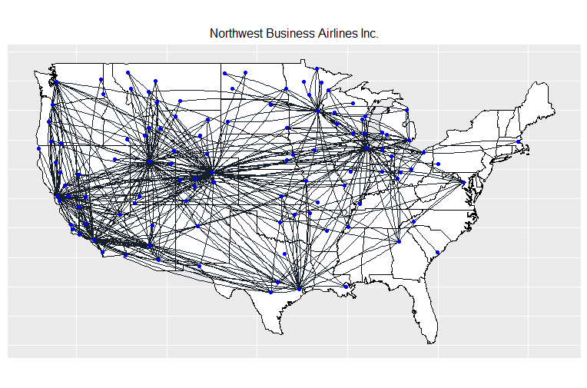

Slide 15
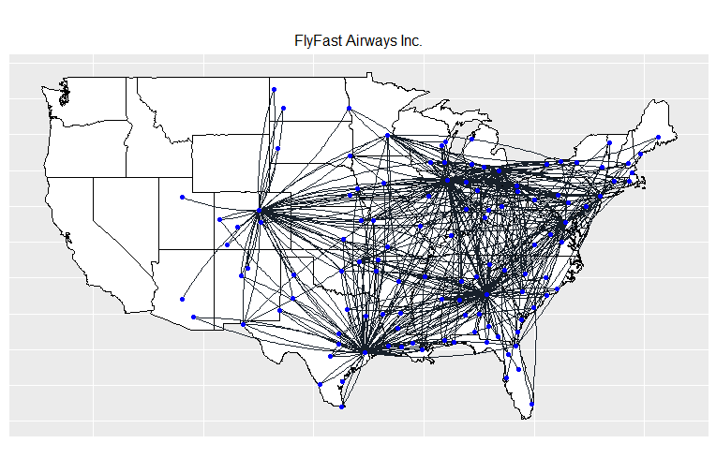

Slide 16
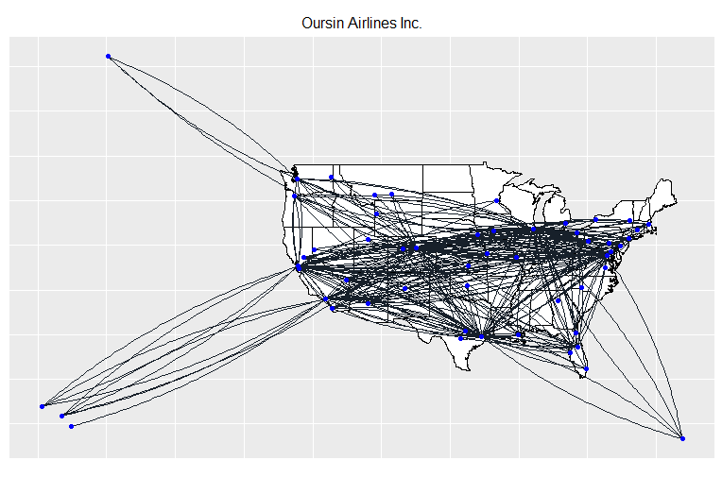

Slide 17
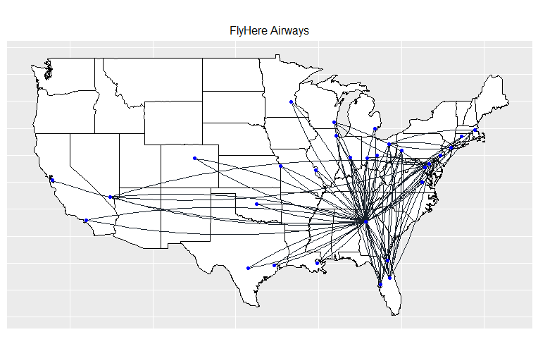

Slide 18
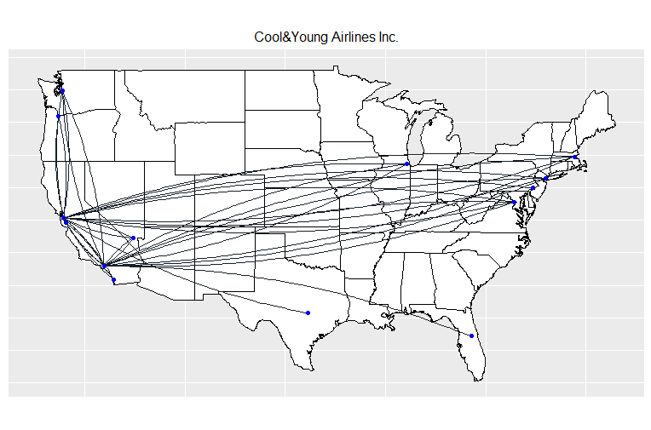

Slide 19
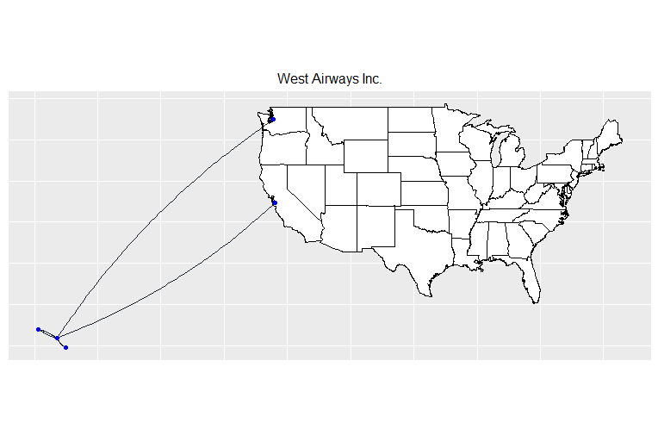

Slide 20
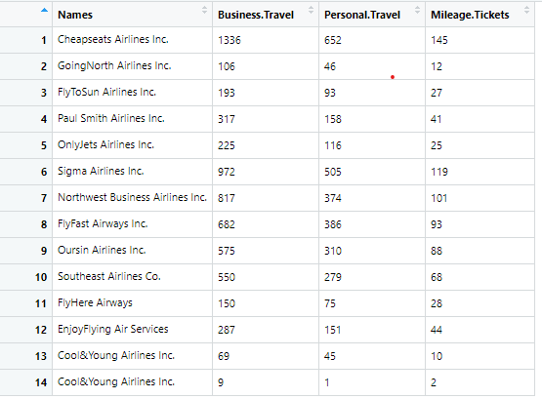
Partner Analysis
02
Based on Travel Type
Notes:
From the diagram, it is obvious that Females aged 30 to 60 are more sensitive to the price.

Slide 21
02
Most Preferred Airline On The Basis Of Travel Type:
Cheapseats Airlines Inc.
Business - 1336
Personal - 652
Mileage Tickets - 145
Least Preferred Airline On The Basis Of Travel Type:
Cool&Young Airlines Inc.
Business - 9
Personal - 1
Mileage Tickets - 2

Slide 22
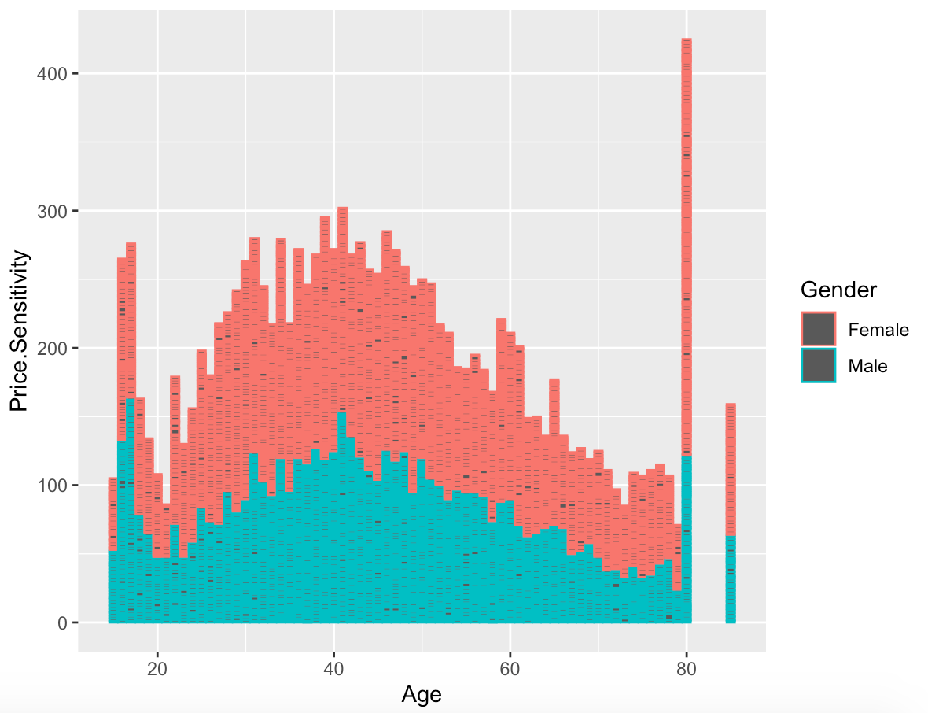
Customer analysis
03
——Visualization
Notes:
From the diagram, it is obvious that Females aged 30 to 60 are more sensitive to the price.

Slide 23
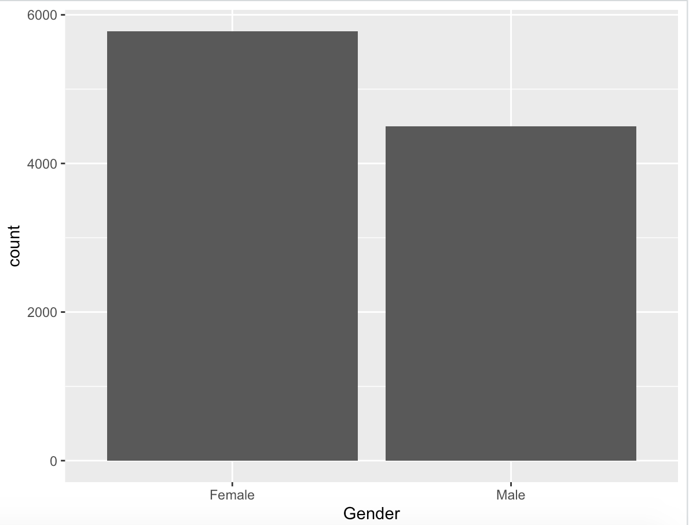
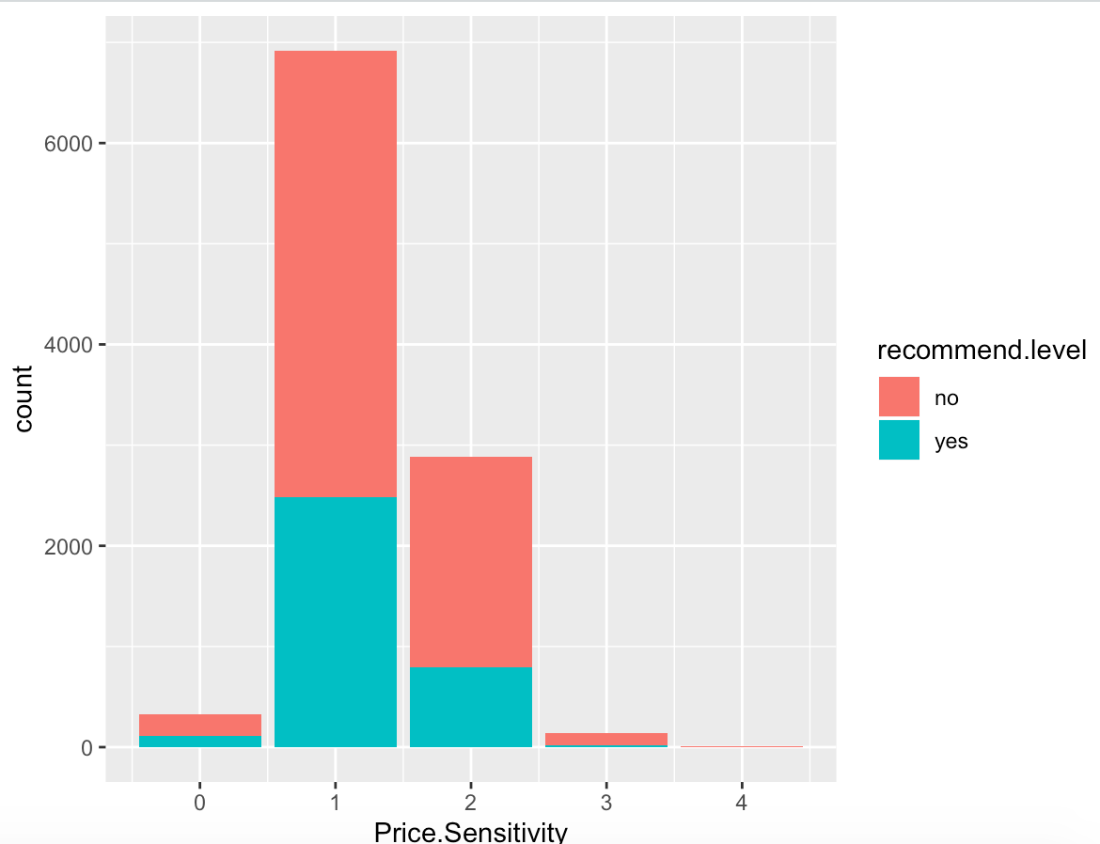
Customer analysis
03
——Visualization
Notes:
Since the number of females is larger than that of males and price sensitivity is related to the recommended level, the company shouldn’t ignore the price changes.

Slide 24
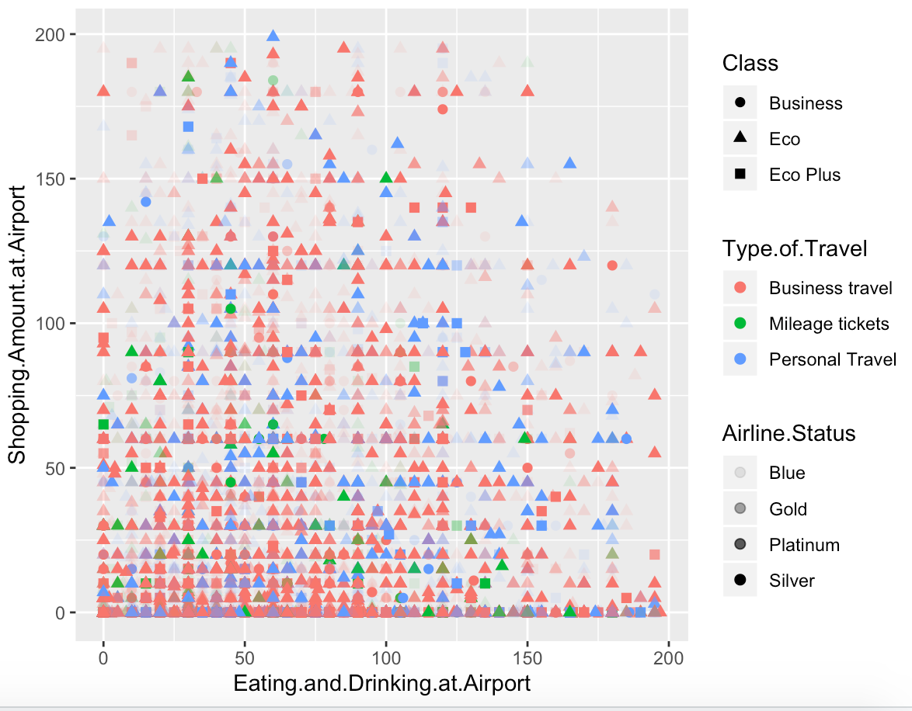
Customer analysis
03
——Visualization
Notes:
And look at this picture, no matter whether people shop or eat at the airport, the number of customers in economy class who travel for business or personally counts most.
And blue customers usually spend more money at airports. Southeast could start with this point to set some bonuses to attract customers.

Slide 25
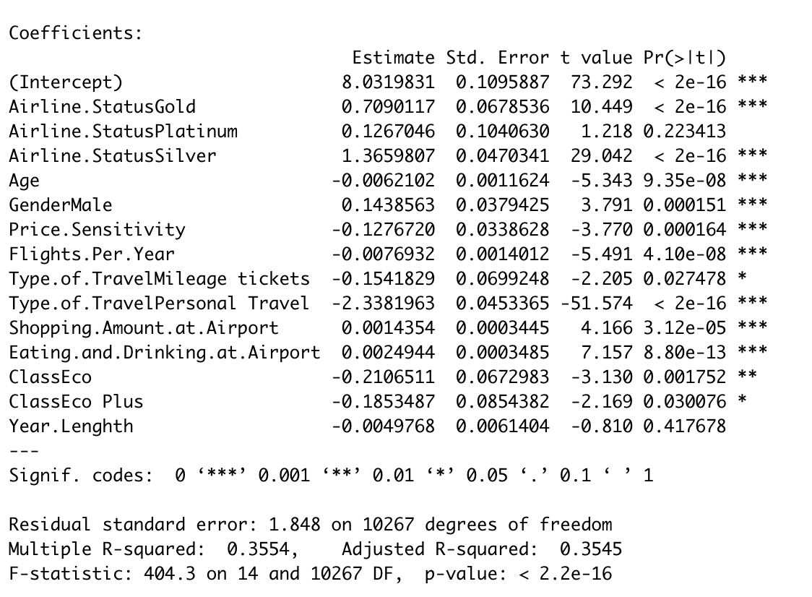
Customer analysis
03
——linear model
Notes:
We tried to build models to find out factors related to the recommendation. We used linear models to evaluate the significant factors. The results displayed like this:
The variables with three asterisks represent a highly significant p-value, which reflects that the variable plays an important role in the recommendation.

Slide 26
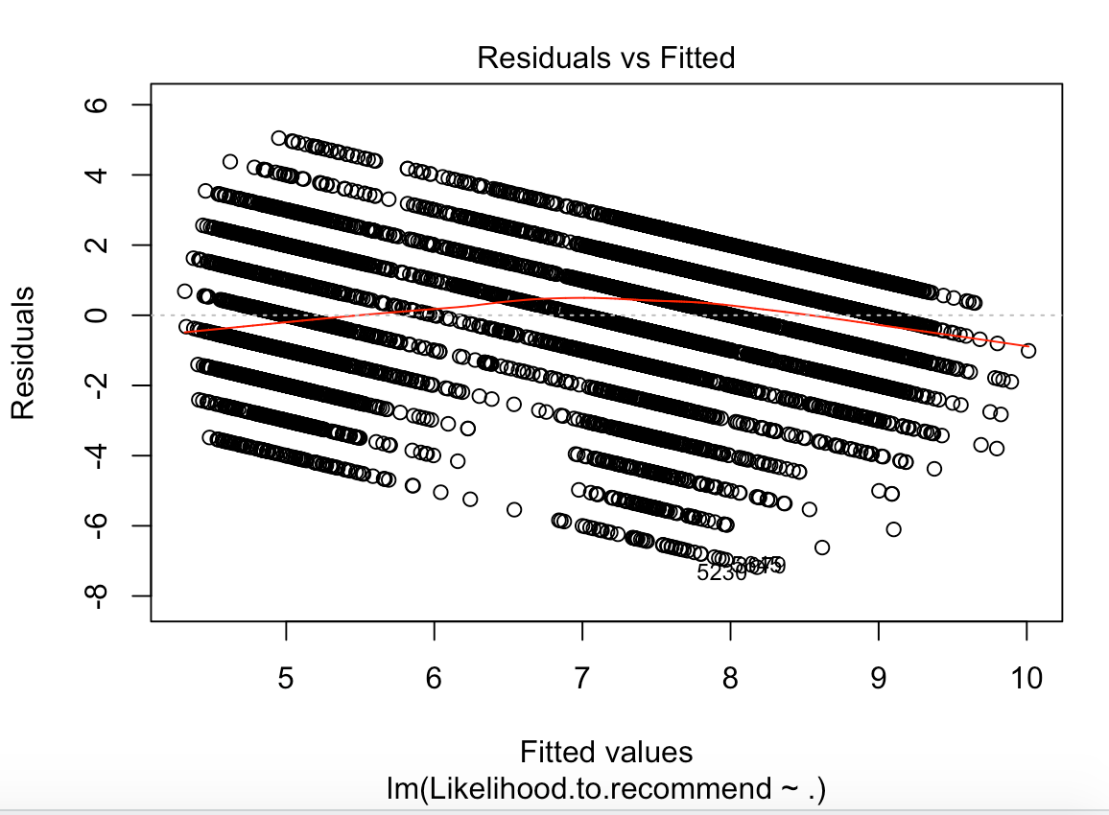
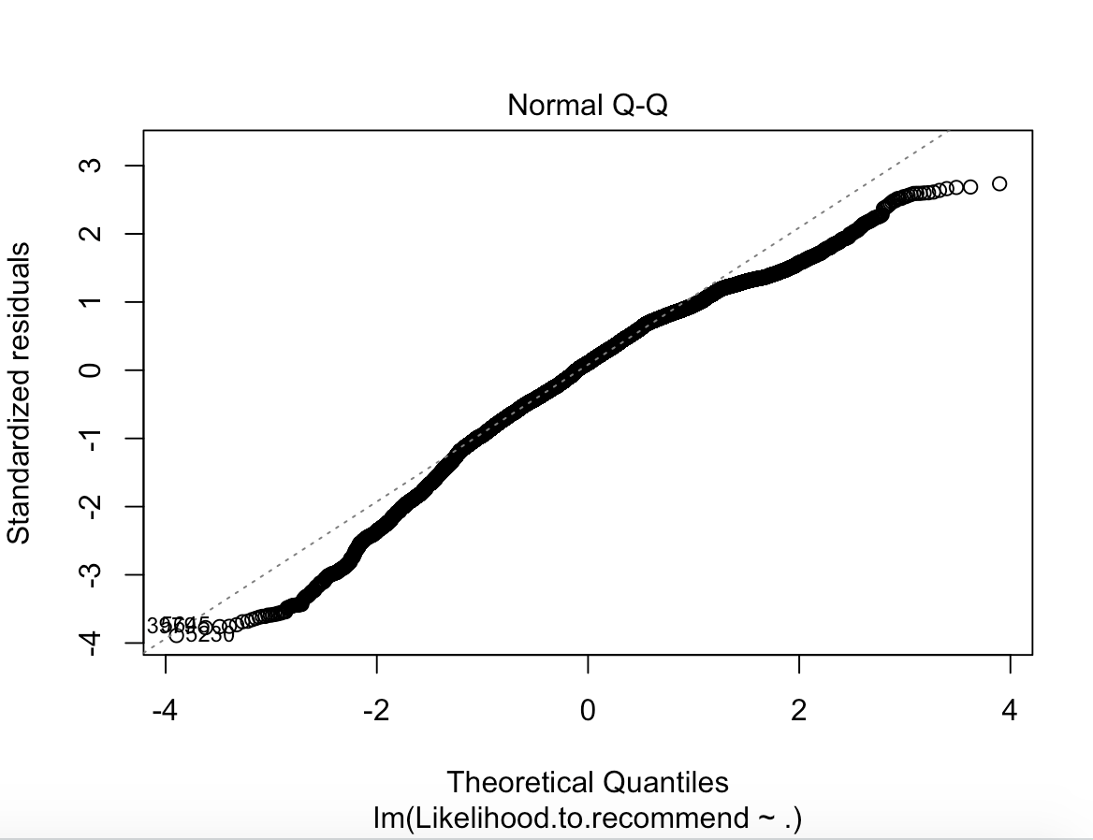
Customer analysis
03
——linear model
Airline status
age
gender
price sensitivity
Flight frequency
travel type
consumption at the airport
class
Notes:
Through these two pictures, we can figure out that the residuals are in normal distribution. It is proved that the result of the model is correct.
So, these six factors will influence the likelihood of the recommendation. The company is supposed to pay attention to improve these services or add some coupons to retain customers based on discovery.

Slide 27
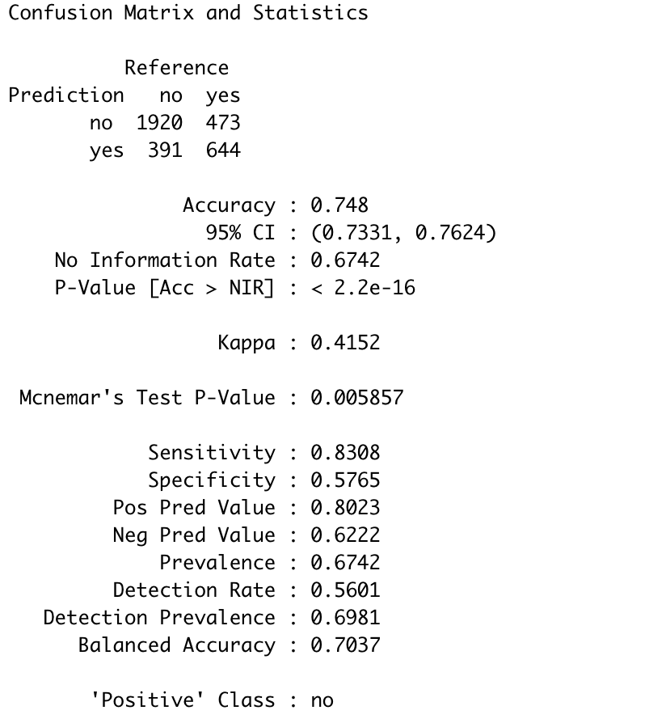
Customer analysis
03
——SVM
Notes:
We also used Support Vector Machine to predict whether a customer would recommend or not. The accuracy of the result is 0.748, which means the prediction model is reliable. If the company gets some data from a customer himself, we can predict his behavior to make plans on a customized scheme.

Slide 28
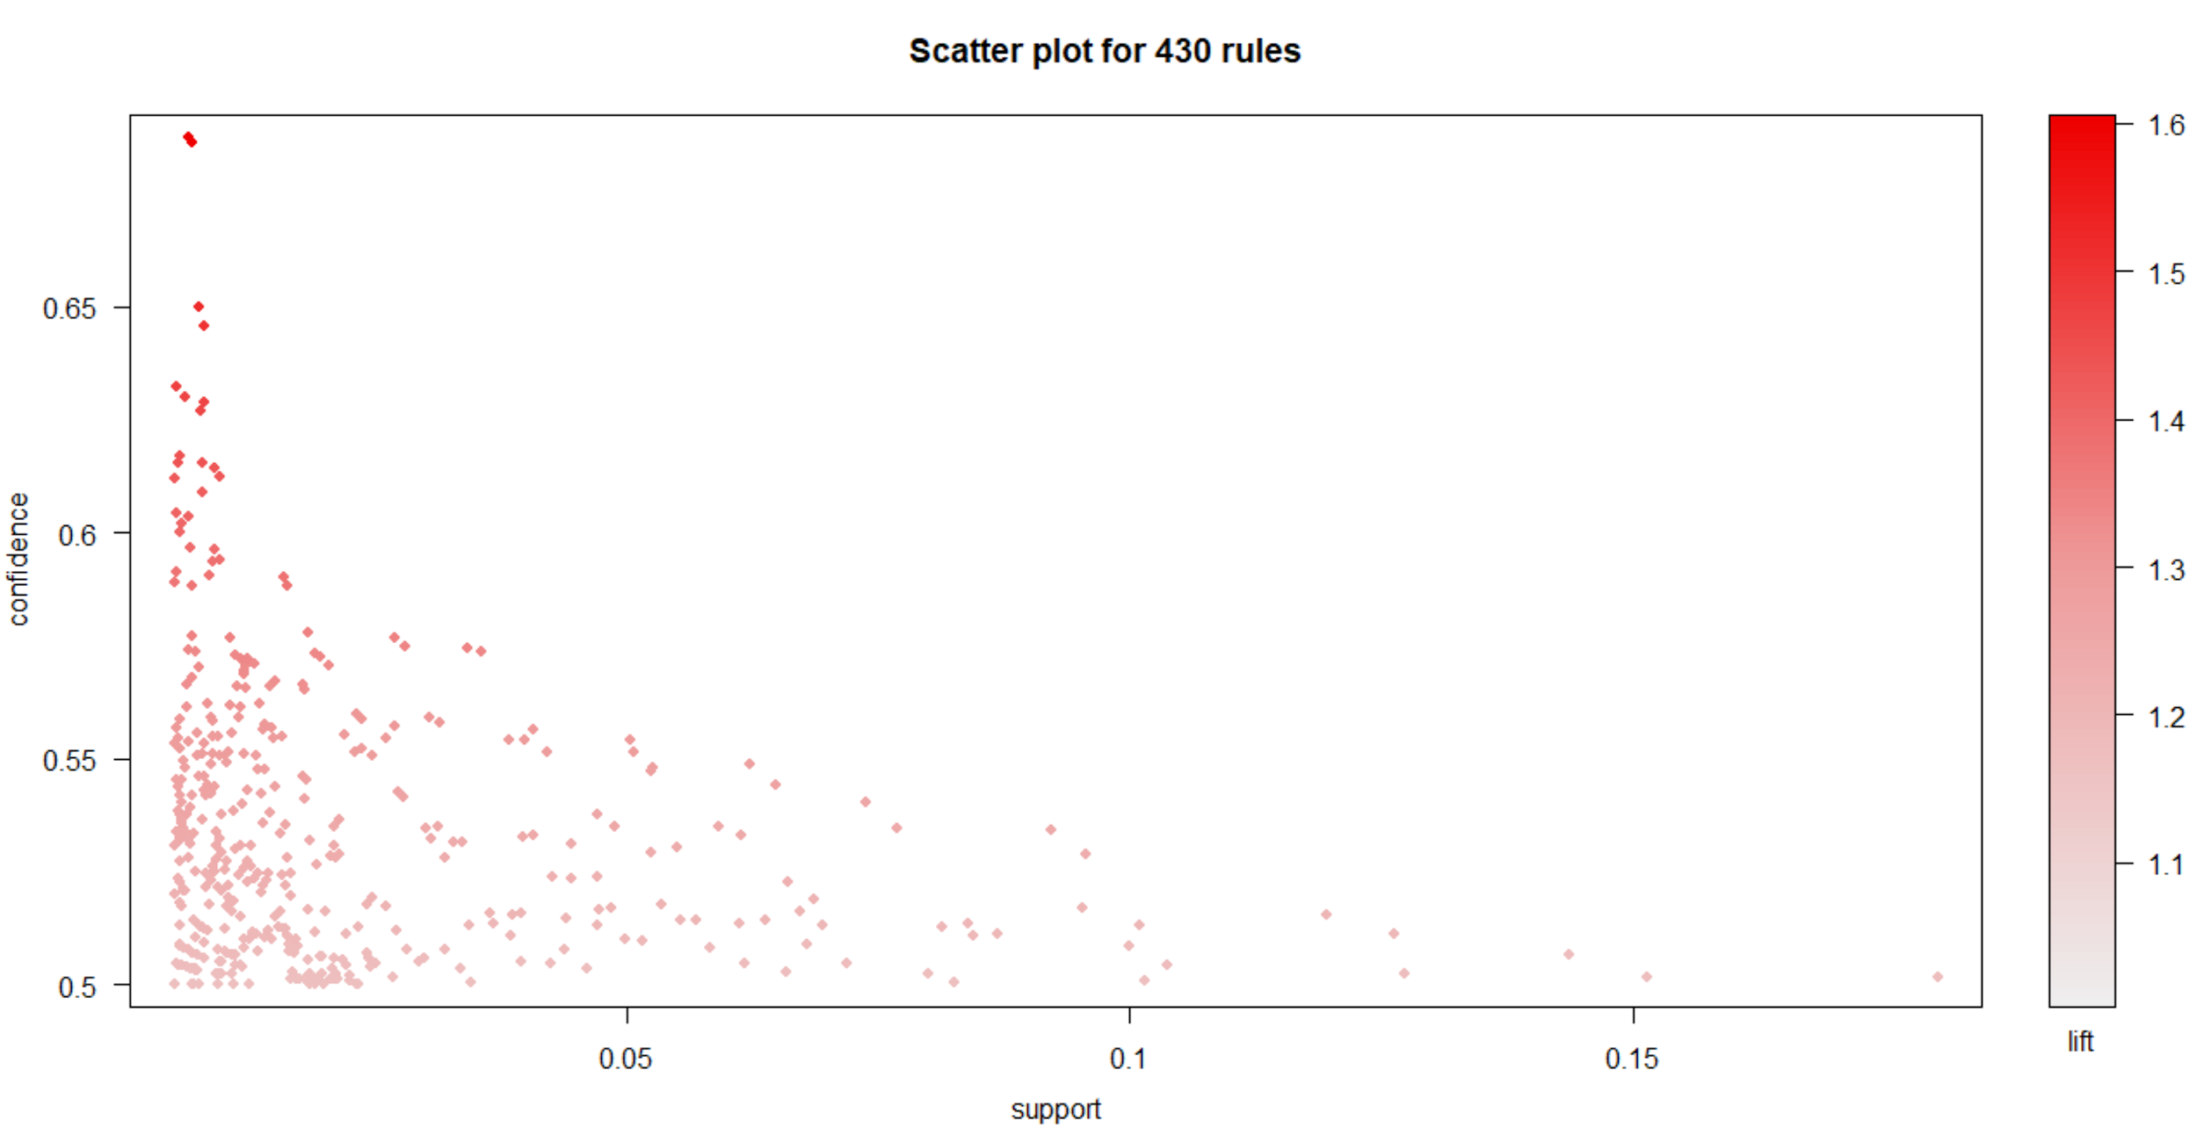
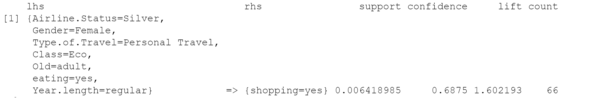
Flights analysis
04
——Association Rules

Slide 29
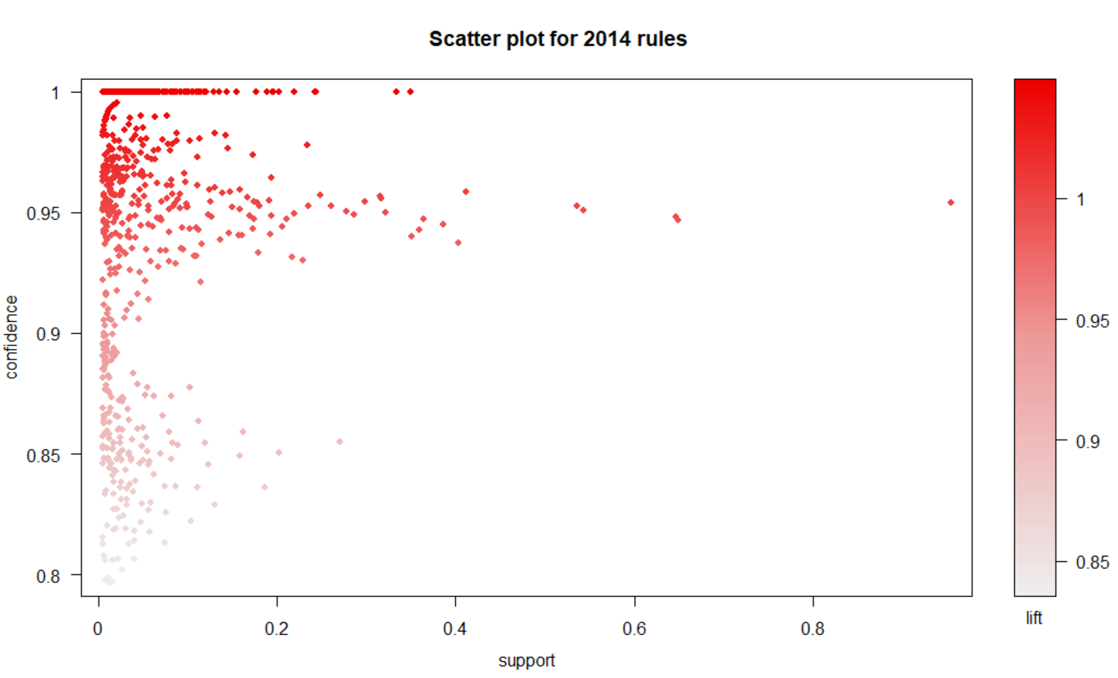
Flights analysis
04
——Association Rules
Notes:
© Copyright Showeet.com – Creative & Free PowerPoint Templates

Slide 30
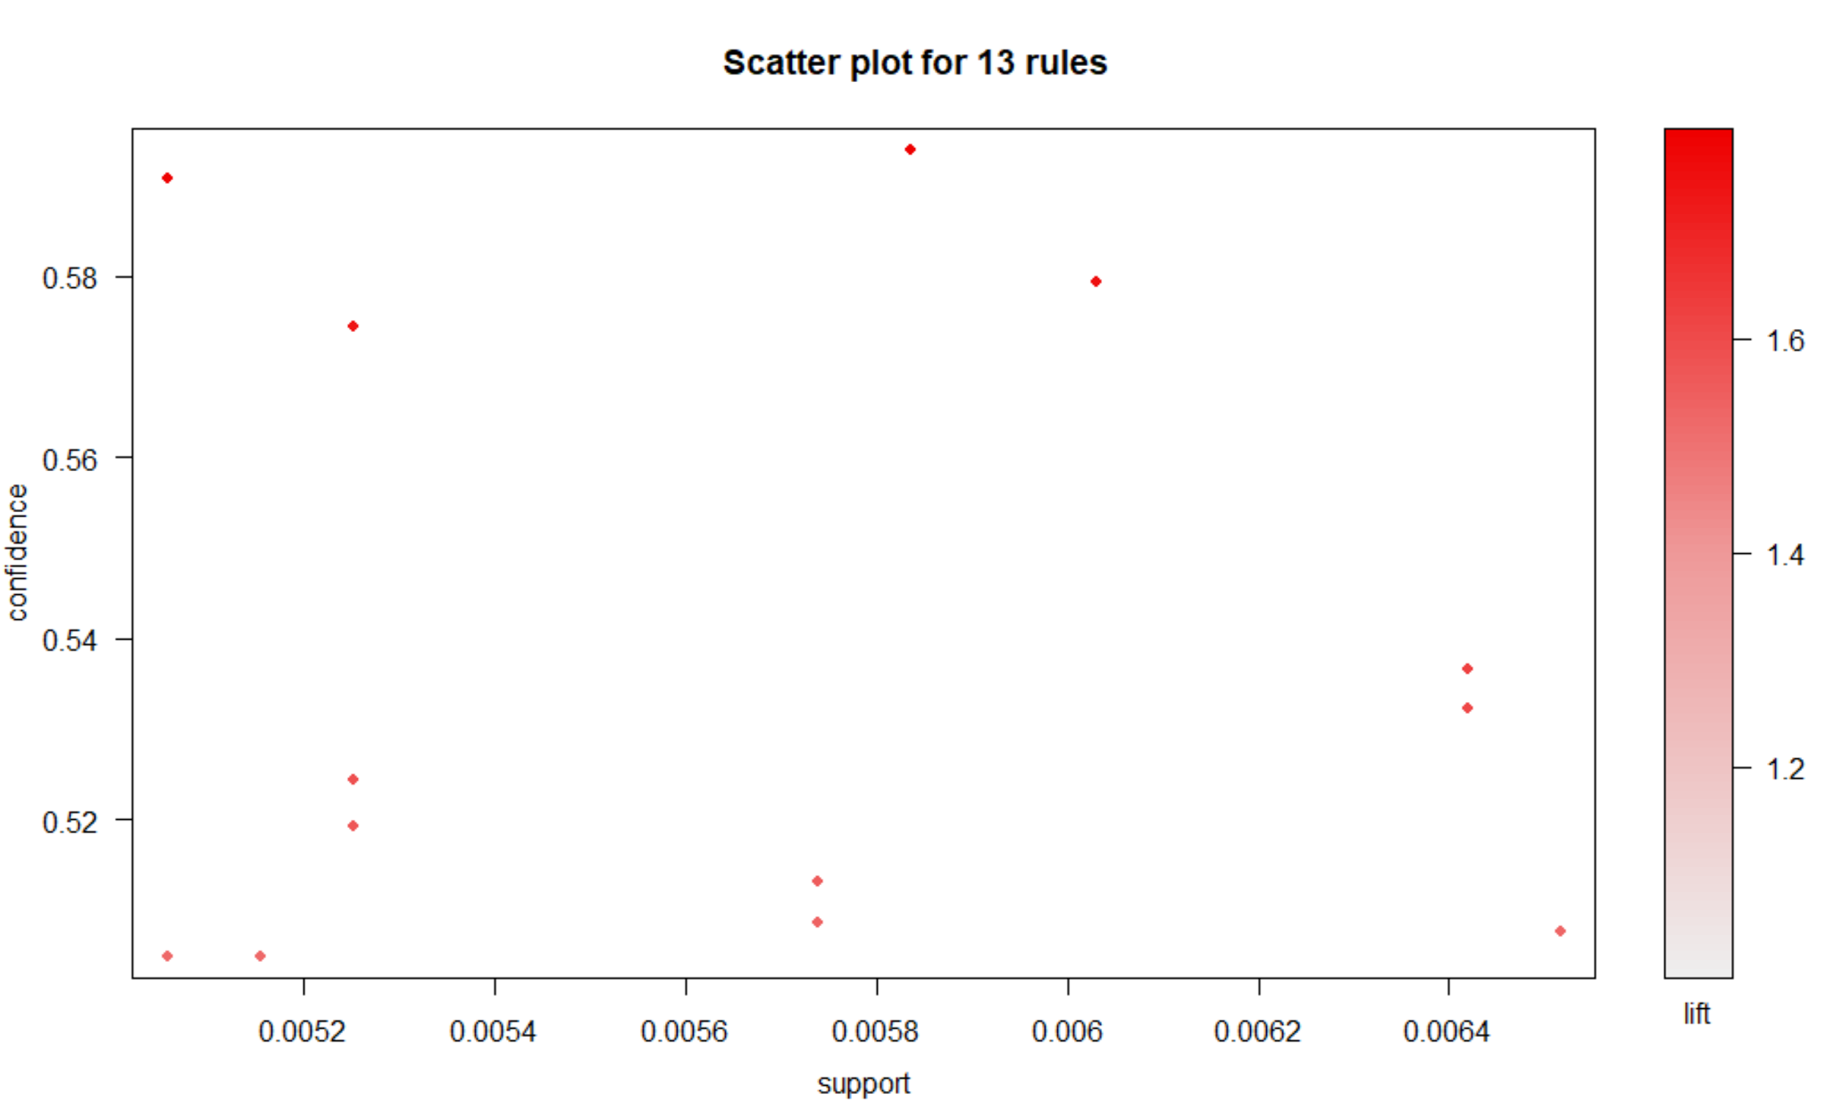
Flights analysis
04
——Association Rules

Slide 31
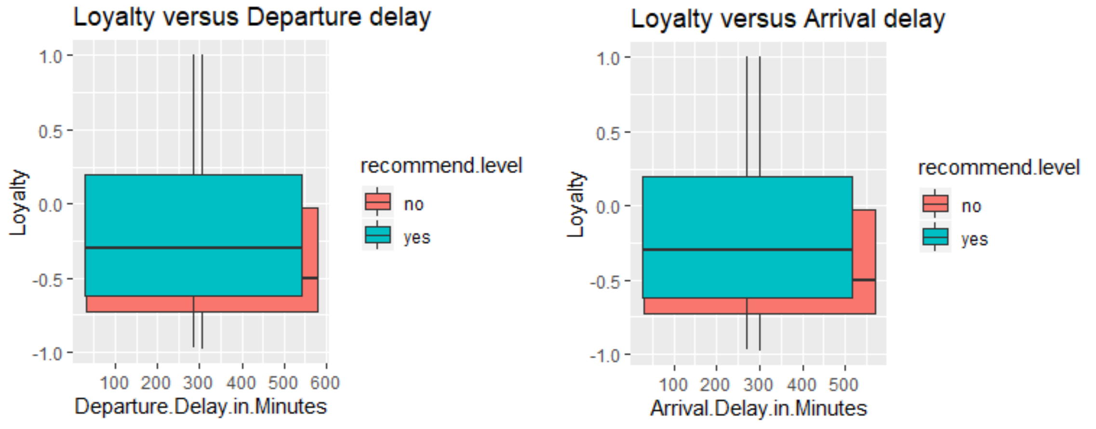
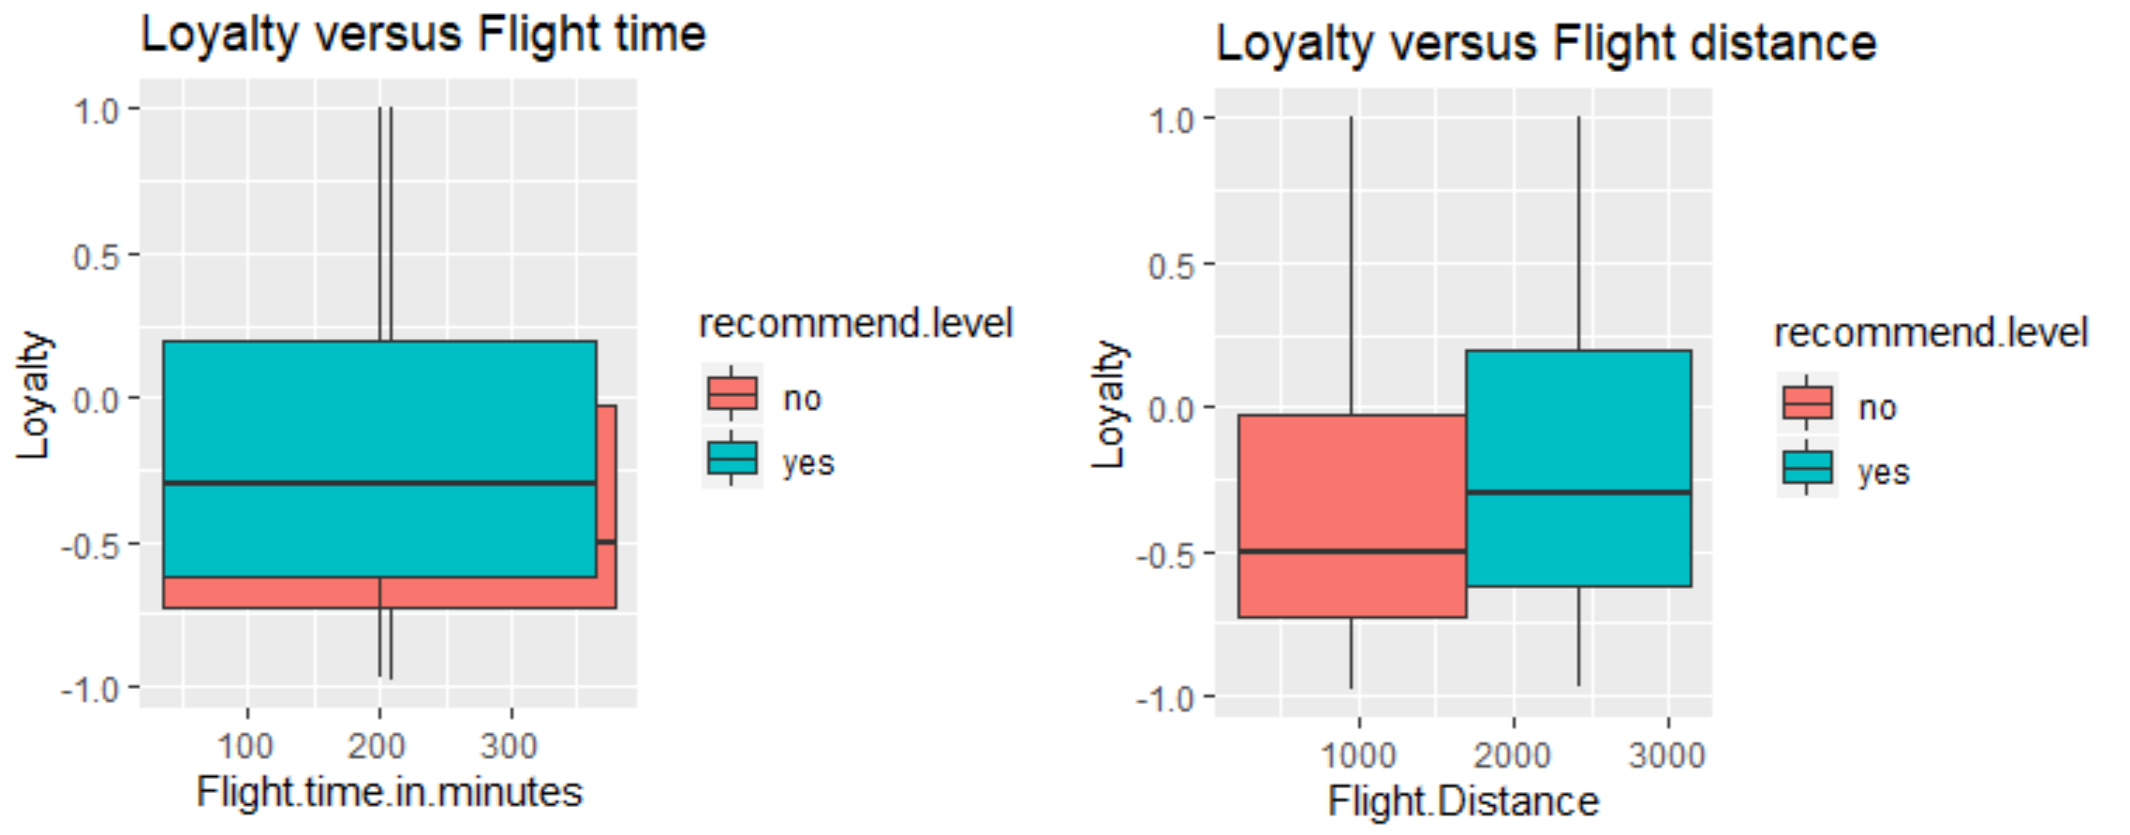
Flights analysis
04
——Visualization

Slide 32
Feedback Analysis
05
Notes:
© Copyright Showeet.com – Creative & Free PowerPoint Templates

Slide 33
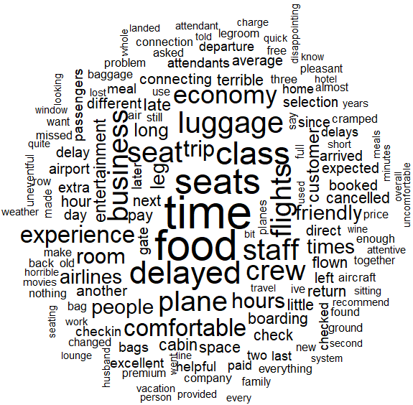
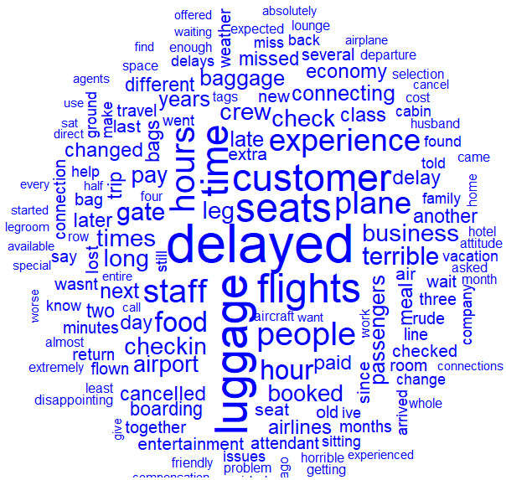
Top Feature words based on Negative Feedback
05
Negative Loyalty
Low NPS
Notes:
© Copyright Showeet.com – Creative & Free PowerPoint Templates

Slide 34
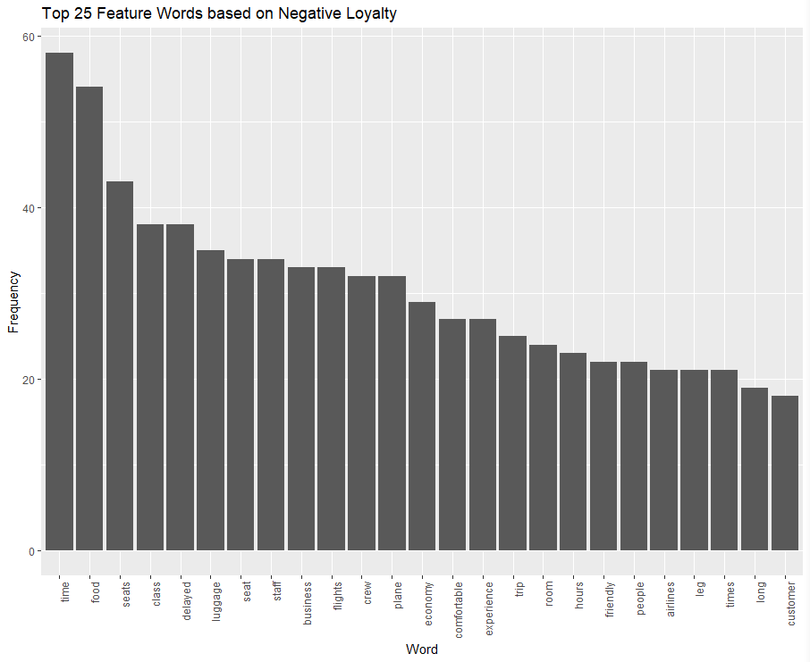
Top 25 Feature Words based on Negative Loyalty
05
Time
Food
Seats
Delayed
Luggage
Staff
Business
Flights
Crew
Plane
Economy
Comfortable
Experience
Trip
Room
Hours
Friendly
People
Airlines
Leg
Times
Long
Customer
Notes:
© Copyright Showeet.com – Creative & Free PowerPoint Templates

Slide 35
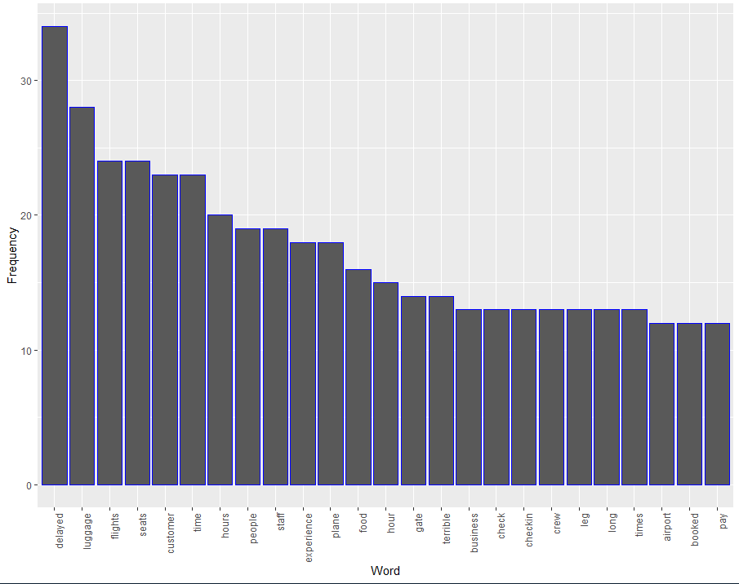
Top 25 Feature Words based on Low NPS
05
Delayed
Luggage
Flights
Seats
Customer
Time
Hours
People
Staff
Experience
Plane
Food
Hour
Gate
Terrible
Business
Check
Crew
Leg
Long
Times
Airport
Booked
Pay
Notes:
© Copyright Showeet.com – Creative & Free PowerPoint Templates

Slide 36
06
Recommendation
From the Partner analysis:
Add airlines and Cooperate more with Cheapseats Airlines Inc.
From the customer analysis:
1.Pay attention to women, provide them with special additional service
2.Increase efforts to advertise our additional service about shopping and eating in the Airport to economy class.
From the flight analysis:
1. Make flights on time to improve likelihood to recommend
2. Improve customer’s experience of long-time and short-distance travel.
From the feedback analysis:
Make flights on time and improve the luggage service.
Notes:
© Copyright Showeet.com – Creative & Free PowerPoint Templates

Slide 37
Q&A
Any questions?
Photo credit: PeterArreola via Pixabay (Creative Commons Zero license)
Notes:
© Copyright Showeet.com – Creative & Free PowerPoint Templates

Slide 38
Thank You!
Notes:
© Copyright Showeet.com – Creative & Free PowerPoint Templates

