Slide 1
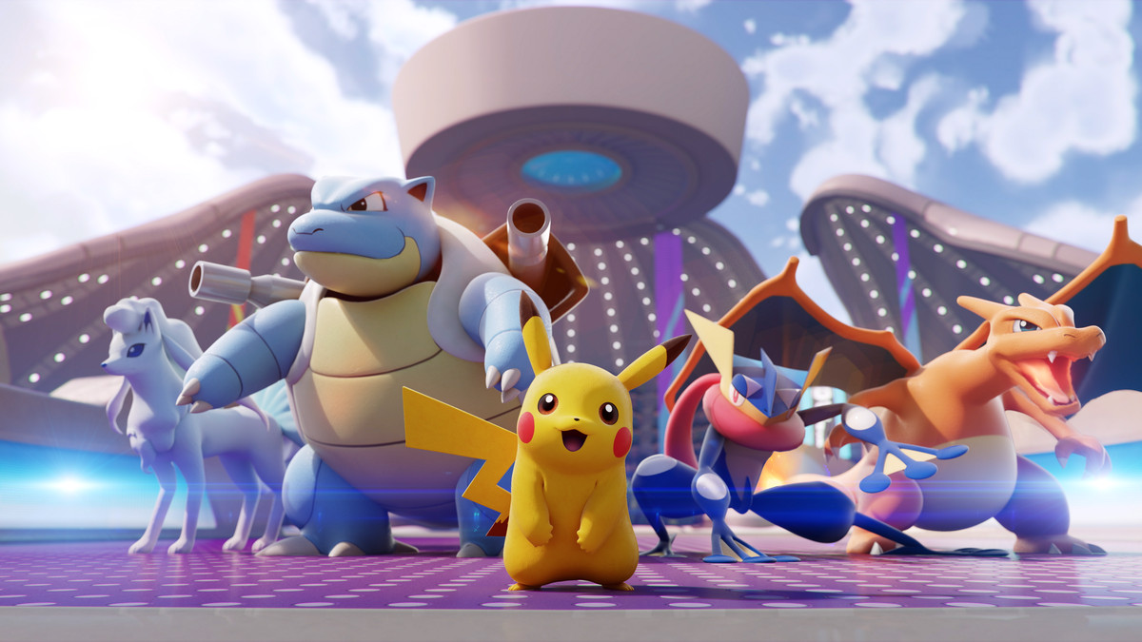
Topic: To Find Legendary Pokemon Using Machine Learning By: Siddhant Acharya

Slide 2
Introduction:
Pokemon is a renowned video game played by millions of people across the world.
Pokemons are of different characters having different abilities that battle out with each other.
Most of them are normal (with limited abilities and strength and with no special powers)
The legendary (with special powers and abilities) ones are rare.

Slide 3

Problem Statement:
All the Pokemons are stored in one place which is called the Pokedex or the Index for the Pokemons.
In this project, I’ll be finding out these legendary Pokemons from the whole Pokedex using Machine Learning algorithms.

Slide 4
Goals:
Create a dataset of all the Pokemons.
Develop a model to analyze which pokemon is legendary and which is not?
Build a User Interface (UI) for the users to interact with the web app.
Deploying the app on a Cloud Platform.

Slide 5
Dataset and Algorithm used:
Dataset: Pokemon_data.csv
Algorithm: Random Forest Classifier

Slide 6
Parameters of the Dataset:
Name
Type_1
Type_2
Total
HP
Attack
Defense
Special Attack
Special Defense
Speed
Generation
isLegendary
Color
hasGender
Pr_Male
Egg_Group_1
Egg_Group_1
hasMegaEvolution
Height_m
Weight_kg
Catch_Rate
Body_style

Slide 7
Random Forest:
Random forest is a Supervised Machine Learning Algorithm that is used widely in Classification and Regression problems.
It builds decision trees on different samples and takes their majority vote for classification and average in case of regression.

Slide 8
What is Random Forest Classifier?
A random forest is a meta estimator that fits several decision tree classifiers on various sub-samples of the dataset and uses averaging to improve the predictive accuracy and control over-fitting.
The sub-sample size is controlled with the max_samples parameter if bootstrap=True (default), otherwise the whole dataset is used to build each tree.

Slide 9
Possible Complications:
Pokemon as a game is ever-evolving and with each succeeding generation of Pokemons passing a new dataset of Pokemons is generated. Updation of the dataset is required.
A lot of the Pokemons have a few similarities with the legendary Pokemons concerning their abilities. So, the model has to take care of this edge case.

Slide 10
Points of failures:
Sparse datasets could turn out to be an issue as Random Forest Algorithm is not that good at handling sparse data.
Many decisions can also make the model a bit slow.

Slide 11
Related Work:
Predicting Play Calls Using a Random Forest Classifier.
Project of game prediction based on LeBron’s stats using 3 Machine Learning Models
Logistic Regression project for load default prediction.
Regression project to build a song popularity predictor.
Inventory stock demand forecasting
Project for customer ad clicks.

Slide 12

Thank you!

