Slide 1
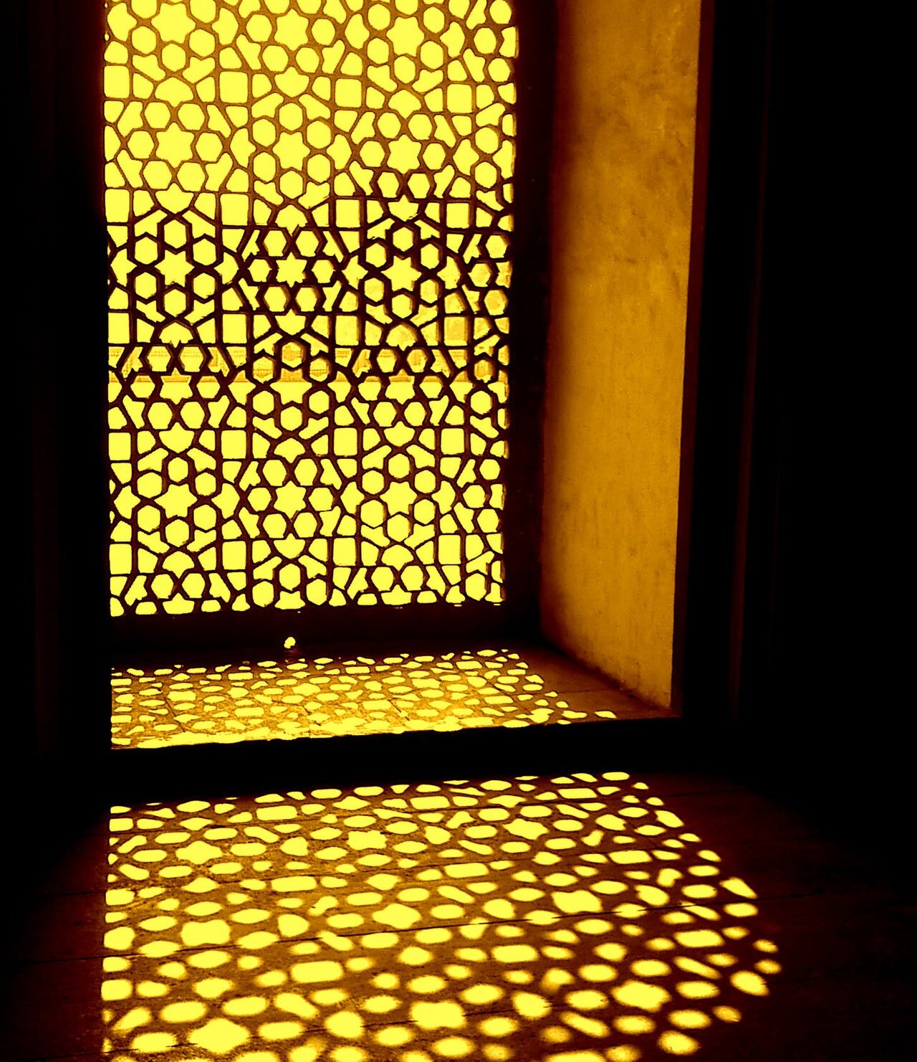
SUSTAINABILITY CONSULTING
VERDEAXIS
Closing the gap between regulation and reality.
We help developers, manufacturers and listed companies get certified, cut energy and carbon, and report it with confidence.
Siddhant Jain Founder · IGBC AP · EDGE Expert & Auditor
info@verdeaxis.com +91 97255 23213 verdeaxis.com
Notes:
Cover. The jaali image sets up the story on the next slide: India already knew how to build for its climate. The stripe along the bottom is real data: global temperature, 1880 to 2025, one stripe per year (NASA GISTEMP).

Slide 2
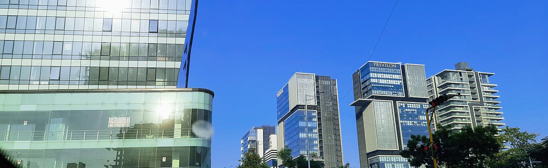
India has always known how to build for heat.
Jaalis, courtyards and thick walls kept buildings cool without machines. Modern buildings can do the same, if the right decisions are made early, when they cost the least.
We help you make those decisions with models and real numbers, then get the result certified.
Notes:
The story slide. The point is that good performance is cheapest at design stage, not that modern buildings are bad.

Slide 3
A new firm with seven years of practice behind it
AT A GLANCE
WHAT WE DO
WHO IT'S FOR
HOW WE WORK
WHERE
Green building certification, energy and daylight modelling, GHG accounting, LCA and ESG reporting.
Developers, manufacturers and exporters, listed companies, and the architects who design for them.
You deal with the founder, not a junior team. Advice comes from our own models and numbers.
Based in India. Project experience in France, Vietnam, Cambodia and Thailand.
7+
100+
5
6
years in practice
projects worked on
countries
rating systems
Notes:
Executive summary. Founder figures are personal track record, not the firm's.

Slide 4
What's changing, and what it means for you
01 WHY NOW
100 kW
2027
2026
New commercial buildings above this connected load fall under ECSBC, India's energy code.
By March 2027, India's top 1,000 listed companies need BRSR Core assurance.
The EU's carbon border tax (CBAM) entered its definitive phase in January.
WHAT IT MEANS FOR YOU
WHAT IT MEANS FOR YOU
WHAT IT MEANS FOR YOU
Energy modelling is now part of compliance, not an optional extra.
Expect their suppliers to be asked for emissions data as well.
Exporters without verified emissions data are charged on default values, which usually cost more.
Source: BEE, ECSBC 2024
Source: SEBI
Source: EU Regulation 2023/956
Notes:
Check each figure against the latest SEBI, BEE and EU text before sending externally.

Slide 5
Four kinds of client, four different reasons to call
01 WHO WE HELP
CLIENT
WHAT'S PUSHING THEM
WHAT WE DO
Developers and owners
Tenant requirements, green finance and ECSBC compliance.
Certification under LEED, IGBC, EDGE or GRIHA, backed by energy and daylight models.
Manufacturers and exporters
EU CBAM, and buyers asking for product carbon and Scope 3 data.
GHG inventories, product LCA, EPD support and green factory certification.
Listed companies and funds
BRSR Core assurance, investor questionnaires and GRESB.
Scope 1–3 inventories, BRSR and GRI reporting, and physical climate-risk studies.
Architects and MEP teams
Credits that depend on simulation, on tight design timelines.
Energy, daylight and microclimate studies, delivered as part of your team.
Notes:
Ask which row the prospect recognises themselves in, then go to that service.

Slide 6
Measure, certify, report
02 WHAT WE DO
01
02
03
Measure
Certify
Report
Find the baseline and build the evidence.
Take the project through to award.
Show investors and regulators the numbers.
GHG inventory, Scope 1, 2 and 3
Energy and daylight simulation
Microclimate and climate-risk studies
LCA, EPDs and CBAM emissions data
LEED, EDGE, IGBC and GRIHA
WELL and Fitwel
ECSBC and BEE compliance
Reviewer queries and appeals
BRSR Core and BRSR
GRI, CDP and TCFD
ESG strategy and roadmaps
SBTi target-setting support
Notes:
The three pillars. Most clients start with one and come back for the other two.

Slide 7
We test the design in a model before anyone builds it
02 BUILDING PERFORMANCE
ENERGY
DAYLIGHT
Know the energy bill before it's built.
Bright rooms, without glare or heat.
Baseline and proposed models in DesignBuilder, EnergyPlus and eQUEST, for LEED, ECSBC and BEE.
sDA, ASE, daylight factor and glare (DGP) studies, plus façade and shading options.
MICROCLIMATE
CARBON
Outdoor spaces people can use in May.
Know the carbon in your materials.
UTCI and PET comfort, pedestrian wind, heat island, solar access and site shading.
Whole-building and product LCA in One Click LCA and Excel, EPD support, links to Scope 3.
Every study ends with a one-page summary in plain English: what to change, what it costs and which credits it earns.
Notes:
The founder runs these models personally. That is the main technical difference from a documentation-only consultant.

Slide 8
Six rating systems, chosen to fit the project
02 CERTIFICATION
SYSTEM | ISSUED BY | WHAT WE DELIVER
LEED | USGBC / GBCI | BD+C, Core and Shell, ID+C, O+M
EDGE | IFC / GBCI | Design and final certification, EDGE audits
IGBC | CII | New buildings, green factories, homes
GRIHA | GRIHA Council | GRIHA V-2019, Large Developments
WELL | IWBI | Health and wellbeing strategy
Fitwel | Center for Active Design | Occupant health certification
FOUNDER CREDENTIALS
IGBC AP
Accredited Professional, CII-IGBC
EDGE Expert
IFC / GBCI
EDGE Auditor
GBCI
Not sure which system fits? That is what the free feasibility review is for.
Notes:
IGBC AP and EDGE Expert & Auditor are the founder's accreditations. LEED, GRIHA, WELL and Fitwel are project experience.

Slide 9
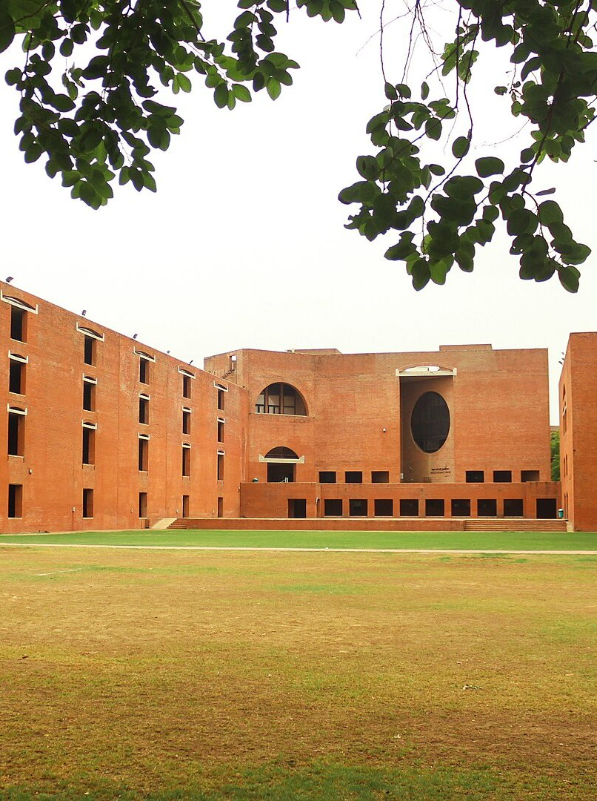
03 A NOTE FROM THE FOUNDER
In seven years and more than a hundred projects, I saw the same thing again and again. Certification was left to the end, after the big decisions were already made.
VERDEAXIS works the other way round. We model first, decide with numbers, and then certify what actually gets built.
And if a certification isn't worth it for your project, I'll tell you.
Siddhant Jain
Founder, VERDEAXIS
Notes:
DRAFT in the founder's voice. Siddhant to rewrite in their own words before use.

Slide 10
You work with the founder, start to finish
03 FOUNDER
SJ
Siddhant Jain
Founder and Principal Consultant · IGBC AP · EDGE Expert & Auditor
Seven years in consultancy teams, working on 100+ certification, simulation and carbon projects across India, France, Vietnam, Cambodia and Thailand.
Builds the energy, daylight and microclimate models in DesignBuilder and EnergyPlus, and LCA models in One Click LCA and Excel.
Has prepared Scope 1–3 inventories and ESG disclosures for industrial portfolios, including GRESB-aligned reporting.
Leads every VERDEAXIS project personally, from the first call to the final certificate.
Notes:
Replace the SJ panel with a portrait photo (3.4 x 4.3 in).

Slide 11
Selected projects the founder has worked on
03 TRACK RECORD
PROJECT | LOCATION | SCOPE | NOTES
Commercial campus | Gandhinagar, India | LEED v4.1 O+M | Targeting Gold
28-floor tower | Ho Chi Minh City, Vietnam | LEED BD+C v4 | Core and Shell
Pet food facilities | France | LEED BD+C v4 | Two industrial sites
Rice milling factory | Cambodia | EDGE v3.1 | Final certification
Industrial portfolio | Thailand | ESG and GHG, Scope 1–3 | GRESB-aligned reporting
Industrial park | Samut Sakhon, Thailand | Physical climate risk | WRI, NASA and Fathom data
Worked on by the founder as part of previous consultancy teams, before VERDEAXIS was formed. Client names withheld.
Notes:
These are projects the founder worked on while employed at previous firms. Say so plainly and describe your own role on each.

Slide 12
Five steps from first call to certificate
04 HOW WE WORK
01
02
03
04
05
Scope
Analyse
Document
Submit
Certify
Brief, goals and the right rating system.
Site visit, data audit, models and GHG baseline.
Credit documents, drawings and model files.
Upload, reviewer queries and any appeals.
Award, handover, then re-certification and reporting.
What you can expect: a timeline agreed up front, a direct line to the founder, and no surprise costs.
Notes:
Process slide.

Slide 13
Start with a free review, or bring us in for the whole job
04 ENGAGEMENT
START HERE
02
03
04
Feasibility review
Certification, end to end
Simulation support
Carbon and ESG
Best for Any new project
Best for Developers and owners
Best for Architects and MEP teams
Best for Manufacturers, listed firms
Best-fit system, target rating and the main gaps. Free, with a written fee proposal after.
Registration, modelling, documents, submission and reviewer responses, through to award.
Energy, daylight and microclimate studies, delivered to your design programme.
GHG inventories, LCA and EPDs, CBAM data and BRSR reporting.
Notes:
No prices in the profile. Quote after the feasibility review.

Slide 14
NEXT STEP
Send us your drawings. We'll tell you what's possible.
SIDDHANT JAIN, FOUNDER
info@verdeaxis.com
+91 97255 23213
verdeaxis.com
The first feasibility review is free. You get:
The rating system that fits your project, timeline and budget
The main design and documentation gaps, before you register
What modelling or carbon work you'll actually need
A realistic timeline from kickoff to award
India · France · Vietnam · Cambodia · Thailand
Each stripe is one year of global average temperature, 1880–2025. Data: NASA GISTEMP. Stripes concept: Ed Hawkins, #ShowYourStripes. Photos (CC BY-SA 4.0, Wikimedia Commons): jaali, Om Pratap Singh; SG Highway, Kushagra140; IIM Ahmedabad, Perspectives Photography Club.
Notes:
Close on the free feasibility review. Credits line must stay while the Commons photos are used.

