Slide 1
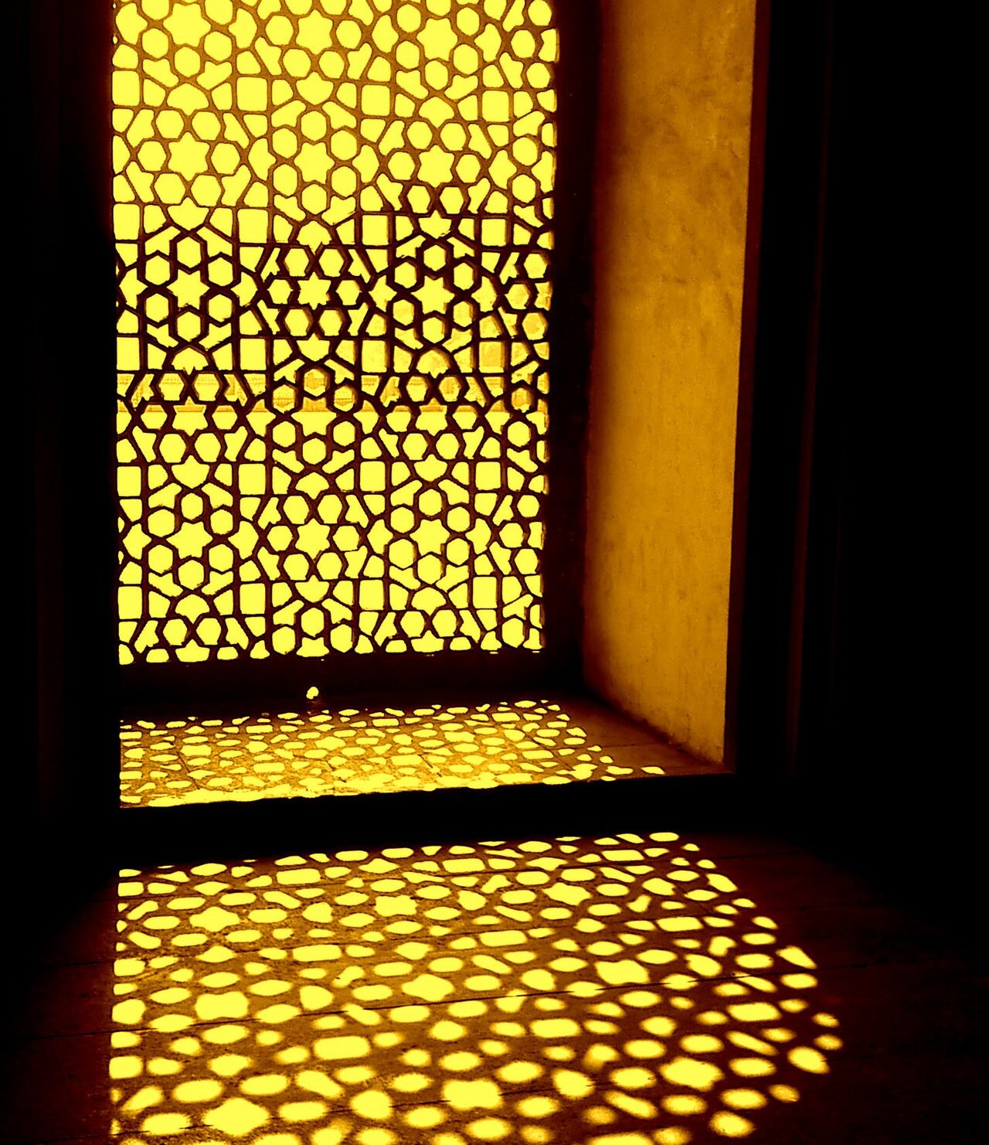
SUSTAINABILITY CONSULTING
VERDEAXIS
Closing the gap between regulation and reality.
Green building certification, building performance simulation, and carbon and ESG work for projects in India and across Asia.
Siddhant Jain Founder · IGBC AP · EDGE Expert & Auditor
info@verdeaxis.com +91 97255 23213 verdeaxis.com
Notes:
Cover. The jaali image sets up the story on the next slide: India already knew how to build for its climate. The stripe along the bottom is real data: global temperature, 1880 to 2025, one stripe per year (NASA GISTEMP).

Slide 2
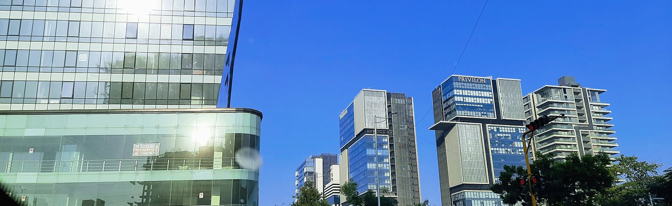
India knew how to build for heat. Then we started building in glass.
Jaalis, courtyards and thick walls kept buildings cool long before air conditioning. Our new skylines are mostly glass, cooled by machines and paid for every month.
VERDEAXIS brings climate sense back into design, and proves it with simulation, carbon data and certification.
Notes:
The story slide. Say it plainly: we are not against glass, we are against designing without data.

Slide 3
A new firm with seven years of practice behind it
AT A GLANCE
WHAT WE DO
WHO IT'S FOR
HOW WE WORK
WHERE
Green building certification, energy and daylight modelling, GHG accounting, LCA and ESG reporting.
Developers, manufacturers and exporters, listed companies, and the architects who design for them.
The founder leads every project. Advice comes from our own models and carbon numbers.
Based in India. Project experience in France, Vietnam, Cambodia and Thailand.
7+
100+
5
6
years in practice
projects delivered
countries
rating systems
Notes:
Executive summary. Founder figures are personal track record, not the firm's.

Slide 4
The rules are changing faster than most projects
01 WHY NOW
~33%
2070
1,000
2026
of India's electricity is used by buildings.
India's net-zero year. ECSBC already applies to commercial buildings of 100 kW and above.
listed companies come under BRSR Core assurance by March 2027.
EU CBAM's definitive phase began. Steel, aluminium and cement exporters must back their emissions with data.
Source: CEA, MoSPI
Source: Government of India, BEE
Source: SEBI
Source: EU Regulation 2023/956
Most buildings and supply chains are still being planned for yesterday's rules. That gap is where we work.
Notes:
Check each figure against the latest SEBI, BEE and EU text before sending externally.

Slide 5
Four kinds of client, four different reasons to call
01 WHO WE HELP
CLIENT
WHAT'S PUSHING THEM
WHAT WE DO
Developers and owners
Tenant requirements, green finance and ECSBC compliance.
Certification under LEED, IGBC, EDGE or GRIHA, backed by energy and daylight models.
Manufacturers and exporters
EU CBAM, and buyers asking for product carbon and Scope 3 data.
GHG inventories, product LCA, EPD support and green factory certification.
Listed companies and funds
BRSR Core assurance, investor questionnaires and GRESB.
Scope 1–3 inventories, BRSR and GRI reporting, and physical climate-risk studies.
Architects and MEP teams
Credits that depend on simulation, on tight design timelines.
Energy, daylight and microclimate studies, delivered as part of your team.
Notes:
Ask which row the prospect recognises themselves in, then go to that service.

Slide 6
Measure, certify, report
02 WHAT WE DO
01
02
03
Measure
Certify
Report
Find the baseline and build the evidence.
Take the project through to award.
Tell investors and regulators what changed.
GHG inventory, Scope 1, 2 and 3
Energy and daylight simulation
Microclimate and climate-risk studies
LCA, EPDs and CBAM emissions data
LEED, EDGE, IGBC and GRIHA
WELL and Fitwel
ECSBC and BEE compliance
Reviewer queries and appeals
BRSR Core and BRSR
GRI, CDP and TCFD
ESG strategy and roadmaps
SBTi target-setting support
Notes:
The three pillars. Most clients start with one and come back for the other two.

Slide 7
We test the design in a model before anyone builds it
02 BUILDING PERFORMANCE
Energy
DesignBuilder, EnergyPlus, eQUEST
Daylight and glare
Climate-based daylight modelling
Baseline and proposed models for LEED, ECSBC and BEE, HVAC options, ASHRAE 90.1 studies.
sDA, ASE and daylight factor, glare (DGP), façade and shading for Indian climates.
Microclimate
Outdoor comfort and wind
LCA and carbon
One Click LCA, Excel models
UTCI and PET comfort, pedestrian wind, heat island, solar access and site shading.
Whole-building and product LCA, embodied carbon, EPD support, links into Scope 3.
Every model comes with a plain-language summary of what it means for the design, the cost and the credits.
Notes:
The founder runs these models personally. That is the main technical difference from a documentation-only consultant.

Slide 8
Six rating systems, chosen to fit the project
02 CERTIFICATION
SYSTEM | ISSUED BY | WHAT WE DELIVER
LEED | USGBC / GBCI | BD+C, Core and Shell, ID+C, O+M
EDGE | IFC / GBCI | Design and final certification, EDGE audits
IGBC | CII | New buildings, green factories, homes
GRIHA | GRIHA Council | GRIHA V-2019, Large Developments
WELL | IWBI | Health and wellbeing strategy
Fitwel | Center for Active Design | Occupant health certification
FOUNDER CREDENTIALS
IGBC AP
Accredited Professional, CII-IGBC
EDGE Expert
IFC / GBCI
EDGE Auditor
GBCI
Notes:
IGBC AP and EDGE Expert & Auditor are the founder's accreditations. LEED, GRIHA, WELL and Fitwel are project experience.

Slide 9
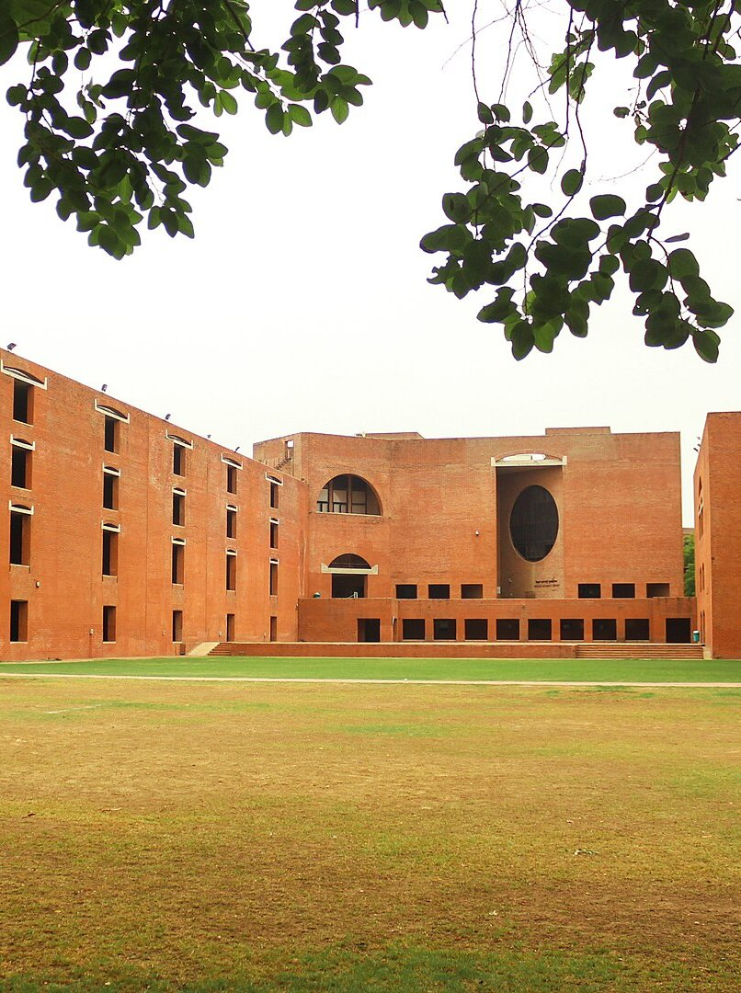
03 A NOTE FROM THE FOUNDER
Over seven years and more than a hundred projects, I kept seeing the same thing. Certification was treated as paperwork at the end, after the big decisions had already been made without data.
I started VERDEAXIS to work the other way round: model first, decide with numbers, then certify what actually gets built.
And if a certification isn't worth it for your project, I'll say so.
Siddhant Jain
Founder, VERDEAXIS
Notes:
DRAFT in the founder's voice. Siddhant to rewrite in their own words before use.

Slide 10
You work with the founder, start to finish
03 FOUNDER
SJ
Siddhant Jain
Founder and Principal Consultant · IGBC AP · EDGE Expert & Auditor
Seven years and 100+ projects in certification, simulation and carbon, across India, France, Vietnam, Cambodia and Thailand.
Builds the energy, daylight and microclimate models in DesignBuilder and EnergyPlus, and LCA models in One Click LCA and Excel.
Has prepared Scope 1–3 inventories and ESG disclosures for industrial portfolios, including GRESB-aligned reporting.
Leads every VERDEAXIS project personally, from the first call to the final certificate.
Notes:
Replace the SJ panel with a portrait photo (3.4 x 4.3 in).

Slide 11
Six projects from the founder's portfolio
03 TRACK RECORD
PROJECT | LOCATION | SCOPE | NOTES
Commercial campus | Gandhinagar, India | LEED v4.1 O+M | Targeting Gold
28-floor tower | Ho Chi Minh City, Vietnam | LEED BD+C v4 | Core and Shell
Pet food facilities | France | LEED BD+C v4 | Two industrial sites
Rice milling factory | Cambodia | EDGE v3.1 | Final certification
Industrial portfolio | Thailand | ESG and GHG, Scope 1–3 | GRESB-aligned reporting
Industrial park | Samut Sakhon, Thailand | Physical climate risk | WRI, NASA and Fathom data
Delivered by the founder before VERDEAXIS was formed. Client names withheld.
Notes:
Be clear these are the founder's projects, not the firm's. Offer references on request.

Slide 12
Five steps from first call to certificate
04 HOW WE WORK
01
02
03
04
05
Scope
Analyse
Document
Submit
Certify
Brief, goals and the right rating system.
Site visit, data audit, models and GHG baseline.
Credit documents, drawings and model files.
Upload, reviewer queries and any appeals.
Award, handover, then re-certification and reporting.
What you can expect: a timeline agreed up front, a direct line to the founder, and no surprise costs.
Notes:
Process slide.

Slide 13
Start with a free review, or bring us in for the whole job
04 ENGAGEMENT
START HERE
02
03
04
Feasibility review
Certification, end to end
Simulation support
Carbon and ESG
Best for Any new project
Best for Developers and owners
Best for Architects and MEP teams
Best for Manufacturers, listed firms
Target rating, best-fit system, the main gaps and a scope of work. Free of charge.
Registration, modelling, documents, submission and reviewer responses, through to award.
Energy, daylight and microclimate studies, delivered to your design programme.
GHG inventories, LCA and EPDs, CBAM data and BRSR reporting.
Notes:
No prices in the profile. Quote after the feasibility review.

Slide 14
NEXT STEP
Send us your drawings. We'll tell you what's possible.
SIDDHANT JAIN, FOUNDER
info@verdeaxis.com
+91 97255 23213
verdeaxis.com
The first feasibility review is free. You get:
The rating system that fits your project, timeline and budget
The main design and documentation gaps, before you register
What modelling or carbon work you'll actually need
A realistic timeline from kickoff to award
India · France · Vietnam · Cambodia · Thailand
Each stripe is one year of global average temperature, 1880–2025. Data: NASA GISTEMP. Stripes concept: Ed Hawkins, #ShowYourStripes. Photos (CC BY-SA 4.0, Wikimedia Commons): jaali, Om Pratap Singh; SG Highway, Kushagra140; IIM Ahmedabad, Perspectives Photography Club.
Notes:
Close on the free feasibility review. Credits line must stay while the Commons photos are used.

