Slide 1

SUSTAINABILITY CONSULTING
VERDEAXIS
Closing the gap between regulation and reality.
We help developers, manufacturers and listed companies get certified, cut energy and carbon, and report it with confidence.
Siddhant Jain Founder · IGBC AP · EDGE Expert & Auditor
info@verdeaxis.com +91 97255 23213 verdeaxis.com
Notes:
Cover. The mark is a V whose right stroke is built from shading louvres: building design and data in one shape. The stripe along the bottom is real data: global temperature, 1880 to 2025, one stripe per year (NASA GISTEMP).

Slide 2
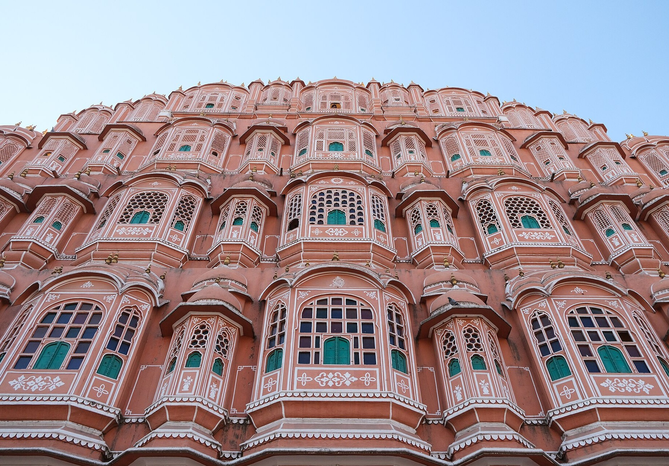
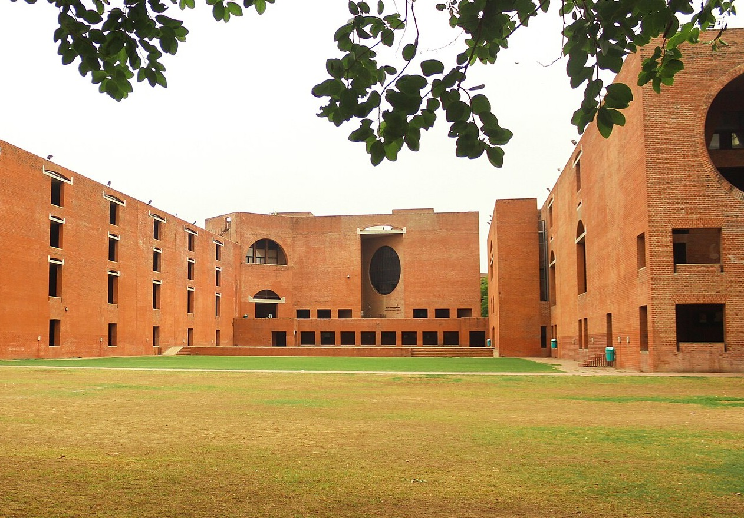
Hawa Mahal, Jaipur, 1799. 953 small windows pull breezes through the palace.
IIM Ahmedabad, 1974. Deep-set openings and brick walls that shade themselves.
India has always known how to build for heat.
Modern buildings can do the same, if the right decisions are made early, when they cost the least. We help you make those decisions with models and real numbers, then get the result certified.
Notes:
The story slide. Two Indian buildings designed around the climate, 175 years apart. The point: good performance is cheapest at design stage. Photos: Hawa Mahal by Adityaoberai (CC BY 4.0); IIM Ahmedabad by Perspectives, the Photography Club of IIM Ahmedabad (CC BY-SA 4.0), both via Wikimedia Commons.

Slide 3
A new firm with seven years of practice behind it
AT A GLANCE
WHAT WE DO
WHO IT'S FOR
HOW WE WORK
WHERE
Green building certification, energy and daylight modelling, GHG accounting, LCA and ESG reporting.
Developers, retail and logistics owners, manufacturers, listed companies, and their architects.
You deal with the founder, not a junior team. Advice comes from our own models and numbers.
Based in India. Project experience in Malaysia, France, Vietnam, Cambodia and Thailand.
7+
200+
6
6
years in practice
certified projects
countries
rating systems
Notes:
Executive summary. Founder figures are personal track record, not the firm's.

Slide 4
India's rulebook is being rewritten
01 INDIA
MANDATE | WHAT IT REQUIRES | WHO IT AFFECTS | STATUS
Carbon Credit Trading Scheme | Emission-intensity targets for 490 plants in eight sectors. Shortfalls are covered by buying carbon credits. | Cement, aluminium, refining, textiles, paper | In force
BRSR Core | Assured ESG data from India's top 1,000 listed companies, with value-chain disclosures phasing in. | Listed companies and their suppliers | Top 1,000 by FY 2026-27
Building energy codes | ECBC is notified in 25 states and UTs. ECSBC 2024, its successor, adds sustainability requirements. | New commercial buildings | States adopting
Star rating for large buildings | Proposed: new buildings of 20,000 m² or more need at least a BEE 3-star rating or an approved equivalent. | Developers and owners | Draft, July 2026
Climate finance taxonomy | Will define which projects count as green for banks and investors. Buildings are a priority sector. | Anyone raising green finance | Draft framework
NDC 2035 | 47% lower emissions intensity than 2005 and 60% non-fossil power by 2035. Net zero by 2070. | Every sector | Submitted April 2026
Status as of October 2026. Sources: MoEFCC/PIB, SEBI, BEE and Ministry of Power, NITI Aayog, Ministry of Finance, UNFCCC.
Notes:
CCTS: targets notified Oct 2025 (aluminium, cement, chlor-alkali, pulp & paper) and Jan 2026 (refineries, petrochemicals, textiles, secondary aluminium), 490 obligated entities (PIB). BRSR Core: SEBI glide path, top 1,000 in FY 2026-27. ECBC notified by 25 states/UTs by Dec 2024; NITI Aayog found no state had yet adopted ECSBC 2024. Star-rating rule: Ministry of Power draft, July 2026. Taxonomy: DEA draft framework, May 2025. NDC 2035: approved 25 March 2026, communicated 24 April 2026. Re-check before each use.

Slide 5
Export markets and investors are asking for the same numbers
01 BEYOND INDIA
Malaysia starts ISSB-based climate reporting for its largest listed companies.
First CBAM certificates bought for 2026 imports. Malaysia adds Scope 3 and assurance for the largest issuers.
EU: every new building must be zero-emission.
2025
2027
2030
2026
2028
EU CBAM's definitive phase: steel, aluminium and cement exporters must show verified emissions.
EU: all new public buildings must be zero-emission.
Over 40 jurisdictions are adopting ISSB climate reporting. Your buyers, lenders and parent companies will ask for numbers you can stand behind.
Notes:
CBAM: Regulation (EU) 2023/956, definitive phase from 1 Jan 2026; first certificate sales and declarations in 2027 for 2026 imports; 50-tonne de minimis from Omnibus 2025/2083. EPBD recast (EU) 2024/1275: zero-emission new buildings, public bodies from 2028, all from 2030. Malaysia NSRF: Group 1 (RM2bn+ Main Market) from 2025; Scope 3 and Scope 1-2 assurance for Group 1 from 2027. ISSB: IFRS Foundation says 40+ jurisdictions adopting or taking steps (2026).

Slide 6
Four kinds of client, four different reasons to call
01 WHO WE HELP
CLIENT
WHAT'S PUSHING THEM
WHAT WE DO
Developers, retail and logistics
Tenant requirements, green finance, energy codes and the proposed star-rating rule.
Certification under LEED, IGBC, EDGE or GRIHA, backed by energy and daylight models.
Manufacturers and exporters
EU CBAM, India's carbon market (CCTS) and buyers asking for product carbon data.
GHG inventories, product LCA, EPD support and green factory certification.
Listed companies and funds
BRSR Core assurance, investor questionnaires and GRESB.
Scope 1–3 inventories, BRSR and GRI reporting, and physical climate-risk studies.
Architects and MEP teams
Credits that depend on simulation, on tight design timelines.
Energy, daylight and microclimate studies, delivered as part of your team.
Notes:
Ask which row the prospect recognises themselves in, then go to that service.

Slide 7
Measure, certify, report
02 WHAT WE DO
01
02
03
Measure
Certify
Report
Find the baseline and build the evidence.
Take the project through to award.
Show investors and regulators the numbers.
GHG inventory, Scope 1, 2 and 3
Energy and daylight simulation
Microclimate and climate-risk studies
LCA, EPDs, CBAM and CCTS data
LEED, EDGE, IGBC and GRIHA
WELL and Fitwel
ECBC, ECSBC and BEE star ratings
Reviewer queries and appeals
BRSR Core and BRSR
GRI, CDP and TCFD
ESG strategy and roadmaps
SBTi target-setting support
Notes:
The three pillars. Most clients start with one and come back for the other two.

Slide 8
We test the design in a model before anyone builds it
02 BUILDING PERFORMANCE
ENERGY
DAYLIGHT
Know the energy bill before it's built.
Bright rooms, without glare or heat.
Baseline and proposed models in DesignBuilder, EnergyPlus and eQUEST, for LEED, ECSBC and BEE.
sDA, ASE, daylight factor and glare (DGP) studies, plus façade and shading options.
MICROCLIMATE
CARBON
Outdoor spaces people can use in May.
Know the carbon in your materials.
UTCI and PET comfort, pedestrian wind, heat island, solar access and site shading.
Whole-building and product LCA in One Click LCA and Excel, EPD support, links to Scope 3.
Every study ends with a one-page summary in plain English: what to change, what it costs and which credits it earns.
Notes:
The founder runs these models personally. That is the main technical difference from a documentation-only consultant.

Slide 9
Six rating systems, chosen to fit the project
02 CERTIFICATION
SYSTEM | ISSUED BY | WHAT WE DELIVER
LEED | USGBC / GBCI | BD+C, Core and Shell, ID+C, O+M
EDGE | IFC / GBCI | Design and final certification, EDGE audits
IGBC | CII | New buildings, green factories, homes
GRIHA | GRIHA Council | GRIHA V-2019, Large Developments
WELL | IWBI | Health and wellbeing strategy
Fitwel | Center for Active Design | Occupant health certification
FOUNDER CREDENTIALS
IGBC AP
Accredited Professional, CII-IGBC
EDGE Expert
IFC / GBCI
EDGE Auditor
GBCI
Not sure which system fits? That is what the free feasibility review is for.
Notes:
IGBC AP and EDGE Expert & Auditor are the founder's accreditations. LEED, GRIHA, WELL and Fitwel are project experience.

Slide 10
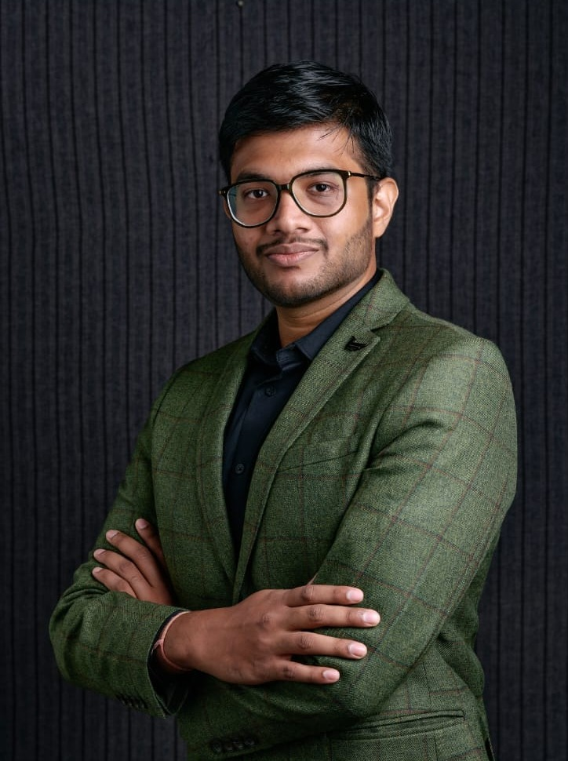
03 MEET THE FOUNDER
Siddhant Jain
Founder and Principal Consultant · IGBC AP · EDGE Expert & Auditor
Over seven years I've worked on more than 200 certified green building projects, from retail stores to logistics parks. The same thing kept happening: certification was left to the end, after the big decisions were already made.
VERDEAXIS works the other way round. We model first, decide with numbers, and then certify what actually gets built.
And if a certification isn't worth it for your project, I'll tell you.
Notes:
The founder's note is a draft in Siddhant's voice. Edit it until it sounds like you.

Slide 11
The experience behind VERDEAXIS
03 EXPERIENCE
CERTIFICATION
CARBON AND REPORTING
MODELLING
200+ certified green building projects in India and Malaysia
Retail, offices, stores, logistics parks and industry
LEED, EDGE, IGBC, GRIHA, WELL and Fitwel
GHG reporting for multinational organisations
Decarbonisation roadmaps to meet climate targets
GRESB, GRI Standards and the UN SDGs
Energy, daylight and microclimate in DesignBuilder and EnergyPlus
Building and product LCA in One Click LCA and Excel
Physical climate-risk assessments
TOOLS DesignBuilder · EnergyPlus · eQUEST · One Click LCA · Excel-based carbon models
Notes:
Experience gained while working in previous consultancy teams. VERDEAXIS itself is new.

Slide 12
Selected projects the founder has worked on
03 TRACK RECORD
PROJECT | LOCATION | SCOPE | NOTES
Green building portfolio | India and Malaysia | Multiple rating systems | 200+ certified projects
Commercial campus | Gandhinagar, India | LEED v4.1 O+M | Targeting Gold
28-floor tower | Ho Chi Minh City, Vietnam | LEED BD+C v4 | Core and Shell
Pet food facilities | France | LEED BD+C v4 | Two industrial sites
Rice milling factory | Cambodia | EDGE v3.1 | Final certification
Industrial portfolio | Thailand | ESG and GHG, Scope 1–3 | GRESB-aligned reporting
Industrial park | Samut Sakhon, Thailand | Physical climate risk | WRI, NASA and Fathom data
Worked on by the founder as part of previous consultancy teams, before VERDEAXIS was formed. Client names withheld.
Notes:
These are projects the founder worked on while employed at previous firms. Say so plainly and describe your own role on each.

Slide 13
Five steps from first call to certificate
04 HOW WE WORK
01
02
03
04
05
Scope
Analyse
Document
Submit
Certify
Brief, goals and the right rating system.
Site visit, data audit, models and GHG baseline.
Credit documents, drawings and model files.
Upload, reviewer queries and any appeals.
Award, handover, then re-certification and reporting.
What you can expect: a timeline agreed up front, a direct line to the founder, and no surprise costs.
Notes:
Process slide.

Slide 14
Start with a free review, or bring us in for the whole job
04 ENGAGEMENT
START HERE
02
03
04
Feasibility review
Certification, end to end
Simulation support
Carbon and ESG
Best for Any new project
Best for Developers and owners
Best for Architects and MEP teams
Best for Manufacturers, listed firms
Best-fit system, target rating and the main gaps. Free, with a written fee proposal after.
Registration, modelling, documents, submission and reviewer responses, through to award.
Energy, daylight and microclimate studies, delivered to your design programme.
GHG inventories, LCA and EPDs, CBAM data and BRSR reporting.
Notes:
No prices in the profile. Quote after the feasibility review.

Slide 15

NEXT STEP
Send us your drawings. We'll tell you what's possible.
SIDDHANT JAIN, FOUNDER
info@verdeaxis.com
+91 97255 23213
verdeaxis.com
The first feasibility review is free. You get:
The rating system that fits your project, timeline and budget
The main design and documentation gaps, before you register
What modelling or carbon work you'll actually need
A realistic timeline from kickoff to award
India · Malaysia · France · Vietnam · Cambodia · Thailand
Verde (green) + axis: the line everything is measured against.
Each stripe is one year of global average temperature, 1880–2025. Data: NASA GISTEMP. Stripes concept: Ed Hawkins, #ShowYourStripes. Photos via Wikimedia Commons: Hawa Mahal by Adityaoberai (CC BY 4.0); IIM Ahmedabad by Perspectives, IIM Ahmedabad Photography Club (CC BY-SA 4.0).
Notes:
Close on the free feasibility review. Credits line must stay while the Commons photos are used.

