Slide 1

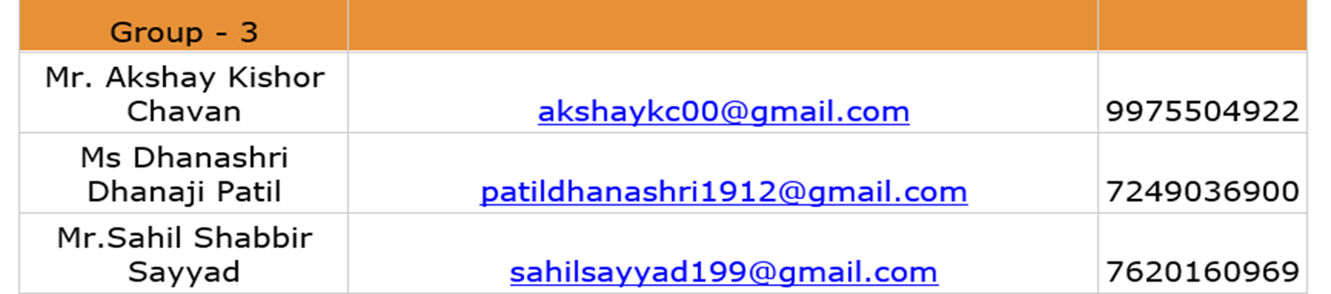
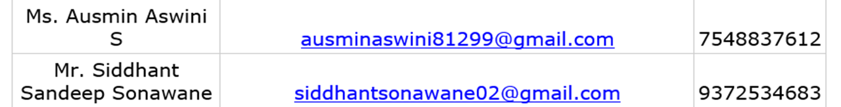
CUSTOMER CHURN PREDICTION
Group Members

Slide 2
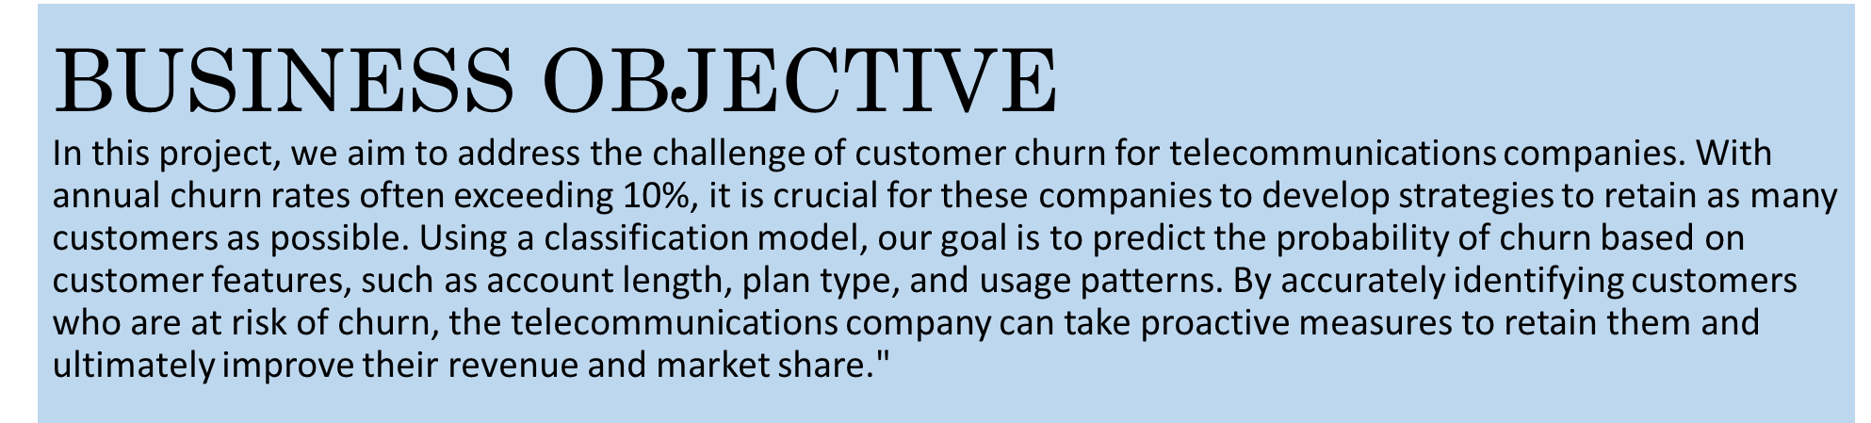

WHAT IS CHURN? In the telecommunications industry, churn refers to the percentage of customers who have stopped doing business with a company during a certain period of time, either by canceling their subscription or switching to a competitor. High churn rates can lead to a decline in revenue and market share.“

Slide 3


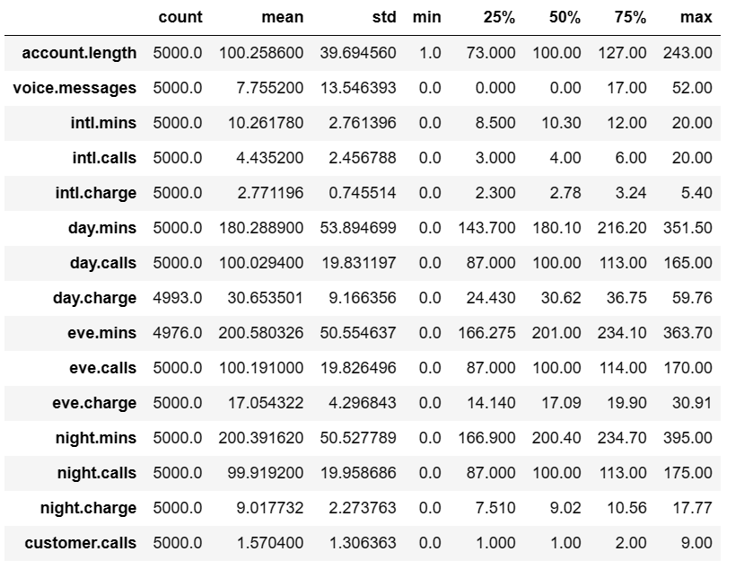
Description of Data

Slide 4
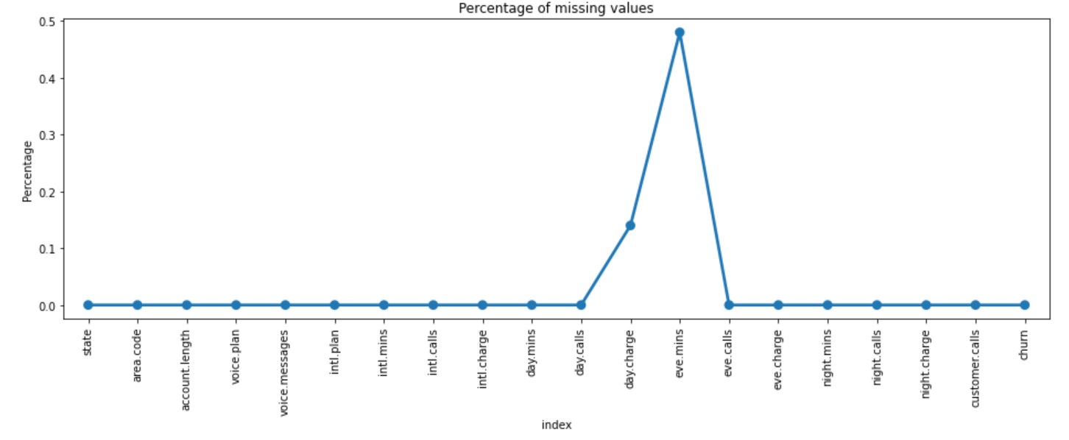
Dealing with Null Values
Observation : Here we can see some null values present in day.charge and eve.mins features.There are more than 1% null values in day.charge column and around 5% null values in evening.minutes column, So 0.62% percent total null values present in the data.
Note: Median imputation will work better because it is a number that is already present in the data set and is less susceptible to outlier as compared to mean imputation.

Slide 5
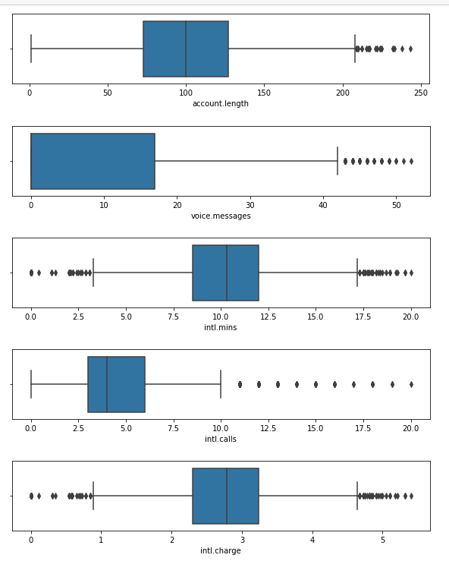
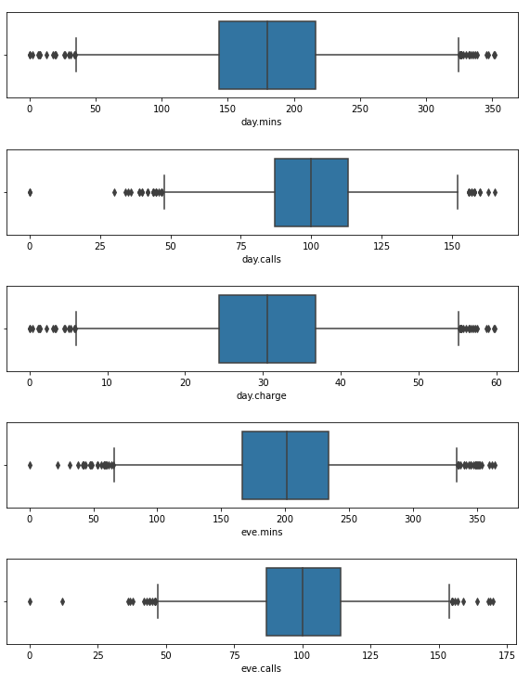
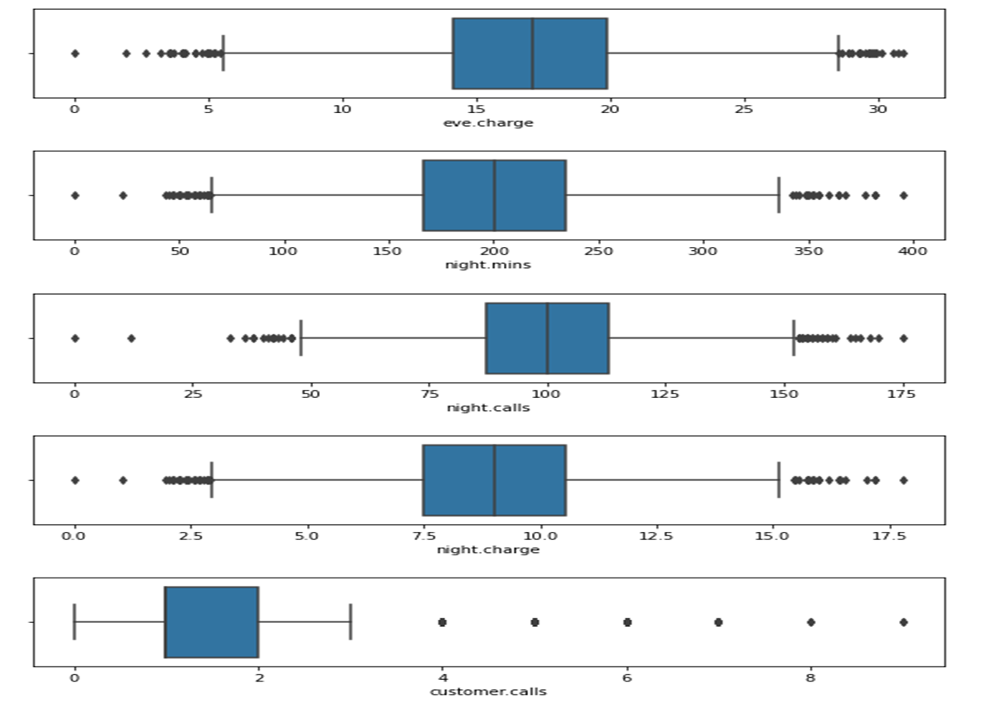
Outliers Detection

Slide 6
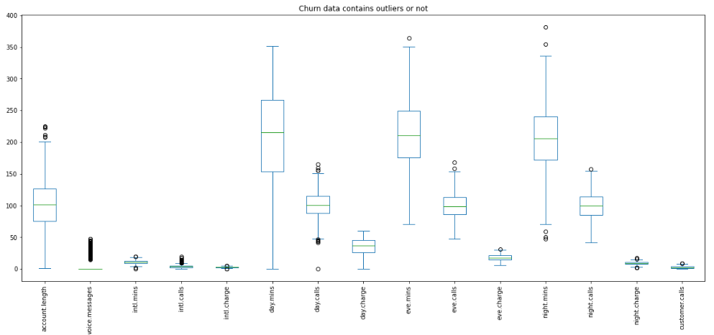
Outliers Detection Checking outliers are present in data containing only churn= 'yes'
Observation- Outliers are present in almost each numerical feature of data-set containing churn="yes", so we can not delete this outliers directly because by deleting outliers will affect our prediction. Also we can conclude that some outliers are churning.

Slide 7
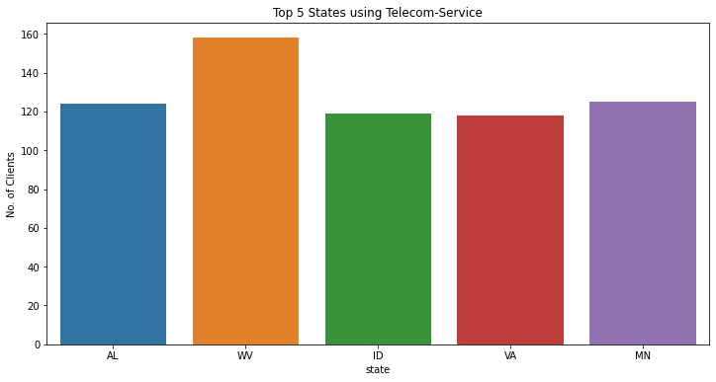
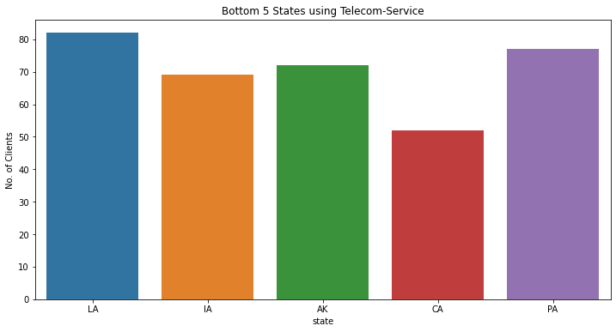
UNIVARIATE ANALYSIS
TOP 5 STATES
we observe that a particular state has a significantly higher representation in the dataset compared to other states, we could potentially deduce that the company has a strong presence in that state.¶
BOTTOM 5 STATES
Here we observe , that a particular state has very low representation, we could conclude that the company may not have a strong presence in that state and may need to focus on expanding in that region.

Slide 8
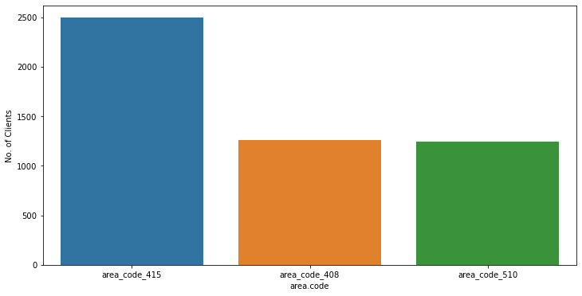
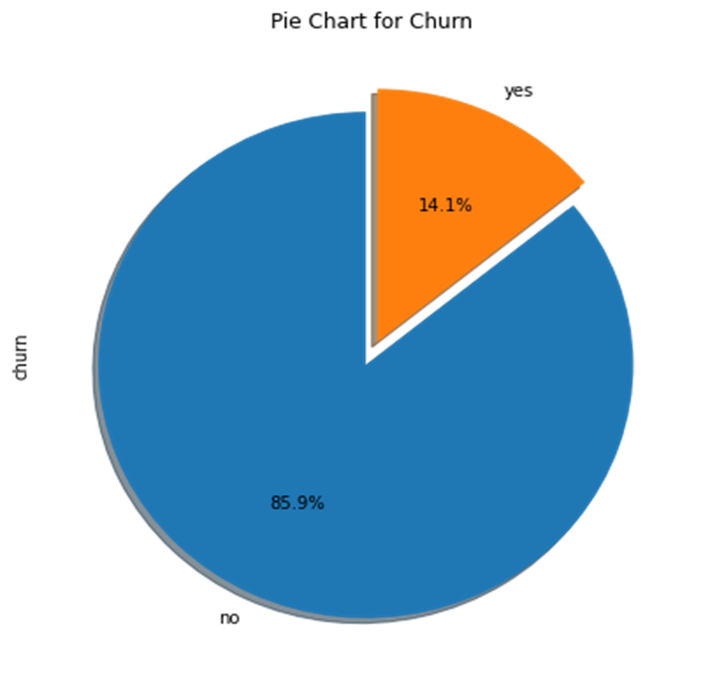
Area Code
This visualization shows the distribution of customers based on their area codes. From the plot, we can observe that the majority of the customers have area code '415', followed by '510' and '408'. This information can help the company understand which area codes have a high concentration of customers.
Suggestion : Plan marketing strategies according to the density of the clients in that particular area.
Analysing Churn Column
After analyzing the churn column, we can say that 14.1% of customers have churned and 85.9 customers have not churned

Slide 9
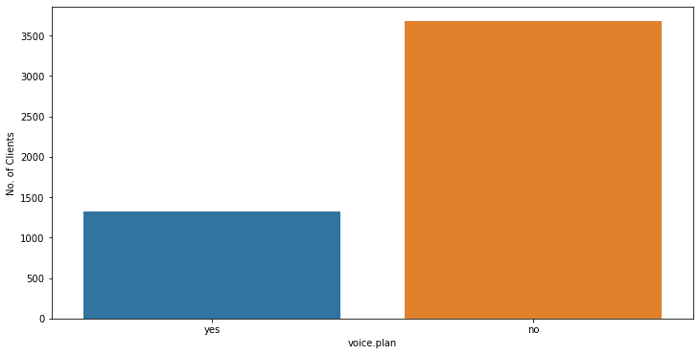
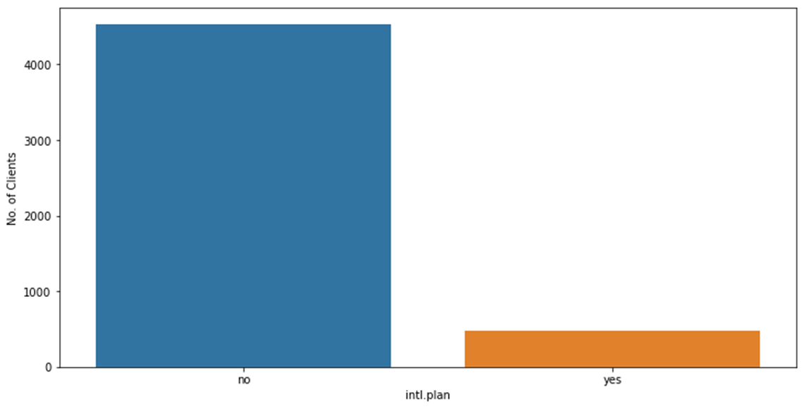
Voice plan
International plan
The voice plan information can provide insight into customer behavior, such as the willingness to pay for added features, and it can also indicate customer preferences and needs.
Suggestion : By understanding the voice mail plan, the company can better tailor their products and services to meet the needs of their customers.
Suggestion : Offering an international plan may not be a high priority for customers who does not have an 'International plan' and that there may be limited interest in such a plan. There may be an opportunity to promote and market international plans to the group of customers who use 'International.plans' .

Slide 10
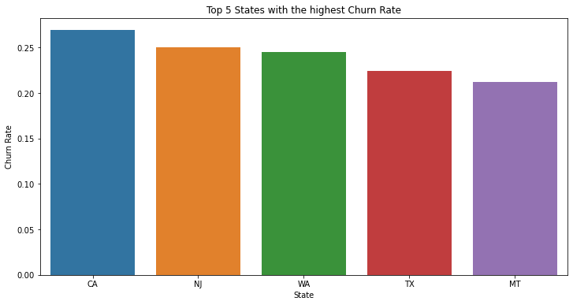
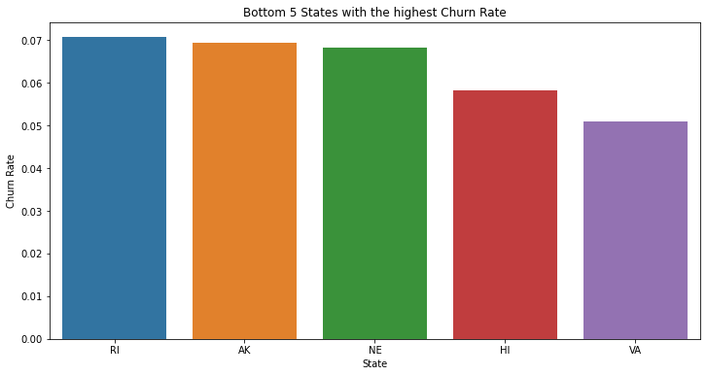
BIVARIATE ANALYSIS Churn with respect to states
Above two chart shows the states with respect to churn rate. For example, if the bar for a certain state is high, that means the churn rate for that state is high and if the bar is low, the churn rate for that state is low.

Slide 11
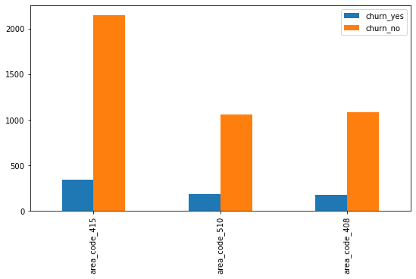
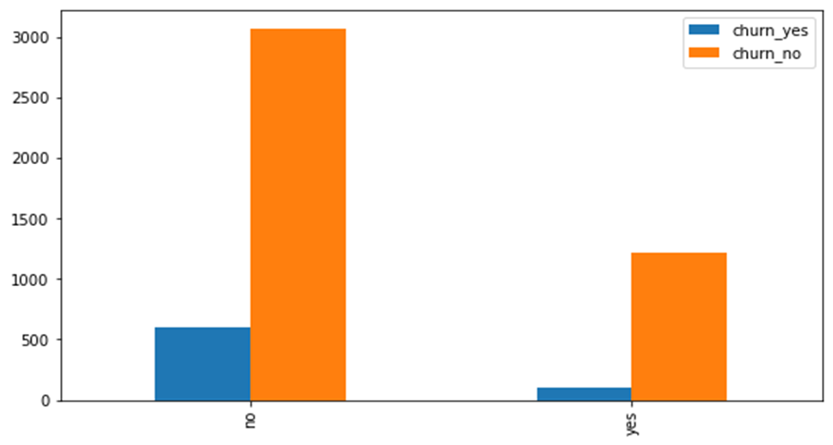
Churn with respect to Area Code
Churn with respect to voice plan
From the above plot we can see that highest churn rate is from area_code_415 followed by area_code_510 and area_code_408.
The distribution of churned and non-churned customers is roughly the same across all three area codes.
This shows that area code may or may not be a significant factor in predicting customer churn.
From the above plot it is clear that Customers who are not using voice plan are more likely to churn as compare to the Customer who are using voice plan.
This shows that most customers are not interested in purchasing additional voice services, or it could mean that a "no" voice plan is the default option for new customers.
Suggestion : Understanding the customers' preferences and behaviors related to voice plans could be an area for the company to focus on in order to increase customer satisfaction and potentially reduce churn.

Slide 12
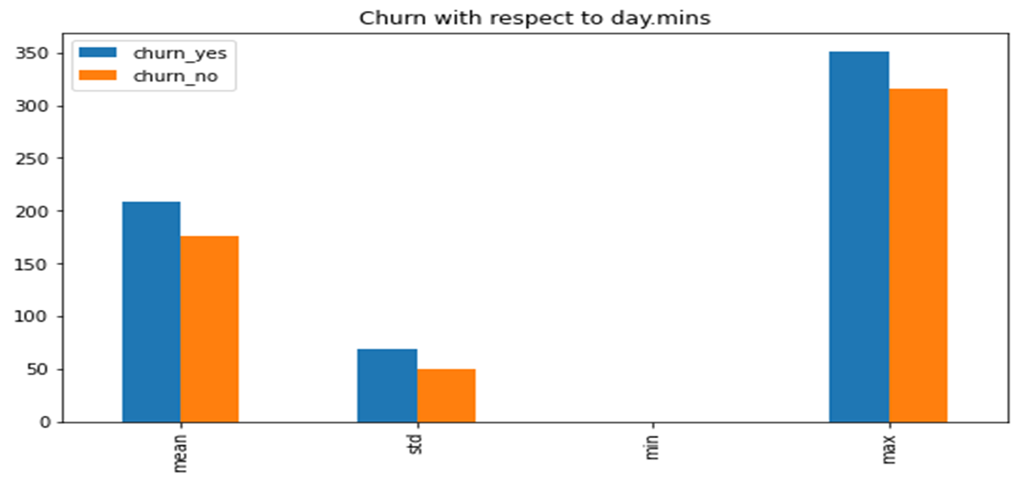
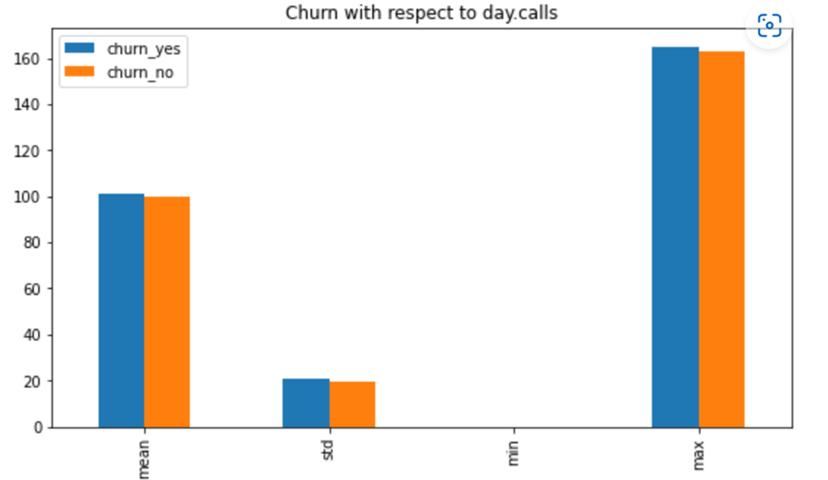
Analyzing Target feature with respect to Numerical feature
Churn with respect to Day Calls
Churn with respect to Day Minutes
Note : Customers churning rate is high on the basis of minutes customer used service during the day. This might be because of charges they are charging during the day.
Note :Here also we can see the same proportion of churning and not churning amongst the customers on the basis of total number of calls during the day.

Slide 13
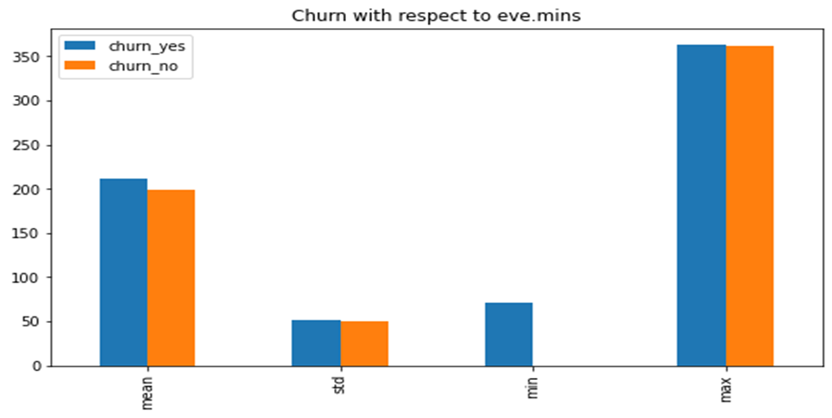
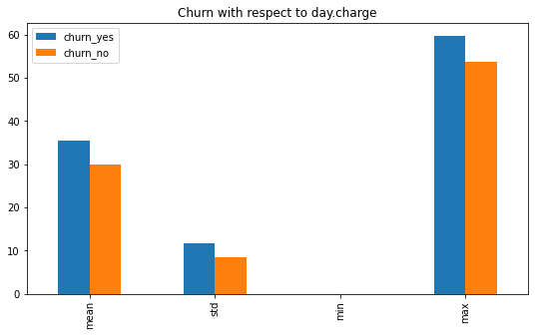
Churn with respect to Day Charge
Churn with respect to Evening Minutes
Note : Here we can observe that on an average churning rate is higher for the total charge during the day.
Note : The minimum clients have churned from the service is 80. This might be because of poor service they were getting.

Slide 14
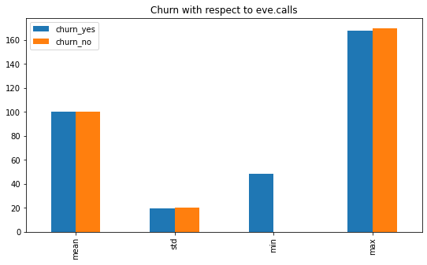
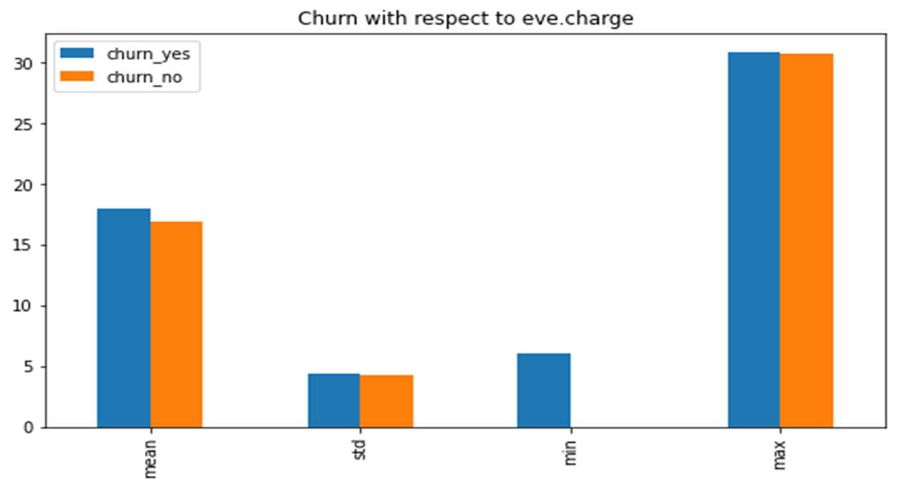
Churn with respect to Evening Calls
Churn with respect to Evening Charge
Note : Minimum 48 customer have churned due to the calling service during evening.
Note: Here we can see that minimum 6 customer have churned due to the charges during the evening.

Slide 15
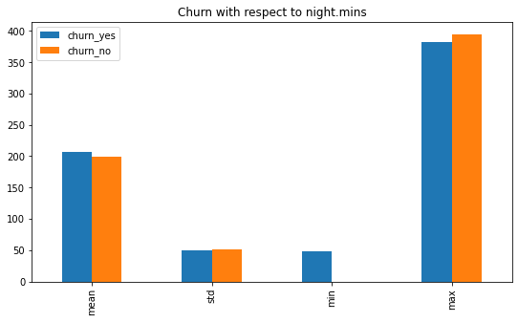
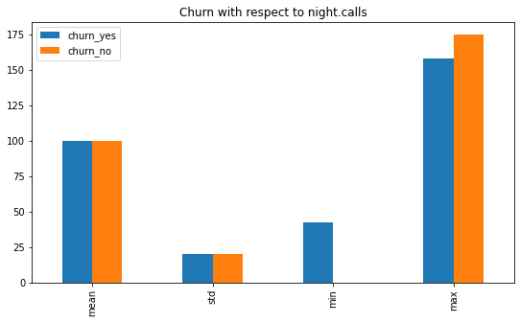
Churn with respect to night minutes and night calls
Note : The minimum range of 40-50 clients have churned because the night service.

Slide 16
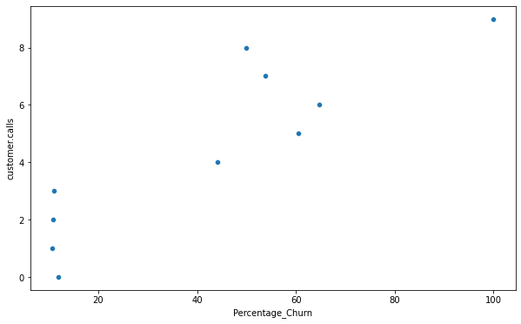
Calculating the Customer service calls vs Churn percentage
Note : Here we can see kind of linear relationship between customer service calls with target variable churn, As the number customer service call increases the percentage churn also increases. From the above analysis we found that the customer who called service center 5 times or more than 5 times have churn percentage more than 60%.This high churn rate indicating that issues of customers are not getting solved by service centers Thus customers are churning due to bad customer service.

Slide 17
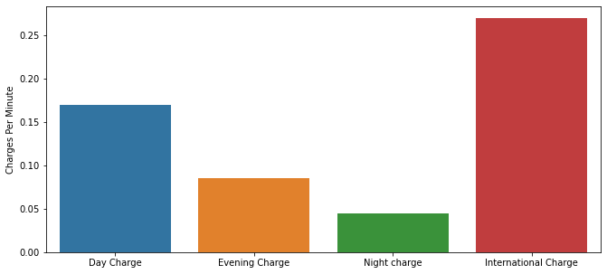
Calculating international, day, evening and night call charges per minute
Note :
The charges for international calls are comparatively high to the other charges which is obvious thing but it may be the reason of customer churning who have international plan.

Slide 18
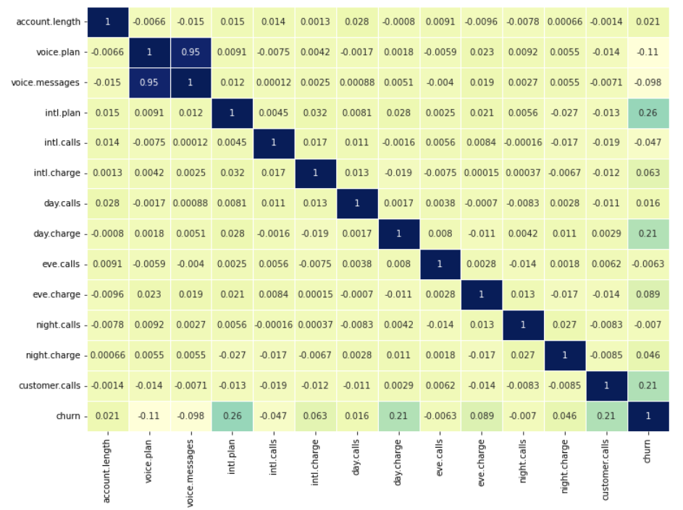
Correlation
Observation : In correlation matrix, voice.message and voice.mail features are highly correlated. we can use either of the feature for model building.
Note : We are going to use voice.mail for model building, since the distribution of the voice.mail with respect to churn is significant also using voice.messages in model building, giving good accuracy but not precision and recall. Our data contains imbalance classes so we can not rely only on accuracy of the model.

Slide 19
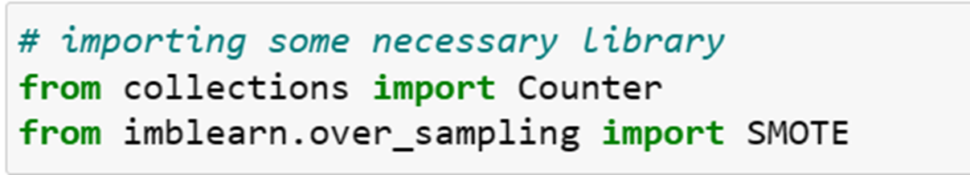
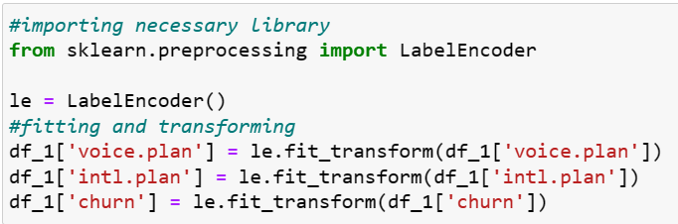
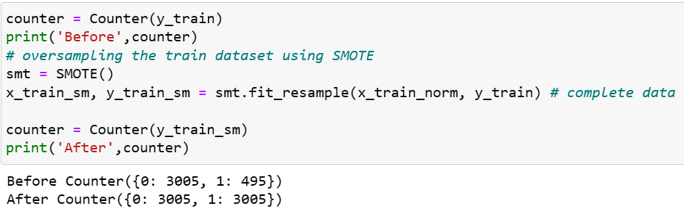
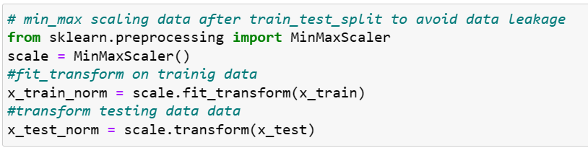
Data Preprocessing
Handling imbalance data using SMOTE
Feature Transformation-Label Encoding
Feature Scaling after Splitting data to avoid data leakage

Slide 20
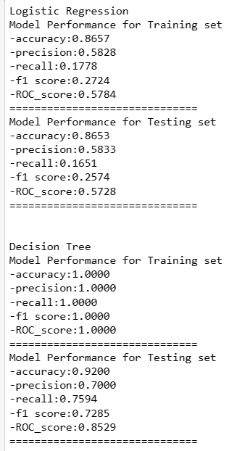
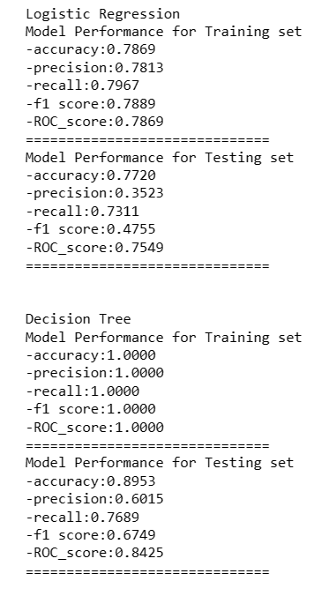
Performance Analysis Before Resampling After Resampling

Slide 21
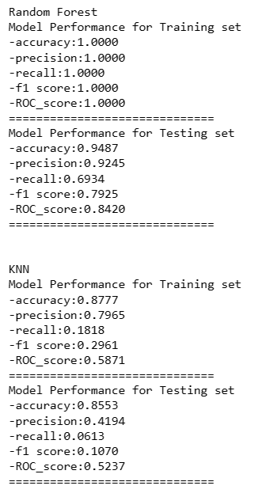
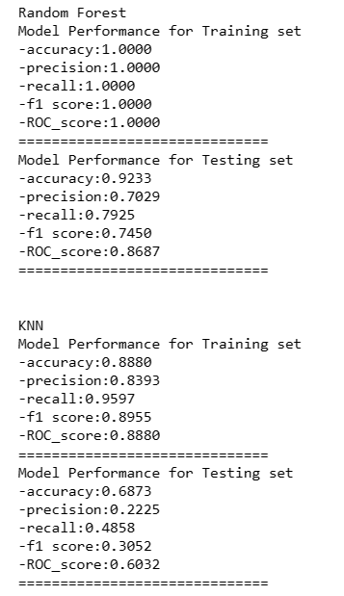
Before Resampling After Resampling

Slide 22
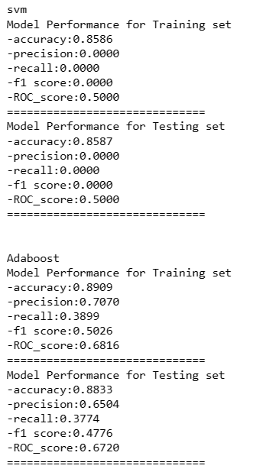
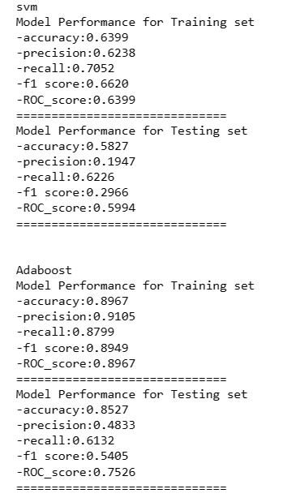
Before Resampling After Resampling

Slide 23
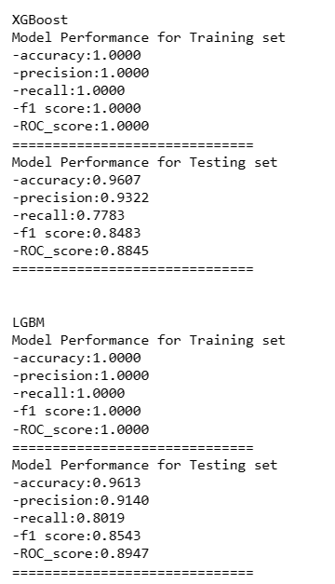
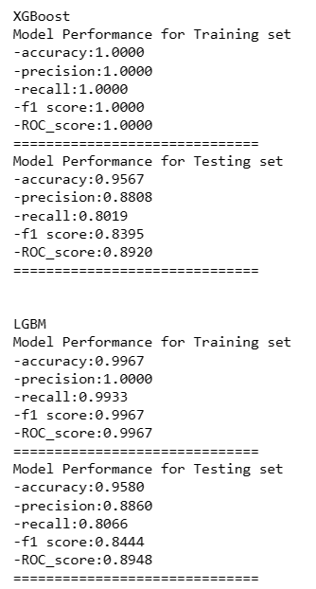
Before Resampling After Resampling

Slide 24
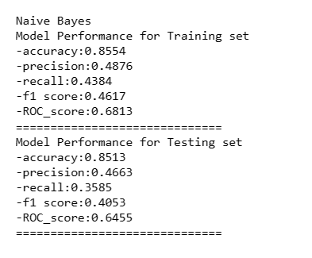
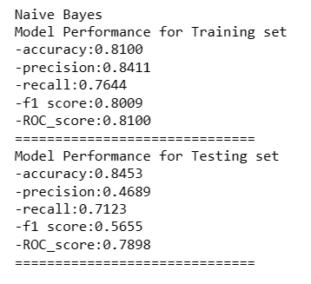
Before Resampling After Resampling
Performance Analysis after Resampling
Observation : Random Forest , XGBoost and LGBM are performing best as compare to others. So, we are selecting these models for hyperparameter tuning.
Note : This models works better than other models because these models are based on ensemble methods which are techniques that create multiple models and then combine them to produce improved results.

Slide 25
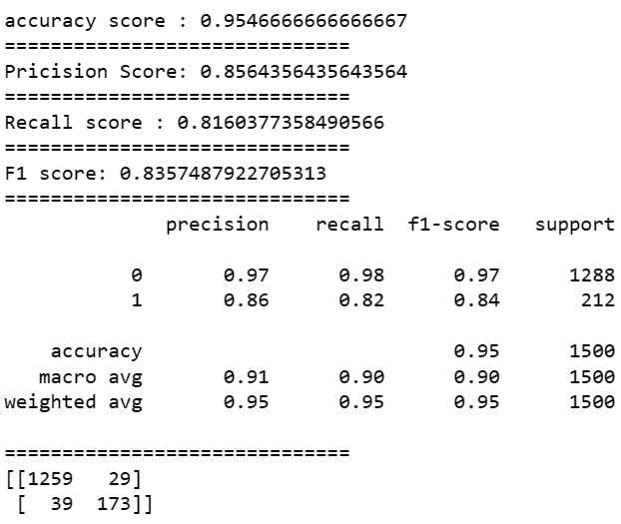
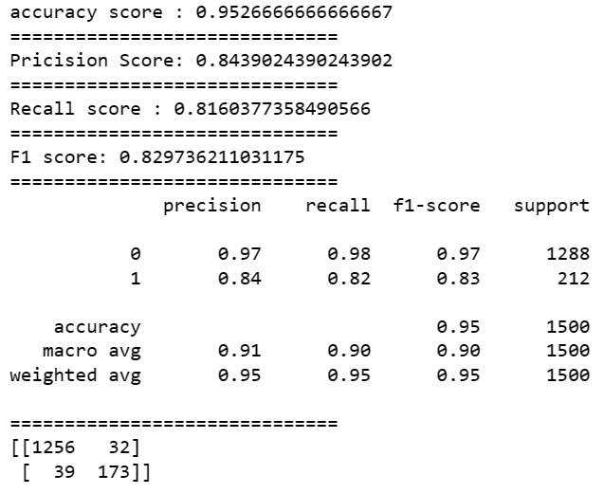
Model Building
Random Forest Random Forest2

Slide 26


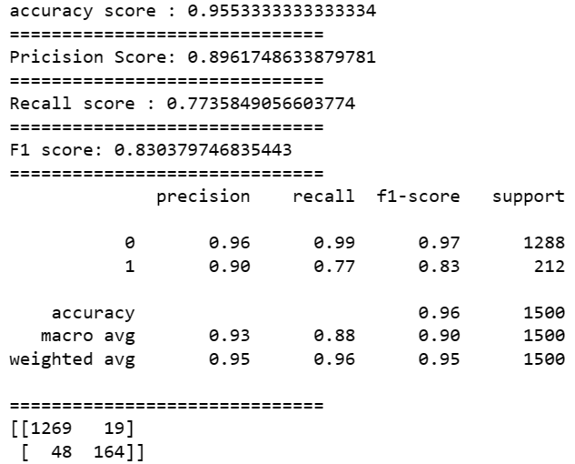
LGBM LGBM2 XGBOOST

Slide 27
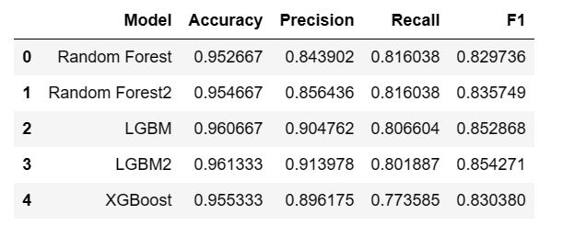
Model Building
DataFrame of models performance
Note : Final model would be LGBM2.

Slide 28
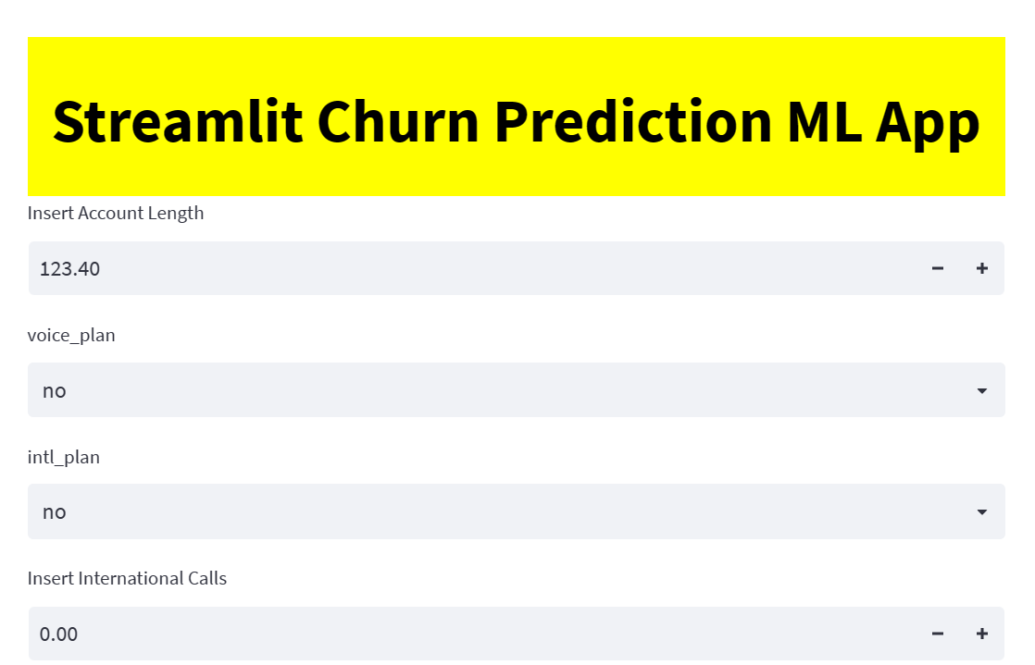
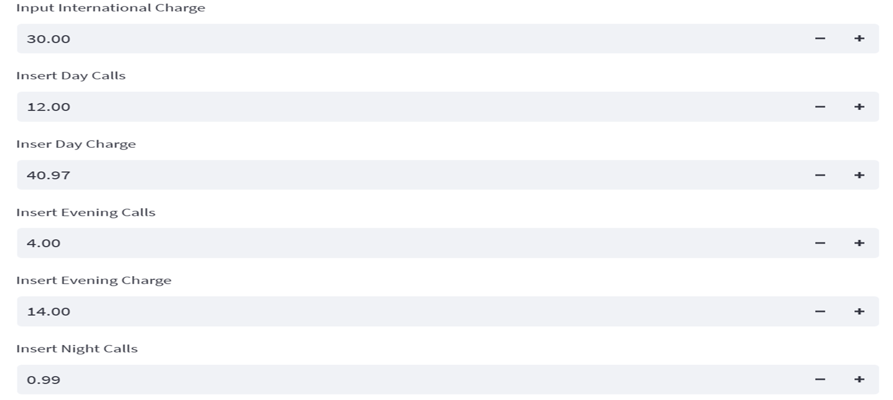

Model Deployment Usign Streamlit

Slide 29



Model Deployment Usign Streamlit

Slide 30
Suggestions
Offer attractive plan
Reduce prices
Target high-risk customers
Monitor usage patterns
Leverage predictive analytics
Improve customer service

