Slide 1
Welcome Freshmen!

Slide 2
Design Wing
The Creative Soul of IIITA

Slide 3
Design is so simple that is why it is so complicated.
-Paul Rand

Slide 4
WHY CHOOSE US ?
Don’t ask why, ask why not?
Visual Design nowadays is used everywhere be it entertainment industry, game development, VFX , advertising or even softwares & applications.
We not only teach you how to design stuffs but we develop designers who in the future will excel in this profession. We make you highly skilled in graphic designing which will not only help you here but also in the future as we don’t go behind success, we go behind excellence.

Slide 5
Backbone of Every Society
The Graphics Wing is the backbone for every society present in IIITA. All the posters, logos, brochures, apps, t-shirts, websites, videos etc. made in IIITA are designed by us. Everything ranging from the design of official placement brochure to the t-shirt design of Effervescence, the small family of Graphics Wing do it all.

Slide 6
Time for A Virtual Tour
Let’s have a look at some of the posters designed by our creative family

Slide 7
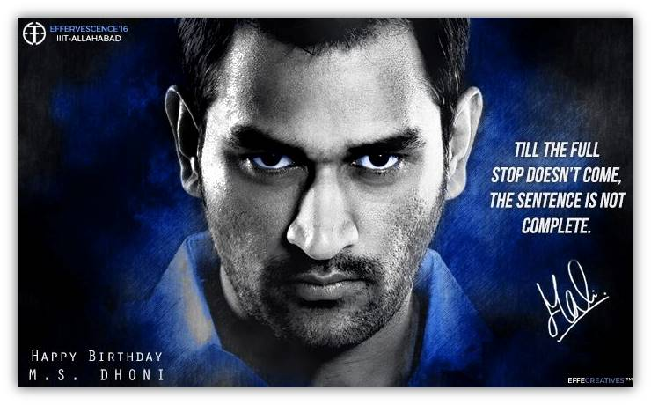

Slide 8
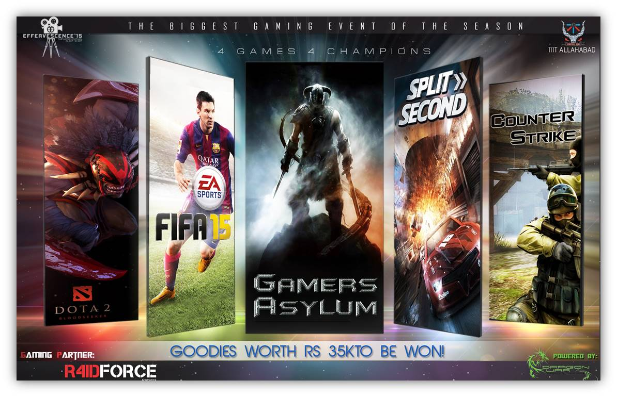

Slide 9


Slide 10


Slide 11


Slide 12


Slide 13


Slide 14


Slide 15


Slide 16

Approach Us!
Co-ordinators
Abhishek Sharma Rishab Rai
+ 91-9918992179 + 91-9794048882
Anmol Singh Sethi Siddharth Simharaju Vinit Mankar
+91-7800392141 +91*7706888651 +91-7706020707
Austin Kispota Siddhath Srivastava
+91-8092171975 +91-8765531793

Slide 17
Thanks!
Any Questions?

