Slide 1

Deep dive into multi-label classification
Multi-label classification originated from the investigation of text categorisation problem, where each document may belong to several predefined topics simultaneously.

Slide 2
Boosting algorithms for multi-label multiclass problems
In this presentation we learning about AdaBoost learning as our Boosting algorithms for multi-label classification
The purpose of boosting is to find a highly accurate classification rule by combining many weak or base hypotheses, each of which may be only moderately accurate. We assume access to a separate procedure called the weak learner or weak learning algorithm for computing the weak hypotheses.
The boosting algorithm finds a set of weak hypotheses by calling the weak learner repeatedly in a series of rounds. These weak hypotheses are then combined into a single rule called the final or combined hypothesis.

Slide 3
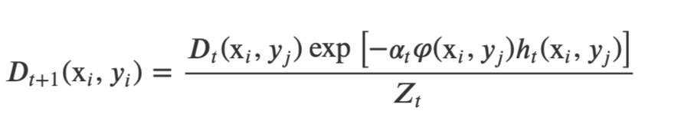
AdaBoost.MH (multi label hamming trees )
INPUT: a training set 𝑆= {(x𝑖,𝑦𝑖),𝑖=1,…,𝑁} where x𝑖∈X and 𝑌𝑖⊆𝑌
AdaBoost.MH iteratively, builds a committee of weak hypotheses of decision stumps
D𝑡(x𝑖,𝑦𝑗)=1/NM for all 𝑖=1,…,𝑁 and 𝑗=1,…,𝑀
In each iteration t, AdaBoost.MH builds a weak hypothesis ℎ𝑡. Depending on the predictions of the generated weak hypothesis ℎ𝑡 over the training samples, the weight distribution 𝐷𝑡 will be updated to boost the misclassified samples
The weight, 𝐷𝑡(x𝑖,𝑦𝑗), will be updated according to the rule
where 𝑍𝑡 is the normalization factor chosen to ensure that 𝐷𝑡+1 is a distribution

Slide 4
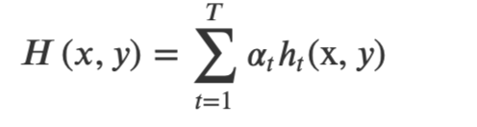

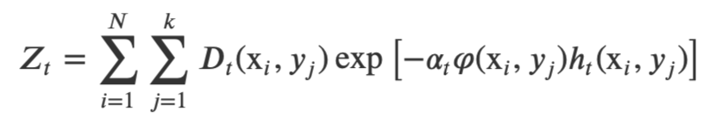
𝜑(𝑥𝑖,𝑦𝑗) is the target function that takes the value +1, if 𝑦j is the predefined label of x𝑖, or −1 otherwise.
In the next iteration (t+ 1), the new distribution 𝐷𝑡+1 will pass with the training samples to the weak learner to build a new weak hypothesis ℎ𝑡+1.
Linear combination of the weak hypotheses forms the the final hypothesis, 𝐻 , which is used to predict the label 𝑦 of a new sample 𝑥.
The Hamming Loss of the final hypothesis H is

Slide 5
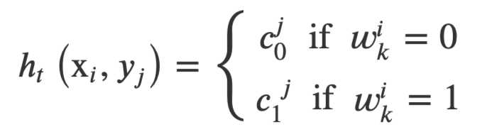
AdaBoost.MH for Text Categorisation
𝑇={𝑡1,…,𝑡𝑟} is a set of all terms extracted from the training documents
Each document x𝑖 is represented as a vector <𝑤i1,…,𝑤𝑖𝑟> of r binary weights, in which 𝑤𝑖𝑘 =1 if 𝑡𝑟 occurs in 𝑥𝑖 or 0 otherwise
Each document is represented as a vector of terms, and AdaBoost.MH uses the terms to determine the appropriate category for the document. To perform this task, AdaBoost first analyses the absence or the presence of each term 𝑡𝑘 in a document x𝑖 to make a decision whether it belongs to the category 𝑦𝑗 as follows:
where 𝑐𝑗0 and 𝑐𝑗1 are real-valued constants chosen at iteration t according to the minimization policy of the normalization factor 𝑍𝑡

Slide 6
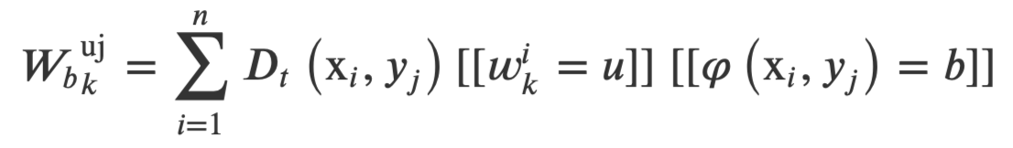
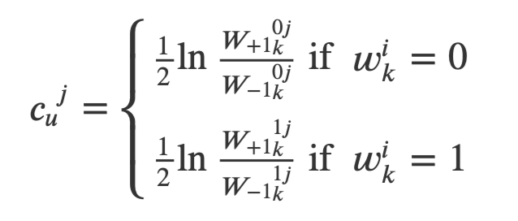
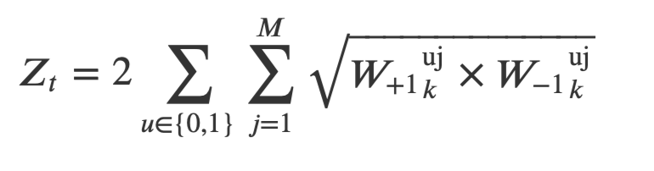
Based on the idea of domain-partitioning, 𝑐𝑗𝑢 (for 𝑢∈{0,1}) is calculated as follows: let 𝑋0={x: 𝑡𝑘∈x} be a set of all documents in training set in which the term 𝑡𝑘 occurs and 𝑋1={x: 𝑡𝑘∉x} be a set of all documents in which 𝑡𝑘 does not occur
The weight of each document x𝑖∈𝑋𝑢 which is (is not) labelled by 𝑦𝑗 with respect to the distribution 𝐷𝑡 is calculated as:
for b∈{−1,+1} ,u∈{0,1} and k∈{1,…,r} and the function [[.]] is the comparison operator
Thus, for each term 𝑡𝑘, 𝑐𝑗𝑢 is calculated as:
and by choosing 𝛼𝑡=1:

Slide 7
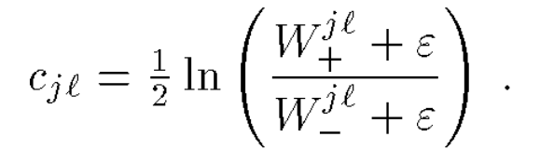

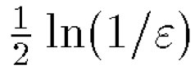
Then among all the terms, the best terms that obtained the smallest value of 𝑍𝑡 will be used to build the hypothesis ℎ𝑡(x𝑖,𝑦𝑗) for each category.
it may well happen that Wjl+ or Wjl- is very small or even zero, in which case cj will be very large or infinite in magnitude.
In practice, such large predictions may cause numerical problems, and there may be theoretical reasons to suspect that large, overly confident predictions will increase the tendency to overfit. To limit the magnitudes of the predictions, in our implementation, we use instead the “smoothed” values
In this experiments, we set Since both Wjl+ and Wjl- are bounded between 0 and 1, this has the effect of bounding |cjl| by roughly .

