Slide 1
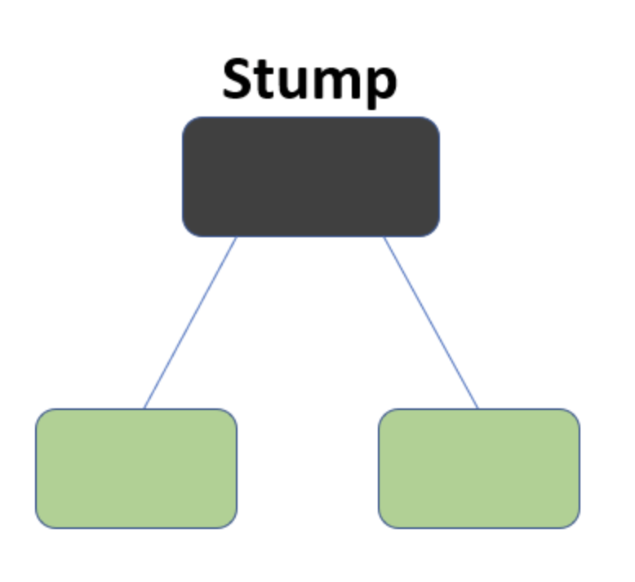
What is the AdaBoost Algorithm?
AdaBoost also called Adaptive Boosting is a technique in Machine Learning used as an Ensemble Method. The most common algorithm used with AdaBoost is decision trees with one level that means with Decision trees with only 1 split. These trees are also called Decision Stumps.

Slide 2
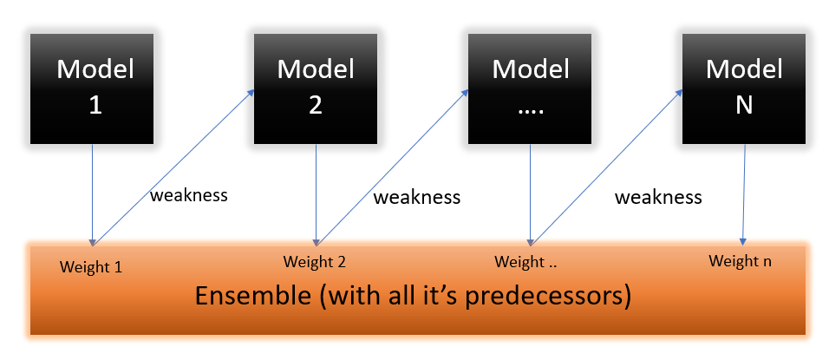
The algorithm first builds a model and gives equal weights to all the data points. It then assigns higher weights to points that are wrongly classified. Now all the points which have higher weights are given more importance in the next model. It will keep training models until and unless a lower error is received.

Slide 3
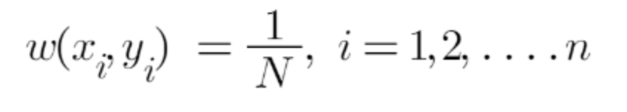
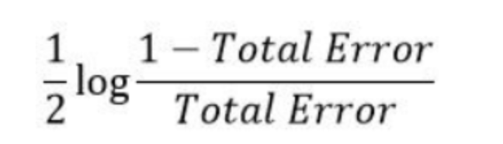
Understanding the working of AdaBoost Algorithm
Step 1 -> Assigning sample weights
Step 2 -> Finding the first classifier for decision stump 1 by calculating the Gini Index of each tree. The tree with the lowest Gini Index will be our first stump.
Step 3 –> We’ll now calculate the “Amount of Say” for this classifier in classifying the datapoints using this formula:
where total error is the summation of all the sample weights of misclassified data point
Step 4 –> update the weights
where – is used for correctly classified data and + for wrongly classified data

Slide 4
Step 5 –Divide the data into ranges from new weights .Selects random numbers from 0-1. Since incorrectly classified records have higher sample weights, the probability to select those records is very high.
Step 6 – Now this act as our new dataset and we need to repeat all the above steps i.e.
Assign equal weights to all the datapoints
Find the stump that does the best job classifying the new collection of samples by finding their Gini Index and selecting the one with the lowest Gini index
Calculate the “Amount of Say” and “Total error” to update the previous sample weights.
Normalize the new sample weights.
Iterate through these steps until and unless a low training error is achieved

Slide 5
A toy example We need to segregate10 points represented by plus or minus

Slide 6
Round 1: Three “plus” points are not correctly classified; They are given higher weights.

Slide 7
Round 2: Three “minus” points are not correctly classified; They are given higher weights.

Slide 8
Final Classifier: integrate the three “weak” classifiers and obtain a final strong classifier.

Slide 9
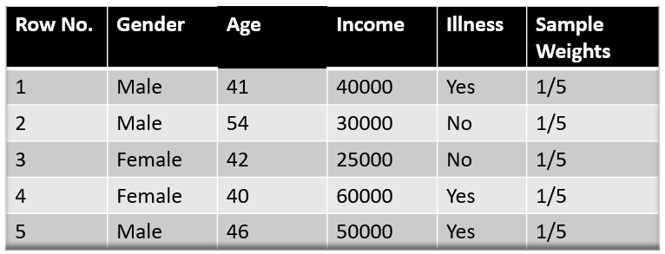
Eg-2
let’s say Gender has the lowest gini index so it will be our first stump.

Slide 10
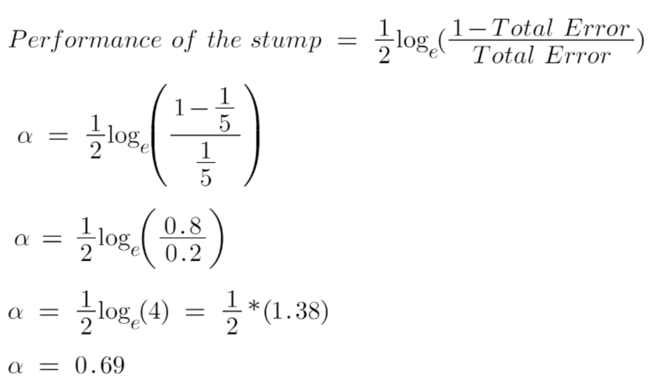
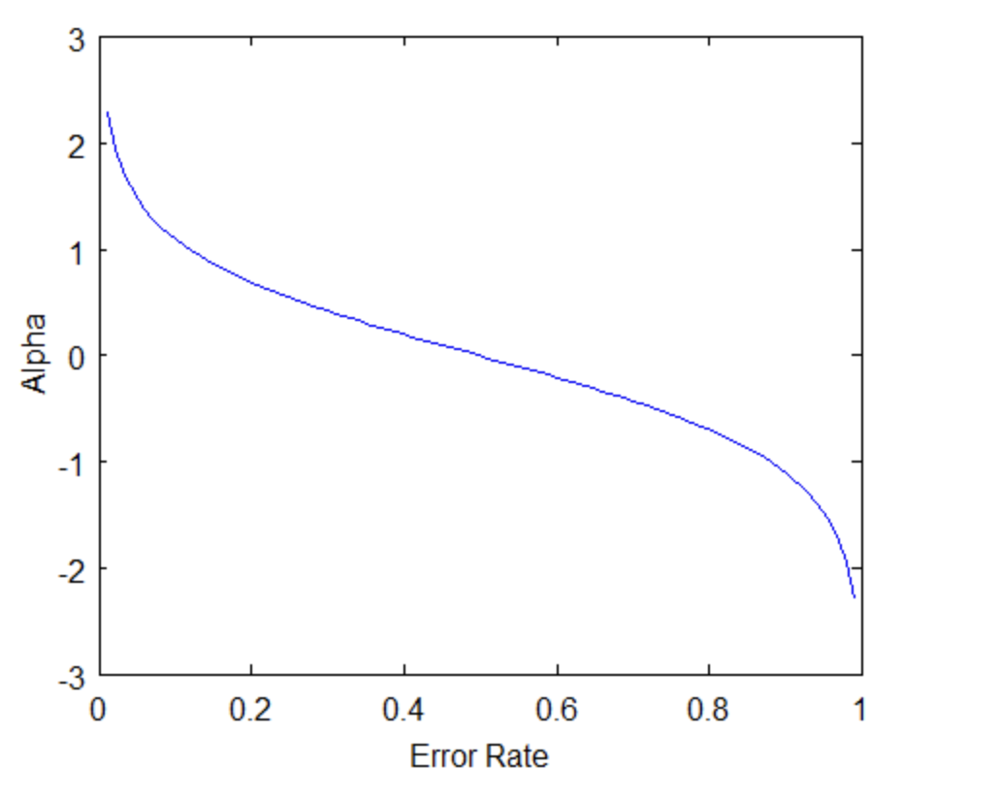

Slide 11
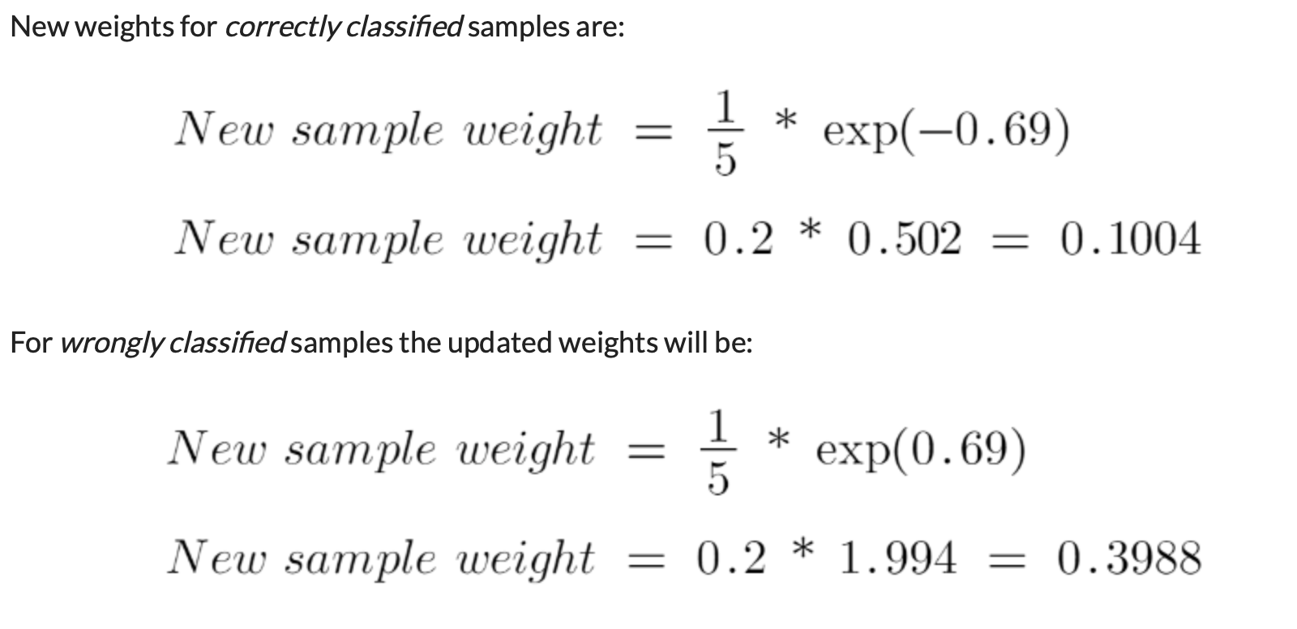
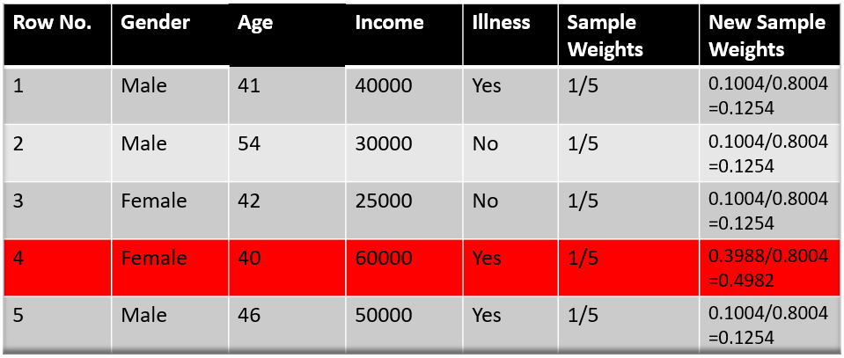

Slide 12
