Slide 1
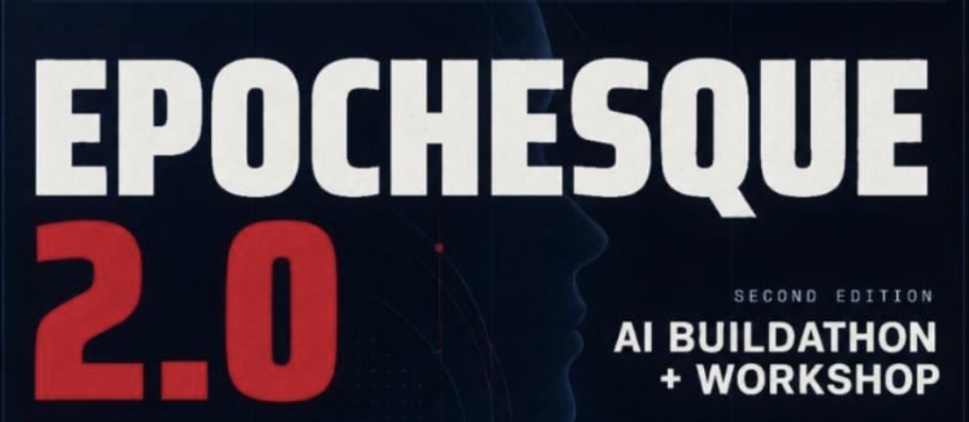
RepoPilot
BUILD THE BRAIN. DEBUG ON AUTOPILOT.
Track 2 — Build the Brain, Not the Puppet
Team: Aman Tyagi — Agent Brain | Sahaj Kumar — Tools & Security | Siddhant Asati — Frontend, API & Demo

Slide 2
Problem Understanding
DEBUGGING IS NOT A CHECKLIST.
THE GAP
Real debugging is iterative: developers inspect code, form hypotheses, run checks, interpret evidence, and change direction when reality disagrees.
A fixed workflow can execute actions — but it cannot reliably decide what the next action should be after an unexpected result.
FIXED AUTOMATION
AUTONOMOUS LOOP
Task
Tool A
Tool B
Done
Task
Plan
Choose
Observe
Replan
Verify
Track requirement: BUILD THE BRAIN, NOT THE PUPPET — the agent adapts from observations rather than following a predetermined script.

Slide 3
Technical Architecture
STACK
DATA FLOW
Frontend
React / Vite
User task
FastAPI
API
FastAPI + Pydantic
AgentCore
Agent
AgentCore + LLM interface
Tool Registry
Tools
File • Shell • Search • Calculator
Tool result / observation
Testing
Pytest + integration tests
Next action or final result
Agent modules: Planner • Memory • Parser • Tool Registry • Events | Demo repos: broken-login • broken-python • broken-api

Slide 4
Proposed Solution
RepoPilot is an autonomous AI software debugging engineer that investigates repositories, selects tools, observes results, recovers from failures, and verifies a solution.
TASK
PLAN
ACT
OBSERVE
REFLECT
REPLAN
VERIFY
RESULT
KEY DIFFERENTIATOR
WHAT THE USER SEES
The next action is chosen from what the agent observes — not from a hardcoded debugging sequence.
Trace
Plan / tool / observation events
Recovery
Failure → reflection → replan
Verification
Tests / checks before final result

Slide 5
Innovation & Novelty
01
AUTONOMOUS TOOL SELECTION
02
OBSERVATION-DRIVEN REASONING
Chooses among available tools based on the current debugging state.
Tool outputs become evidence for the next decision.
03
FAILURE → REFLECTION → REPLAN
04
FROM SCRIPT TO AGENT
Unexpected results trigger adaptation instead of simple termination.
The core abstraction is an OODA-style loop, not a fixed command chain.
AUTOMATION A → B → C | REPΟPILOT OBSERVE → DECIDE → ACT → ADAPT

Slide 6
Impact & Benefits
CURRENT PROTOTYPE SCOPE
WHO BENEFITS
3
demo repository types
3
demo scenarios
Developers
Less manual investigation and clearer debugging evidence.
4
tool classes
1
adaptive agent loop
Engineering teams
Repeatable tool-assisted investigation with visible execution history.
Agent builders
A concrete example of autonomous planning, observation and recovery.
Impact claim: RepoPilot targets reduced repetitive debugging effort and faster evidence gathering. No unmeasured productivity percentages are claimed.
SDG relevance: SDG 9 — Industry, Innovation & Infrastructure (software innovation / developer infrastructure).

