Slide 1
AI RECRUITER – SHORTLIST A SUITABLE CANDIDATE FOR SPECIFIC JOB ROLE
BY TEAM ENIGMA:
Shivam Yadav
Srivatsa Prakki
Siddhant Kesarkar
Mandar Patil

Slide 2
Introduction
An AI Recruiter Chatbot which assess the candidate on his/her technical knowledge about the job post, Strength of Video resume and his/her personality via a quick conversation.
In today’s world, opportunity is less and competition is more. So, there are lots of resume for a single available job post and shortlisting suitable candidates is tedious and requires lots of man hours.

Slide 3
Technology Stack
Python 3
IBM Watson Assistant
IBM Watson Personality Insight
IBM Speech to Text
HTML5, CSS3

Slide 4
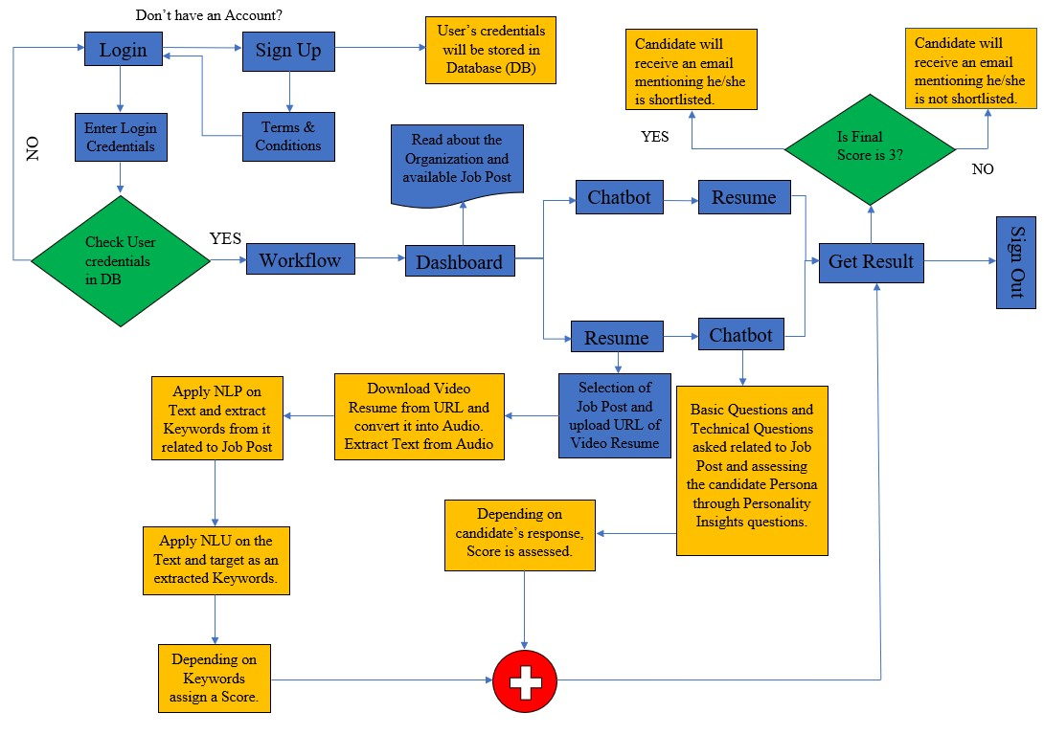
Block Diagram

Slide 5
Outcome Achieved
Software Bot enabled with Artificial Intelligence, which screens the candidate application, identify his skills & personality traits through conversation and shortlists suitable candidate for interview & send confirmation about his/her progress via email.

Slide 6
Conclusion
In the today’s business atmosphere, the main challenge of the manager’s is the selection of the right candidate, then development of the candidate and the retention of the candidate in the organization.
The recruitment of the effective, efficient and deserving candidates is very difficult task for the human resource department of the company.
The decision of the human resource department to recruit one wrong candidate can prove fatal for the organization, in terms of money, time and reputation of the company.
The selection process ensures that the best suitable candidates in terms of skills, education and experience should be chosen for the particular job.
The selection’s process main goal is to match the job requirements with the person’s technical knowledge and individual characteristics.

Slide 7
Limitation of Project
Issues with accuracy and reliability.
Too much dependency on certain keywords.
Lacks nuance of human judgement.

Slide 8
Future Scope
Since video resume is being taken, the concept of micro expression can be implemented in the future. Skills matching of candidate to be recruited with previously hired or already working employee to get most suitable candidate for organisation (Candidate matching).
Follow-up activity with organization can be planned for the selected candidate in which the company can rate the employee work – Can be used in bigger organization.
Company oriented UI can be created which will take the required details form the company and Chatbot will be created accordingly, further it will be deployed on candidate-oriented UI and most suitable candidates will get shortlisted.

Slide 9
Reference
[1] Lokhande, P. S., Fankar Aslam, Nabeel Hawa, Jumal Munir, and Murade Gulamgaus. "Efficient way of web development using python and flask." (2015).
[2] https://www.w3schools.com/w3css/
[3] https://www.w3schools.com/html/
[4] Memeti, S., & Pllana, S. (2018). PAPA: A parallel programming assistant powered by IBM Watson cognitive computing technology. Journal of computational science, 26, 275-284.
[5] https://cloud.ibm.com/docs
[6] Manning, Christopher, and Hinrich Schutze. Foundations of statistical natural language processing. MIT press, 1999.
[7] https://towardsdatascience.com/how-to-extract-keywords-from-pdfs-and-arrange-in-order-of-their-weights-using-python-841556083341

Slide 10
THANK YOU!!!

