Slide 1

BINARY SEARCH
Coding Club 2024
Siddhant Attavar

Slide 2
Problem
Given a sorted list of numbers A and a number x, find the index of x in A or return -1 if x is not present in A
Example:
A = [1, 2, 3, 5], x = 3 # Result: 2
A = [1, 2, 3, 5], x = 4 # Result: -1

Slide 3
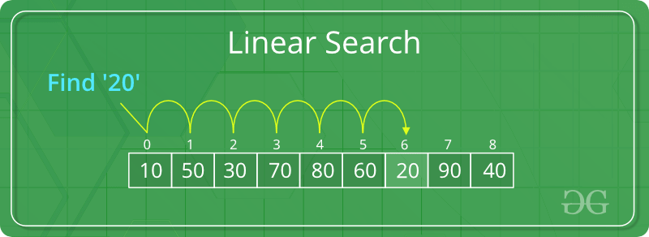
LINEAR SEARCH

Slide 4
Multiple Queries
What if we had to modify our algorithm to answer for multiple query values of x?

Slide 5
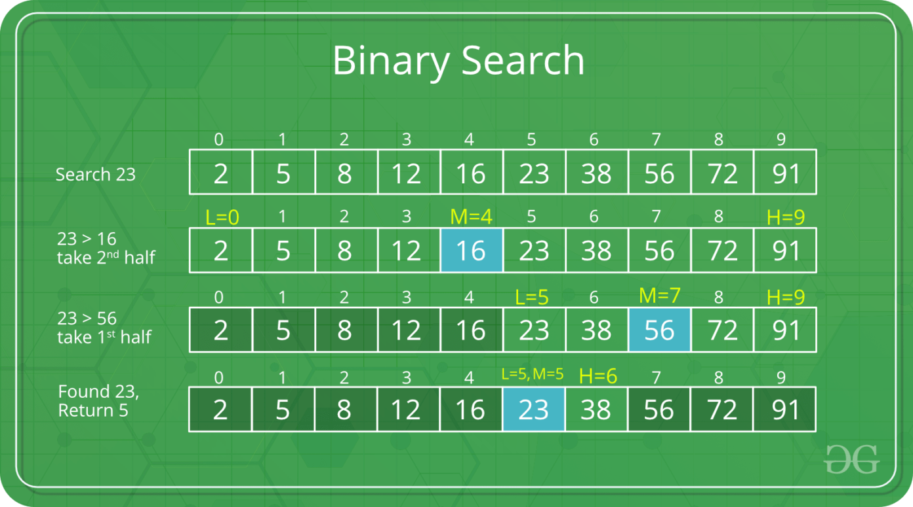
BINARY SEARCH

Slide 6
The Algorithm
https://codeforces.com/edu/course/2/lesson/6/1/practice/contest/283911/problem/A

Slide 7
Lowerbound & Upperbound
https://codeforces.com/edu/course/2/lesson/6/1/practice/contest/283911/problem/D

Slide 8
Solving equations with binary search
https://codeforces.com/edu/course/2/lesson/6/2/practice/contest/283932/problem/E

Slide 9
Binary Search on the Answer
https://codeforces.com/edu/course/2/lesson/6/3/practice/contest/285083/problem/A

Slide 10
Questions?

