Slide 1
PROBLEM STATEMENT
In today's competitive market, businesses struggle to understand and cater to the unique needs and behaviors of different customer segments. Traditional marketing strategies often lack the precision needed for personalized customer experiences, leading to missed opportunities for enhancing customer satisfaction and loyalty. To address these challenges, this project leverages RFM (Recency, Frequency, Monetary) analysis to effectively segment customers based on their purchasing behavior. By gaining deeper insights into customer preferences, we can develop targeted marketing strategies that improve customer engagement, retention, and overall sales performance, ultimately driving business growth.
2
1
3
Recency
How recent was a customer's latest purchase?
Frequency
How often does a customer make purchases?
Monetary
How much does a customer spend?

Slide 2

02
03
Data inspection
Data Cleaning
04
RFM Metrics
Data Analytics/ML
01
Import Raw Data
Visualisation
Score Assignment
05
08
Stratergy Development
RFM Segmentation
06
07

Slide 3
Data Analysis and Visualisation Tools
1
2
3
4
5
Microsoft Excel
For initial data organization, basic calculations, and possibly for creating simple visualizations
VS Code
Source Code editor by Microsoft for debugging,syntax highlighting and code completion,snippets etc..
Pandas In Python
A Python library used for working with data sets.It has functions for cleaning,exploring and manipulating the data.
NumPy In Python
A Python Library used for numerical operations, handling arrays and complex mathematical functions needed for data processing.
Power BI
A microsoft tool for aggregating,analysing,
visualising and shairing data through interactive dashboards and reports.

Slide 4






Data Cleaning Checklist
Removing Duplicates
Filtering Data
Verifying Data Accuracy
Handling Missing Values
Correcting Inconsistencies
Creating Necessary Features

Slide 5
Data Collection and Assessment
01
02
Data Profiling
Present Visualisation Dashboard
10
03
Calculate RFM Metrics
Analyse Segment Characteristic
METHODOLOGY
Score Customers On RFM Matrices
09
04
Visualise RFM Segments
Segment Customers Based On RFM Matrices
08
05
Designed Targeted Marketing Stratergies
07
06
Profile RFM Segments

Slide 6
RFM CALCULATIONS
Counts the number of times a customer has made a purchase within a specified period.
Count the total number of purchases made by each customer within the analysis period.
Measures the total amount of money a customer has spent within a specified period.
Sum the monetary value of all purchases made by each customer within the analysis period.
RECENCY
Measures the number of days since a customer's last purchase.Identify the date of the most recent purchase for each customer.
Subtract this date from a fixed reference date (e.g., the current date or end date of the dataset) to get the number of days since the last purchase
FREQUENCY
MONETARY
FORMULAE
Recency = Reference Date - Last Purchase Date
FORMULAE
Frequency = Total Number of Purchases
FORMULAE
Monetary = Sum of Purchase Values

Slide 7
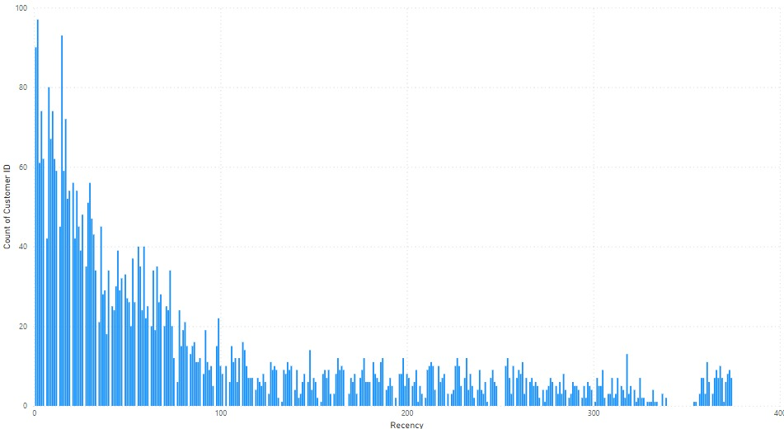
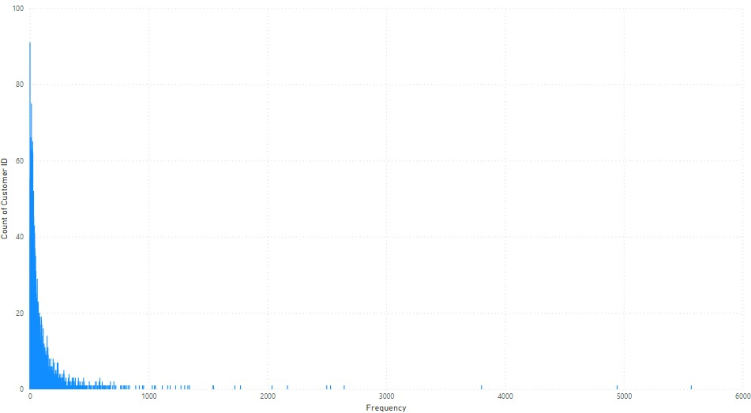
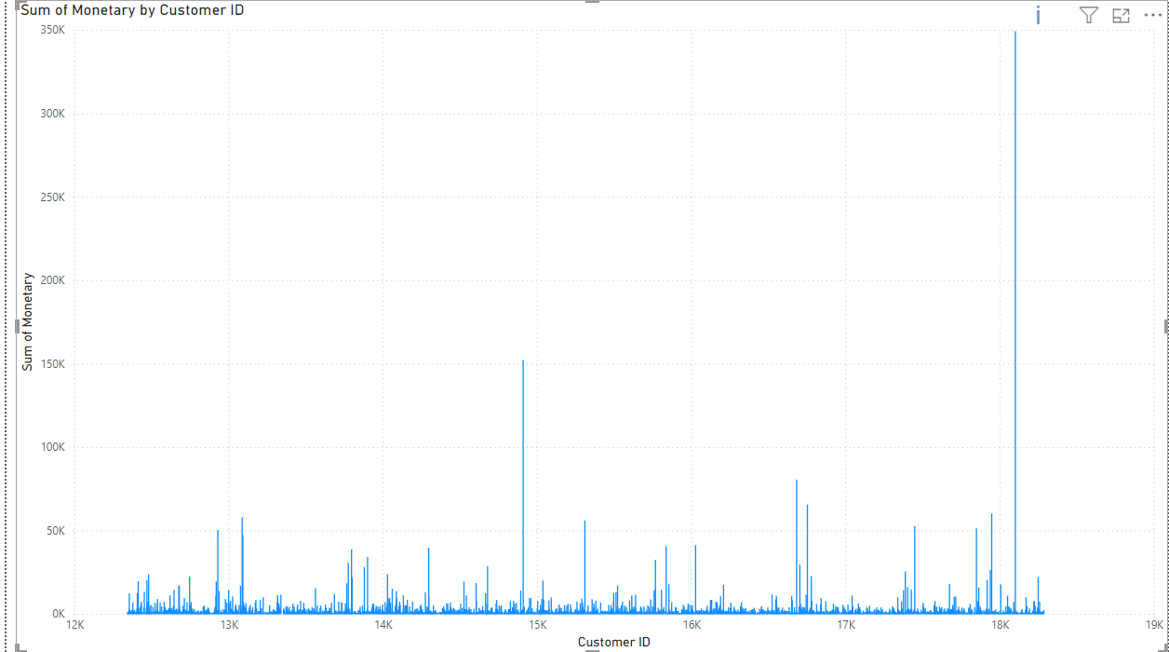
RFM ANALYSIS (Year 2009-2010)
RECENCY
FREQUENCY
MONETARY

Slide 8
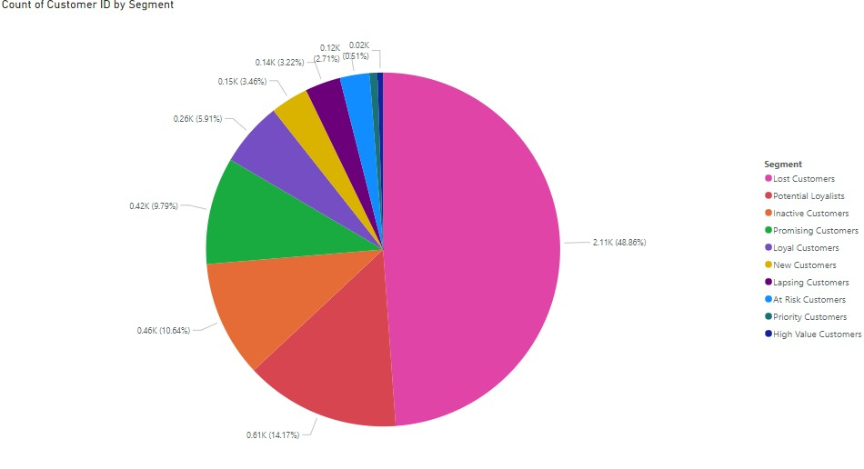
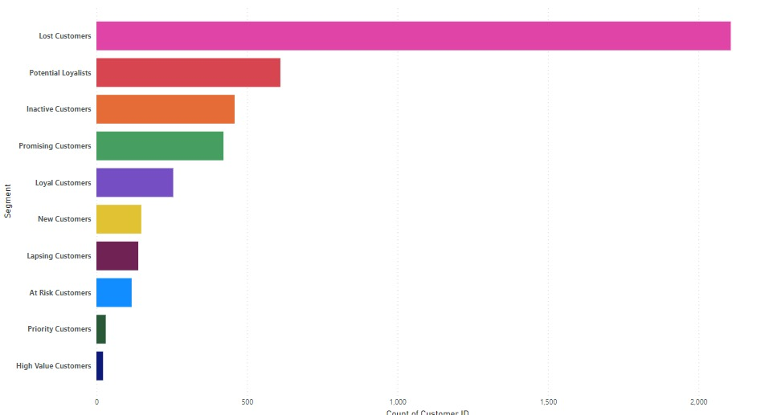
SEGMENTATION (Year 2009-2010)

Slide 9
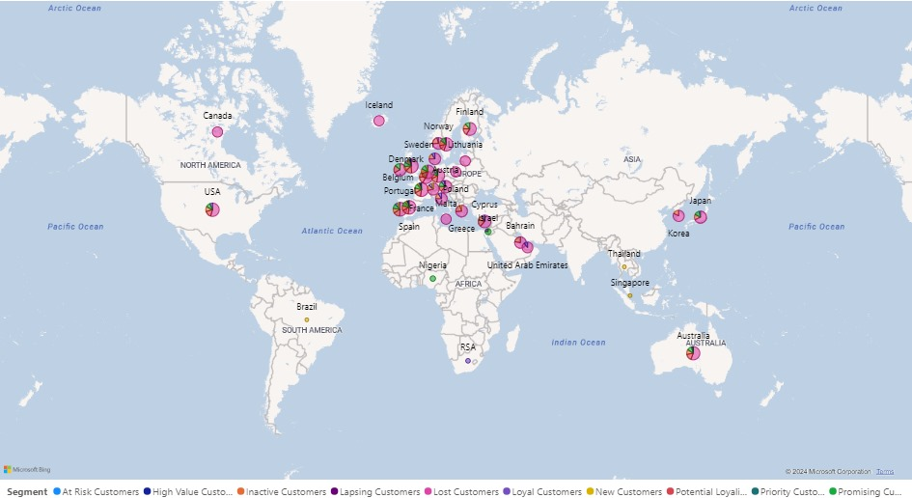
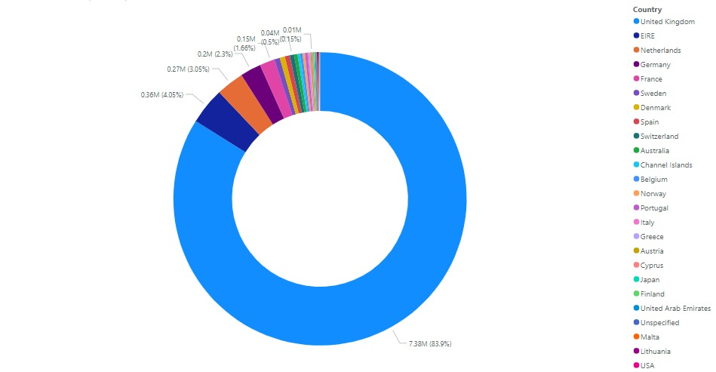
REGION-WISE SEGMENTATION (Year 2009-2010)

Slide 10
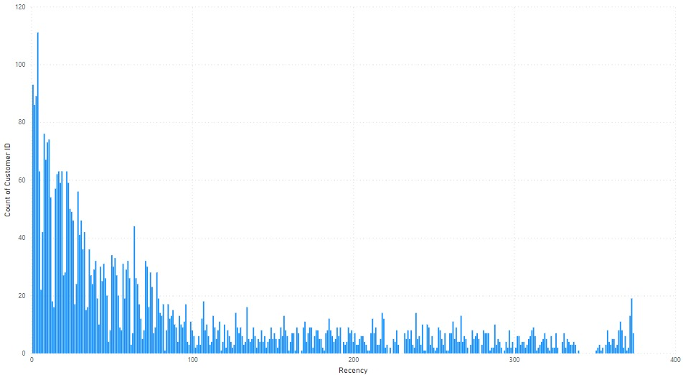
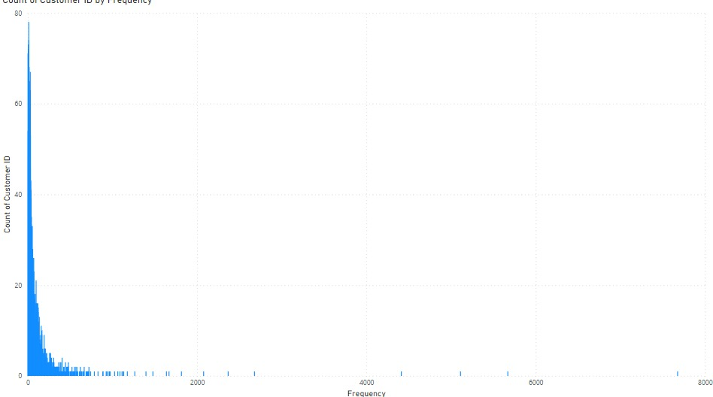
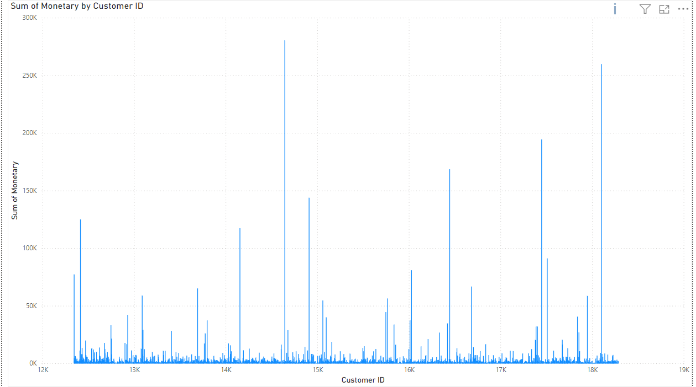
RFM ANALYSIS (Year 2010-2011)
RECENCY
FREQUENCY
MONETARY

Slide 11

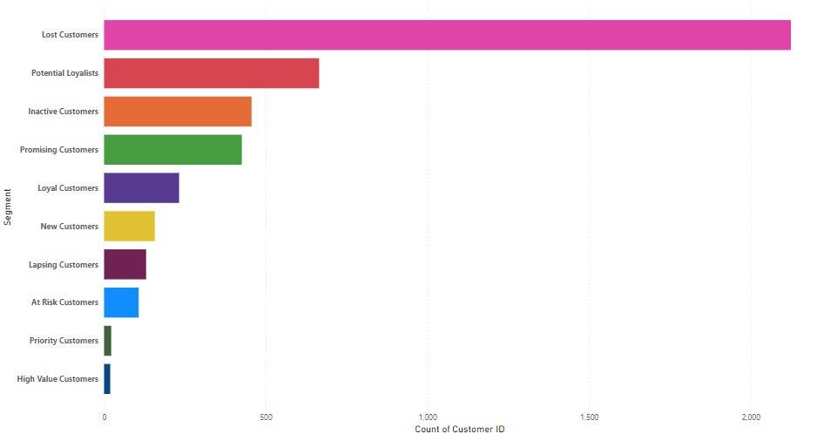
SEGMENTATION (Year 2010-2011)

Slide 12
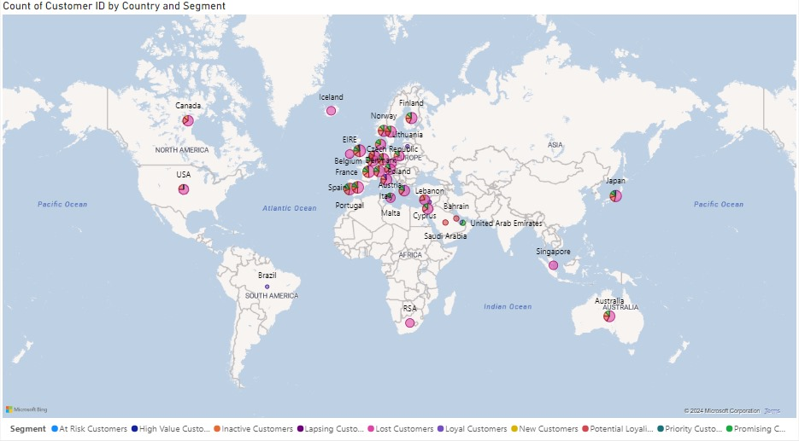
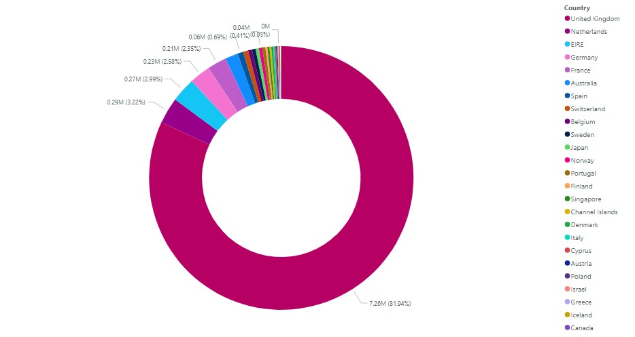
REGION-WISE SEGMENTATION (Year 2010-2011)

Slide 13
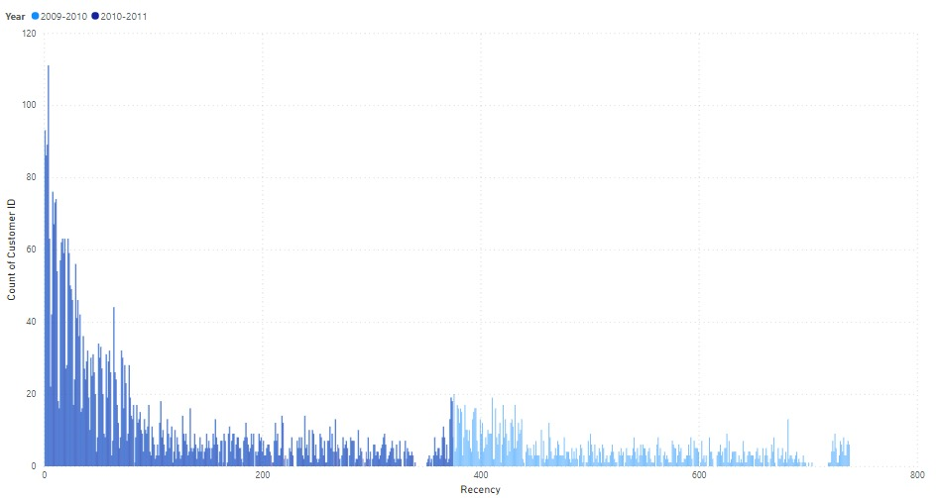
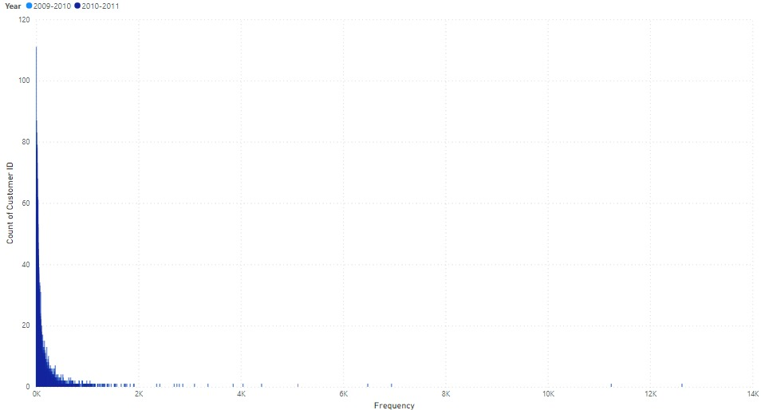
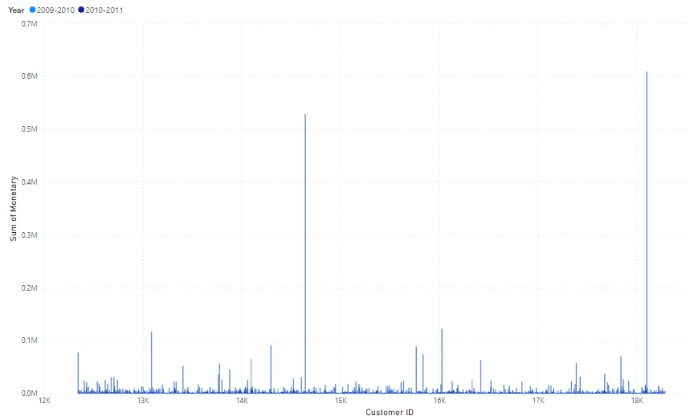
COMBINED RFM ANALYSIS (Year 2009-2011)
RECENCY
FREQUENCY
MONETARY

Slide 14
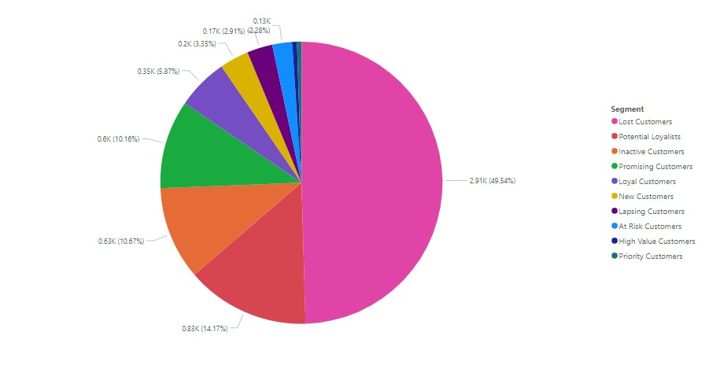
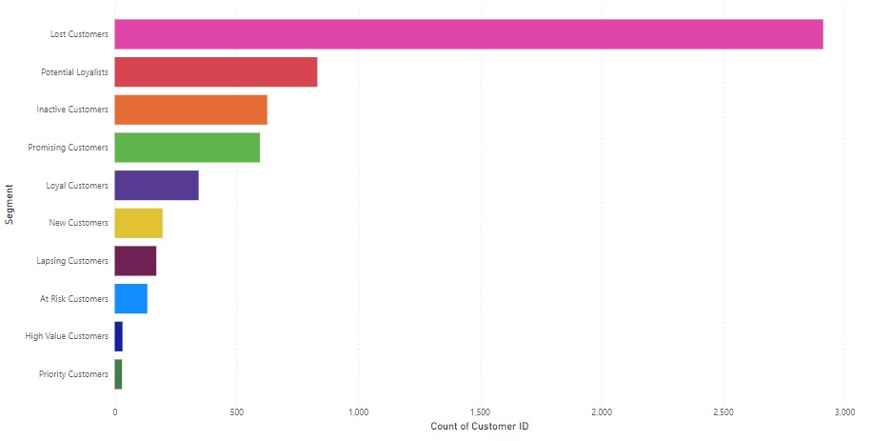
COMBINED SEGMENTATION (Year 2009-2011)

Slide 15
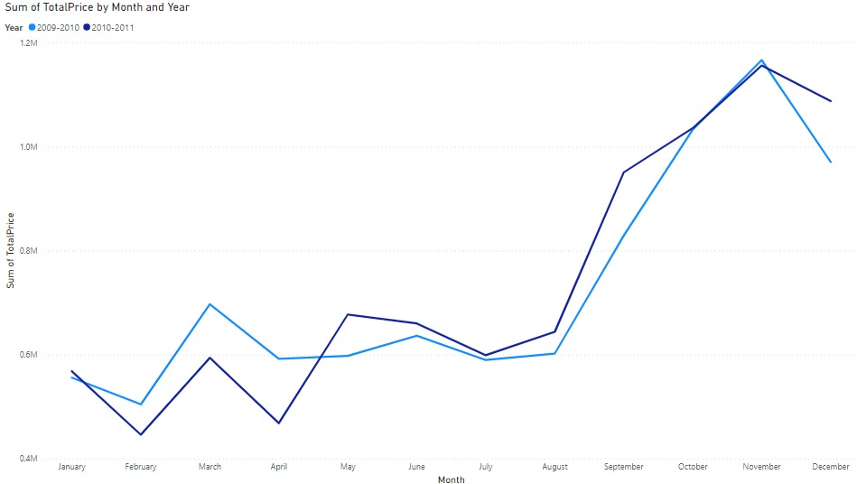
SALES TREND ANALYSIS (Year 2009-2011)

Slide 16
STRATEGIES FOR DIFFERENT SEGMENTS
SEGMENTS | CRITERIA | DESCRIPTION | MARKETING STRATEGIES
Inactive Customers | R=1 F=1, M=1 | Low spenders, low frequency, and not recent. | Short Term: Send win-back campaigns with discounts. Long Term: Highlight new product launches and seasonal promotions.
New Customers | R=4-5, F=1, M=1 | Recently acquired customers. | Short Term: Send welcome e-mails with introductory offers. Long Term: Establish a welcome series with tutorials and product highlights
Loyal Customers | R=4-5, F=4-5, M=3-5 | Customers who purchase often and spend a good amount. | Short Term: Provide special offers and Thank You notes. Long Term: Develop a personalised recommendation system and VIP events.
Lapsing Customers | R=1-2, F=2-3, M=2-3 | Low frequency and not recent. | Short Term: Provide remainders about past purchase and offer discounts. Long Term: Create a reactivation campaign with compelling offers.
Priority Customers | R=1, F=4-5, M=4-5 | Big spenders who haven’t purchased for a long time. | Short Term: Provide exclusive deals and gifts. Long Term: Establish a VIP program with dedicated support and personalized offers.
Potential Loyalists | R=4-5, F=2-3, M=2-3 | Recent customers with potential to become loyal. | Short Term: Provide Discounts on next purchase. Long Term: Create loyalty incentives and personalised engagement.
At Risk Customers | R=1-2, F=3-5, M=3-5 | High spenders who haven’t purchased for a while. | Short Term: Offer significant discounts and loyalty rewards. Long Term: Develop a re-engagement program with high value incentives.
High Value Customers | R=5, F=5, M=5 | Customers who purchase recently, frequently, and spend the most. | Short Term: Offer exclusive discounts and early access to new products. Long Term: Implement a loyalty program with tiers, reward points and special perks.
Lost Customers | R=1, F=1, M=1 | Lowest spenders, least frequent, and not recent. | Short Term: Offer deep discounts or last-chance offers. Long Term: Create a compelling win back campaign with attractive incentives.
Promising Customers | R=3-4, F=1-2, M=1-2 | Recent shoppers but not frequent. | Short Term: Engage with personalised offers and recommendations. Long Term: Increase frequency with subscription services and consistent communication.

Slide 17
CONCLUSION
1
2
3
4
5
Effective Customer Segmentation:
The RFM analysis successfully categorized customers into distinct segments, allowing for a deeper understanding of customer behaviors and preferences.
Targeted Marketing Strategies:
Tailored marketing strategies for each segment have been proposed, aiming to enhance customer engagement, retention, and overall sales performance.
Insights from Visualizations:
Visual graphs, such as histograms, pie charts, and heat maps, provided clear insights into the distribution of recency, frequency, monetary values, and customer segments.
Geographic Distribution:
The map visualization highlighted regional variations in customer segments, informing geographically targeted marketing efforts.
Trend Analysis:
Line charts showed sales trends over time, helping to identify seasonal patterns and opportunities for targeted promotions.

Slide 18
Thank You!
.

