Slide 1

Introduction and Objectives
Introduction: Overview of the project aiming to develop a machine learning model for classifying music tracks into different genres.
Purpose: Highlight the objectives and significance of the project, including applications in music recommendation, content organization, market segmentation, and academic research.
Objectives: Mention the primary objectives focusing on model development, feature utilization, and performance comparison.
Dataset: Briefly introduce the "GTZAN Genre Collection" dataset consisting of 1000 audio tracks categorized into 10 genres.

Slide 2
Methodology and Conclusion
Methodology: Describe the approach focusing on implementing and evaluating KNN and Naive Bayes classifiers.
Implementation Details: Provide specifics on implementing each classifier, including parameter tuning and feature space utilization.
Evaluation Metrics: Highlight the performance evaluation metrics, including accuracy, precision, recall, and F1-score.
Conclusion: Summarize the project's objectives, methodologies, and key findings.
Future Directions: Suggest potential avenues for further research and improvement in music genre classification.

Slide 3
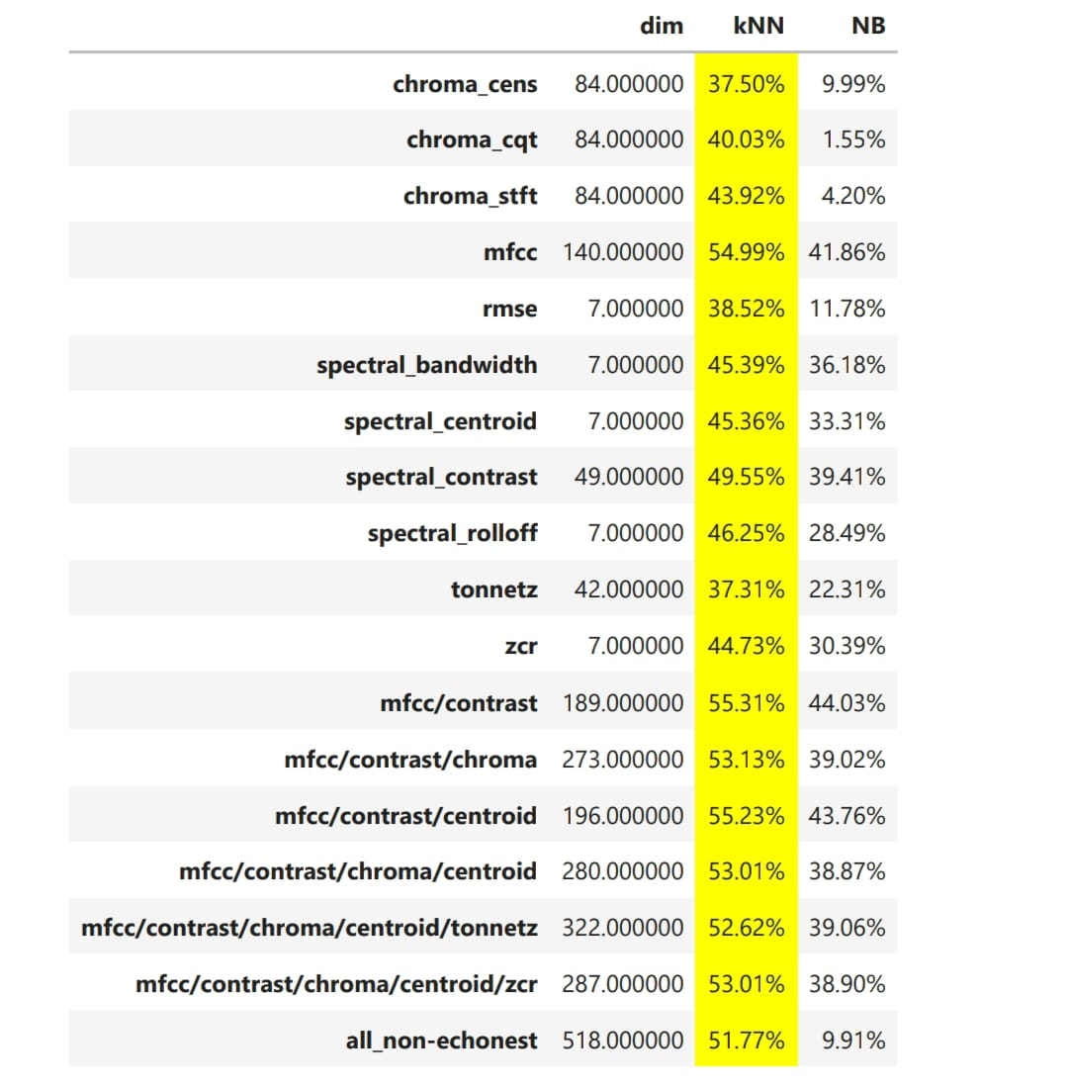
DIFFERENCE IN KNN AND NB

Slide 4
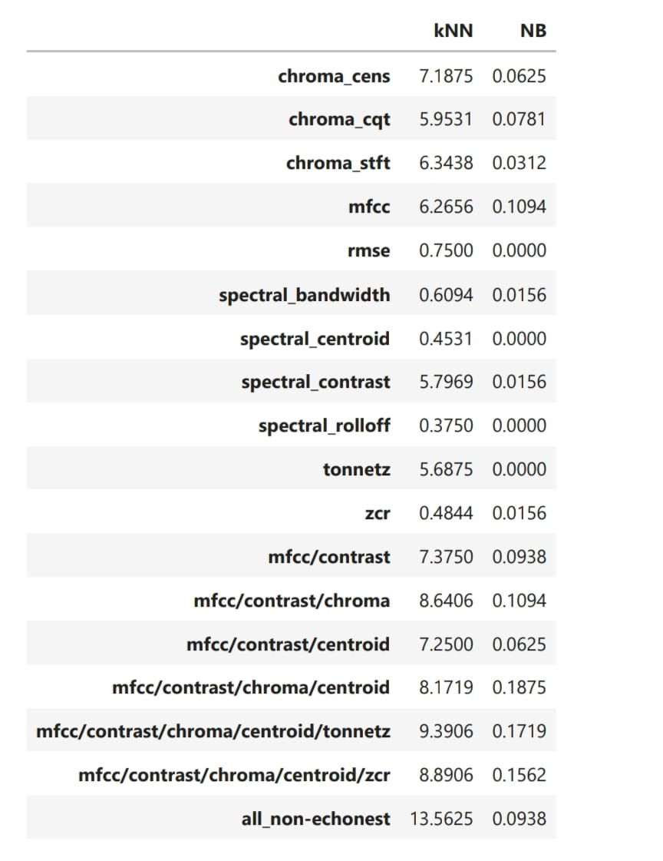
DIFFERENCE IN KNN AND NB

Slide 5
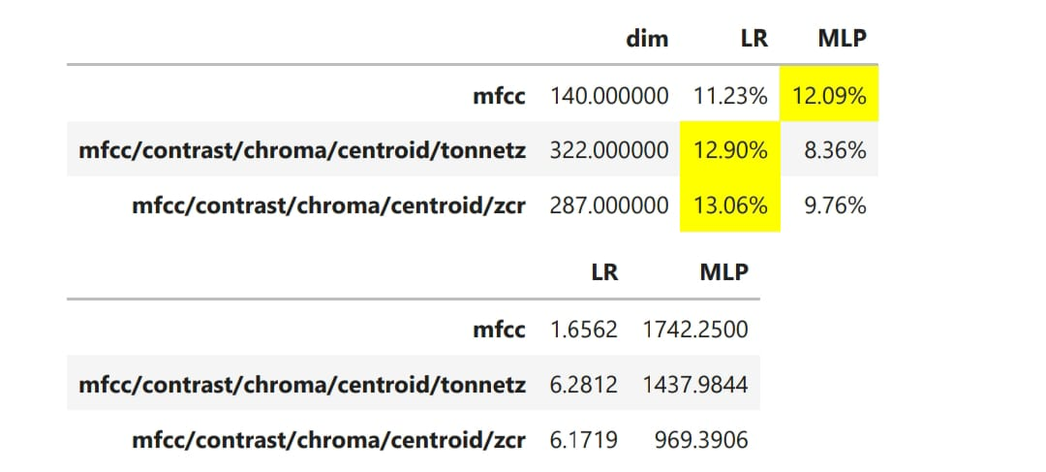
MULTIPLE GENRES

Slide 6
BIBLIOGRAPHY
@inproceedings{fma_dataset,
title = {{FMA}: A Dataset for Music Analysis},
author = {Defferrard, Micha\"el and Benzi, Kirell and Vandergheynst, Pierre and Bresson, Xavier},
booktitle = {18th International Society for Music Information Retrieval Conference (ISMIR)},
year = {2017},
archiveprefix = {arXiv},
eprint = {1612.01840},
url = {https://arxiv.org/abs/1612.01840},
}
@inproceedings{fma_challenge,
title = {Learning to Recognize Musical Genre from Audio},
subtitle = {Challenge Overview},
author = {Defferrard, Micha\"el and Mohanty, Sharada P. and Carroll, Sean F. and Salath\'e, Marcel},
booktitle = {The 2018 Web Conference Companion},
year = {2018},
publisher = {ACM Press},
isbn = {9781450356404},
doi = {10.1145/3184558.3192310},
archiveprefix = {arXiv},
eprint = {1803.05337},
url = {https://arxiv.org/abs/1803.05337},
}

