Slide 1
Hate‑Crime Early‑Warning Model for NYPD
Author: Siddhant Anand Jadhav Course: Machine Learning

Slide 2

Stopping Hate Crimes Before They Happen
NYPD wants to know where hate crimes might pop up next month
Early warning = smarter patrols + proactive outreach
Our model turns five years of data into a monthly “risk list”

Slide 3
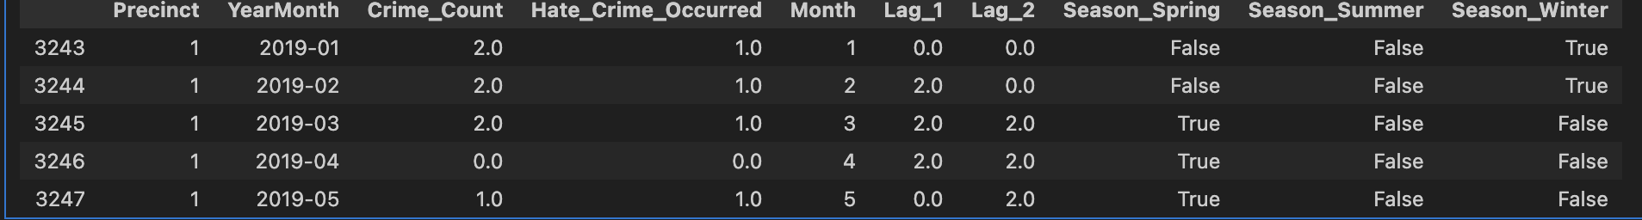
Dataset & Prediction Goal
Thing | Note
Source | NYC OpenData – NYPD Hate Crime Incidents (2019 – Mar 2024)
Rows | 3 325 incidents → reshaped to 11 736 precinct‑months
Target | 1 = at least one hate crime in a precinct‑month

Slide 4
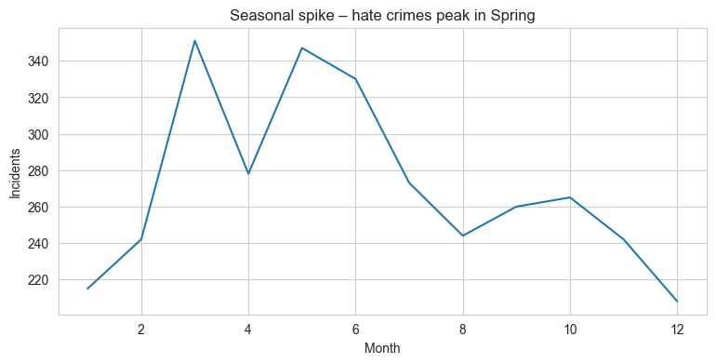
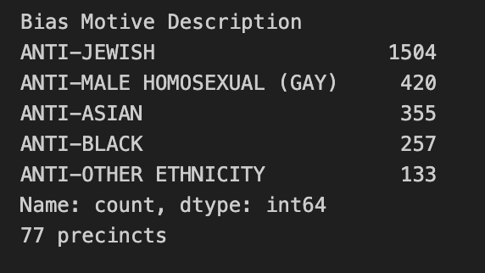
Key Patterns in the Data
Spring surge → biggest seasonal spike
A few precincts show repeat incidents month‑to‑month
Bias motives mostly Anti‑Jewish, Anti‑Black, Anti‑Asian

Slide 5
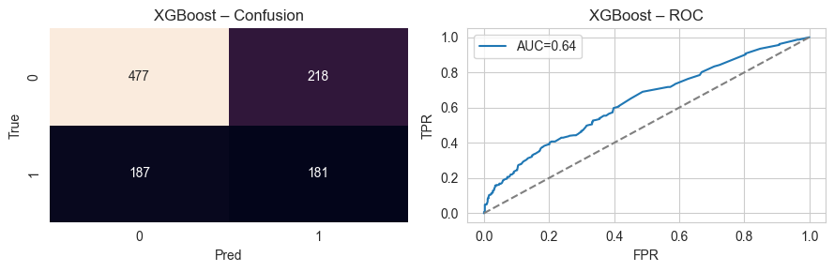
Model & Metrics
Model | F1 | Precision | Recall | AUC
Logistic Reg. | 0.26 | 0.72 | 0.16 | 0.65
Random Forest | 0.32 | 0.55 | 0.23 | 0.60
XGBoost | 0.47 | 0.45 | 0.49 | 0.64

Slide 6
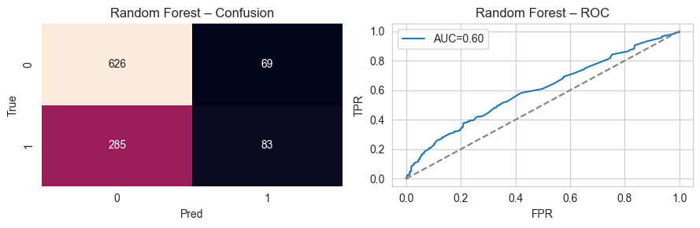
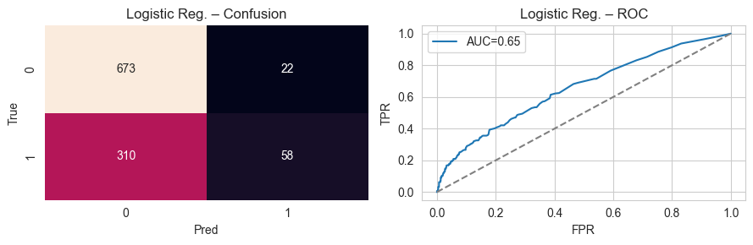
Model & Metrics

Slide 7
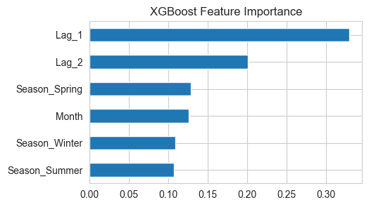
What Drives Risk
Lag 1 (incidents last month) – strongest predictor
Month in calendar year – seasonality effect
Season_Spring flag – confirms spring surge we saw earlier

Slide 8
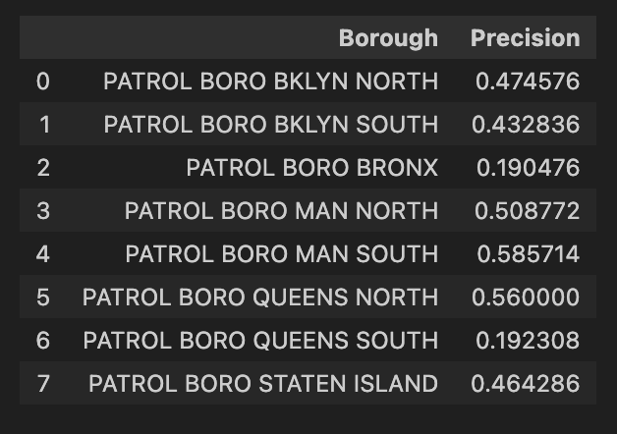
Fairness & Ethics Check
Precision by borough sits 0.48 – 0.60 → balanced across city
I’ll keep tracking as we add demographics
Model is an assistant, not an arrest warrant

Slide 9
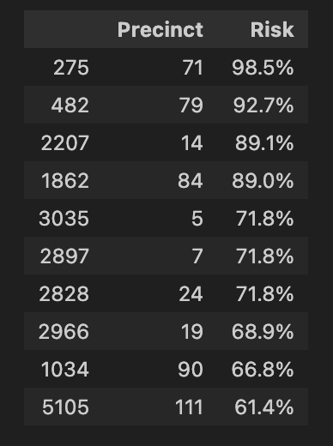
How NYPD Can Use This
Next‑month workflow:
Shows top‑5 risk precincts from XGBoost each month
Email top‑5 list to commanders
Patrol shift + school/faith‑group visits
Re‑evaluate model quarterly
Future work: add census features, test XGBoost, calibrate thresholds.

Slide 10
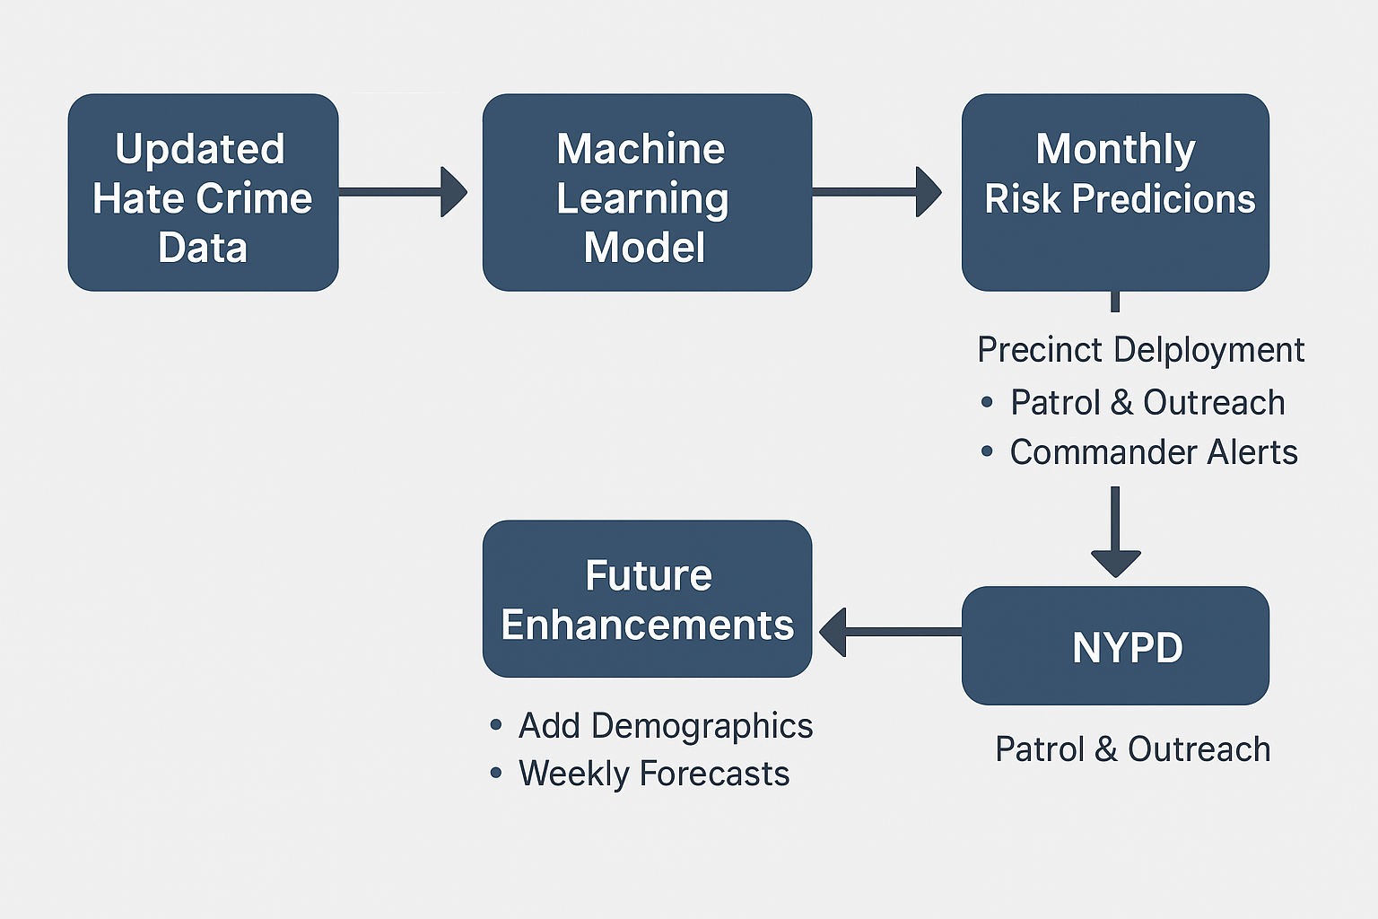
How NYPD Can Use This
This flow shows the end‑to‑end pipeline: fresh hate‑crime data feeds the ML model, which produces a monthly ‘risk list.’
Commanders can use it to plan patrols and outreach, and their feedback powers future upgrades like adding demographics and moving to weekly forecasts.

Slide 11
What’s Missing & What’s Next
Demographic context missing Plan: join census income & race data to add socioeconomic signals.
Recall still modest (49 %) Plan: Recall lifted with XGBoost — aim for 60 % via tuning & census data
Only borough‑level fairness check Plan: break down by race/ethnicity once demographics are merged.
Monthly batch only Plan: explore weekly scoring if NYPD gains appetite for faster updates.

Slide 12
THANK YOU ANY QUESTIONS?

