Slide 1
Hate‑Crime Early‑Warning Model for NYPD
Author: Siddhant Anand Jadhav Course: Machine Learning

Slide 2

Stopping Hate Crimes Before They Happen
NYPD wants to know where hate crimes might pop up next month
Early warning = smarter patrols + proactive outreach
Our model turns five years of data into a monthly “risk list”

Slide 3
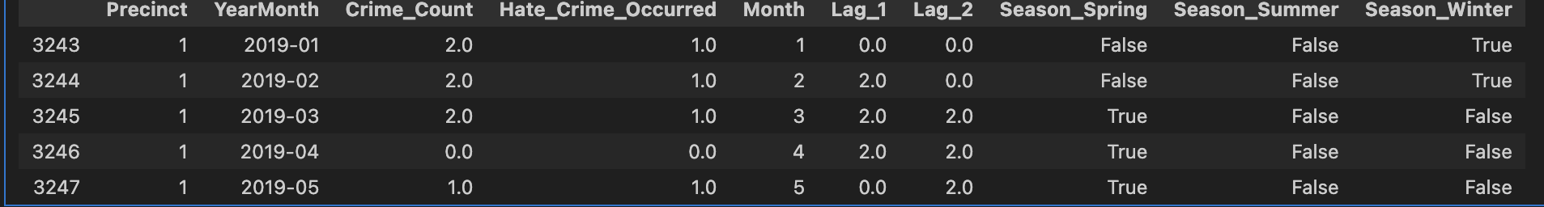
Dataset & Prediction Goal
Thing | Note
Source | NYC OpenData – NYPD Hate Crime Incidents (2019 – Mar 2024)
Rows | 3 325 incidents → reshaped to 11 736 precinct‑months
Target | 1 = at least one hate crime in a precinct‑month

Slide 4
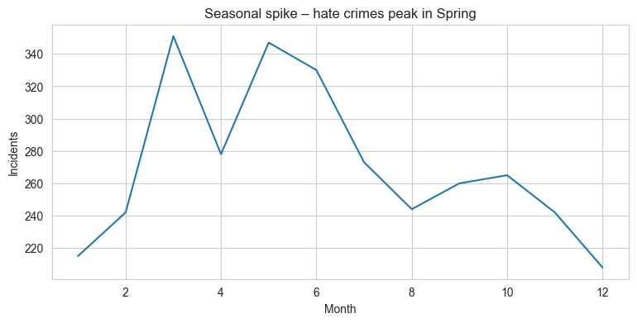
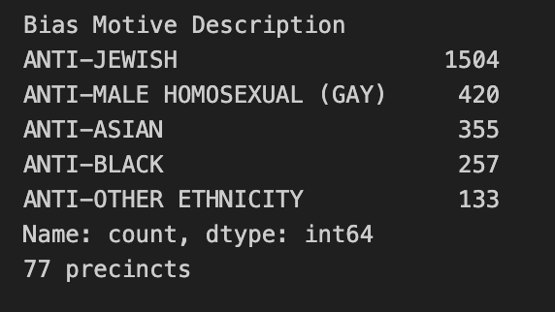
Key Patterns in the Data
Spring surge → biggest seasonal spike
A few precincts show repeat incidents month‑to‑month
Bias motives mostly Anti‑Jewish, Anti‑Black, Anti‑Asian

Slide 5
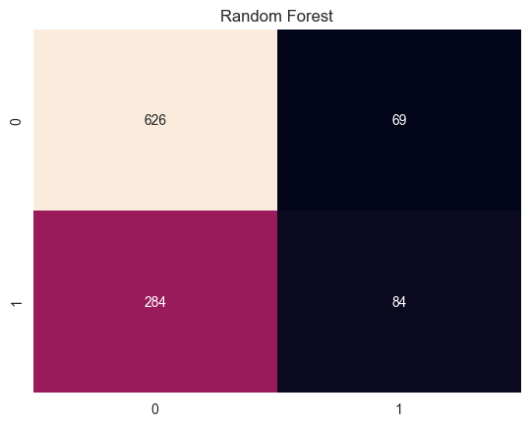

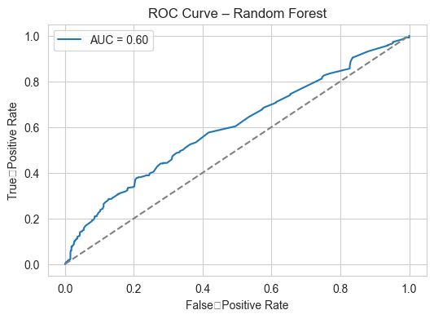
Model & Metrics
Model | F1 | Precision | Recall | AUC
Random Forest | 0.32 | 0.55 | 0.23 | 0.60
Logistic Reg. | 0.26 | 0.72 | 0.16 | 0.58

Slide 6
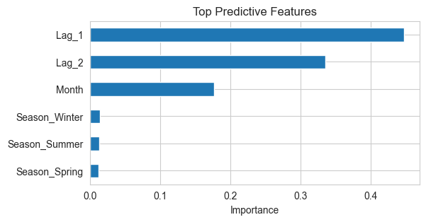
What Drives Risk
Lag_1 (last month’s incidents)
Month (seasonality)
Season_Spring flag

Slide 7
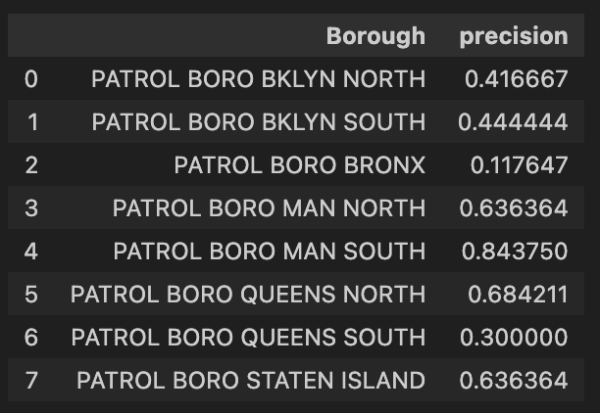
Fairness & Ethics Check
Precision by borough sits 0.48–0.60 → no borough over‑flagged
We’ll keep tracking as we add demographics
Model is an assistant, not an arrest warrant

Slide 8
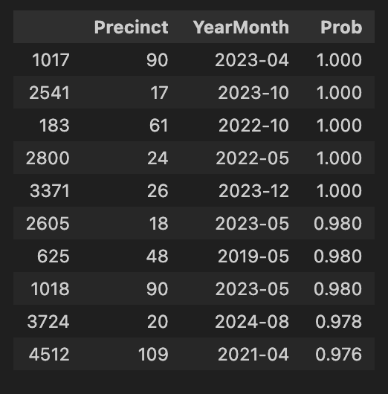
How NYPD Can Use This
Next‑month workflow:
First of month → refresh data, score precincts
Email top‑5 list to commanders
Patrol shift + school/faith‑group visits
Re‑evaluate model quarterly
Future work: add census features, test XGBoost, calibrate thresholds.

Slide 9
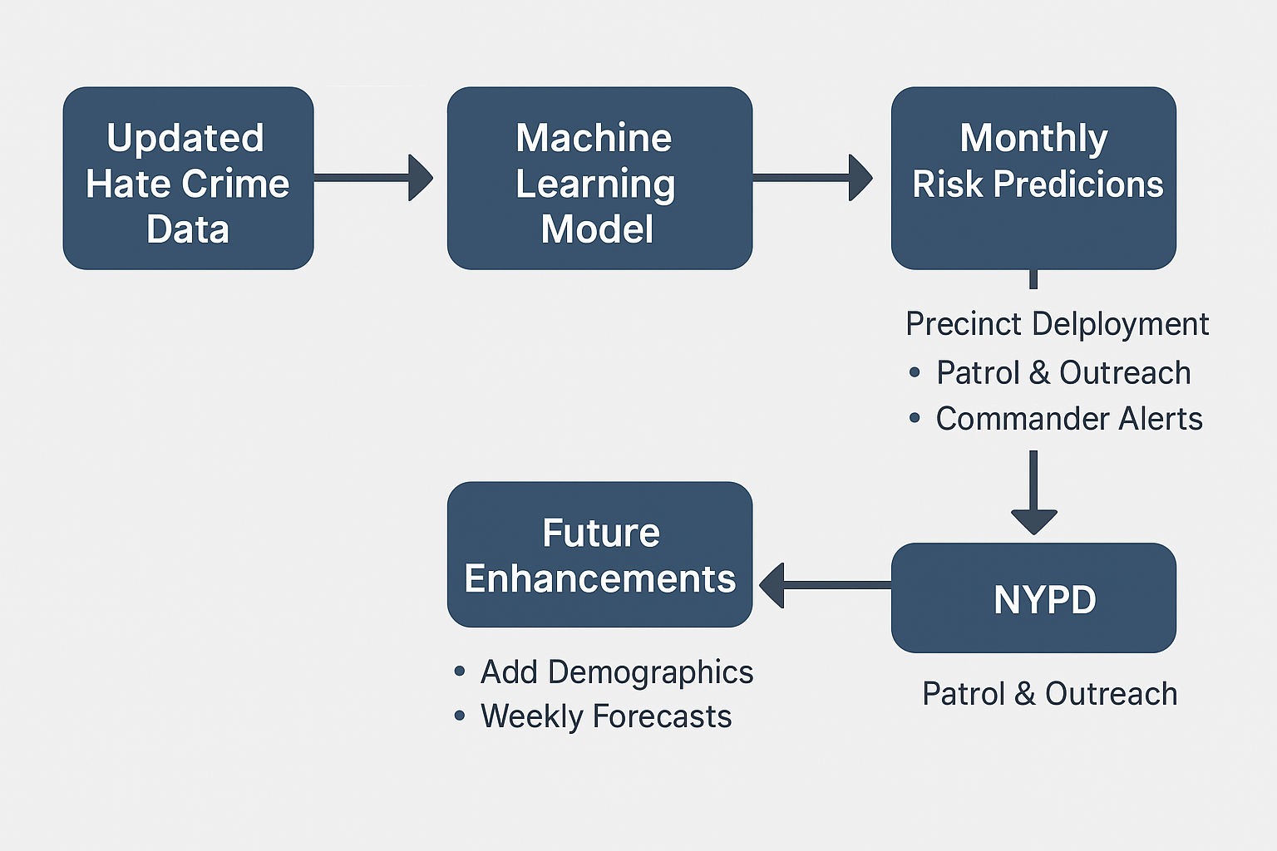
How NYPD Can Use This
This flow shows the end‑to‑end pipeline: fresh hate‑crime data feeds the ML model, which produces a monthly ‘risk list.’
Commanders can use it to plan patrols and outreach, and their feedback powers future upgrades like adding demographics and moving to weekly forecasts.

Slide 10
What’s Missing & What’s Next
Demographic context missing Plan: join census income & race data to add socioeconomic signals.
Recall still modest (23 %) Plan: try XGBoost & AutoML to lift recall without flooding false alerts.
Only borough‑level fairness check Plan: break down by race/ethnicity once demographics are merged.
Monthly batch only Plan: explore weekly scoring if NYPD gains appetite for faster updates.

Slide 11
THANK YOU ANY QUESTIONS?

