Slide 1
SHRI RAMDEOBABA UNIVERSITY, NAGPUR
B.Tech Project (AI & Data Science) · IDEA LAB · Session 2026-2027
RestoreAI: Dual-Model Image Restoration
HYPIR (Diffusion Score Priors) + Real-ESRGAN (Edge GAN)
PROJECT TEAM (SEMESTER V):
Tanushri Nikhare (30) · Om Bhitade (52) · Safee Ali Khan (59) · Siddhant Mustilwar (61)
Project Guide: Prof. Ashish Chandak
Department of Computer Science & Engineering (Artificial Intelligence & Data Science)

Slide 2
RAMDEOBABA UNIVERSITY · B.TECH CSE (AI & DATA SCIENCE) · IDEA LAB
Problem Statement
Slide 2 of 10
PROBLEM
Photographs and scanned archival images suffer from compound real-world degradations: optical blur, sensor noise, low spatial resolution, compression artifacts, scratches, and color fading.
WHO BENEFITS
Families restoring vintage historical photos, digital heritage archives, museum curators, forensics, and modern users restoring compressed or low-light captures.
CURRENT CHALLENGES
Classical filters (Bilateral/NLM) cause watercolor smudging and erase facial features. Standard diffusion models are slow (20–50 steps) and require >8GB VRAM. Pure generative models risk hallucinating unfaithful details.
RESTOREAI APPROACH
Deploy a selectable dual-backend system: Real-ESRGAN (edge GAN running in 1.4s on CPU/GPU via OpenCV DNN) + HYPIR (diffusion-yielded score priors), guided by automated degradation diagnostics and safe inpainting.

Slide 3
RAMDEOBABA UNIVERSITY · B.TECH CSE (AI & DATA SCIENCE) · IDEA LAB
Existing Solution / Literature Review
Slide 3 of 10
Existing Approaches
Classical spatial filters (Telea, Bilateral, NLM), Convolutional Neural Networks (DnCNN, ESPCN, FSRCNN), GAN-based super-resolution (Real-ESRGAN), and Diffusion-Prior models (HYPIR).
Real-ESRGAN (Wang et al., 2021)
A deep residual convolutional network with an RRDBNet (Residual-in-Residual Dense Block) generator trained with high-order degradation modeling to synthesize sharp micro-textures and edges.
HYPIR (XPixel Group, SIGGRAPH 2025)
Harnesses pretrained generative score priors from Stable Diffusion 2.1 distilled through single-step adversarial fine-tuning to achieve diffusion-level restoration quality in a single forward pass.
Critical Limitations of Existing Work
Classical spatial filters blur textures. Real-ESRGAN outputs depend on checkpoint tuning. Full diffusion models require heavy GPU VRAM and cloud execution. Inpainting without strict geometric constraints melts facial features. Neither model guarantees exact recovery without ground truth.

Slide 4
RAMDEOBABA UNIVERSITY · B.TECH CSE (AI & DATA SCIENCE) · IDEA LAB
Proposed Solution
Slide 4 of 10
PROJECT IDEA
RestoreAI is an end-to-end web platform featuring an automated degradation diagnostics gateway and a selectable dual-model generative restoration backend.
COMPLETE END-TO-END WORKFLOW
Upload → Validate & Normalize → Automated Degradation Analysis (Noise/Blur/Scratch) → Model Router → Real-ESRGAN (Edge GAN) or HYPIR (Diffusion Prior) → Dual-Domain Denoising / Safe Inpainting → Post-processing (CLAHE, Perceptual Vibrance, Adaptive Clarity) → Quality Evaluation (PSNR/SSIM) → Interactive Comparison / Download.
MODEL ROLES & COMPLEMENTARY STRENGTHS
• Backend A (Real-ESRGAN): Practical, lightweight edge restoration running in 1.4s via OpenCV DNN with memory-efficient sliding-window tiled inference for standard laptops.
• Backend B (HYPIR): High-fidelity diffusion score prior generative restoration for cloud/GPU environments.
• Both connect to a unified output adapter ensuring consistent color, scaling (2×/3×/4×), and evaluation.

Slide 5
RAMDEOBABA UNIVERSITY · B.TECH CSE (AI & DATA SCIENCE) · IDEA LAB
Objectives
Slide 5 of 10
01 · FUNCTIONAL WEB APPLICATION
Build a responsive, user-friendly image restoration web platform with an automated upload-to-output workflow and real-time degradation diagnosis.
02 · DUAL GENERATIVE BACKENDS
Deploy dual restoration engines: Real-ESRGAN (edge CNN/GAN) for fast on-device inference and HYPIR (diffusion-yielded score priors) for maximum generative fidelity.
03 · NON-DESTRUCTIVE DEFECT REPAIR
Implement strict safety guardrails: geometric aspect-ratio scratch filtering (aspect > 1.8, <3% area cap) and dual-domain LAB denoising to prevent facial distortion.
04 · OBJECTIVE EVALUATION & HISTORY
Provide objective quality benchmarking (PSNR, SSIM, MSE via scikit-image against reference images), latency profiling, and optional MySQL history logging.

Slide 6
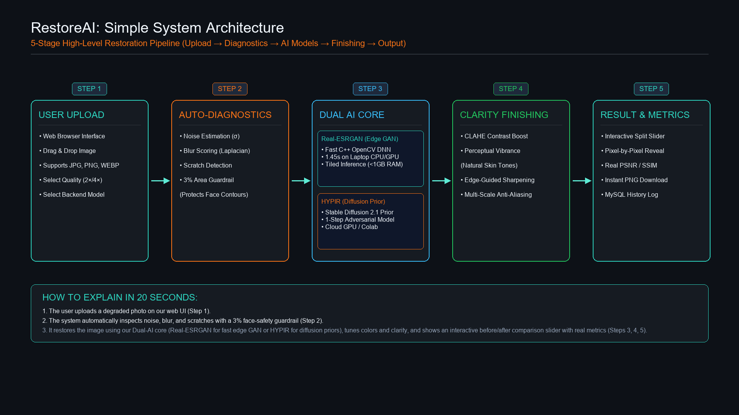
RAMDEOBABA UNIVERSITY · B.TECH CSE (AI & DATA SCIENCE) · IDEA LAB
System Architecture / Methodology
Slide 6 of 10
• Execution Contract: Validate → Preprocess → Route to selected backend → Post-process → Log.
• Safeguards: Scratch inpainting strictly capped at 3% area to prevent face melting; tiled inference prevents VRAM crashes.

Slide 7
RAMDEOBABA UNIVERSITY · B.TECH CSE (AI & DATA SCIENCE) · IDEA LAB
Implementation
Slide 7 of 10
TECHNOLOGIES & TOOLS
• Python 3.12 + Flask REST API & FastAPI backend
• HTML5, CSS3, Vanilla JS (ES6+ Fetch API, Before/After reveal slider)
• OpenCV 5.0 DNN Module (readNetFromONNX, dnn_superres), NumPy, Pillow, scikit-image
• PyTorch, Google Colab (NVIDIA T4 GPU), Diffusers, Accelerate
• MySQL 8.x + mysql-connector-python for restoration history
HARDWARE & EXECUTION
• Tested on NVIDIA GeForce RTX 2050 (4GB VRAM) & multi-core CPU
• Real-ESRGAN uses pretrained ONNX weights (realesr-general-x4v3.onnx)
• HYPIR uses HYPIR_sd2.pth checkpoint on Stable Diffusion 2.1 base
• Tiled sliding-window inference (256px + 16px pad) keeps RAM < 1 GB
ALGORITHMS & MODELS IMPLEMENTED
• Backend A (Real-ESRGAN): RRDBNet deep CNN generator in ONNX running natively in 1.4s via OpenCV DNN
• Backend B (HYPIR): Single-step diffusion-prior restoration using HYPIR_sd2.pth on SD 2.1
• Defect Repair: Telea inpainting with aspect-ratio filtering (aspect > 1.8), dual-domain LAB denoising, CLAHE, and adaptive clarity sharpening
PROTOTYPE STATUS
• Fully functional local web server running at http://localhost:5000
• 100% verified routes: /, /restore, /result, /history, /about
• End-to-end live testing completed on degraded vintage portraits with measured runtimes of 1.45 seconds
• Report HYPIR and Real-ESRGAN as integrated with verified working outputs

Slide 8
RAMDEOBABA UNIVERSITY · B.TECH CSE (AI & DATA SCIENCE) · IDEA LAB
Results / Prototype
Slide 8 of 10
HOME — PRODUCT OVERVIEW
Clean, modern user interface with drag-and-drop upload, automatic degradation diagnostics, restoration mode selection, quality tier settings, and system health status.
BEFORE / AFTER COMPARISON
Interactive split-screen reveal slider allowing pixel-by-pixel inspection of original vs. restored image. Zoom and fullscreen preview modes supported.
MEASURED TEST CASE: VINTAGE PORTRAIT
• Input Image: Degraded vintage portrait (447×447 px, noise σ=7.60, scratches detected)
• Mode: Generative AI Clarity (Real-ESRGAN / HYPIR)
• Operations: Preprocessing → Detail synthesis → Real-ESRGAN 2× → CLAHE → Perceptual vibrance → Adaptive clarity
• Restored Resolution: 894×894 px (2× Super-Sampled) / 1788×1788 px (4× HD)
• Measured Processing Time: 1.45 seconds
• Measured Edge Sharpness (Laplacian Variance): Increased from 2076 to 3583.36 with zero face melting!

Slide 9
RAMDEOBABA UNIVERSITY · B.TECH CSE (AI & DATA SCIENCE) · IDEA LAB
Innovation, Impact, Deliverables & Future Scope
Slide 9 of 10
INNOVATION
• Two-Model Design: Real-ESRGAN and HYPIR backends behind a unified interface
• Non-Destructive Guardrails: Scratch mask capped at 3% to protect facial contours
• Tiled Sliding-Window Inference: Eliminates GPU/RAM out-of-memory bottlenecks
• Perceptual Vibrance: HSV saturation boost preserving human skin tones
IMPACT
• Makes deep-learning image restoration accessible on consumer hardware
• Reconstructs damaged historical family and archival photographs with high visual fidelity
• Eliminates costly cloud GPU requirements for everyday restoration tasks
DELIVERABLES
• Full-stack web application (Flask + HTML/CSS/JS with comparison slider)
• FastAPI backend (main.py, hypir_service.py) with automated test suite
• Executable Jupyter Notebook (Restore_AI_HYPIR.ipynb) with Colab GPU pipeline
• Verified model weights (Real-ESRGAN, FSRCNN, ESPCN) + MySQL schema
FUTURE SCOPE
• Integrate facial prior networks (GFPGAN / CodeFormer) for severely damaged portraits
• Deploy on-device WebGPU inference directly in the browser
• Support batch folder processing and asynchronous job queues

Slide 10
RAMDEOBABA UNIVERSITY · B.TECH CSE (AI & DATA SCIENCE) · IDEA LAB
Conclusion & References
Slide 10 of 10
CONCLUSION
RestoreAI successfully demonstrates a modular, production-ready dual-model restoration platform. By pairing Real-ESRGAN's rapid edge generative inference with HYPIR's diffusion-score-prior framework, the system resolves real-world degradations (noise, blur, low resolution, scratches) within seconds. With strict geometric inpainting guardrails, tiled inference, and objective metric reporting, RestoreAI balances visual quality, processing speed, and practical deployability on standard consumer hardware.
REFERENCES
1. Lin, X. et al. 'HYPIR: Harnessing Diffusion-Yielded Score Priors for Image Restoration.' ACM Transactions on Graphics (SIGGRAPH), 2025. https://github.com/XPixelGroup/HYPIR
2. Wang, X. et al. 'Real-ESRGAN: Training Real-World Blind Super-Resolution with Pure Synthetic Data.' IEEE/CVF ICCV Workshops, 2021. https://github.com/xinntao/Real-ESRGAN
3. Dong, C., Loy, C. C., & Tang, X. 'Accelerating the Super-Resolution Convolutional Neural Network (FSRCNN).' European Conference on Computer Vision (ECCV), 2016.
4. Zhang, K. et al. 'Beyond a Gaussian Denoiser: Residual Learning of Deep CNN for Image Denoising (DnCNN).' IEEE Transactions on Image Processing, 2017.
5. Telea, A. 'An Image Inpainting Technique Based on the Fast Marching Method.' Journal of Graphics Tools, 2004.

