Slide 1
17th June 2021
ARM11 – Assembler & Emulator
Extension: A Concurrent Application of Blockchain Mining and Exchange in C
Ashvin Arsakularatne
aa9220@ic.ac.uk
Kavya Chopra
kc2320@ic.ac.uk
Siddhant Singh
ss5120@ic.ac.uk
Ye Lun Yang
yly19@ic.ac.uk

Slide 2
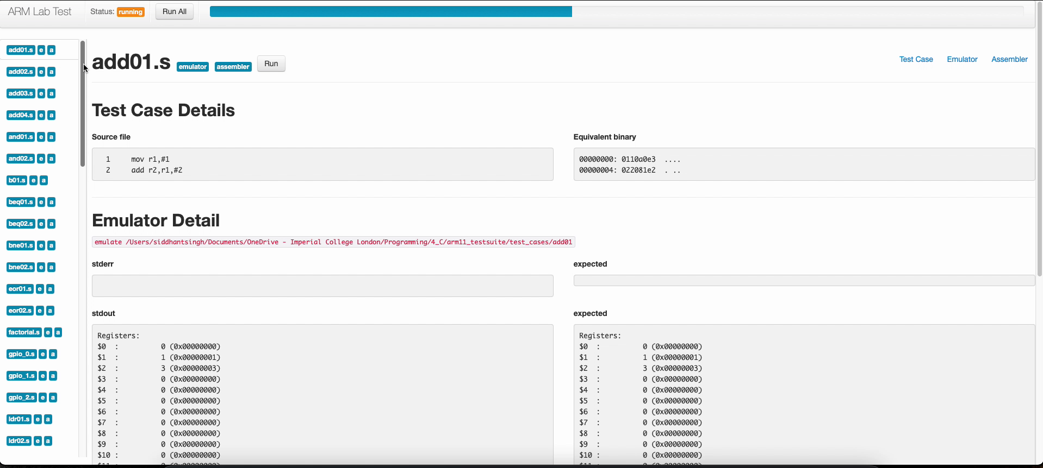
Test Cases (passes all ☺)

Slide 3
EMULATOR

Slide 4
Roadblock (CSPR flags)
Initial design:
Multiple helper functions used to calculate C flag
Discrepancies in types
Issues difficult to detect
How we modified it:
gdb debugging
Local test cases
Repeat until functions work and all test cases pass

Slide 5
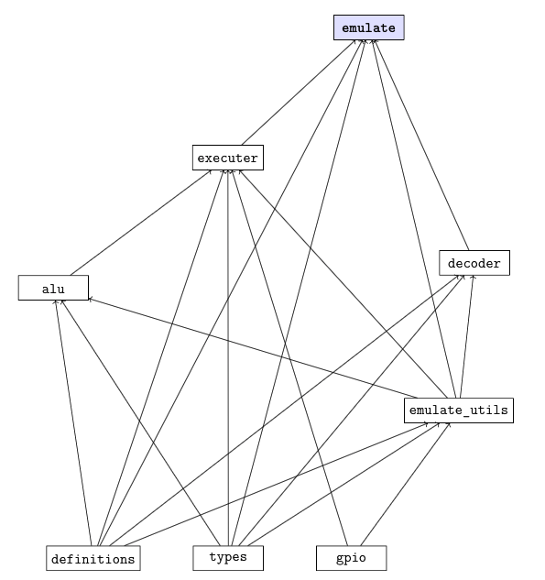
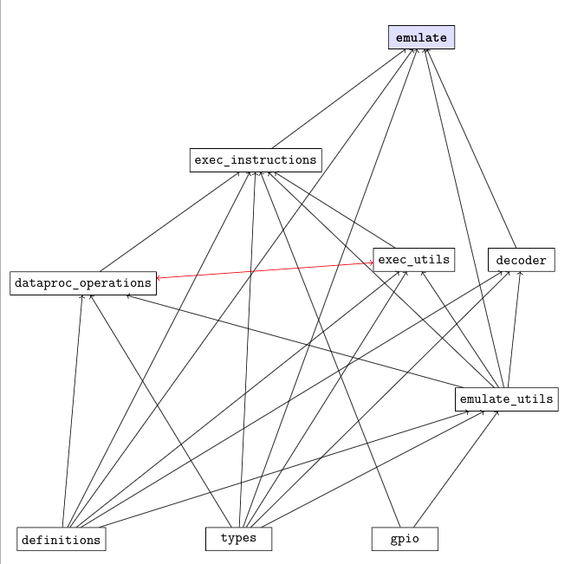
Cyclic File Dependencies

Slide 6
Cyclic File Dependencies
Initial Design:
Nested dependencies
Cyclic dependencies
How we modified it:
Deleted all dependencies from all the header files
Modified the dependencies in the .c files accordingly
Drew graph that mapped out all dependencies between the files
Merged relevant files to remove cyclic dependencies

Slide 7
ASSEMBLER

Slide 8
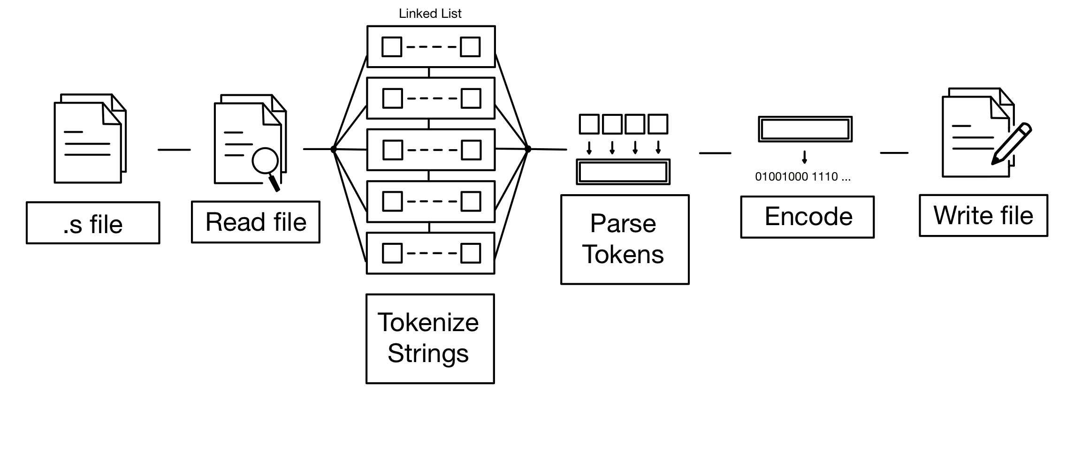
General Structure

Slide 9
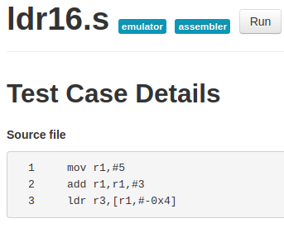
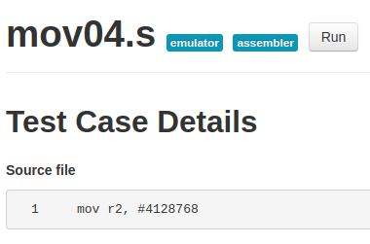
Interesting Test Cases #1
ldr16.s
Separators #, -
mov04.s
Special op2

Slide 10
Roadblock (parse_operand2())
Many cases
Difficult optimal implementation

