Slide 1

Predicting severity of an accident
Siddhant Sinha

Slide 2
PROBLEM STATEMENT
To predict the severity of a road accident using various attributes given such as road condition, car speed etc.
This may depend on several factors such as Road condition, lighting, speed, junction, weather, etc.
We need to select appropriate attributes and then train a model.

Slide 3
Data acquisitioN
Dataset – Seattle’s road traffic accident dataset made available by this course itself was used.
Dataset consists of 38 attributes. It has 194,673 data rows and each row represents one accident.
The label is denoted of SEVERITYCODE which is 1 for non severe accident and 2 for severe accident. Goal will be to predict this once the model has been trained.

Slide 4
Attributes
Some of the attributes are -
Road Condition
Light Condition
Speeding
Collision Type
Weather

Slide 5

Feature selection
This is the first step
Find related attributes and significance of a particular attribute on SEVERITY.
It can be done by finding correlation between every pair of attribute.
We plot a heat map

Slide 6
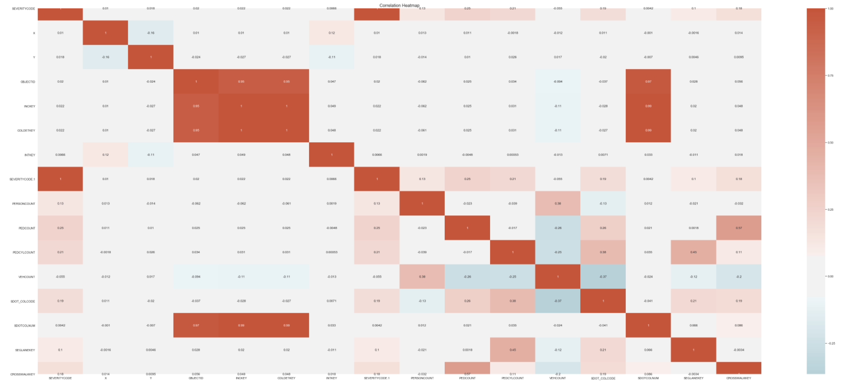
HEAT MAP

Slide 7
FEATURE SELECTION
I selected following attributes to train the model
ADDRTYPE
COLLISIONTYPE
JUNCTIONTYPE
PEDCOUNT
PEDCYLCOUNT
VEHCOUNT
WEATHER
ROADCOND
LIGHTCOND
SPEEDING
SDOT_COLDESC
ST_COLDESC

Slide 8
CLEANING DATA
Find out missing values for attributes selected
All the attributes had fairly less number of missing values except SPEEDING.
SPEEDING had 185340 missing values. But it was realised that all the values present were Yes and instead of No it contained NaN.
So I replaced all NaN with No in the SPEEDING column.
For all other columns those rows which contained missing values were dropped.

Slide 9
data imbalance
Number of data points for label 1 are 126270
Number of data points for label 2 are 56625 only.
Sample out 56625 data points from class label 1 to have equal number of data points

Slide 10
Label Encoding
Most of the values are in form of text.
So, I used preprocessing.LabelEncoder() from sklearn to encode these values into numbers.

Slide 11
STANDARD SCALAR AND SPLIT
Apply standard Scalar to normalise the data.
Also, split the data into train and test set and train a decision Tree Classifier over it.

Slide 12
Train the model
Decision Tree classifier trained on 101925 samples with a maximum depth of 20 using the data generated in previous slide

Slide 13
RESULTS
F1 Score obtained was 0.680907372400756

Slide 14
CONCLUSION
Road traffic accidents are leading to an increased damage to property and cost to life
Able to mitigate situations of a road traffic accident effectively by using data can be extremely helpful.
In this project I used several attributes that contribute to severity of a road traffic accident and built a model to make severity predictions for the future cases.

