Slide 1
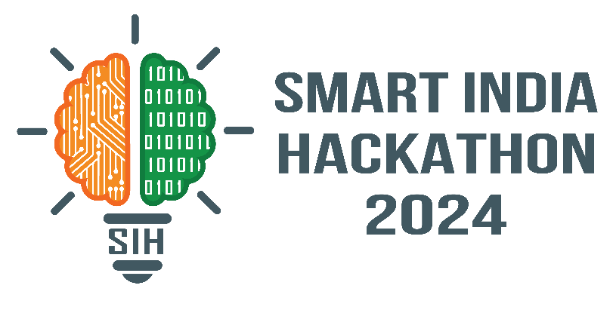

SMART INDIA HACKATHON 2024
TITLE PAGE
Problem Statement ID – SIH1696
Problem Statement Title- A software application - Ground water level predictor
Theme- Smart automation
PS Category- Software
Team ID-
Team Name (Registered on portal) – Synchron-us

Slide 2
IDEA TITLE
Synchron - US
`
Proposed Solution :-
Build a software application for predicting and analyzing groundwater levels based on environmental factors such as rainfall, land use, population, and hydrogeology.
The app will also fill in data gaps in time-series data and forecast groundwater levels in space and time.
Detailed Explanation:-
Uses a combination of real-time and historical groundwater data along with environmental factors to predict future groundwater levels.
Integration of Geographic Information Systems (GIS) and Machine Learning (ML) models to analyze and visualize groundwater levels.
User-friendly interface for public access to forecast groundwater levels at any location and time.
Innovation and Uniqueness:-
Machine Learning for Complex Pattern Recognition: Identifies hidden and non-linear relationships between environmental variables, enabling more accurate predictions.
Multivariate Analysis: Handles complex interdependencies between multiple factors like rainfall, temperature, soil moisture, and human water usage.

Slide 3
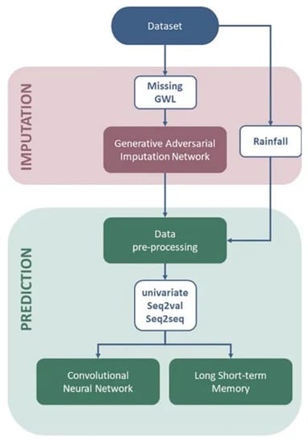
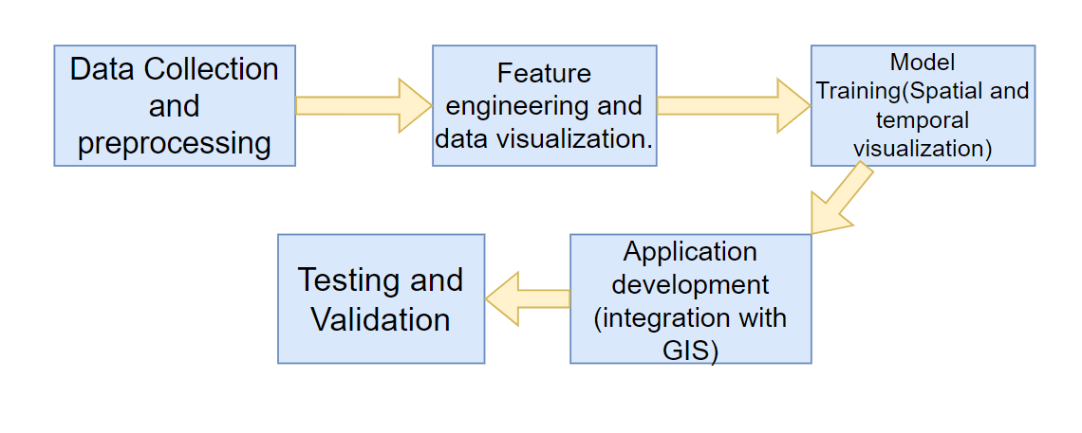
TECHNICAL APPROACH
Synchron - US
Technologies to be Used:-
Programming Languages:- Python, R
Frameworks:- TensorFlow, scikit-learn, GIS software (e.g., QGIS)
Database:- MySQL/PostgreSQL
Visualization Tools: Plotly, Matplotlib, Leaflet (for map visualizations)
Methodology and Process:-
Data Collection:- Groundwater levels, rainfall, land use, and population data.
Data Preprocessing:- Cleaning, normalization, and geospatial alignment.
Modeling:- Time-series forecasting using LSTM; spatial modeling with GIS-based ML models.
Implementation Flow:-

Slide 4
FEASIBILITY AND VIABILITY
Synchron - US
Feasibility:-
Data availability from public agencies like CGWB ensures reliable inputs.
Proven ML algorithms for time-series and spatial data.
Cloud infrastructure can handle scalability for user queries and real-time predictions.
Challenges:-
Missing or incomplete data, especially in remote areas.
Real-time data updating and model retraining for accuracy.
Integrating diverse datasets (spatial, temporal) into one unified model.
Strategies:-
Use imputation techniques to fill missing data.
Set up continuous data pipelines for real-time updates.
Regular model retraining using new data points.

Slide 5
IMPACT AND BENEFITS
Synchron - US
Impact:-
Helps manage water resources more efficiently by predicting groundwater depletion.
Provides critical information for agricultural planning and urban development.
Aids policymakers and environmentalists in maintaining the health of aquifers.
Benefits:-
Social :- Informs communities about groundwater availability, ensuring sustainable water usage.
Economic :- Helps farmers and industries optimize water use, reducing costs.
Environmental :- Supports conservation efforts by identifying stressed aquifers and promoting better land use practices.

Slide 6
RESEARCH AND REFERENCES
Synchron - US
References:-
Data from the Central Ground Water Board (CGWB) and similar agencies.
Research on groundwater modeling and ML-based prediction techniques.
Open-source GIS tools and libraries for spatial analysis.
https://youtu.be/XgOjTtA13sk?si=_nVfXItYBHffLVUl (Similar project related to it but used different approach)

