Slide 1

SMART INDIA HACKATHON 2026
SMART INDIA
HACKATHON
2026
Problem Statement ID- SIH26055
Problem Statement Title- Smart Scan Strategy for Electronic Warfare (DRDO)
AAMS-X
Adaptive Autonomous Mission Spectrum eXplorer
Theme- Robotics and Drones
PS Category- Software
Team ID-123075
Team Name- Alphax
Notes:
Official TSRD source: https://huggingface.co/datasets/alan-turing-institute/turing-synthetic-radar-dataset . Installed file tsrd_val_stare_config_0.h5 contains 648,034 pulses with no pulse-count truncation. Source SHA-256 d25a4189f287ca044f46718baea7471eb1f9ab766b7715c738bb8edf8ac1e474. Results computed by scripts/validate_official_tsrd.py: 24 paired worlds, 192 evaluations, seeds 42–47, 240 slots, 64 bands, window widths 2,4,8,16. All eight policies share each immutable world/noise and budget. Seeds vary modeled receiver noise and policy randomness over ONE source recording, not independent source samples. Values are global occupied-cell recall, not individual pulse recall or publisher deinterleaving benchmark scores. Receiver energy is modeled from source pulse occupancy, not measured IQ data. Mean fixed / MAG-NTS / Thompson recall (%) by width: 2 = 2.71 / 13.27 / 15.83; 4 = 5.47 / 31.48 / 36.75; 8 = 11.07 / 37.38 / 39.55; 16 = 21.96 / 52.34 / 55.30. Thompson leads on this file. No universal superiority or field-validation claim. Full per-seed results, Student-t confidence intervals and paired deltas: docs/validation/tsrd/report.json; width-*.csv. Stored replay checksums verified for all 24 worlds. Timing averages are conditional on intercepted episodes. Earlier simulation evidence remains separately labelled in the app. e-CALLISTO is measured solar-radio data without radar emitter truth. The SIH screenshot specifies theme Robotics and Drones.

Slide 2
Alphax
AAMS-X: ADAPTIVE SCAN SCHEDULING FOR ELECTRONIC WARFARE
SMART INDIA
HACKATHON
2026
THE PROBLEM :
OUR SOLUTION:
KEY FEATURES :
Limited Observation Window: The receiver has limited instantaneous bandwidth and sees only one contiguous slice of a wide spectrum. Fixed sweeps spend equal time on inactive and useful bands.
Observation-Only Active Sensing: The policy receives selected-band energy, HIT/MISS and confidence. Regression tests guard the observation boundary.
Receiver Digital Twin
Discounted Bayesian Belief
Expected Information Gain
Associative Memory
Change Detection (CUSUM)
Periodicity Estimation
Live Duel & Offline Replay
3D Spectrum Intelligence Cube
Missed Short Events: Bursts and periodic emitters can appear and vanish between revisits, so predetermined sweeps miss them.
MAG-NTS Scheduler: Memory-augmented, information-guided, non-stationary Thompson sampling scores every legal contiguous window.
Partial, Non-Stationary Information: Only the selected window is observed, activity patterns drift over time, and a change cannot be known instantly.
Adaptive & Cost-Aware: Discounted Beta beliefs, CUSUM change detection and periodicity estimation, with a penalty for retuning cost.
WHY WE STAND OUT
Truth-isolated policy
Uncertainty-aware decisions
Explainable at every step
Reproducible benchmarks
Costly, Opaque Decisions: Retuning costs dwell time, and black-box schedulers give operators no reason why a band was chosen.
Explainable & Fair Evaluation: Each decision stores its score components and alternatives; policies are compared on identical paired worlds.
@SIH Idea submission- Template
2
Notes:
Policy input includes only selected-band observations and public receiver settings. HIT is detector output, and unobserved cells remain unknown. The truth-leak regression guard is an architectural test, not an adversarial sandbox.

Slide 3
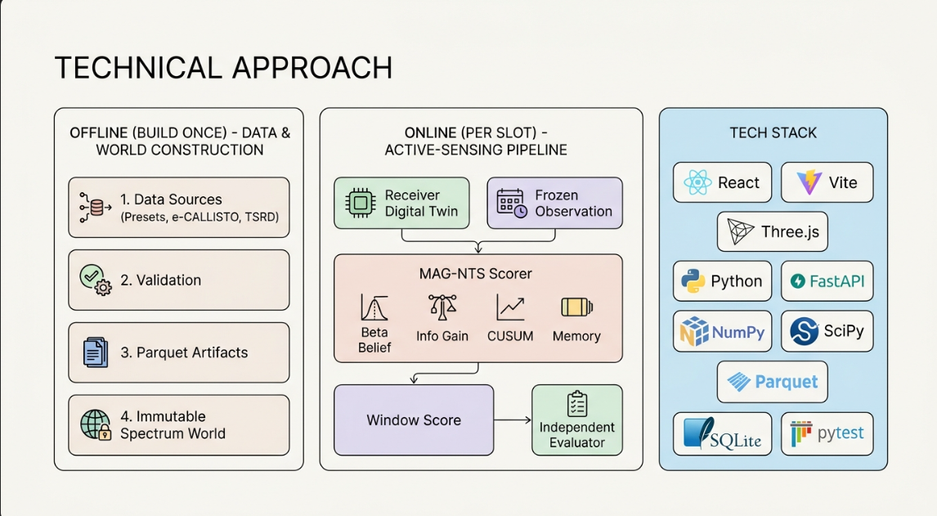
Alphax
TECHNICAL APPROACH
SMART INDIA
HACKATHON
2026
ONLINE (PER SLOT)
OBSERVATION-ONLY POLICY
Frozen selected-window observations
Energy, HIT/MISS and confidence
Simulation, e-CALLISTO
TSRD via Hugging Face
Update beliefs and temporal evidence
Memory, recurrence and CUSUM
Score legal contiguous windows
Information, uncertainty and costs
NPZ + Parquet
Source and artifact hashes
Select window and sense
Bandwidth and dwell limits apply
New observation starts the next decision
Independent evaluator: truth + trace
@SIH Idea submission- Template
3
Notes:
The loop begins with prior observations, updates online state, chooses a legal window, senses, and repeats. The evaluator separately owns labels and computes metrics. TSRD PDWs retain ToA, frequency, pulse width, AoA, amplitude and local emitter labels in Parquet. The adapter simulates receiver energy over retained pulse occupancy. Source: https://huggingface.co/datasets/alan-turing-institute/turing-synthetic-radar-dataset ; installed manifest: data/processed/tsrd-stare-d25a4189f287.json. NPZ stores compact arrays, Parquet stores samples, and SQLite indexes traces.

Slide 4
Alphax
FEASIBILITY AND VIABILITY
SMART INDIA
HACKATHON
2026
Technical Feasibility
Economic Feasibility
Maintenance & Safety Feasibility
Working prototype: simulator, receiver digital twin, MAG-NTS and baselines
Interpretable maths (Beta beliefs, information gain, CUSUM), no hidden neural network
Local launch and Azure hosted demo
Built on established open-source tools
Parameter | Current Prototype | Future Scope
Data | Simulation, TSRD, e-CALLISTO | Calibrated SDR
Software | Open-source Python | Low-cost scaling
Backend | FastAPI, Azure | Multi-user service
Frontend | React + Three.js | Operator console
Storage | SQLite + Parquet | Dedicated database
Observation-only research workbench
Regression tests guard policy inputs
Checksummed traces and dataset provenance
Limits stated: digital-twin approximation, not field validated
Modular policies, ablations and datasets
Operational Viability
Implementation Viability
✔ Simulator and receiver digital twin
✔ MAG-NTS scheduler with 4 baselines
✔ REST + WebSocket API
✔ React dashboard and 3D cube
✔ Automated backend and browser tests
Research & Future Viability
Dashboard: Command Center, Live Duel, Benchmark Lab
Local replay works offline after setup
CSV/JSON exports for audit
For EW researchers, SDR developers, evaluators
Expanded TSRD and measured-data evaluation
Calibrated SDR / hardware-in-the-loop
Multi-receiver cooperation, richer policies
Broader measured data, edge evaluation
RUNS LOCALLY • FULLY OPEN-SOURCE STACK • REPRODUCIBLE • MODULAR & EXTENSIBLE
@SIH Idea submission- Template
4
Notes:
Current installed sources include simulation, e-CALLISTO and TSRD stare-mode data. TSRD contains 648,034 retained pulses, with no pulse-count truncation reported in this file. Deployed readiness and catalog: https://aams-x-916960484603.asia-south1.run.app/api/status and /api/datasets. Cloud Run serves the demo; the implementation uses a local SQLite registry and compressed trace files. Hardware calibration, cooperative receivers and multi-user service infrastructure remain future work.

Slide 5
Alphax
IMPACT AND BENEFITS
SMART INDIA
HACKATHON
2026
1. SENSING IMPACT
Adaptive Scan Allocation
Learns where to look next from observed hits and misses. Official TSRD: mean recall 31.48% vs fixed 5.47% at 4/64 bands. Thompson reaches 36.75% on this recording.
2. EW ANALYSTS & RESEARCHERS
Explainable Decisions
Each action stores score components, beliefs and five candidates including the chosen window. A ten-stage trace explains the decision.
3. TRUST & SAFETY
No False Certainty
Measured-RF runs show N/A for truth-based metrics, Ground Truth is off by default, and a truth-leak test guards the policy.
4. EVALUATION SYSTEM
One Reproducible Workbench
Fair duels use an identical world, detector noise and timing budget. TSRD: 24 paired worlds and 192 policy evaluations. Six seeds, four receiver budgets, eight policies, stored replays.
5. TECHNOLOGY & RESEARCH
Interpretable by Design
Ablations remove memory, information gain or change detection. The saved seed-42 periodic demo estimates an 18-slot period. Other runs can differ.
6. SOCIAL & ECONOMIC
Stretches Scarce Receiver Bandwidth
Software evaluation of receiver allocation before hardware trials. Three source modes and an open-source stack.
Turning a bandwidth-limited receiver into an adaptive, explainable, uncertainty-aware spectrum scout
@SIH Idea submission- Template
5
Notes:
Official TSRD source: https://huggingface.co/datasets/alan-turing-institute/turing-synthetic-radar-dataset . Installed file tsrd_val_stare_config_0.h5 contains 648,034 pulses with no pulse-count truncation. Source SHA-256 d25a4189f287ca044f46718baea7471eb1f9ab766b7715c738bb8edf8ac1e474. Results computed by scripts/validate_official_tsrd.py: 24 paired worlds, 192 evaluations, seeds 42–47, 240 slots, 64 bands, window widths 2,4,8,16. All eight policies share each immutable world/noise and budget. Seeds vary modeled receiver noise and policy randomness over ONE source recording, not independent source samples. Values are global occupied-cell recall, not individual pulse recall or publisher deinterleaving benchmark scores. Receiver energy is modeled from source pulse occupancy, not measured IQ data. Mean fixed / MAG-NTS / Thompson recall (%) by width: 2 = 2.71 / 13.27 / 15.83; 4 = 5.47 / 31.48 / 36.75; 8 = 11.07 / 37.38 / 39.55; 16 = 21.96 / 52.34 / 55.30. Thompson leads on this file. No universal superiority or field-validation claim. Full per-seed results, Student-t confidence intervals and paired deltas: docs/validation/tsrd/report.json; width-*.csv. Stored replay checksums verified for all 24 worlds. Timing averages are conditional on intercepted episodes. Earlier simulation evidence remains separately labelled in the app. e-CALLISTO is measured solar-radio data without radar emitter truth. The SIH screenshot specifies theme Robotics and Drones.

Slide 6
Alphax
RESEARCH, EVIDENCE AND ADOPTION
SMART INDIA
HACKATHON
2026
Source | Key Finding | Research Gap
Official TSRD benchmark 24 worlds, seeds 42–47 | 4/64 recall: MAG 31.48% Fixed 5.47%, TS 36.75% | One validation recording Modeled receiver energy
e-CALLISTO archive (Anchorage, 2024-05-10) | 705,600 measured samples ingested with SHA-256 provenance | Solar radio, no labelled EW emitter truth
TSRD / Hugging Face Alan Turing Institute | 648,034 official pulses 6 seeds, 8 policies tested | Synthetic radar source No field validation
Periodic challenge | Seed-42 demo: 18 slots 1.8 s at 100 ms/slot | Confidence is heuristic, uncalibrated
DEMO & SOURCE LINKS
LIVE WEBSITE (AZURE): CLICK TO OPEN
GITHUB: Siddhanthkjain2005/AAMS-X
YOUTUBE DEMO: ADD VIDEO LINK HERE
Potential Applications
Defence spectrum monitoring, cognitive radio, spectrum management, SDR receiver platforms
Initial Users
EW research labs, receiver developers, evaluators of scan-strategy algorithms
Proposed Pilot Path
Research prototyping, benchmarking, hardware-in-the-loop pilots
@SIH Idea submission- Template
6
Notes:
[object Object]
Judging resources: live Azure website https://aams-x-sih.livelyocean-37549b44.eastasia.azurecontainerapps.io . Source repository https://github.com/Siddhanthkjain2005/AAMS-X . YouTube placeholder intentionally has no link until the team supplies its video URL. Azure uses a minimum of one running replica; service outages remain possible.

