Slide 1

SMART INDIA HACKATHON 2026
AAMS-X
Adaptive Autonomous Mission
Spectrum eXplorer
An explainable spectrum research workbench
Problem Statement ID
SIH26055
Problem Statement Title
Smart Scan strategy for
Electronic Warfare
Theme
Awaiting portal confirmation
PS Category
Software
Team ID
Not supplied
Team Name (Registered on portal)
AlphaX
Notes:
OPENING (25 seconds)
We are AlphaX. AAMS-X is our software research prototype for SIH26055. A receiver only observes a small part of the spectrum at a time. Our contribution is an inspectable workbench that demonstrates the resulting partial-observation problem and lets a reviewer reproduce the evidence.
PROJECT SCOPE
This presentation describes the supplied software prototype at a high level. It does not establish field readiness or calibrated hardware performance. The registered Team ID and official portal theme were not supplied and must be completed before submission. Do not infer the theme from unofficial listings.
SOURCES
User-supplied SIH2026-IDEA-Presentation-Format.pptx, slides 1 and 7. Project README.md, project identity and interpretation. Official SIH artwork extracted unchanged from the supplied template.
FULL NAME
Adaptive Autonomous Mission Spectrum eXplorer.

Slide 2

AAMS-X
AlphaX
Proposed solution
A local workbench to test and explain adaptive scan decisions
when the receiver can observe only part of the spectrum.
The problem
A narrow observation window leaves most of the spectrum unknown at each instant.
How AAMS-X addresses it
Compare fixed and adaptive policies in the same simulated world, then inspect each recorded decision.
Innovation and uniqueness
Wide spectrum
Limited observation window
Concept illustration, not measured data
One auditable workflow combines live comparison,
explanations, provenance and exact recorded replay.
@SIH Idea submission- Template
Notes:
PROPOSED SOLUTION (45 seconds)
Explain the visual first: the blue field represents a broad unknown spectrum and the amber slice represents a limited observation. It is a concept image, not a measurement. AAMS-X provides a seeded environment, an abstract receiver, existing adaptive and baseline policies, and an independent evaluator in one working local app.
HOW IT ADDRESSES THE PROBLEM
The policy receives observations from the selected window only. Missing observations do not become negative labels. The research UI separates estimated probability from uncertainty. Reviewers can pause, inspect a saved decision, open the 3D view and replay the same stored run.
INNOVATION CLAIM
The differentiator is the integration of explainable partial-observation experiments with reproducibility and visible provenance. MAG-NTS is an experimental composition of established online learning ideas. We do not claim that Thompson sampling, memory, change detection or periodicity estimation are newly invented, or that the composite is universally superior.
SOURCE
README.md, Product workflow, Programmatic truth isolation, MAG-NTS and Limitations.
VISUAL PROVENANCE
Generated with the built-in image generation tool for this presentation. Saved project asset: .alphax-build/spectrum-concept.png. Prompt: Premium scientific editorial illustration on observing a wide radio-frequency spectrum through a limited receiver view. Wide landscape, pure white background, translucent navy-blue spectral wave ribbons and cyan peaks, with one narrow amber glass observation slice. Isometric 3D scientific visualization. No text, numbers, logos, maps, interface panels or military equipment. Conceptual illustration, not measured data.

Slide 3
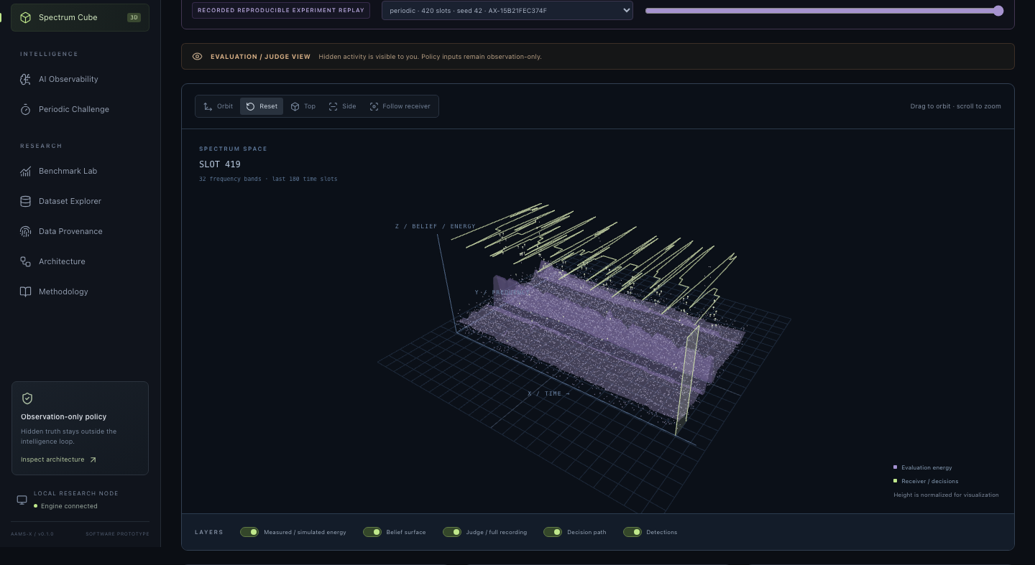
TECHNICAL APPROACH
AlphaX
Methodology and implementation
01
Reproducible inputs
Seeded simulations or a public RF recording.
02
Observation boundary
Only the selected window reaches the policy.
03
Inspectable model state
Recorded beliefs and explanations stay visible.
04
Independent evaluation
Compare policies and save verified traces.
Working prototype: recorded 3D exploration
Technologies
Evaluation view shown. Hidden truth stays outside policy inputs.
Python / FastAPI / NumPy / SciPy
React / TypeScript / Three.js / SQLite
@SIH Idea submission- Template
Notes:
TECHNICAL APPROACH (55 seconds)
Describe the software boundary at a high level. A source adapter produces an immutable world. The receiver returns only the chosen observation window. A policy updates its internal state from those observations. A separate evaluator can inspect hidden simulation truth and record metrics. The evaluator never supplies truth-derived reward to policy updates.
WORKING PROTOTYPE
The pictured Spectrum Intelligence Cube is an authentic screenshot in docs/screenshots/spectrum-cube.png, captured from a recorded periodic run. Evaluation view is enabled in this screenshot, so the audience can see information deliberately withheld from the policy. This distinction is central to explaining the prototype honestly. The screenshot is shown as product evidence, not as a substitute for an editable scientific chart.
TECHNOLOGIES USED
Python 3.11+ with FastAPI, NumPy and SciPy for the local service and scientific work. React, TypeScript and Three.js for the UI. SQLite indexes stored experiments. JSON/CSV exports and checksummed compressed traces support review. Parquet, FITS and HDF5 adapters retain source provenance. Local operation after installation does not require a paid AI API.
IMPLEMENTATION STATUS
Implemented: local simulation, existing policies and ablations, observation boundary, live transport, stored replay, provenance, 3D visualization, metrics and exports. Proposed next work: broader independent validation and a separately reviewed hardware interface.
SOURCES
README.md Architecture, Receiver model, API and event model, Offline replay and performance. backend/contracts.py. docs/VALIDATION.md. Screenshot: docs/screenshots/spectrum-cube.png.

Slide 4
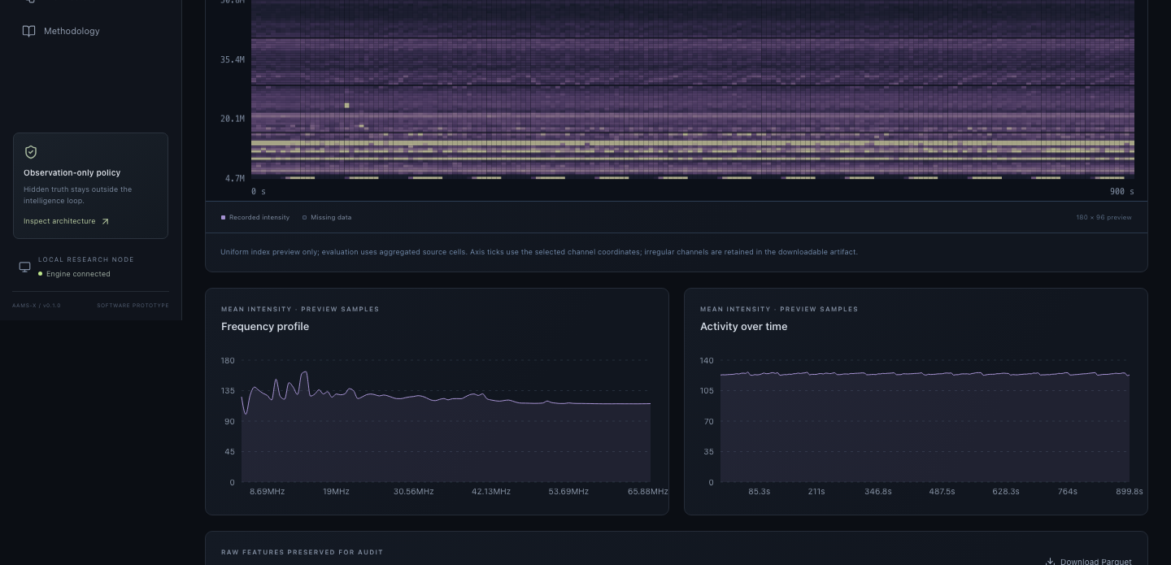
FEASIBILITY AND VIABILITY
AlphaX
A working software prototype with reproducible evidence
32
30
180
backend tests passed
paired simulation worlds
policy evaluations
Challenges and validation strategy
Current limitation | How AlphaX will address it
Official TSRD absent | Obtain authorized data, then verify the import.
Hardware unvalidated | Plan independent calibration and lab review.
Scenario-dependent results | Expand seeds and independent test datasets.
Measured data already included
705,600 standardized solar-radio samples.
No labelled EW emitter ground truth.
Viability: local operation after setup, open-source libraries and no paid API dependency.
@SIH Idea submission- Template
Notes:
FEASIBILITY AND VIABILITY (50 seconds)
We have a working local research application and recorded evidence. The supplied benchmark covers ten presets, three seeds per preset and six policies, giving 30 paired worlds and 180 policy evaluations. The 32 backend tests passed in this workspace during the current session. They cover software contracts and calculations, not operational effectiveness.
ECONOMIC AND PRACTICAL VIABILITY
The prototype uses open-source libraries and runs locally after installation. No paid external model API or bespoke RF hardware is required for the current simulator demonstration. We have not measured deployment cost, energy use, or financial savings. Those should remain future evaluation topics.
DATA STATUS
The public e-CALLISTO recording is ALASKA-ANCHORAGE, 10 May 2024, approximately 16:00 UTC. Standardization retains 705,600 values. It is a solar-radio measurement used to demonstrate ingestion, missing-channel handling and provenance. It cannot support labelled EW interception or classification claims.
RISKS AND MITIGATIONS
The TSRD importer exists, but an authorized publisher artifact is absent. Do not present synthetic test fixtures as official data. Software abstractions need independent hardware calibration before any hardware claim. Small seed counts limit statistical certainty. Existing results show scenario-dependent behavior, so expanding independent data and reporting all baselines is necessary. These are proposed validation steps, not completed milestones.
SOURCES
Current pytest output: 32 passed. docs/VALIDATION.md. docs/DATA.md. data/demo/BENCH-723C785465.json. Actual screenshot: docs/screenshots/measured-rf.png. e-CALLISTO network: https://www.e-callisto.org/ . Public source archive: https://soleil.i4ds.ch/solarradio/ .

Slide 5
IMPACT AND BENEFITS
AlphaX
Simulation evidence shows both gains and limits
Global recall: detected active cells / all active band-time cells
For research reviewers
Replay the same evidence and inspect assumptions behind each comparison.
For engineering teams
Identify software and data gaps before proposing hardware trials.
Expected benefit
More transparent evaluation.
Cost and field benefits remain unmeasured.
Selected scenarios. Means over seeds 42–44, 240 slots. Full suite: 10 scenarios and 6 policies.
Thompson leads in the sparse case. Three seeds do not establish universal superiority or field performance.
@SIH Idea submission- Template
Notes:
IMPACT AND BENEFITS (50 seconds)
This chart contains actual bundled simulation results. It uses four explicitly selected scenarios from the ten-scenario suite. Each mean uses seeds 42, 43 and 44 at a 240-slot horizon. The chart retains the fixed baseline and vanilla Thompson, including the sparse case where Thompson exceeds the composite policy.
READING THE CHART
Global recall divides detected active cells by all active band-time cells, including cells outside the observed window. It is distinct from detector probability of detection conditioned on observing a cell. The bundled report includes confidence intervals, variance, all scenarios and ablations. Wide intervals and only three seeds per scenario limit conclusions. Do not describe these figures as live hardware results, accuracy, or guaranteed gains.
EXPECTED IMPACT
For reviewers and researchers, the immediate value is a transparent comparison workflow with replayable scientific evidence. For engineering teams, the prototype exposes data, software and evaluation gaps before hardware trials. Reusable experiments may reduce duplicated evaluation work, but no economic, environmental, or time-saving amount has been measured.
SOURCE
data/demo/BENCH-723C785465.json, aggregates[*].metrics.recall.mean. Benchmark ID BENCH-723C785465. Local README.md, Fair experiments and metrics and Reproducible evidence included. Chart values derive directly from the JSON report, not copied from marketing claims.

Slide 6
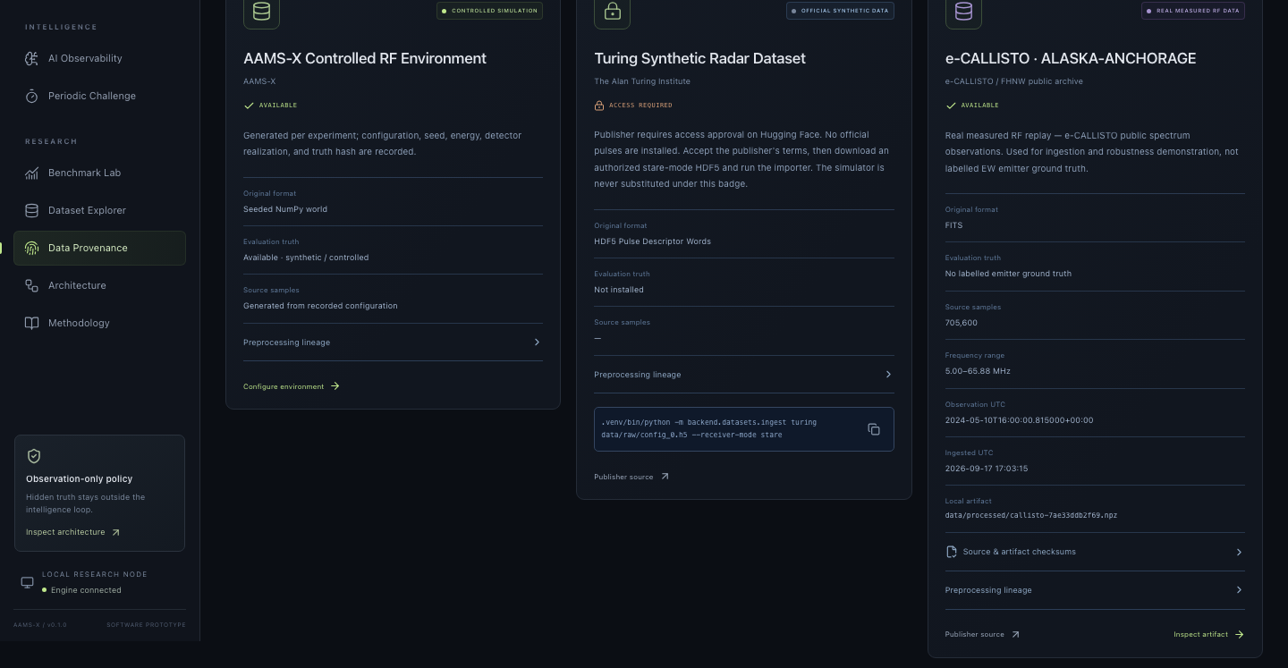
RESEARCH AND REFERENCES
AlphaX
Research foundations and auditable project evidence
01
Russo et al. (2018)
AlphaX evidence package
A Tutorial on Thompson Sampling
arxiv.org/abs/1707.02038
Foundations for learning under uncertainty.
02
Gunn et al. (2026)
The Turing Synthetic Radar Dataset
arxiv.org/abs/2602.03856
Importer implemented. Authorized data still required.
03
e-CALLISTO / FHNW
Public solar-radio observations
BENCH-723C785465
www.e-callisto.org/
Checksummed traces, exact replay,
metric definitions and source manifests.
Measured recording included with source lineage.
Reproduce locally: ./start_demo.sh
Project evidence: README.md, docs/DATA.md, docs/METHODOLOGY.md and the bundled benchmark report.
@SIH Idea submission- Template
Notes:
RESEARCH AND REFERENCES (35 seconds)
Our project uses established research ideas and makes the evidence inspectable. The novelty claim is the integrated workbench and evaluation workflow, not ownership of the underlying statistical methods.
PRIMARY REFERENCES
1. Daniel Russo, Benjamin Van Roy, Abbas Kazerouni, Ian Osband and Zheng Wen. A Tutorial on Thompson Sampling. Foundations and Trends in Machine Learning 11(1), 2018. Preprint: https://arxiv.org/abs/1707.02038 . Used for conceptual background on sequential decisions under uncertainty.
2. Edward Gunn, Adam Hosford, Robert Jones, Leo Zeitler, Ian Groves and Victoria Nockles. The Turing Synthetic Radar Dataset: A dataset for pulse deinterleaving. 2026. https://arxiv.org/abs/2602.03856 . Publisher dataset: https://huggingface.co/datasets/alan-turing-institute/turing-synthetic-radar-dataset . Our workspace has an importer but no authorized official artifact. We make no completed evaluation claim on TSRD.
3. e-CALLISTO, International Network of Solar Radio Spectrometers. https://www.e-callisto.org/ . FHNW public archive: https://soleil.i4ds.ch/solarradio/ . Included recording: https://soleil.i4ds.ch/solarradio/data/2002-20yy_Callisto/2024/05/10/ALASKA-ANCHORAGE_20240510_160000_01.fit.gz . Attribution to the recording station, e-CALLISTO network and FHNW archive.
4. AlphaX project evidence: README.md, docs/DATA.md, docs/METHODOLOGY.md, docs/VALIDATION.md, backend/tests/ and data/demo/BENCH-723C785465.json.
IMAGE SOURCE
Actual product screenshot docs/screenshots/data-provenance.png. Official SIH branding is from the user-supplied SIH 2026 template.
CLOSING
AAMS-X gives judges a working demonstration they can pause, inspect and reproduce. We are seeking further validation of the software research prototype, not claiming operational readiness.
SHORT Q&A
Is it field-tested? No, it is a software research prototype.
Is measured data labelled EW data? No, it is solar-radio data used for ingestion and robustness demonstration.
Does the policy see hidden truth? The policy contract supplies selected-window observations only, and tests guard that boundary.
Is MAG-NTS universally better? No, results depend on scenario and simpler baselines can outperform it.
Can judges rerun the demonstration? Yes, recorded traces, local launcher and metric definitions are supplied.

