Slide 1
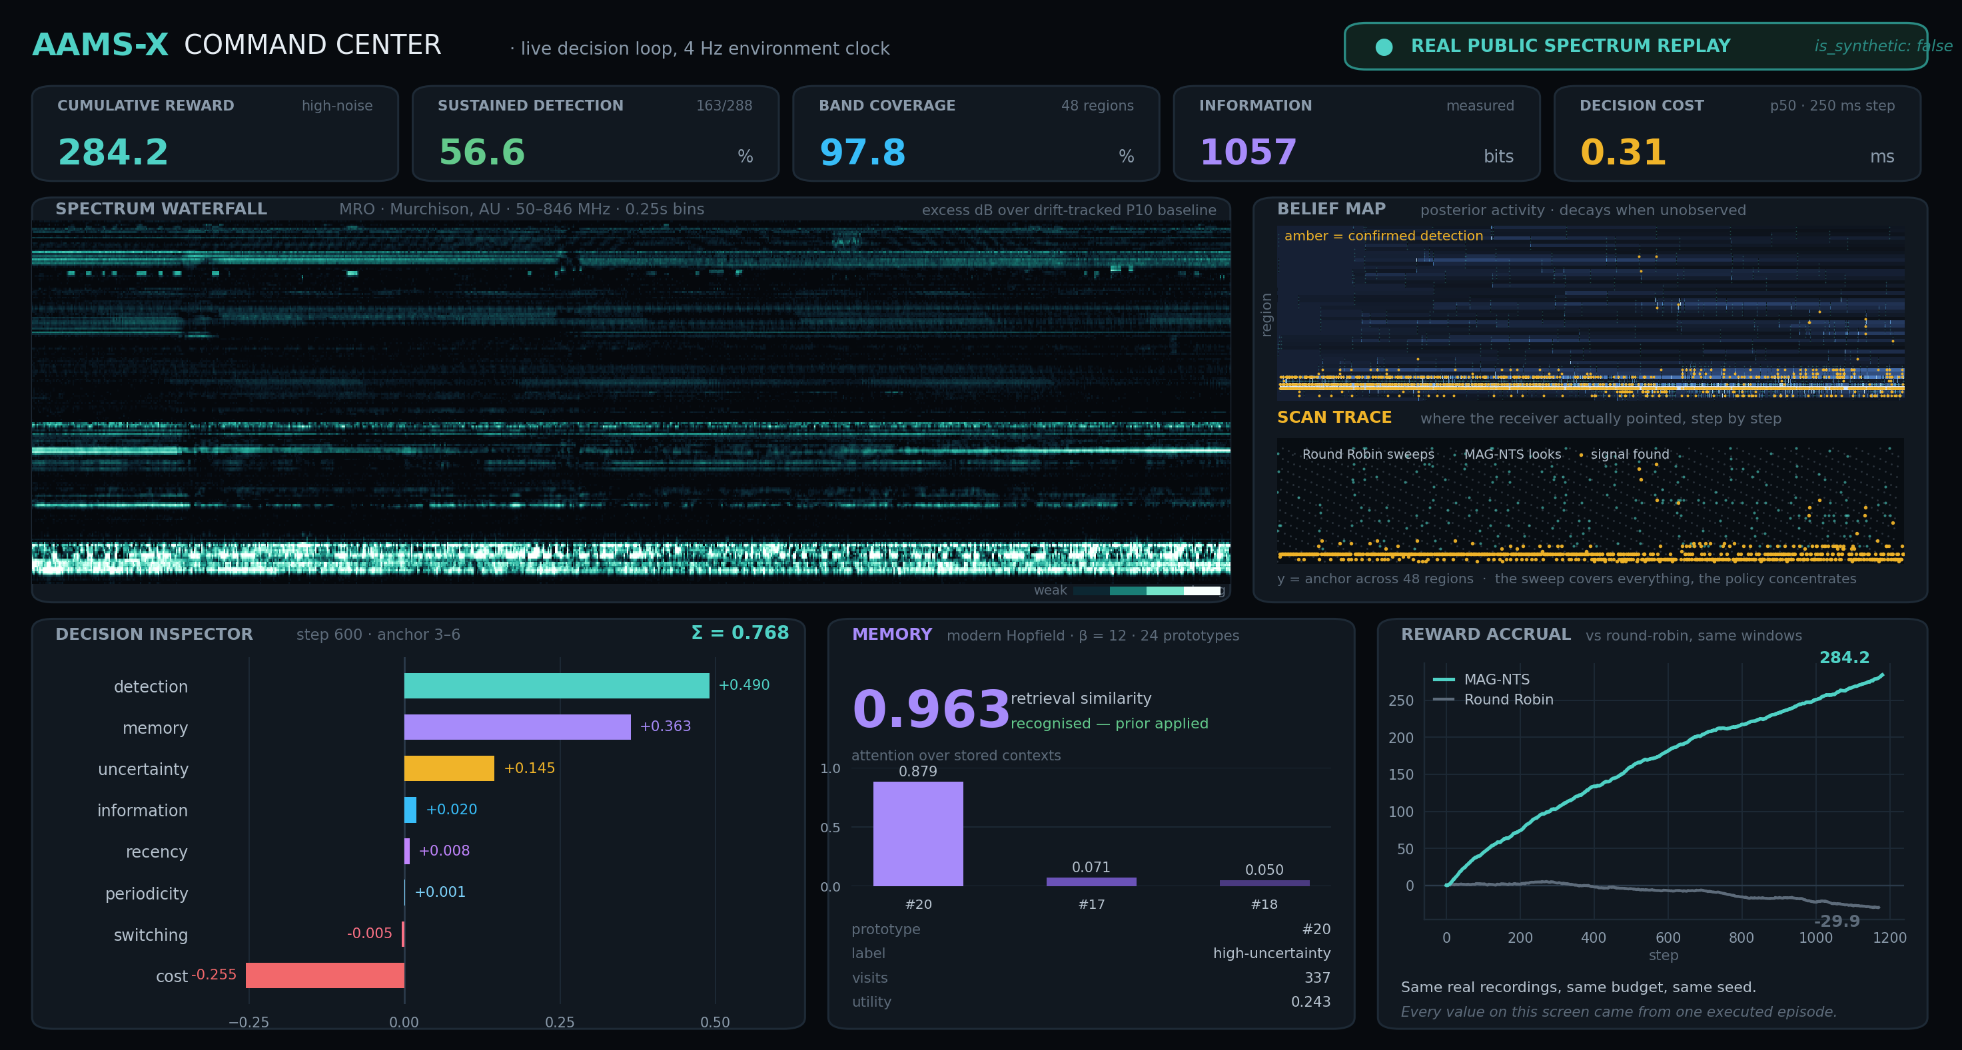

SMART INDIA HACKATHON 2026
AAMS-X
Adaptive Active Multi-band Spectrum eXplorer
An explainable active-sensing scheduler for wideband receivers, measured on real public spectrum.
Problem Statement ID – SIH26055
Problem Statement Title – Smart Scan Strategy for Electronic Warfare
Theme – Robotics and Drones
PS Category – Software
Team ID – < Team ID >
Team Name – Alpha
WORKING SYSTEM · REAL DATA · REPRODUCIBLE
▪ 7 real e-CALLISTO recordings 139 MB cached · 218 M spectrogram cells · is_synthetic: false, always
▪ 252 benchmark episodes 6 seeds × 6 policies × 7 presets — wins and losses both published
▪ 406 / 406 published values re-derive 1,456 stored comparisons audited, 0 disagreements
▪ 0.31 ms median decision against a 250 ms environment step · CPU only, no GPU
▪ Deployed and running http://98.130.46.223 — Docker Compose behind nginx
Command Center, live — real recording replaying, belief map, the eight-term decision decomposition, run KPIs.
SCOPE, STATED UP FRONT
▪ Domain public e-CALLISTO solar-radio recordings, replayed from a local cache.
▪ Out of scope on purpose no transmission, no jamming, no emitter identification, no geolocation, no hardware control.
▪ Transferable part budgeted active sensing under non-stationarity — the mathematics is domain-independent.

Slide 2
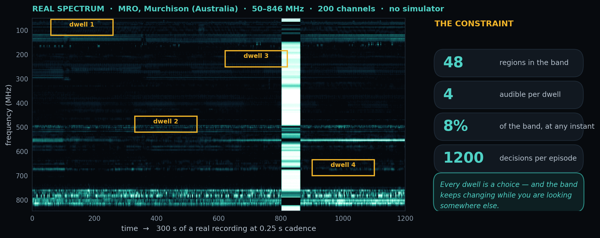
IDEA TITLE
Your Team Name
THE IDEA IN ONE LINE — A receiver can only listen to a slice of the band at a time. AAMS-X decides where to point it next — on real public spectrum recordings, with every decision explainable and every number reproducible.
WHAT IS NEW
▪ Contiguous-window action space. The scheduler picks a physically realisable tuning — a start channel and a span — not an unordered set of regions.
▪ Memory of contexts, not actions. 24 bounded prototypes; retrieval is one modern-Hopfield step at β = 12, so a returning environment is recognised, not relearned.
▪ The score is the algorithm. 8 additive terms with published weights. The UI shows the chosen window and the runner-up, term by term — no post-hoc attribution.
▪ Change detection gates memory. A Page-Hinkley + EWMA detector suppresses stale recall the moment the environment moves.
▪ Losses are published. 3 significant wins, 2 significant losses across 7 presets, each with the mechanism named.
Measured from the cache: 4 of 48 regions visible per step — 8.3 % of the band.
HOW IT WORKS · ONE DECISION, FOUR STAGES
1. Sense
replay a real recording; only the chosen window is revealed
2. Believe
per-region Beta posterior, decaying while unobserved
3. Decide
score every contiguous window on 8 terms, then sample
4. Explain
emit the decomposition, the runner-up and a note
HOW IT ADDRESSES THE PROBLEM
WHAT A JUDGE CAN CHECK IN 60 SECONDS
▪ Scarcity is the constraint 8.3 % of the band is visible per step; the policy turns that into an information-maximising schedule instead of a sweep.
▪ Non-stationarity is explicit periodicity and change detection are separate, measurable terms — not hyperparameters.
▪ Trust is a requirement an operator can read why the receiver moved; a deep-RL policy cannot supply that.
▪ Open the provenance panel source URL, retrieval time, preprocessing chain, licence, is_synthetic: false.
▪ Toggle the truth overlay off the scheduler never had it; belief tracks it anyway.
▪ Run the arena, then the ablation a preset it wins, then one it loses.
▪ Press Replay on a history row the episode re-runs and must reproduce the metrics.

Slide 3
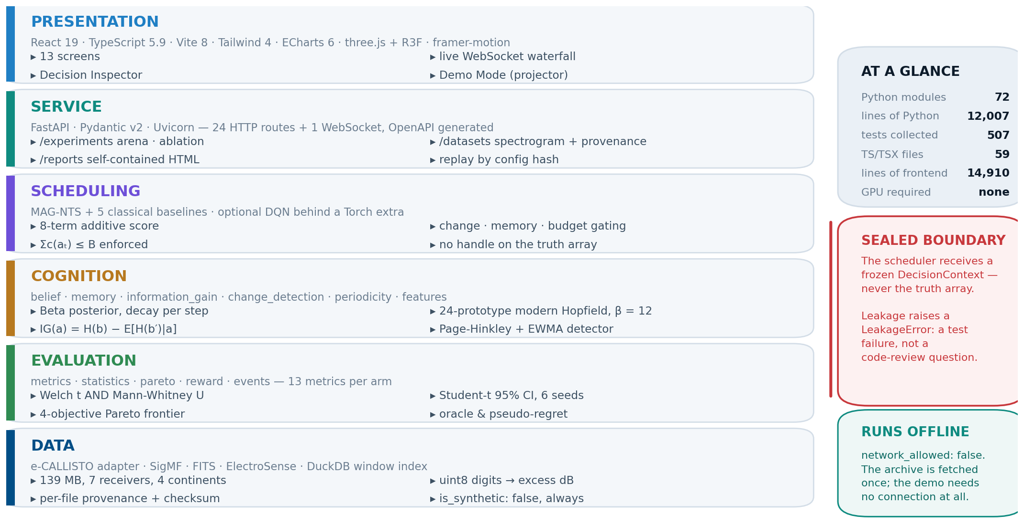
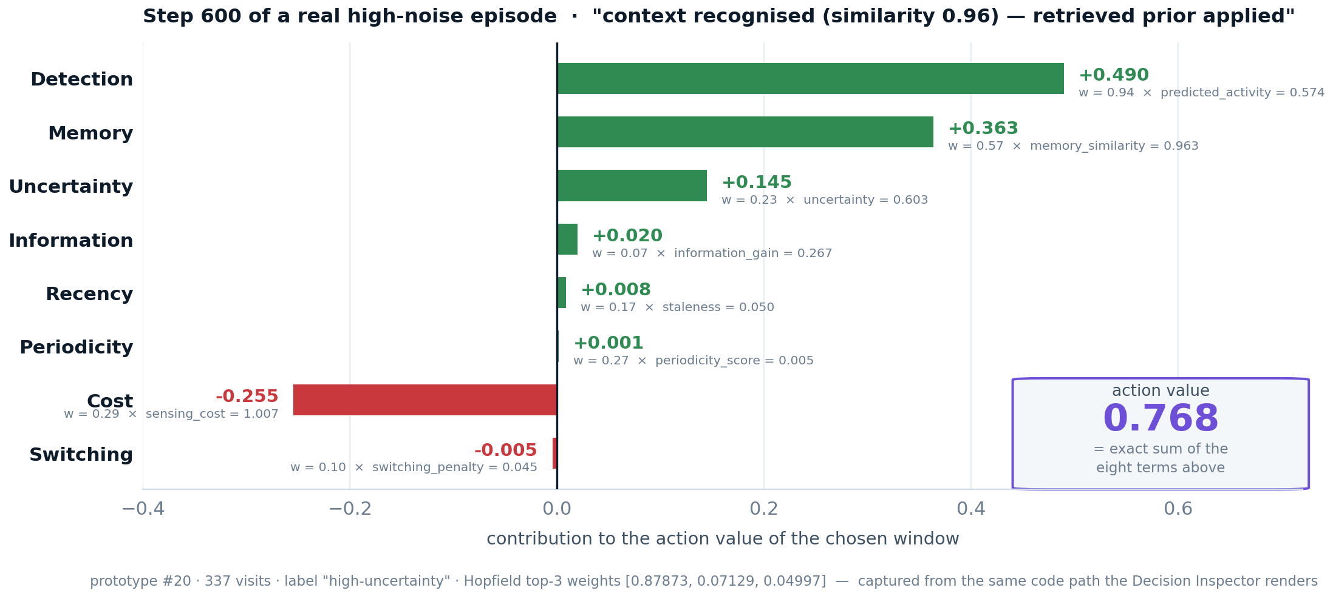
TECHNICAL APPROACH
Your Team Name
TECHNOLOGIES USED
▪ Core Python 3.11 · NumPy · SciPy — 72 modules, 12,007 lines, mypy clean
▪ Service FastAPI · Pydantic v2 · Uvicorn — 24 HTTP routes + 1 WebSocket, OpenAPI generated
▪ Interface React 19 · TypeScript · Vite · Tailwind — 13 screens, Canvas waterfall at 60 fps
▪ Data Parquet + DuckDB window index (3,350 windows) · SQLite run registry
▪ Policies MAG-NTS + 5 classical baselines · optional DQN behind a Torch extra
▪ Delivery Docker Compose · nginx · AWS EC2 · fully offline after the first fetch
▪ Quality pytest (507 collected) · ruff · mypy · verify_docs.py re-derives every published number
Five layers, each one directory. The sealed boundary is enforced by tests.
THE EIGHT-TERM SCORE — THIS IS THE ALGORITHM
THREE COUPLINGS, PLUS A HARD BUDGET
▪ Weights, published detection 0.942 · information 0.066 · memory 0.565 · periodicity 0.270 · uncertainty 0.234 · recency 0.172 · cost 0.292 · switching 0.103
▪ Tuned on train receivers only 45 candidates, 3 seeds, roles: ["train"] — the record is in data/index/mag_nts_tuning.json (advantage +28.57, win-rate 1.0).
▪ Change gating a detected shift damps the memory term for that step.
▪ Memory gating recall applies only above a similarity threshold.
▪ Budget pressure remaining budget rescales the cost and switching terms.
▪ Σc(aₜ) ≤ B enforced the environment rejects an over-budget action; it is not a soft penalty.

Slide 4
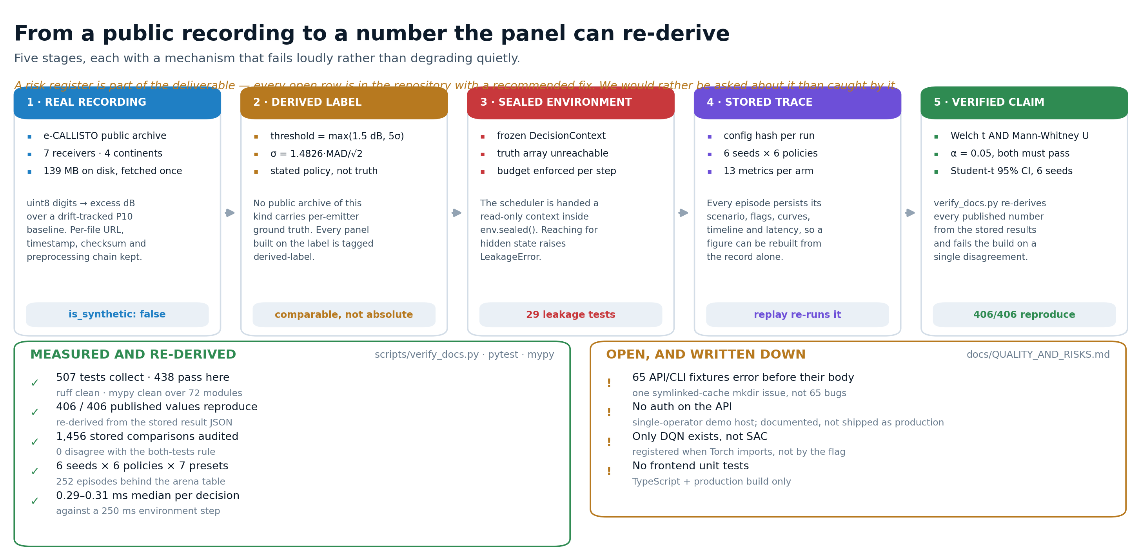
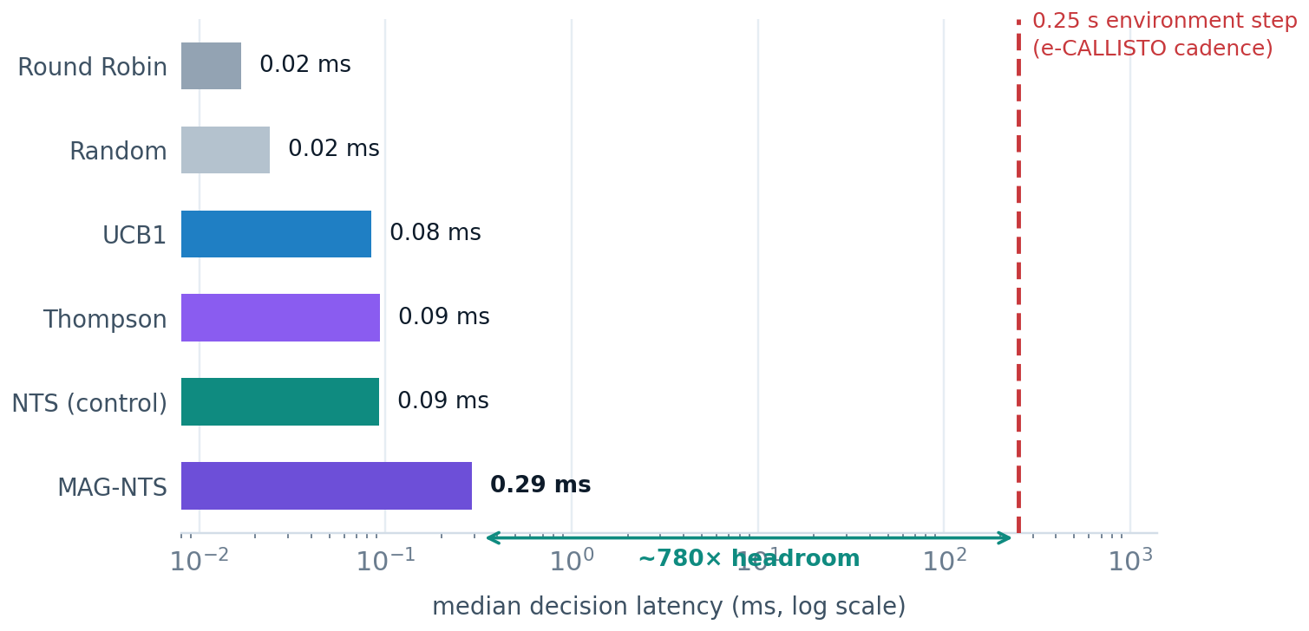
FEASIBILITY AND VIABILITY
Your Team Name
IT RUNS ON THE LAPTOP IN FRONT OF YOU
▪ 0.31 ms median decision against a 250 ms step — three orders of magnitude of headroom.
▪ CPU only NumPy and SciPy; no GPU, no cluster, no broker.
▪ 139 MB, fetched once then fully offline.
▪ Already deployed Docker Compose behind nginx on one EC2 instance.
Five stages from public archive to a number the panel can re-derive here.
POTENTIAL CHALLENGES → HOW EACH ONE IS HANDLED
Abrupt change breaks recall
memory retrieves a prior for a context that is gone: −85.89 reward on sudden-shift.
→ Gating retrieval on the change posterior is specified but not implemented — doing it after seeing the held-out result would be tuning on the test set.
No per-emitter ground truth
no public archive of this kind has one.
→ A stated derived label: excess above max(1.5 dB, 5σ) over a drift-tracked P10 baseline. Every panel from it is tagged derived-label.
Six seeds is a small sample
gaps under roughly ±20 reward are not resolvable.
→ Welch t and Mann-Whitney U must both pass at α = 0.05; anything else is reported as not significant, in either direction.
Not production-hardened
the API is unauthenticated and one query path builds SQL fragments.
→ Both are logged in docs/QUALITY_AND_RISKS.md with a fix order; the demo host is single-operator.

Slide 5
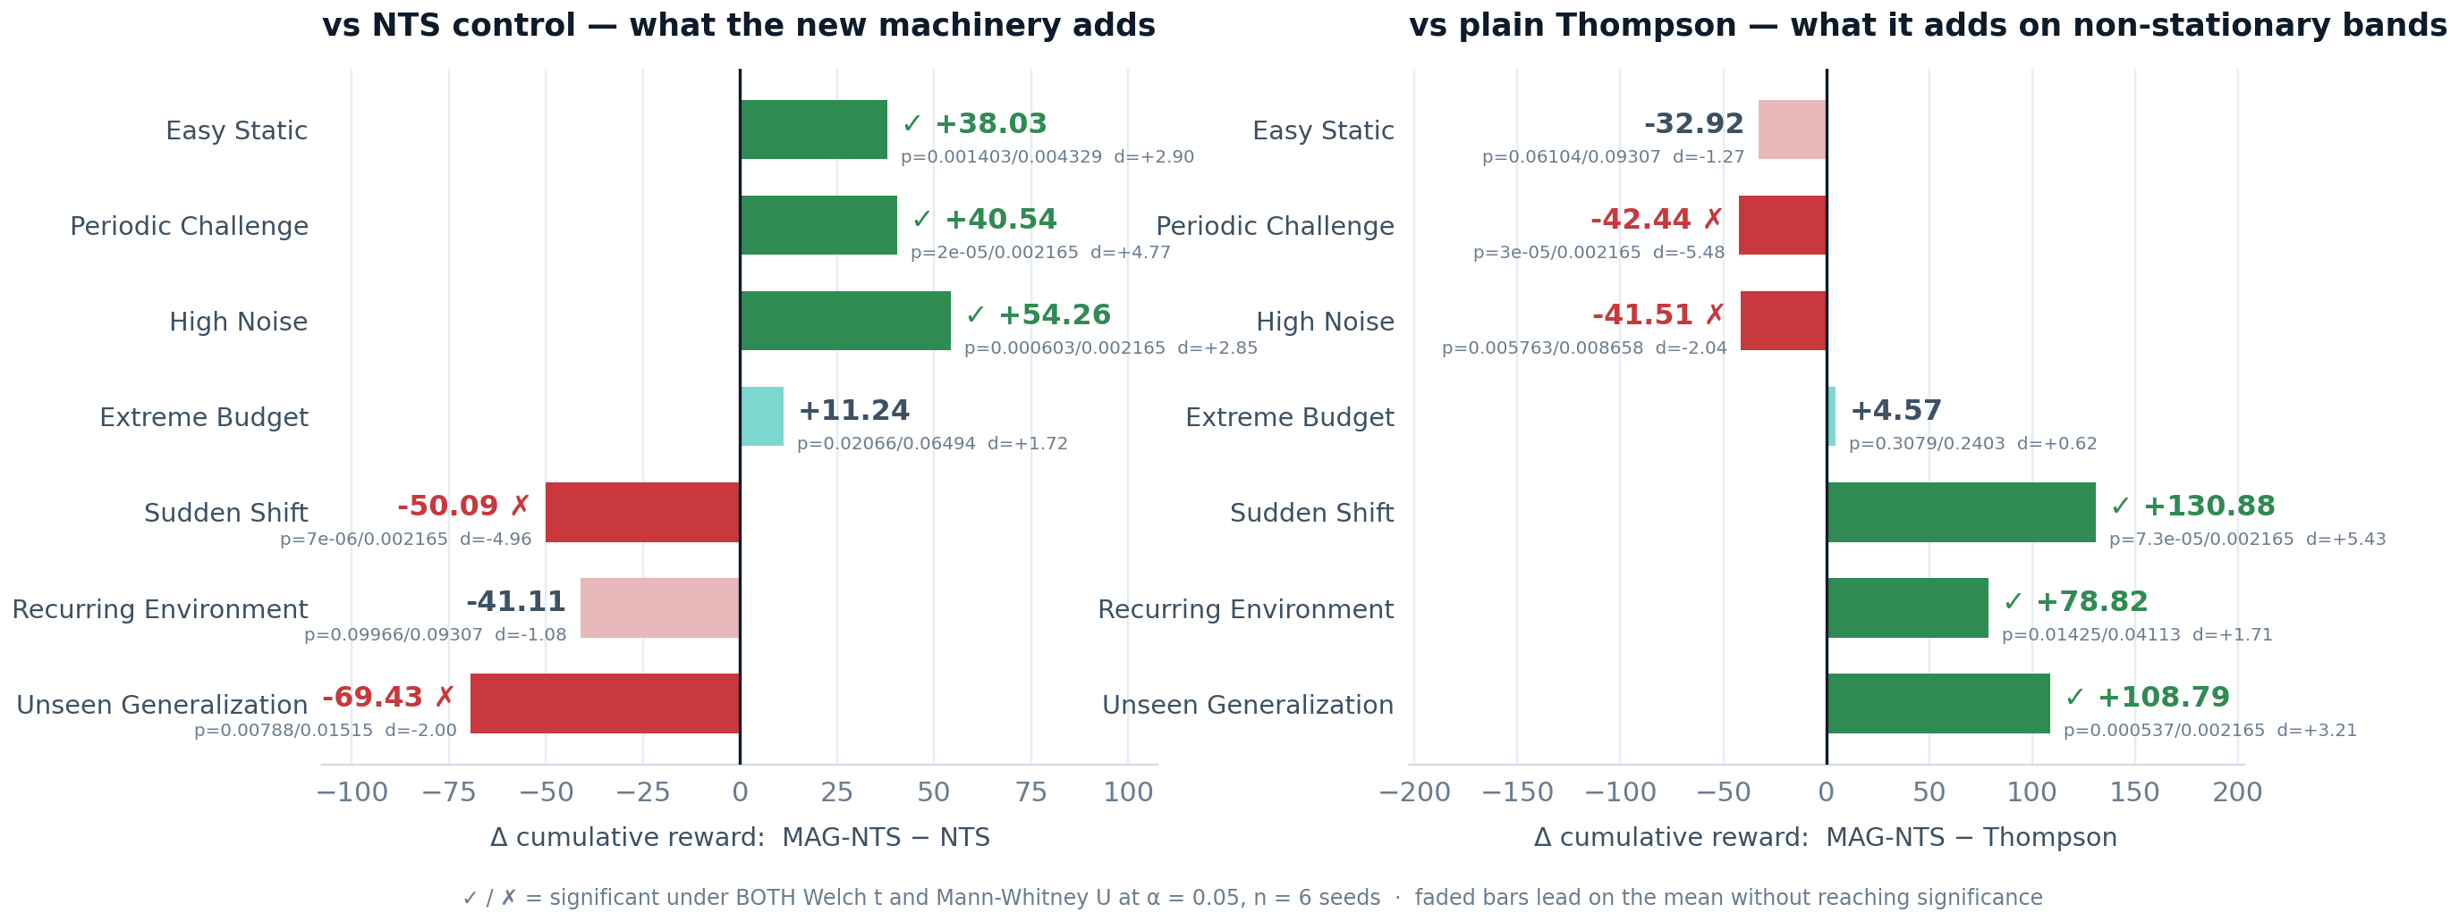
IMPACT AND BENEFITS
Your Team Name
+54.26
reward vs. best classical baseline
high-noise · p = 0.0006 · 6 seeds
+99.07
reward contributed by memory alone
high-noise · p = 0.00005 · ablation
−69.43
reward on the held-out receivers
unseen-generalization · p = 0.0079
0.5594
of the oracle's achievable reward
vs. 0.4331 for the best baseline
Every preset, both directions. A bar counts only when Welch t and Mann-Whitney U both pass at α = 0.05.
BENEFITS, MEASURED RATHER THAN ASSERTED
▪ Economic one commodity CPU replaces a wider or faster receiver for the same detection yield — 0.5594 of oracle reward within a fixed 1,200-step budget.
▪ Scientific wins and losses both published, with the mechanism named; the ablation says which component earns each effect.
▪ Social no transmission, no jamming, no emitter identification, no geolocation, no hardware control — an academic scheduler on public scientific data.
WHO BENEFITS
▪ Spectrum monitoring teams the same decision — which slice to sample next under a hard budget — appears in interference hunting, shared-spectrum enforcement and radio-astronomy RFI surveys.
▪ Researchers a reproducible active-sensing benchmark on public recordings: 7 stations, 3,350 indexed windows, 7 presets, fixed seeds.
▪ Students and reviewers an explainable scheduler where the eight-term score is the algorithm, not a post-hoc attribution.

Slide 6
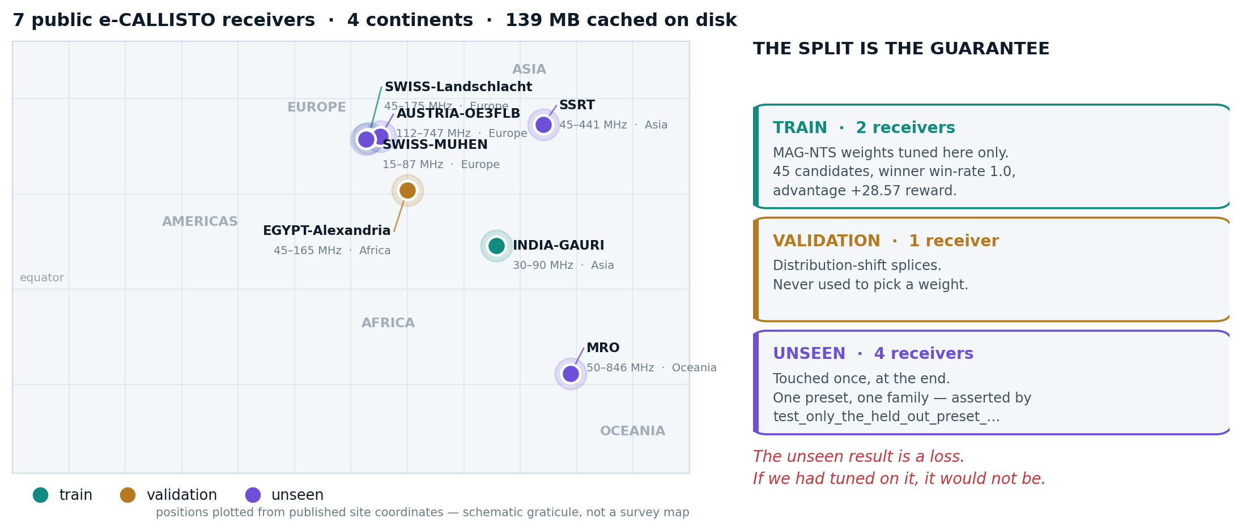
RESEARCH AND REFERENCES
Your Team Name
DATA PROVENANCE AND LABELLING
▪ Archive e-CALLISTO, the international network of solar radio spectrometers (FHNW Institute for Data Science, Brugg/Windisch).
▪ Per recording, stored source URL, retrieval timestamp, source file count, SHA of the cached cube, full preprocessing chain, licence, is_synthetic: false.
▪ Derived label, not ground truth excess above max(1.5 dB, 5σ), σ from a first-difference MAD estimate against a drift-tracking P10 baseline. Every panel computed from it is tagged derived-label.
▪ Split roles are declared train / validation / unseen; the held-out receivers appear in exactly one preset, asserted by a test that fails the build.
Seven public receivers, four continents. Roles are fixed in the catalogue — the held-out stations drive exactly one preset.
METHODS WE BUILD ON
HOW CLAIMS ARE DECIDED, AND WHAT IS OURS
▪ Thompson, 1933 posterior sampling — extended here to contiguous windows.
▪ Auer, Cesa-Bianchi & Fischer, 2002 UCB1 — the confidence-bound baseline.
▪ Raj & Kalyani, 2017 Taming non-stationary bandits (arXiv:1707.09727) — the NTS control policy.
▪ Ramsauer et al., 2021 Hopfield Networks is All You Need (arXiv:2008.02217) — single-step retrieval at β = 12.
▪ Page, 1954 continuous inspection schemes — the Page-Hinkley detector.
▪ Garivier & Moulines, 2011 UCB policies for switching bandits — the change-aware framing.
▪ Lindley, 1956 information provided by an experiment — the information term.
▪ Chaloner & Verdinelli, 1995 Bayesian experimental design — the objective.
▪ Welch, 1947 and Mann & Whitney, 1947 the two tests every claim must pass; both at α = 0.05, or the difference is reported as not significant in either direction.
▪ Ours the contiguous-window action space, the eight-term score with its three couplings, the change-gated bounded context memory, and the 7-preset benchmark on public recordings.
▪ Written down docs/EXPERIMENTS.md (every measured number, wins and losses), LIMITATIONS.md (what it does not do), QUALITY_AND_RISKS.md (verification state and open risks).
▪ Re-derivable scripts/verify_docs.py re-computes 406 published values from the stored JSON and audits 1,456 comparisons; a mismatch fails.

