Slide 1
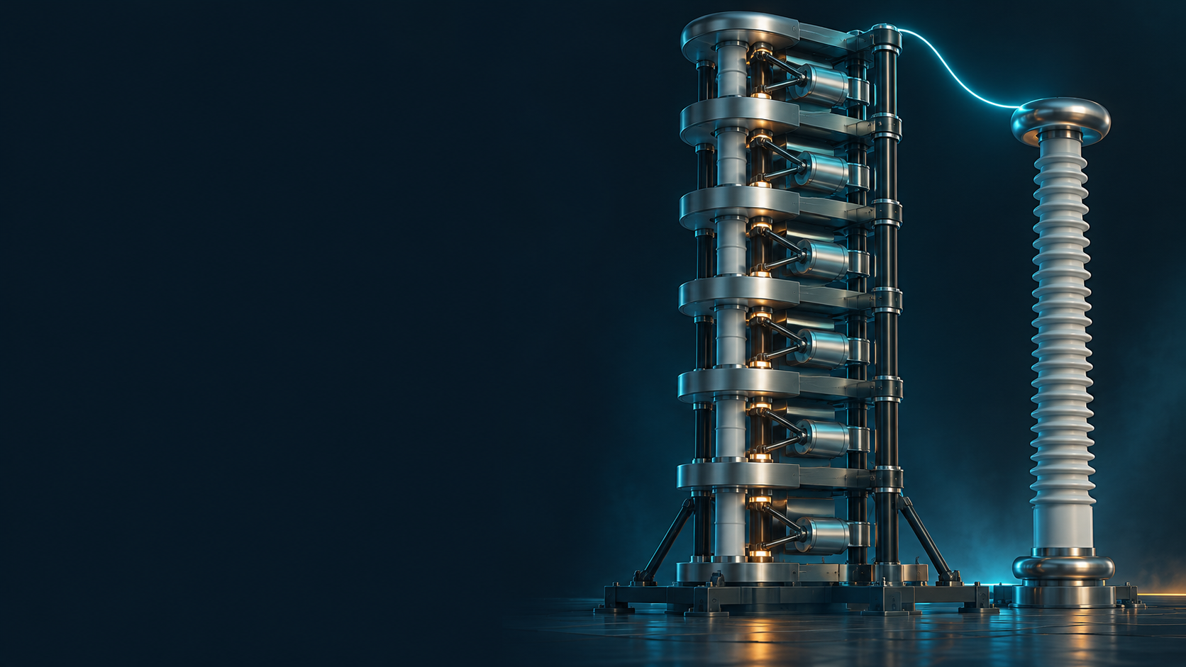
POWERNEXT 2026
TRACK 1
ImpulseTwin AI
Impulse generator settings,
explained and tested
TEAM CR7
Adithya P (Team lead)
Siddhanth K Jain
Kamma Rohan
Dinesh Kulkarni

Slide 2
PROBLEM AND SOLUTION
The test request and recommendation workflow
The right voltage also needs the right pulse shape.
Engineers must meet timing limits with the generator and resistor stock available.
Configure
Check and search
Simulate
Rank and explain
Crest, impulse type, load and profile.
Limits, counted stock and feasible settings.
Circuit waveform and charging requirement.
Stage count, R networks, deviations and alternatives.
Each saved run keeps its settings, assumptions and provenance.
Challenge targets: Lightning 1.2 / 50 µs. Switching 250 / 2,500 µs.
02

Slide 3
VERTICAL LAYERS AND TECH STACK
System architecture
1. Presentation
Next.js, React / React DOM, TypeScript, Tailwind CSS
Browser interface
Apache ECharts, Three.js (WebGL), Lucide, Canvas / SVG
2. API & validation
Python, FastAPI, Starlette, Pydantic, Uvicorn
Python application
HTTP/JSON requests and file uploads with python-multipart
3. Engineering
NumPy, SciPy, pandas, scikit-learn, joblib, Pillow
Physics and scoped ML
CPRI circuit physics, diagnostics, fault scenarios and supported ML
4. Data & models
SQLite, SQLAlchemy, JSON, CSV / XLSX and joblib files
Local persistence
Saved runs, capture provenance, profiles and frozen model artifacts
Build & support
Node.js, npm, PostCSS, pytest, HTTPX
Local toolchain
openpyxl, Matplotlib, pypdf, PyYAML, XGBoost (optional)
03

Slide 4
A COMPLETE RECOMMENDATION
CPRI example: a 1,425 kV lightning pulse
Predicted waveform
Setting | Value
Active stages | 11 of 12
Stage charge | 181.90 kV
Front R / stage | 30 Ω
Tail R / stage | 520 Ω
Stored energy | 22.75 kJ
Front 1.187 µs
Tail 53.74 µs
Charge solves the crest target.
Timing still differs from the target.
Generated circuit reference using assumed demo stock. Hardware suitability remains unverified.
04

Slide 5
BEYOND RECOMMENDATION
Waveform diagnostics and the digital twin
Comparison workflow
Conceptual assembly view
Record what was fired
Stage C
Front R
Loop L
Load C
Save the actual settings and re-solve.
Energy
Rise
Ringing
Object
Upload and review
Tail R
Five virtual component groups
CSV or calibrated image, origin and quality.
Decay
Possible causes with uncertainty
Inspect RLC values, place components digitally and review safety at each step.
Component shifts, measurement or model issues.
Conceptual circuit view. Briefing checkmarks never authorize physical high-voltage work.
05

Slide 6
FAULT TEST LAB
Chopped impulses and generator stage failure
Front and tail chopping
One stage fails to contribute
Front chop 1.06 µs
Tail chop 4.25 µs
Uncharged crest: 1,295.5 kV (−9.1%)
Bypassed crest: 1,312.3 kV (−7.9%)
Generated scenarios at fixed original charge. Results depend on the stated fault topology.
06

Slide 7
WHAT WE CAN DEMONSTRATE
Verification evidence and calibration results
Noiseless generated calibration study
438 backend tests
28 frontend tests
36 / 36 expected outcomes
27 recommendations
9 expected rejections
7 / 7 fault gates
6 / 12 to 12 / 12 passing new setups
Independent numerical checks
07

Slide 8
IMPULSETWIN AI
Conclusion
A working decision-support tool for
high-voltage impulse testing
Engineering value
Extended capabilities
Recommended settings come with
predicted waveforms and clear assumptions.
Waveform diagnostics, virtual assembly
and fixed-charge fault simulations.
Software checks and generated studies support the prototype.
Independent CPRI laboratory accuracy still needs validation.
Thank you
ImpulseTwin AI
08

