Slide 1
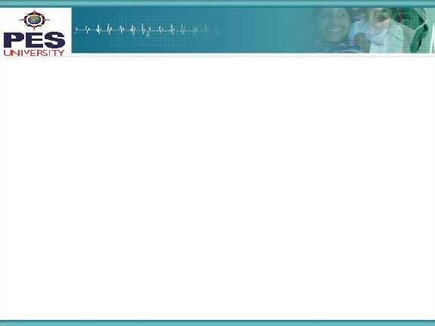



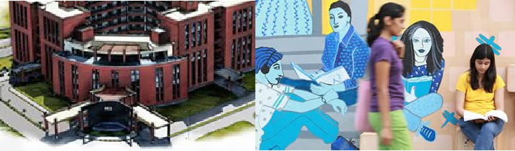

Project Presentation
(Final - ESA)
Project Title
: MUSIC GENERATION
Project Team : Amogh Rajesh Desai PES1201700180
Siddhant Samyak PES1201700247
Amit Kumar PES1201701295
‹#›

Slide 2
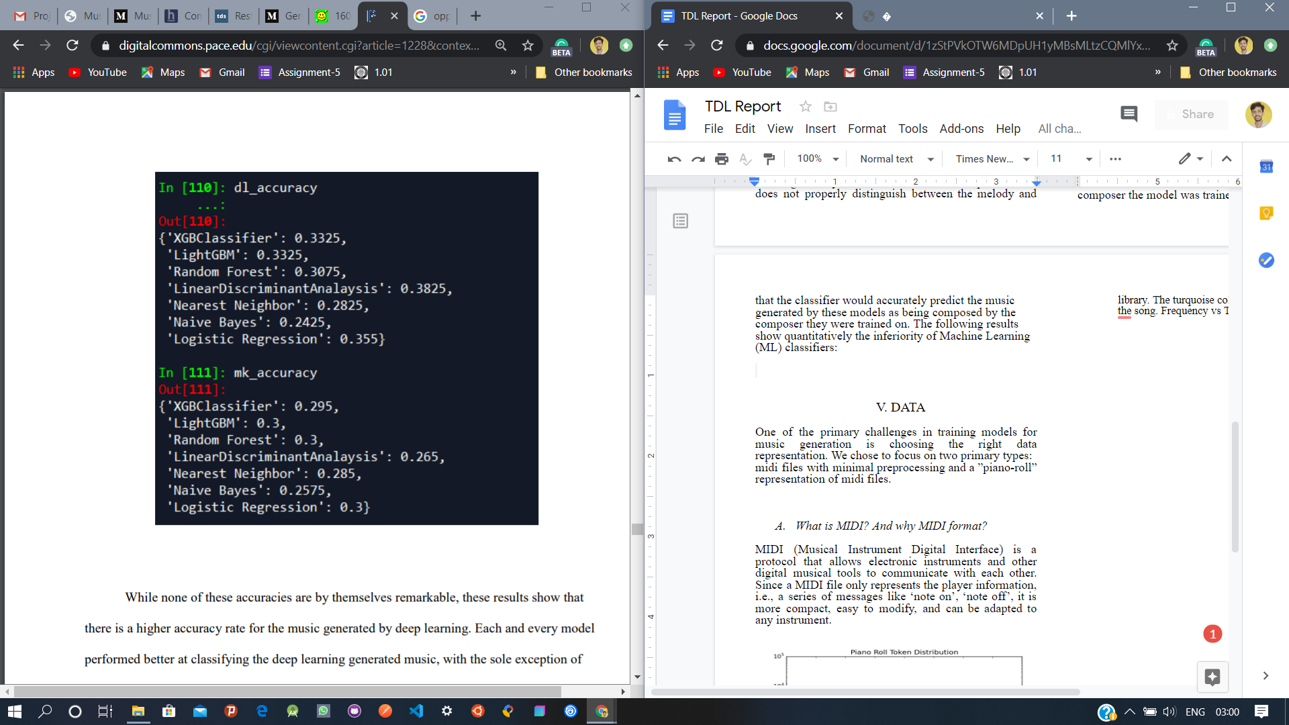
Project Abstract and Scope
Abstract:
This paper depicts the work and analysis of different ways of using deep learning (deep artificial neural networks) to generate musical content.
Based on previous works, a group of 7
different models (classifiers) were
trained and tested on the MIDI dataset
for the purpose of musical notes
generation.
The following results show
quantitatively the inferiority
of Machine Learning (ML) classifiers:
‹#›

Slide 3
Project Abstract and Scope
There is a temporal long-term dependency on the data being fed to the model.
Therefore, in our project, we will mainly tackle the problem of learning complex structure and rhythms based on two models:
Restricted Boltzmann machine (RBM)
Sequential Stacked LSTM
Dataset:
MIDI (Musical Instrument Digital Interface).
A MIDI file only represents the player information, i.e., a series of messages like ‘note on’, ‘note off’.
Compared to other formats, it is more compact, easy to modify, and can be adapted to any instrument.
3

Slide 4
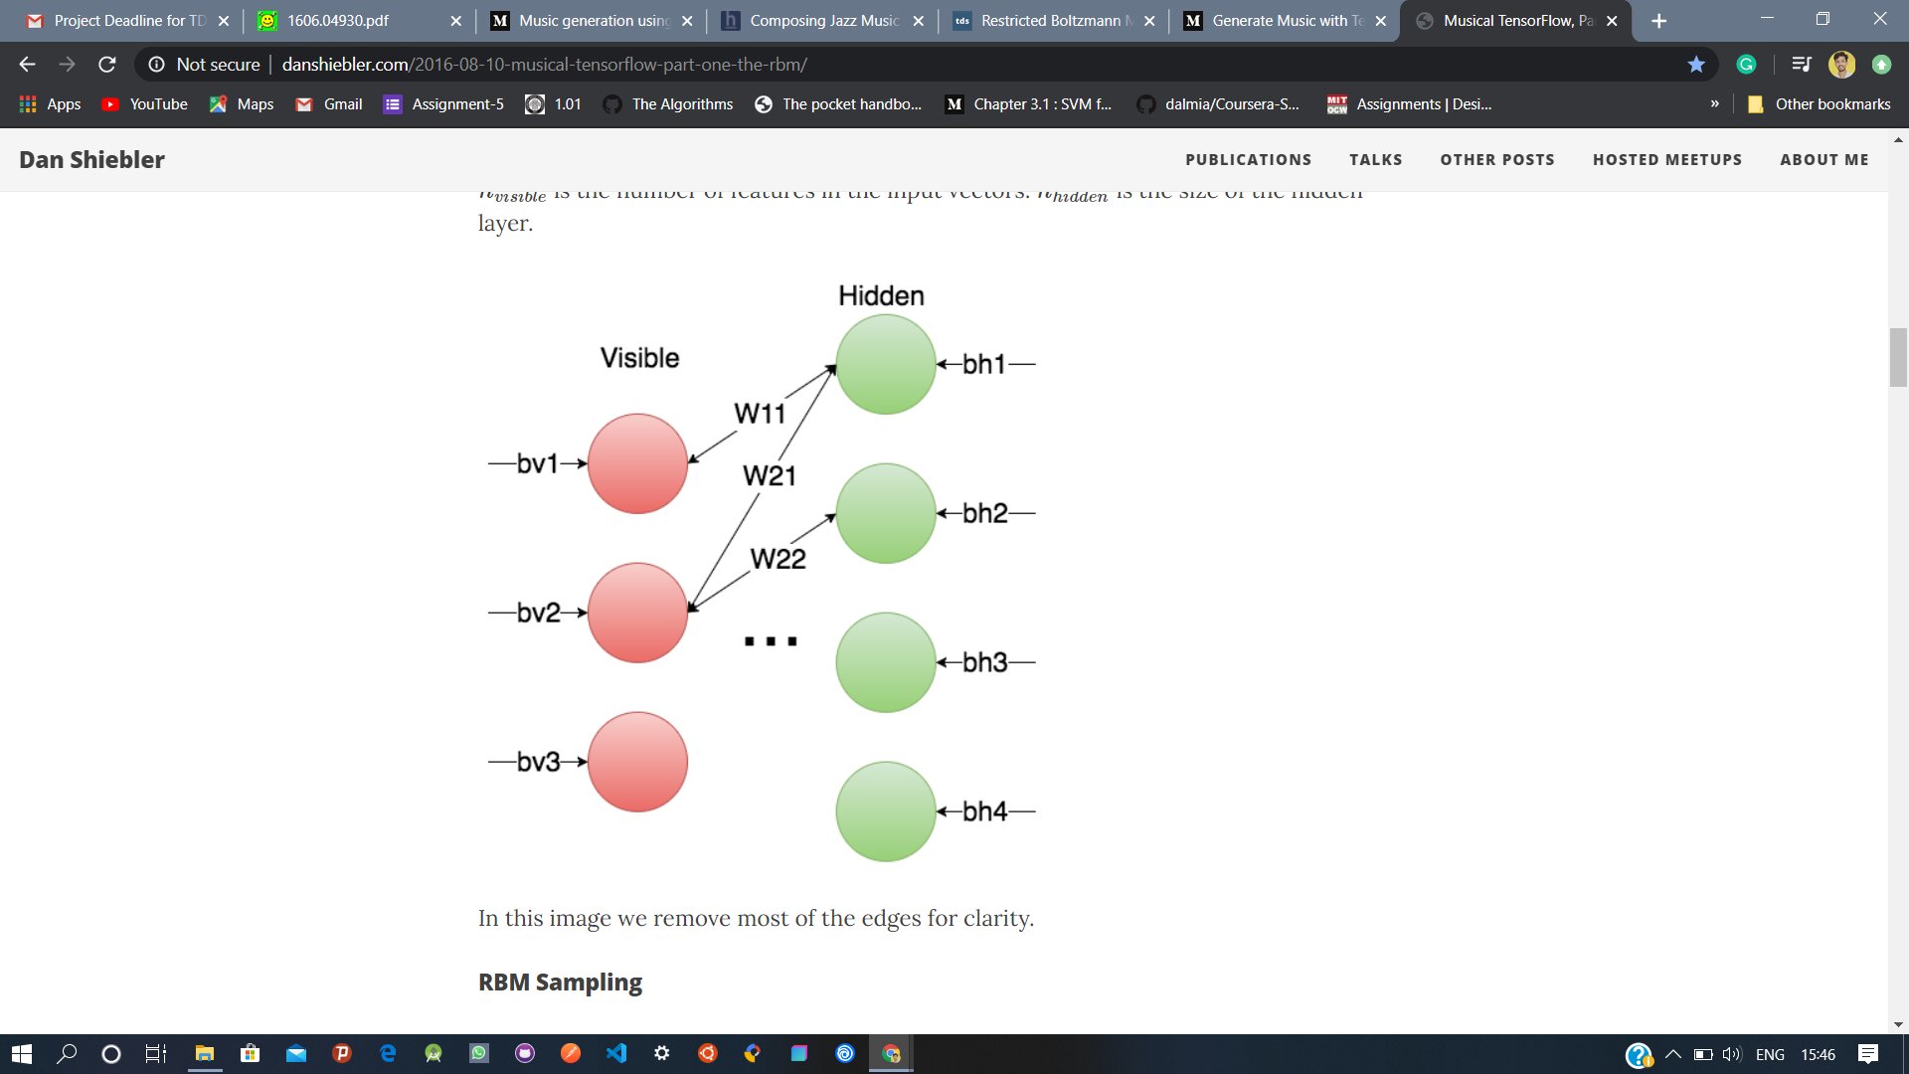
Restricted Boltzmann Machines (RBM)
It is a generative stochastic artificial neural network that is capable of learning a probability distribution over its set of inputs.
The RBM is a neural network with 2 layers, the visible layer, and the hidden layer.
Each visible node is connected to each hidden node (and vice versa), but there are no visible-visible or hidden-hidden connections.
A trained RBM can be fully described with
3 parameters:
1.The weight matrix W: Size = n_visible x n_hidden
Wij is the weight of the connection between
visible node i and hidden node j.
2.The bias vector bv: Vector with n_visible elements.
Element i is the bias for the ith visible node.
3.The bias vector bh: Vector with n_hidden elements.
Element j is the bias for the jth hidden node.
‹#›

Slide 5
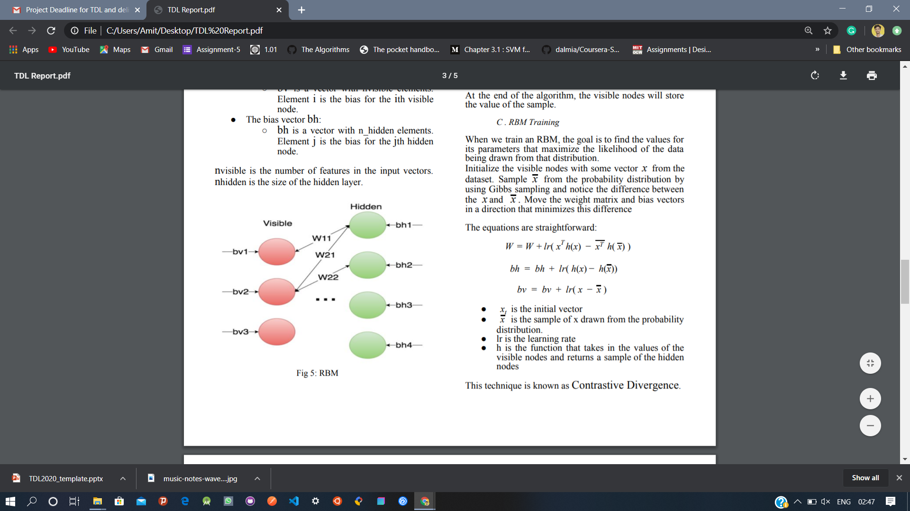
Restricted Boltzmann Machines (RBM)
Gibbs Sampling:
Initialize the visible nodes.
Repeat the following process for k steps, or until convergence:
1. Propagate the values of the visible nodes forward, and then sample the new values of the hidden nodes.
That is, randomly set the values of each hi to be 1
with probability σ(T(W).ν + b.h ). { T(W) = Transpose of W }
2. Propagate the values of the hidden nodes back to the visible nodes, and sample the new values of the visible nodes.
That is, randomly set the values of each ν
to be 1 with i probability σ(W.h + b.ν ) .
RBM Training:
The goal is to find the values for its parameters that maximize the
likelihood of the data being drawn
from that distribution.
Sample x from the probability distribution by
using Gibbs sampling and notice the difference
between the x and x(bar) .

Slide 6
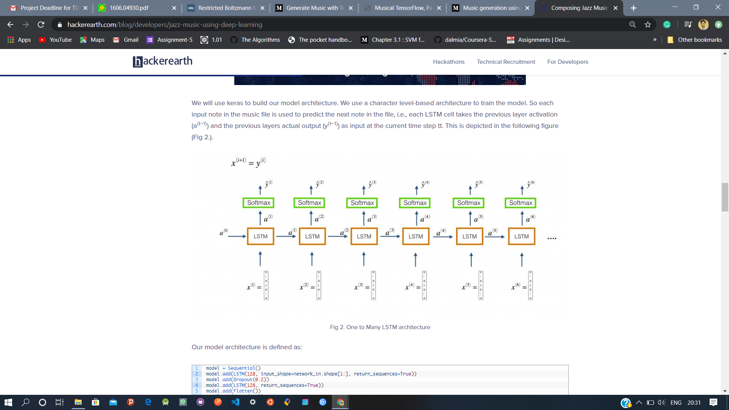
Stacked LSTM Model (Comparitive Model)
Since music is a sequence of notes and chords, it doesn’t have a fixed dimensionality.
In this model, we will be using the Long Short-Term Memory (LSTM) architecture.
A character level-based architecture was used to train the model.
each input note in the music
file is used to predict the next
note in the file, i.e., each LSTM
cell takes the previous layer
activation ( a (t-1) ) and the
previous layers actual output
( y(t-1) ) as input at the current
time step t.
The model consists of two LSTM
layers with each layer consisting
of 128 hidden layers.

Slide 7
Stacked LSTM Model
We use ‘categorical cross-entropy‘ as the loss function and ‘adam‘ as the optimizer.
Model Training:
The architecture gets the notes, creates the input and output sequences, creates a model, and trains the model for 200 epochs.
The output of the LSTM is fed into softmax layer over all the tokens.
The loss corresponds to the cross-entropy error of our predictions at each time step compared to the actual note played at each time step.
We clip our gradients to prevent our gradients from exploding.
We also anneal our learning rate when we see that the rate that our training error is decreasing is slowing.
Sample Generation:
To generate new notes, we need a starting note. So, we randomly pick an integer and pick a random sequence from the input sequence as a starting point.
We use the trained model to predict the next 500 notes. At each time step, the output of the previous layer (ŷ(t-1)) is provided as input (x(t)) to the LSTM layer at the current time step t.
The predicted output is an array of probabilities, we choose the output at the index with the maximum probability. Finally, we map this index to the actual note and add this to the list of predicted output.

Slide 8
Evaluation
One of the major challenges of evaluating the quality of our model is incorporating the notion of musical aesthetics. That is, how “good” is the music that our models ultimately generate?
As such, there is no firm methodology to grade a music/art generative model. We compared the resultant music files generated by the RBM model and Stacked LSTM model.
One possible way is to conduct a blind experiment where volunteers or professionals in the field can offer their opinion on the samples of music generated. Therefore, there is no strict method of evaluation.

Slide 9
Constraints, Assumptions & Dependencies
There are no such formal constraints or dependencies involved with the devised solutions. The assumptions are as follows:
Inheriting a Char RNN model for the Stacked LSTM (comparative model) model based on the assumption that music generation is similar to text generation.
Using Gibbs Sampling as the preferred sampling method in the RBM model.
Guidelines :
Music generation demands long term dependencies.
The generation is similar to text generation.
Formats other than MIDI for music representation do not properly distinguish between the melody and other parts of the piece and in addition do not address the full complexity and therefore they cannot deal with the challenge of learning complex polyphonic structure in music.
‹#›

Slide 10
Future work plan
Given the recent enthusiasm in machine learning inspired art, we hope to continue our work by introducing more complex models and data representations that effectively capture the underlying melodic structure.
Another milestone is to be capable of generating music samples of the desired length.
Furthermore, we feel that more work could be done in developing a better evaluation metric of the quality of a piece – only then will we be able to train models that are truly able to compose original music!
‹#›

Slide 11
References
[1] Nicolas Boulanger-Lewandowski, Yoshua Bengio, and Pascal Vincent. Modeling temporal dependencies in high-dimensional sequences: Application to polyphonic music generation and transcription. Proceedings of the 29th International Conference on Machine Learning, (29), 2012.
[2] Chun-Chi J. Chen and Risto Miikkulainen. Creating melodies with evolving recurrent neural networks. Proceedings of the 2001 International Joint Conference on Neural Networks, 2001.
[3] Douglas Eck and Jurgen Schmidhuber. A first look at music composition using lstm recurrent neural networks. Technical Report No. IDSIA-07-02, 2002.
[4] Daniel Johnson. Composing music with recurrent neural networks.
[5] I-Ting Liu and Bhiksha Ramakrishnan. Bach in 2014: Music composition with a recurrent neural network. Under review as a workshop contribution at ICLR 2015, 2015.
[6] Tomas Mikolov, Kai Chen, Greg Corrado, and Jeffrey Dean. Efficient estimation of word representations in vector space.
[7] Blog post introducing Magenta can be found here: http://magenta.tensorflow.org/welcome-to-magenta

Slide 12
Thank You

