Slide 1
Breast Cancer Survival Analysis
Projected By: Siddharam Kothane

Slide 2
Agenda
INTRODUCTION
Dataset Description
Exploratory Data Analysis (EDA)
Data Exploration
PREPROCESIING
TRAIN-TEST SPLIT
MODEL SELECTION
RESULTS
CONCLUSION

Slide 3
INTRODUCTION
Breast cancer is the most common cancer among women worldwide.
Accounts for about 25% of all cancer cases globally.
Early detection can greatly improve survival rates.
Traditional detection methods are time-consuming and may have human errors.
Machine Learning (ML) can help detect cancer faster and more accurately by analyzing data patterns.

Slide 4
PROJECT'S SIGNIFICANCE AND ITS BENEFITS TO HEALTHCARE STATEMENT
Early Diagnosis Combining multiple risk factors in modelling for breast cancer prediction could help the early diagnosis of the disease with necessary care plans,
Collection, storage, and management of different data and intelligent systems based on multiple factors for predicting breast cancer are effective in disease management.
Visualisation of biomedical data: You can use machine learning to create three dimensional visualisations of biomedical data such as RNA sequences, protein structure, and genomic profiles.
Improved diagnosis and disease identification Identify previously unrecognisable symptom patterns and compare them with larger data sets to diagnose disenses

Slide 5
Dataset Description
Dataset Used: Breast Cancer Wisconsin (Diagnostic) Dataset
Source: UCI Machine Learning Repository / Kaggle
Total Samples: 569
Features: 30 numeric attributes (e.g., radius _ mean, texture _ mean, area _ mean, smoothness _ mean, etc.)
Target Variable: M = Malignant (Cancerous)
B = Benign (Non-Cancerous)

Slide 6
Exploratory Data Analysis (EDA)
Exploring the data allowed us to gain a comprehensive overview of the data's structure. It uncovered potential patterns, helped us identify key trends and get essential insights from the dataset.
Throughout the EDA process, we analyzed the distribution of individual features, investigated correlations, and explored any inherent relationships between variables.
Visualizations also played a crucial role in providing a clear representation of the data, offering insights into breast cancer prediction

Slide 7
First, we made sure there were no Null values and Duplicates in the dataset. There was only one column with null values which was dropped since it only had null values. Our dataset was clean to begin with
Then, we checked our columns to see if they were providing any useful information for us to work with. We found out that columns like "ID" and "Unnamed 32" weren't contributing much to the predictions. Hence, we decided to drop them during preprocessing
Some columns were highly correlated and could lead to overfitting and hence were dropped
To ensure consistent scales for numerical features, we decided to employ Standard Scaler

Slide 8
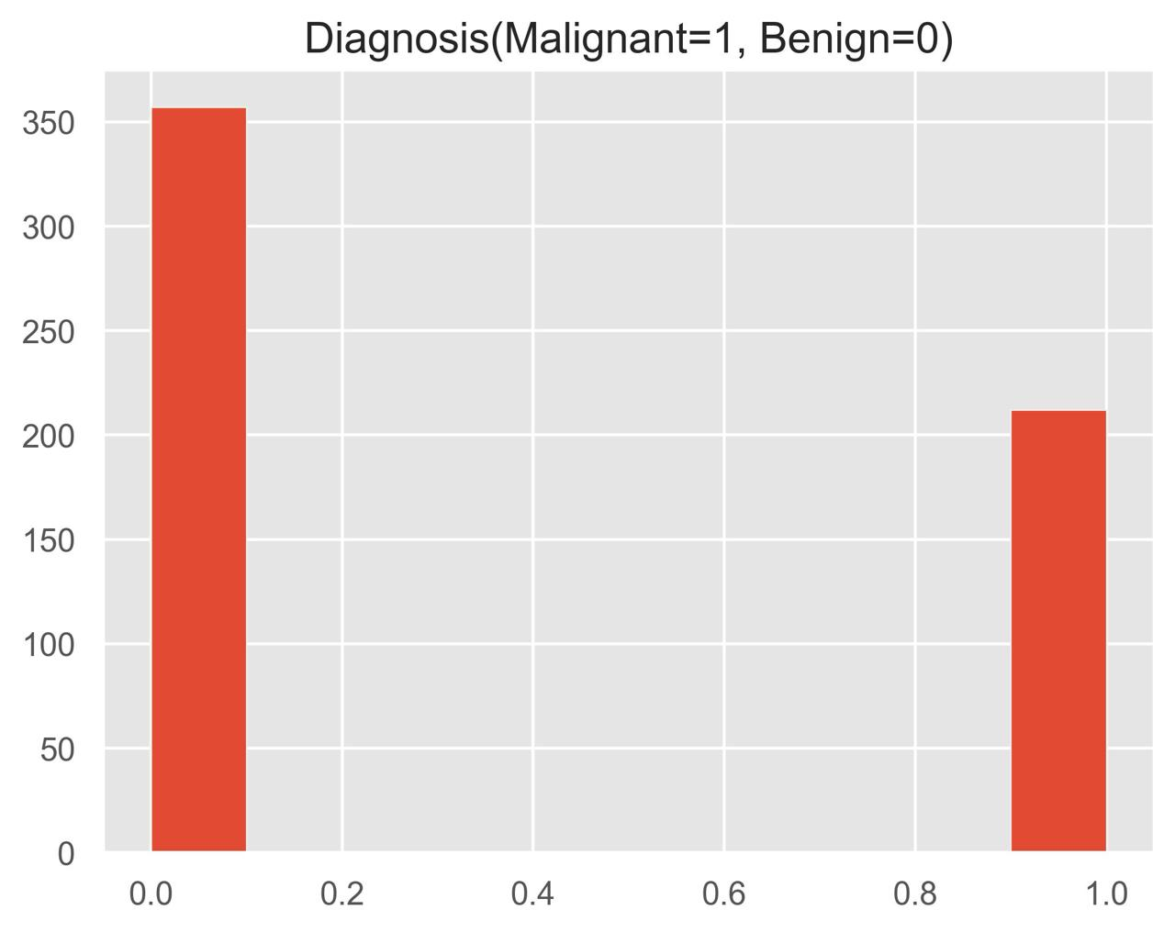
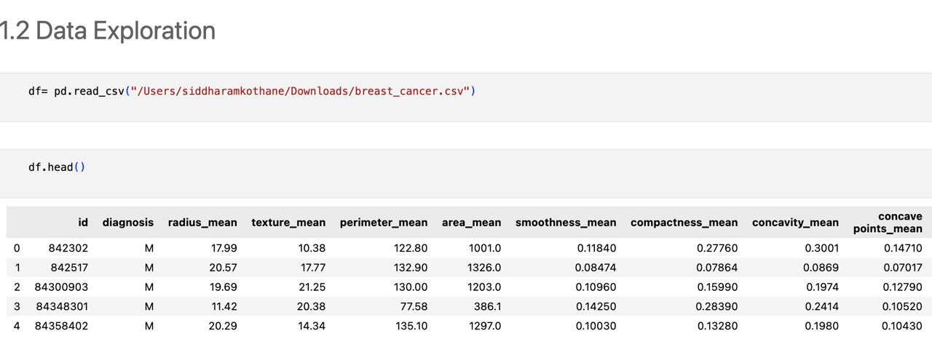
Data Exploration
Target Variable:
M = Malignant (Cancerous) B = Benign (Non-Cancerous)

Slide 9
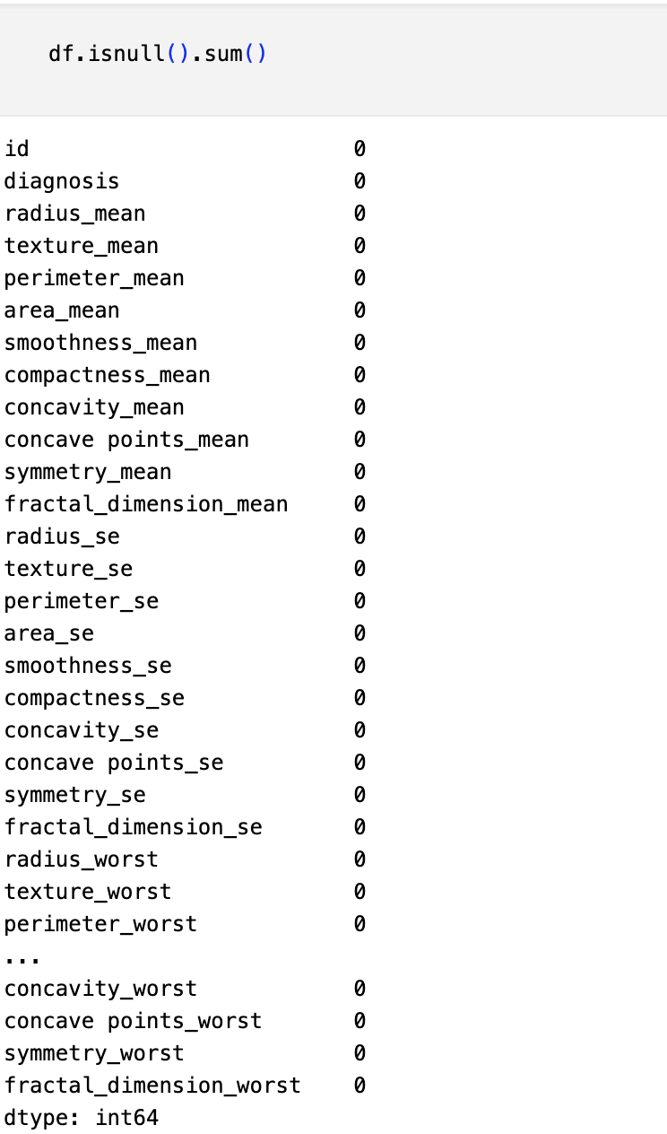
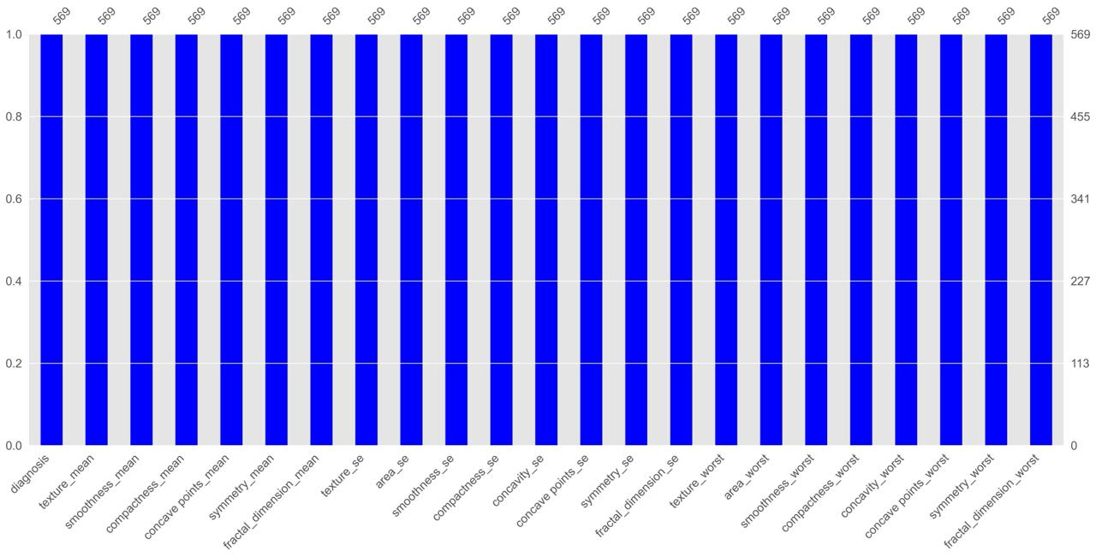
No Null Values Presents in the
dataset

Slide 10
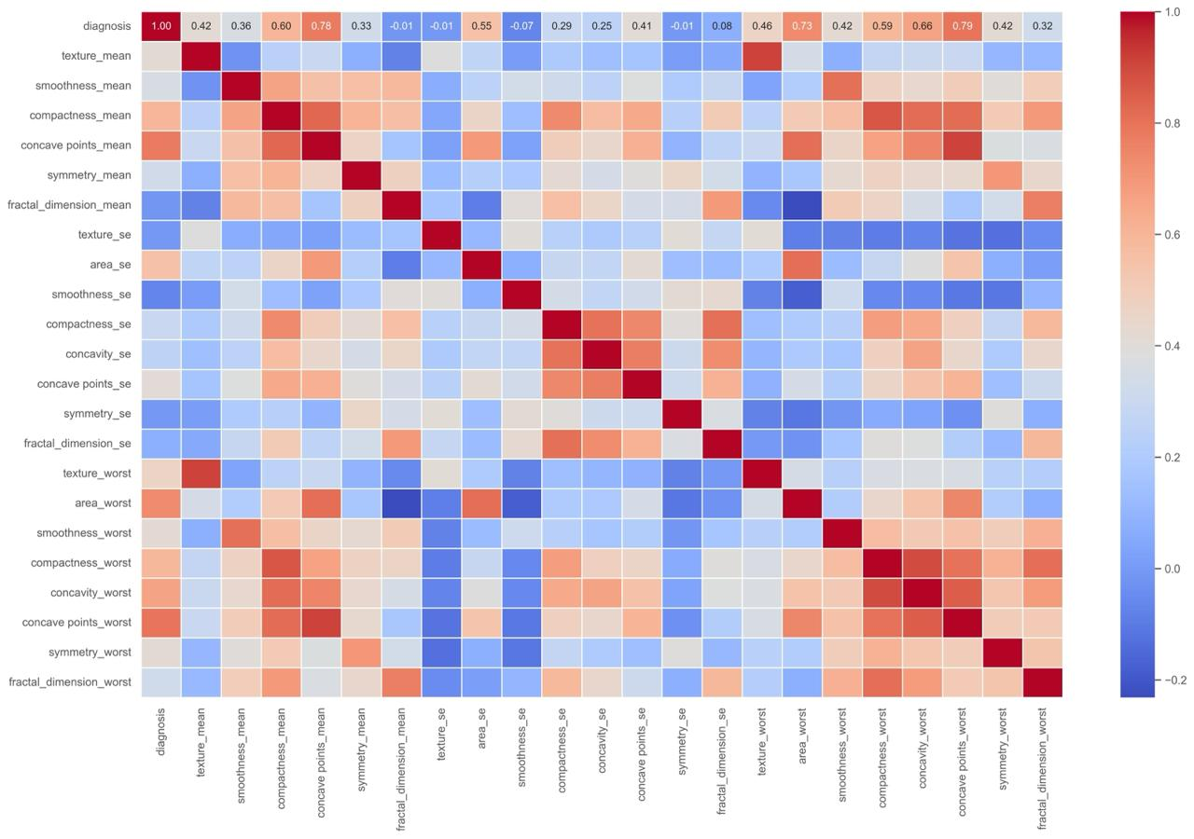
In heatmap highly correlated features are visible so dropouting that values.
Multicollinearity

Slide 11
PREPROCESIING
First, "ID" and "Unnamed 32 columns were dropped as they didn't provide any useful information for our predictions.
Since there is multicollinearity, columns with high correlations with other were dropped.
Then, we encoded the Categorical data into Numerical data with the help of Mapping, It assign a binary numeric values to each unique clasa present in column with categorical data Splitting the data into X and V.
In this stop, we partitioned the dataset into two components: X and y
The variable X encompasses all independent variables, representing the features that contribute to our predictions.
On the other hand, y encapsulates the dependent variable or target variable, serving as the outcome we aim to predict.. Mauris massa ipsum, pharetra id nibh eget, sodales facilisis enim.

Slide 12
TRAIN-TEST SPLIT
We then split the dataset into training data and testing data.
We did an 80:20 split, meaning 80% of our data is Training Data and 20% of our data is Testing Data. So, our test size was set to 0.2.
We took Random State as 40. This guaranteed the reproducibility of our results across different runs.
We also used Stratify y to ensure that our Target Variable (y) is distributed proportionally.
Standard Scaler
We used Standard Scaler to standardize the features of the dataset.
This ensured that the consistency between the features of the dataset was maintained.
Standardization is crucial for certain machine learning algorithms, promoting optimal model performance by mitigating the influence of varying magnitudes among features.

Slide 13
MODEL SELECTION
Models used
Logistic Regression: Logistic Regression is a powerful tool in binary classifiention, Its Biry good at modeling the probability of an event recurring, making it suitable for scenarios whore understanding the likelihood of breast cancer cells is csontinl
Random Forest It is based on the concept of enserable learning, which is a process of combining multiple classifiers to solve a complex problem and to iraprove the performance of the model.
Decision Tree: A decision tren is a supervised learning algorithm that models decisions based on input features
Support Vector Machine (SVC): Support Vector Classification is a robust algorithm employed for classification taska, ospecially when there's a need for clear separation between classes

Slide 14
Model Selection and Consideration
SVC outperforms Logistic Regression, Random Forest, Decision Tree and Naive Bayes in all metrics, demonstrating higher Accuracy, Precision, Recall, and F1 Score. It seems to be a promising model for our task.
Based on the provided metrics, SVC stands out as the best performing mod overall. It schieves a good halance between precision and recall, making it suitable for our Breast Cancer prediction task.
Hence, we will go with Support Vector Classification as our final model as it is quite evident that it performs best for our Breast Cancer problem.

Slide 15
RESULTS
Model Performance Metrics:
Accuracy: 98.25%
Precision: 96%
Recall: 95%
F1 Score: 95%
Confusion Matrix Example:
Predicted Benign Predicted Malignant
Actual Benign 175 2
Actual Malignant 3 107
Interpretation: The model correctly classifies most cases with minimal false negatives (important in cancer detection)

Slide 16
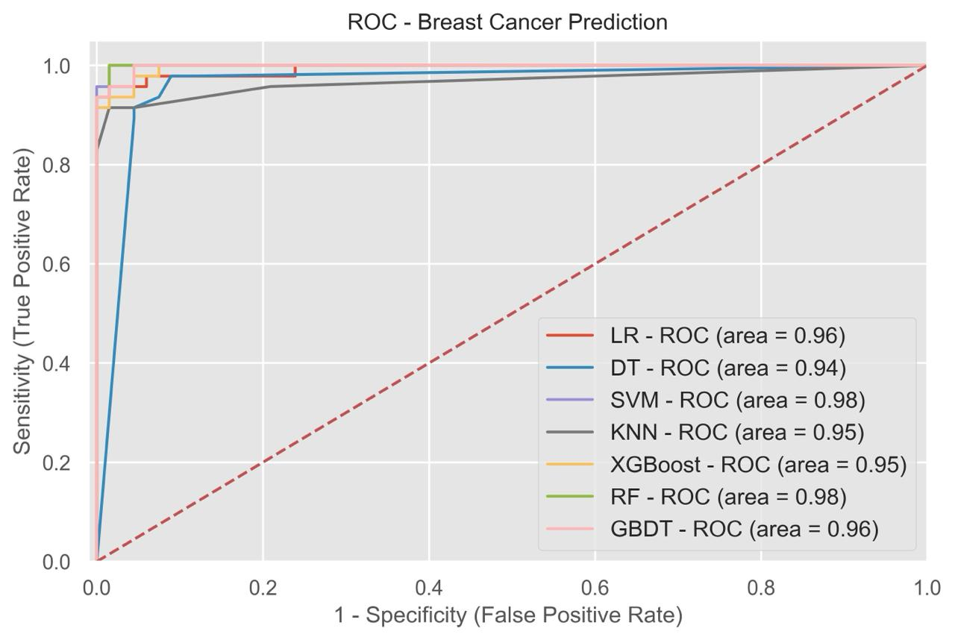
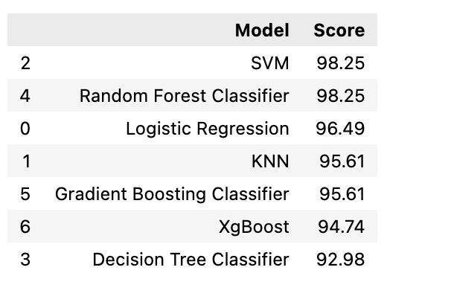

Slide 17

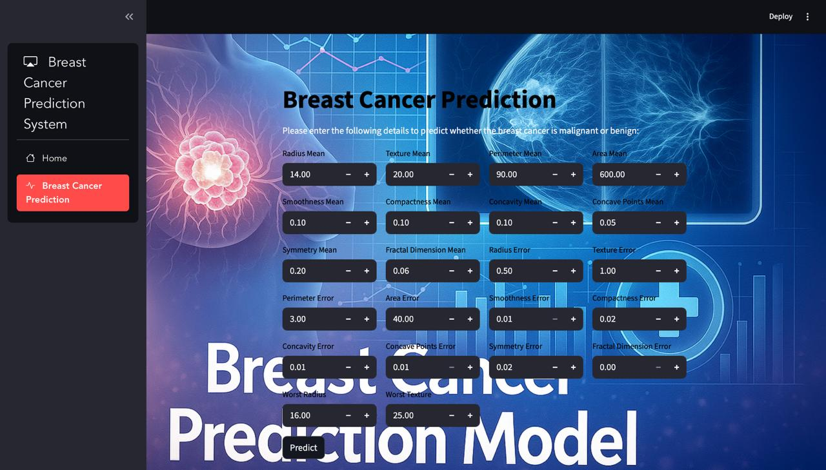
Home Page
Result page

Slide 18
CONCLUSION
With the help of several insights, patterns and trends in our data, we've ved Machine Learning to address the intricate challenge of predicting Breast Cancer.
This project offers significant benefits to banka
Combining multiple risk factor tars in modeling for breast cancer prediction could help the early diagnosis of the disease with necessary care plans.
Collection, storage, and management of different data and intelligent systems based on multiple factors for predicting breast cancer are effective in disease management.
The proposed machine learning approaches could predict breast cancer as the early detection of this disease could help slow down the progress of the disease and reduce the mortality rate through appropriate therapeutic interventions at the right time

Slide 19
Thank You!

