Slide 1
Introduction To
Generative AI

Slide 2
What it is?
We have heard about gen AI ~ lykk its super trending
Stuff like ChatGPT , Gemini , DeepFake etc. etc.
Stuff which can automatically respond to us and acts like they have a brain of their own.

Slide 3
Okay .. Then how is it different from normal AI ??
Normal AI specializes in learning and making predictions.
Generative AI is used for creating content –
like images , text generation.

Slide 4
How it works ??
There are 2 types of machine learning models : Supervised and Unsupervised
Supervised Learning : You have a training set. Eg: Housing Prices Detection
Unsupervised Learning : You have only input values. Groups them, according to certain patterns. Eg: Netflix movie recommendations.

Slide 5
Gen AI is built uses semi-supervised ML models.
Each ML model type for certain function.

Slide 6
Objective of today’s class (●’◡’●)
To learn about the fundamental working of ML algorithms
How they help us in developing gen Ai.

Slide 7
Supervised Machine Learning :
Two types –
Regression : Output is continuous valued
Eg: Detection of housing prices
Classification : Output has discrete values
Eg: Cancer Detection

Slide 8
Understanding the concept : An analogy
You have the following data –
House Area House Price
1000 2000
2000 4000
4000 8000
3000 XXXX -> predict value?

Slide 9
We could predict this easily :
Let’s review our thought process in detail.
Step 1 : Analyse the data
Step 2 : Form a relation
Step 3 : Make prediction

Slide 10
Same steps followed by even AI.
Step 1 and Step 3 are very straightforward.
Step 2 is where our algorithms get involved. To form relation between our input and output.

Slide 11
Let us understand how computers form relations :
Important terms to understand –
Cost Function
Gradient Descent
Let’s explore them in detail..

Slide 12
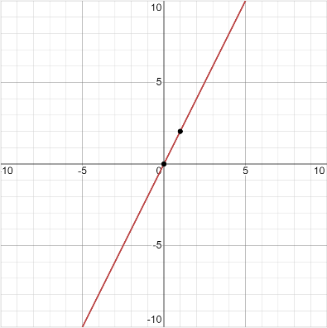
What our computer does first :
PLOTS A
GRAPH

Slide 13
What our computer does :
2) We want to find a relation y=mx+c , such that it fits the
Graph effectively.

Slide 14
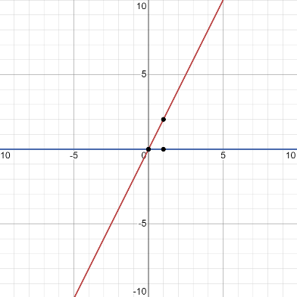
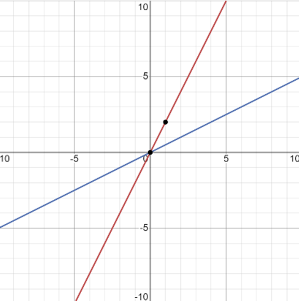
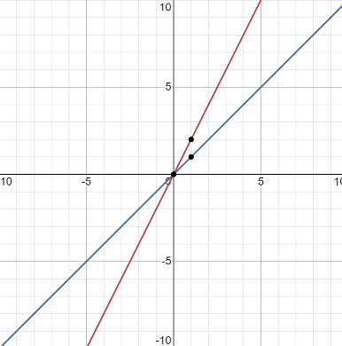
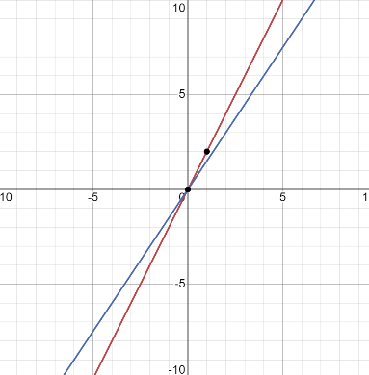
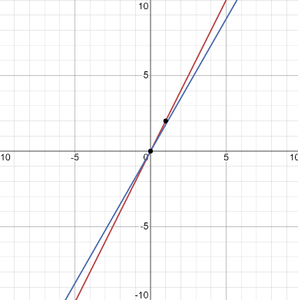
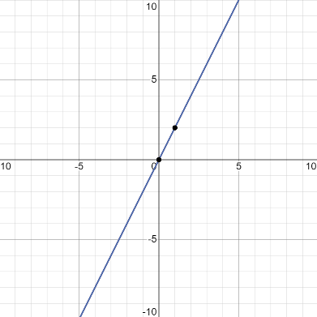
We choose a random initial y=mx+c value . And slowly adjust ‘m’ and ‘c’ to best fit our equation line.

Slide 15
What our computer does :
3) Uses derived relation to find output value. In this case y=2x.
SOOOO, y=2*3000 = 6000 > FINAL ANSWER

Slide 16
What our computer does :
3) Uses derived relation to find output value. In this case y=2x.
SOOOO, y=2*3000 = 6000 > FINAL ANSWER

Slide 17
Now you must be thinking “How does the computer know how to adjust ‘m’ and ‘c’ values”…
Like to increase it or decrease it or stay same. ORRR
“How does it know when to stop.. ????” The answer isssss…..

Slide 18
Cost Function

Slide 19
Calculating our cost function:-
Noww..how do we know
If our current estimate
is good??
You find cost function(cf) :
Closer the cf to 0 , the better

Slide 20
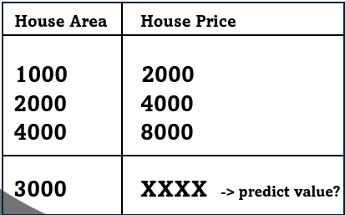
This was our initial table.

Slide 21
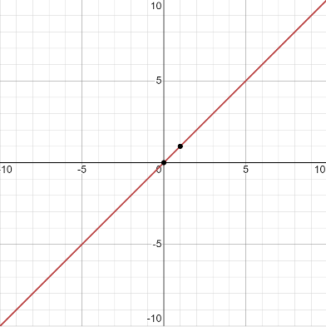
Say our current m = 1 and c = 0
Soo, our eqn is
y=mx

Slide 22
When we draw the table wrt the given input values we get :
House Area House Price
1000 1000
2000 2000
4000 4000

Slide 23
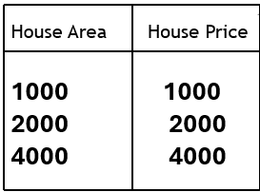
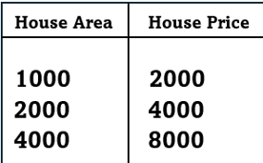
Soo now we hv
2 tables…
We need to calculate how off our prediction is?

Slide 24
Total error:
(2000 – 1000)+
(4000 - 2000)+
(8000 - 4000)
= 7000
Average error =
7000 / 3 = 2333.3

Slide 25
This average error is the cost function for the graph.
Formulae for COST FUNCTION:
(1/2m)* ((i=1 -> m)) ∑ (H(x(i))-y(i))^2

Slide 26
We calculate the cost function for each graph every step of the way
ANDDD.. Choose the one with least cost function

Slide 27
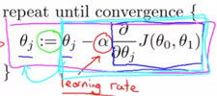
Adjusting m and c values
Gradient Descent Approach
Using this formulae :

Slide 28
Adjusting m and c values
Gradient Descent Approach
Using this formulae :

Slide 29
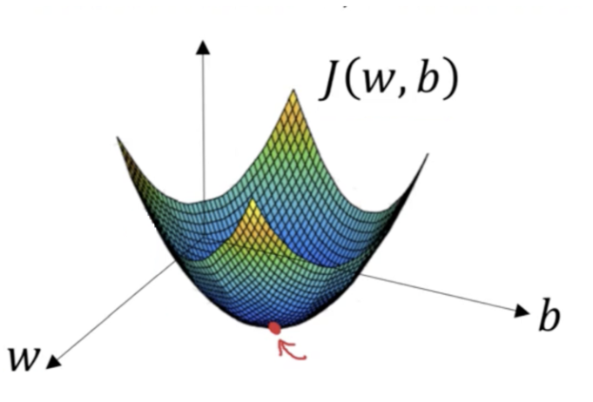


Slide 30
This concept is literally used in every facet of machine learning.
Linear regression, logistic regression , neural networks etc.

