Slide 1

IPL Player Performance Prediction using Machine Learning
Project Review
Presented by:
A.Akash(22481a1217) B. Vijay Babu (23485a1203)
B. N. Siddardha(22481a1230)
Date: 10-10-2025

Slide 2
Dataset Overview
Source: IPL player statistics dataset (season-wise)
Includes batting, bowling, and fielding stats
Sample Players: MS Dhoni, K L Rahul, Rohit Sharma, Virat Kohli
Total Features: Matches, Runs, Wickets, Strike Rate, etc.

Slide 3
Data Preprocessing Techniques
Missing Value Handling: 'No stats' → NaN → dropped rows
Data Type Conversion: String to Numeric (e.g., to_numeric)
Feature Selection: Only relevant features for batting/bowling
Used Pandas, NumPy for preprocessing

Slide 4

Machine Learning Model Used
Algorithm: Linear Regression (from sklearn)
Reason:
Simple and interpretable model
Assumes a linear relationship between features and target
Works well when data has a linear trend
Fast training and prediction
Suitable for small to medium-sized tabular datasets
Used separately for predicting batting runs and bowling wickets
Requires preprocessing like handling missing values and numeric conversion (done in code)

Slide 5
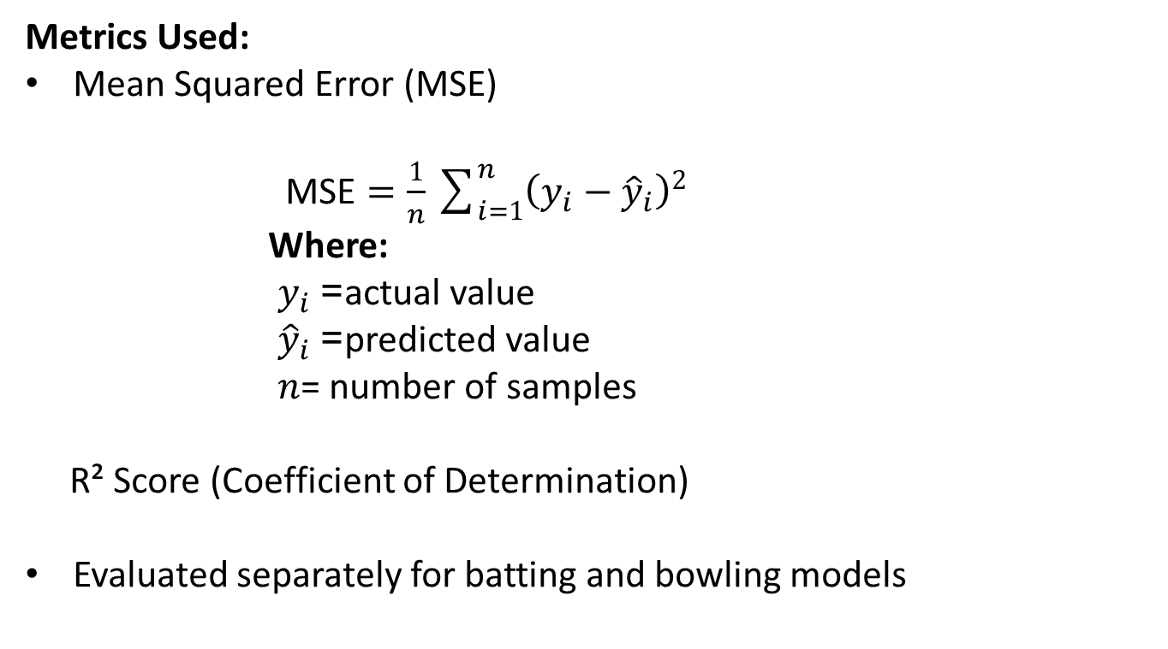
Performance Metrics
Metrics Used:
Mean Squared Error (MSE)
$\text{MSE}=\frac{1}{n}\sum_{i=1}^{n}{{\left(y_{i}−{\hat{y}}_{i}\right)}^{2}}$
Where:
${ y}_{i}$= actual value
${ \hat{y}}_{i}$= predicted value
$n$= number of samples
R² Score (Coefficient of Determination)
Evaluated separately for batting and bowling models

Slide 6
Model Execution & Output
System matches players and predicts:
User inputs partial/full player name via CLI
Predicted Runs Scored
Predicted Wickets Taken
Example players: MS Dhoni, Ruturaj

Slide 7
Conclusion & Thank You
Successfully built ML models for player performance prediction
Implemented data cleaning and model training
CLI tool for real-time predictions
Future Scope: Live data scraping, GUI/Dashboard
Thank you!

