Slide 1
AI101 MINI-PROJECT · TEAM 66
Siddharth Gangwar
Documentation Lead
Entry no. 2026MCB1571
TELCO CUSTOMER CHURN PREDICTION
Janhvi Yadav
Execution Lead
Entry no. 2026EEB1356
Kinjal Khatri
Using Logistic Regression
PPT Lead
Entry no. 2026EEB1366
Amandeep
GITHUB REPO
github.com/Siddharth-122008/telecom-customer-churn
Video Lead
Entry no. 2026AIB1007
1 / 5
Notes:
Introduce the project name, Team 66, the four members with their roles, and the GitHub repo.
1

Slide 2
PROBLEM AND DATA
7,043
WHAT AND WHY
Predict which telecom customers will leave (churn), so the company can act before they go. Keeping a customer costs less than finding a new one.
customers (rows)
21
columns, including the target Churn
DATASET SOURCE
Kaggle: Telco Customer Churn. Inputs include tenure, Contract, MonthlyCharges, InternetService and other service columns.
26.5%
churned (1,869 of 7,043)
2 / 5
Notes:
Explain the business problem in one line. Then the data: 7,043 customers, 21 columns, and about one in four customers left, so the classes are imbalanced. That is why we also look at recall, not only accuracy.
2

Slide 3

APPROACH
DATA · 1
DATA · 2
DATA · 3
LOAD CSV
CLEAN
ENCODE
7,043 customers, 21 columns
Drop customerID, encode Churn as 0 and 1
12 features become 21 numeric columns
MODEL · 4
MODEL · 5
OUTPUT · 6
SPLIT
TRAIN
EVALUATE
80% train (5,634), 20% test (1,409)
StandardScaler, then Logistic Regression
Accuracy, precision, recall, confusion matrix
LIBRARIES
pandas · numpy · matplotlib · seaborn · scikit-learn
3 / 5
Notes:
Walk through the six steps. Data: load, clean, encode. Model: split, scale and train. Output: evaluate. We scale using the training data only, so the test data stays unseen.
3

Slide 4
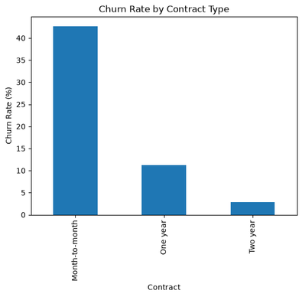
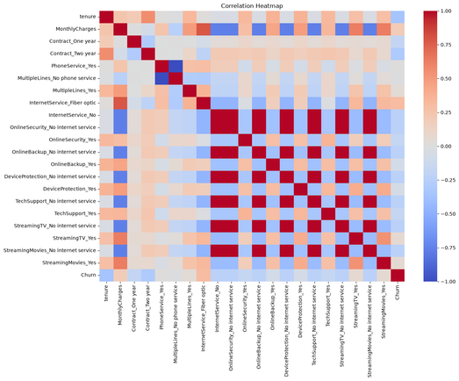
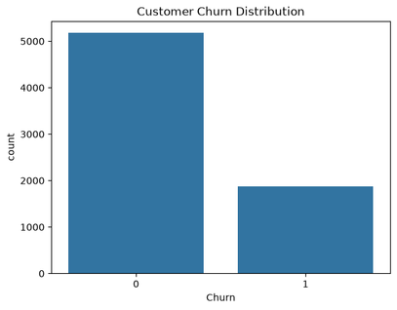
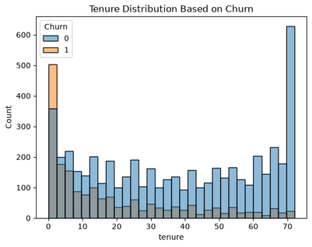
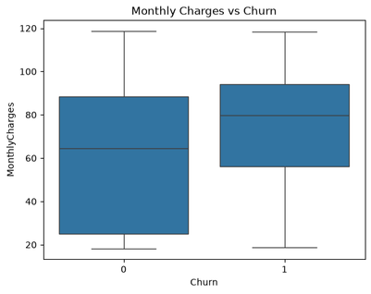
RESULTS
KEY TAKEAWAY
CONFUSION MATRIX
KEY NUMBERS
Predicted: Stayed (left), Churned (right)
1,409 test customers · churn class
Month-to-month customers churn far more often than customers on one- or two-year contracts.
Contract length is one of the clearest signals in this dataset.
921
114
79.6%
Actual Stayed
Accuracy
63.7%
Precision
174
200
Actual Churned
53.5%
Recall
58.1%
Finds 200 of 374 churners.
F1 score
4 / 5
Notes:
Left: month-to-month customers churn far more than two-year customers. Middle: of 374 real churners the model catches 200 and misses 174. Right: accuracy is 79.6%, but recall for churners is only 53.5%. Bottom: the notebook output from the repo (Part 4, evaluation).
4

Slide 5
LEARNINGS
WHAT DIDN’T
WHO DID WHAT
WHAT WORKED
Recall is only 53.5%, so the model misses almost half of the churners. MonthlyCharges overlaps with the service columns, so its coefficient is hard to read.
Siddharth: data loading, README
Contract type and tenure are strong signals: short contracts and new customers leave most. Accuracy reached 79.6%.
Kinjal: analysis plots, slides
Janhvi: model, run steps
Amandeep: evaluation, video
AI-USE DISCLOSURE
ChatGPT: plotting the correlation heatmap and refining the README.
Claude: debugging code, understanding errors, interpreting model , results and to improve language of ppt
All suggestions were checked by running and reviewing the code and comparing results with the notebook outputs.
5 / 5
Notes:
Say one honest limitation, then one line per member on who did what. The AI-use text matches the README.
5

