Slide 1


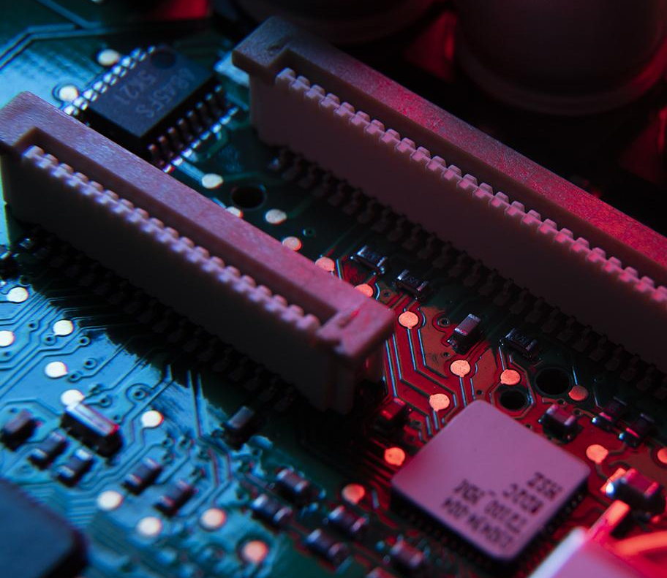
A scenario of a communication system in which two standalone systems can send data through the shortest path using the OSPF protocol using 3 routes
ECE-418
Project On-
By-Siddharth Mehrotra
Section-E2001
Roll No-RE2001A05
Reg No-12006050
Submitted to- Dr. Charanjit Singh
Professor at SEEE

Slide 2
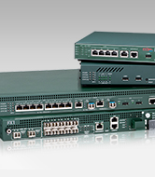
Agenda
01
02
03
04
OSPF
Aim & Objective
Result
Details of Project

Slide 3
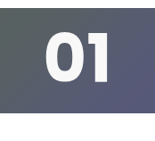
AIM AND OBJECTIVE
AIM:
A scenario of a communication system in which two standalone systems can send data through the shortest path using the OSPF protocol using 3 routes.
OBJECTIVE:
In this scenario, there are two standalone computer systems, System A and System B, that need to communicate with each other. There are three available routes for data transmission between the two systems, and the objective is to use the OSPF protocol to select the shortest path for data transmission.

Slide 4
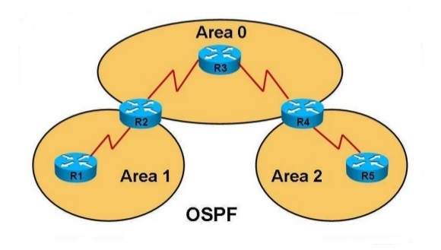
02
What is OSPF?

Slide 5
OPEN SHORT PATH FIRST
OSPF (Open Shortest Path First) is a link-state routing protocol used to determine the shortest path for data to travel through a network. It is an interior gateway protocol (IGP) used by routers to share information about network topology and determine the best path for data to take.
OSPF is designed to work in large and complex networks, and it is more scalable than other routing protocols such as RIP (Routing Information Protocol). OSPF routers exchange information about the network using link-state advertisements (LSAs), which contain information about the router's directly connected links and their status.
Each router in an OSPF network maintains a link-state database (LSDB) that contains information about the network topology, including all the links and routers. Routers use this information to calculate the shortest path to reach a particular destination network.

Slide 6
Details of the Project-
There are two PC’s PC0 and PC1 which are standalone PC’s.
The standalone PC’s are connected to two routers and there are three routers between them as mentioned in the aim of the project.
The transfer of packet will take the shortest path according to the OSPF protocol which is the fast ethernet path which it is taking as visible in the result in the subsequent slides.
I have given network id’s to all the networks so then it is easy to assign the IP addresses to the different network components.
I have assigned IP Address and subnet mask to all the routers using the CLI command which I have mentioned in the report.

Slide 7
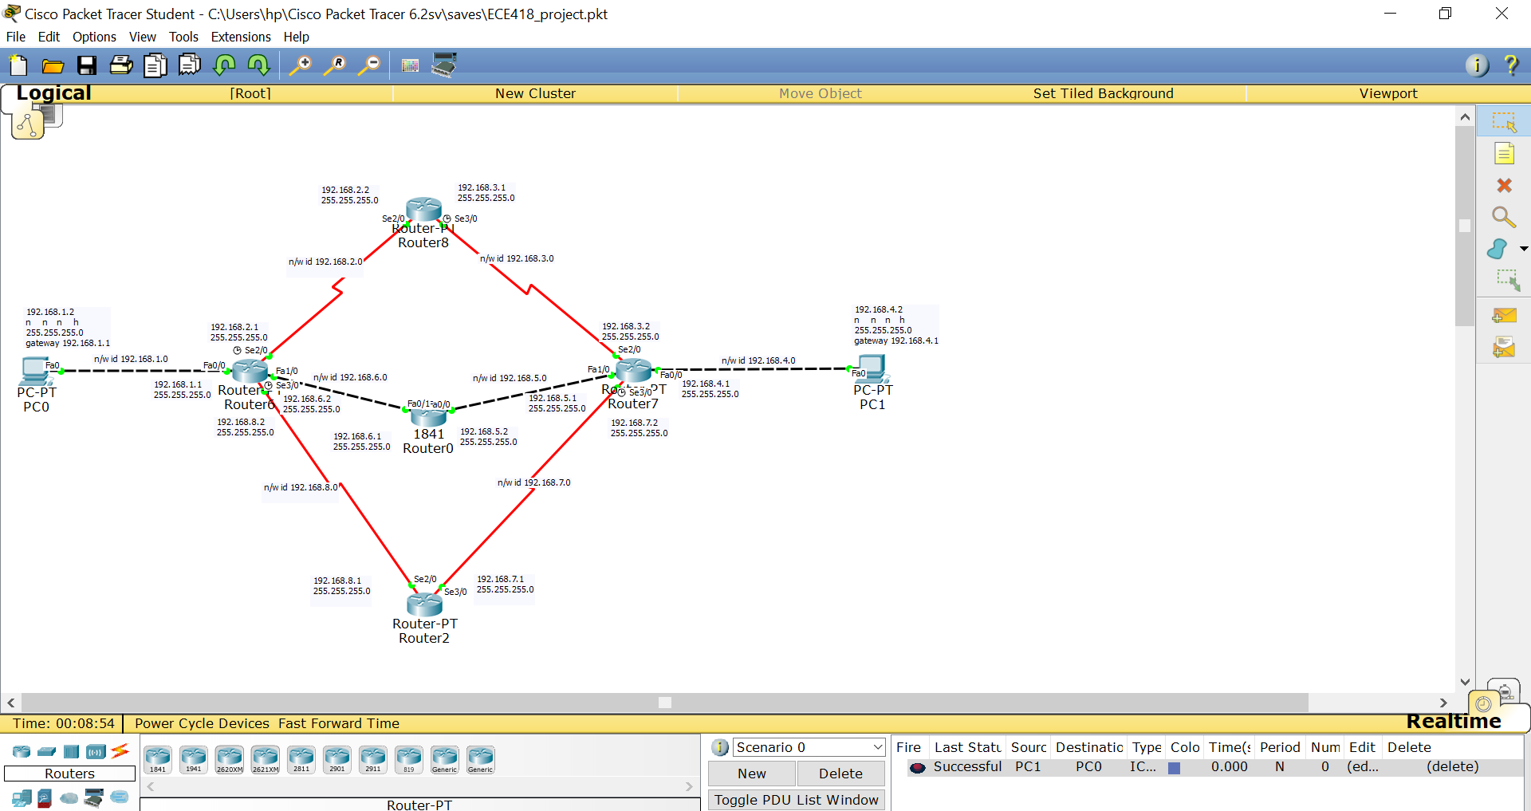
Result-
Circuit Diagram

Slide 8
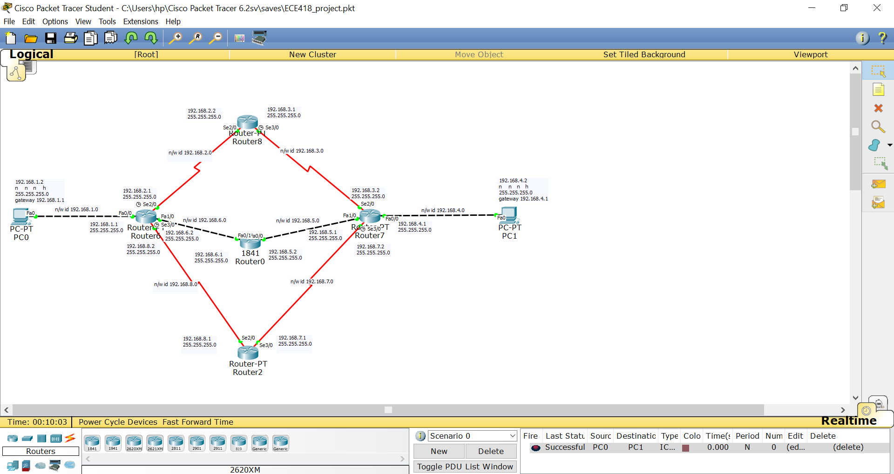
Successful Transmission from PC0 to PC1

Slide 9
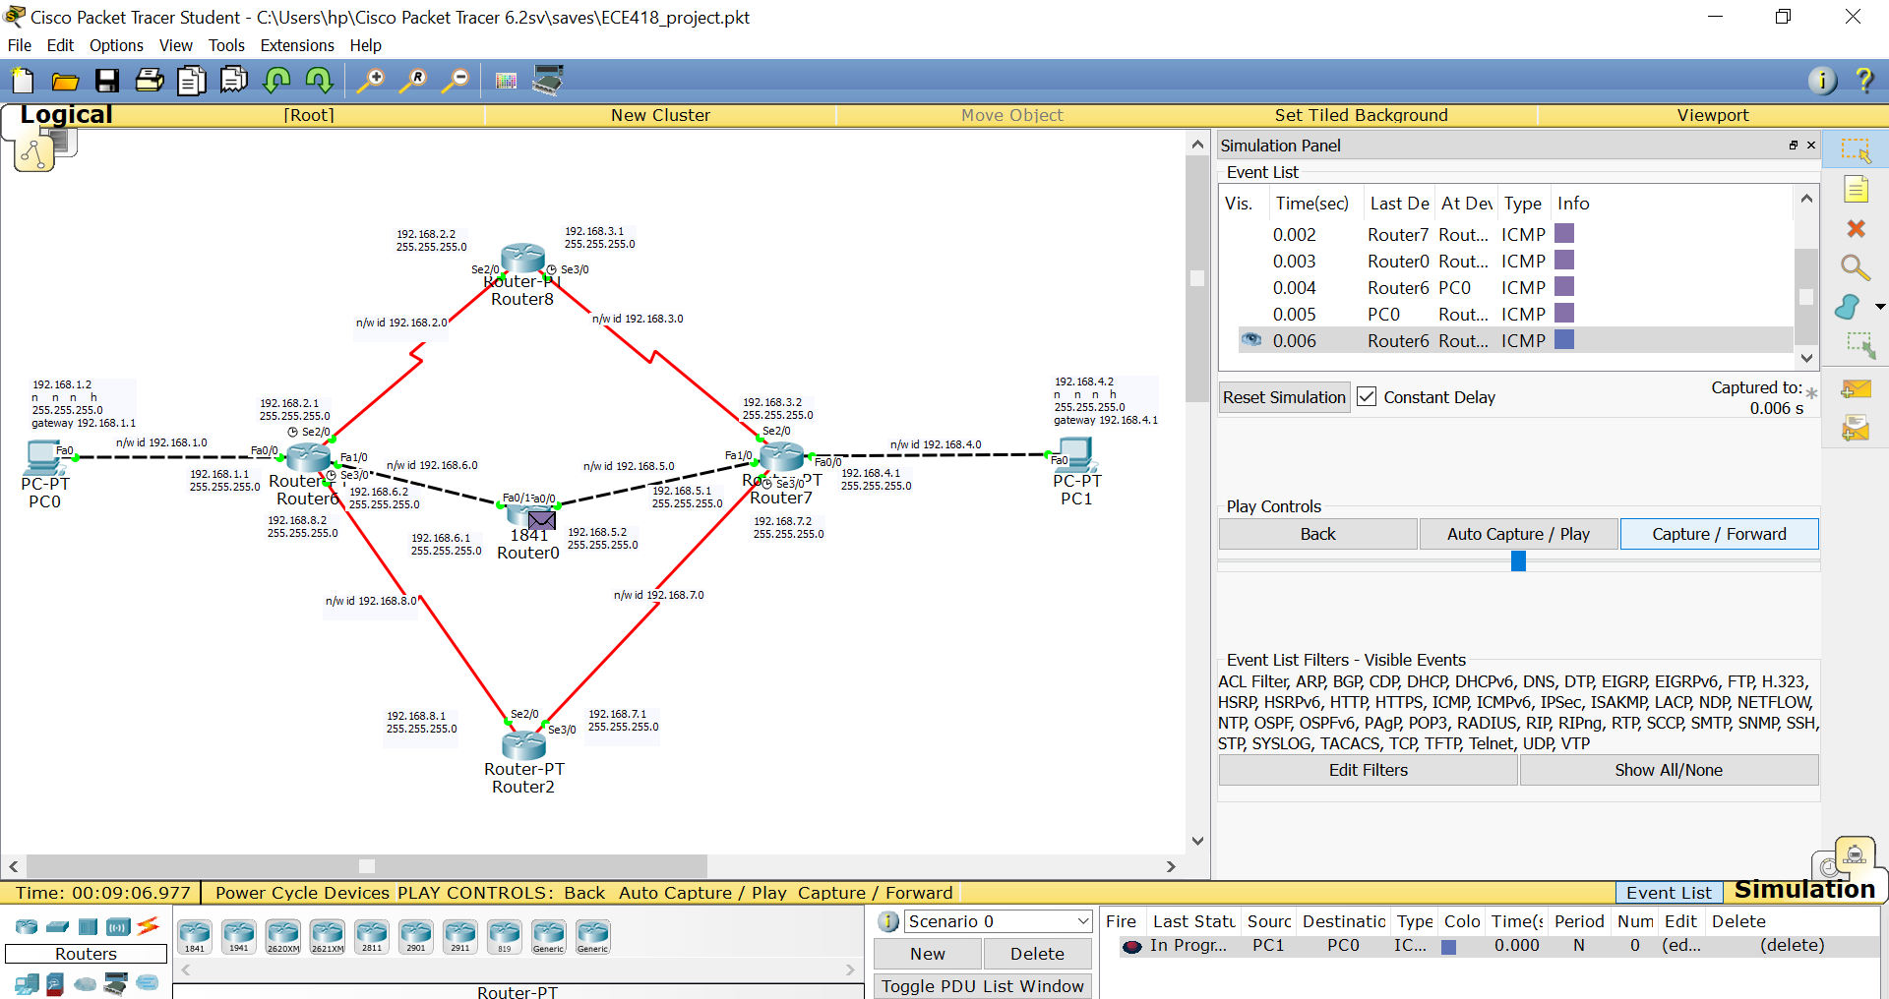
Shortest path being followed

Slide 10
Thanks!

