Slide 1
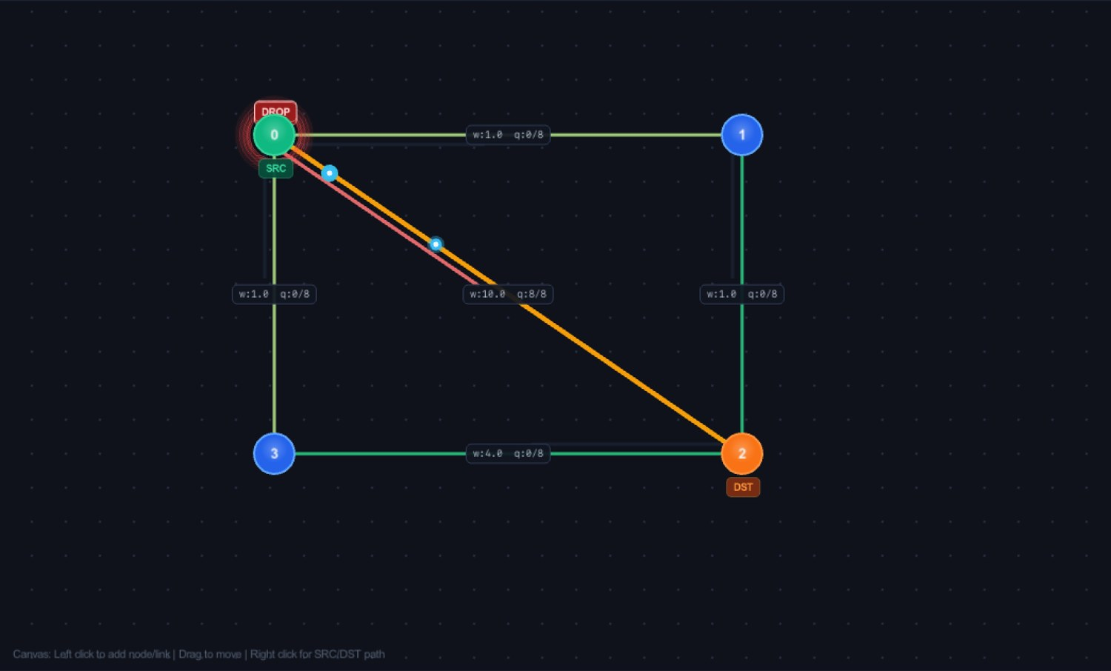
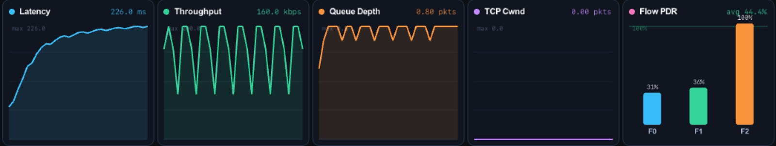
65–70% MILESTONE · REVIEW 2
Network Traffic & Routing Simulator
Interactive simulation of routing, traffic flow and network performance
Computer Networks Lab — BCSE308P | Slot F2 + TF2
Review 2 · Working Prototype Demonstration
Live run: heavy traffic, queue full, packet drop
24BCT0053
24BAI0328
24BAI0337
24BCE0870

Slide 2
Review 1 → Review 2: What Changed
About 30% → about 65–70% of the project is now working
Done at Review 1 (30%)
Requirements and blueprint
Adjacency list + matrix
Dijkstra shortest path
Node-placement canvas
GUI skeleton
Built since Review 1
Bellman-Ford routing + live Dijkstra vs Bellman-Ford benchmark
3 cost modes: Weight, Hop Count, Dynamic (queue-aware)
Traffic generator: CBR, Bursty, TCP, Poisson (up to 64 flows)
Per-link FIFO queues with buffer limit, tail-drop and packet loss
Packet animation with drop alerts on nodes and links
TCP-like congestion window (cwnd) tracking
Live telemetry: latency, throughput, queue depth, cwnd, per-flow PDR
6 preset scenarios, Save/Load topology, CSV export, snapshots
Weight edit with live recompute (in progress at Review 1) is now part of the working editor.

Slide 3
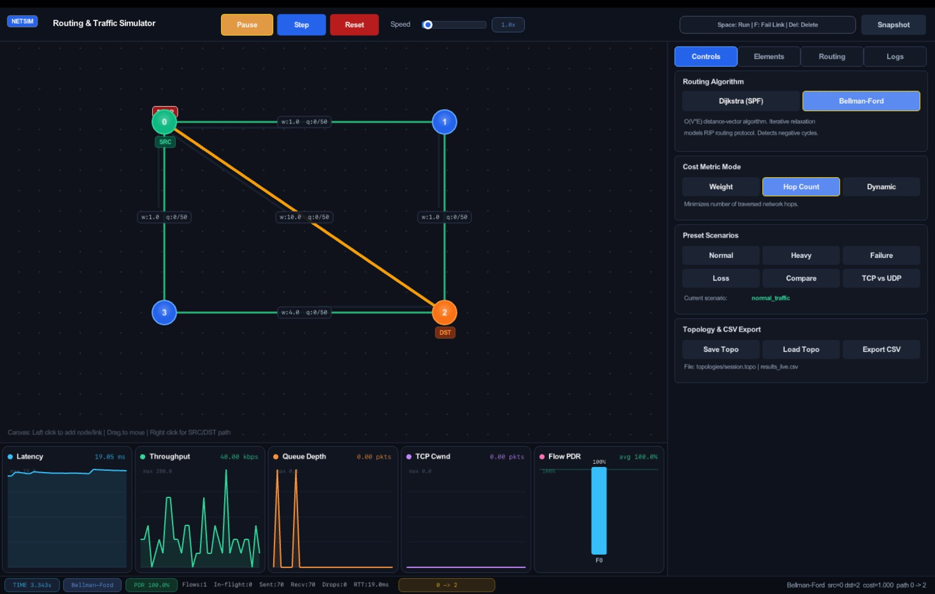
System Overview: The Working Simulator
One window: topology canvas, control panel, live charts and status bar
Canvas
Click to add nodes/links, drag to move, right-click to set SRC/DST
Control tabs
Controls · Elements · Routing · Logs
Live charts
5 real-time panels along the bottom
Status bar
Time, algorithm, PDR, flows, in-flight, sent/recv/drops, RTT, active path
Shortcuts: Space = run/pause · F = fail link · Del = delete
Normal-traffic run: 70 sent, 70 received, PDR 100%

Slide 4
Architecture: Topology → Routing → Traffic → Telemetry
Module pipeline from Review 1, now fully populated
Topology Canvas
Nodes, links, weights, drag and edit
Graph Model
Adjacency list + cost matrix
Routing Engine
Dijkstra, Bellman-Ford, 3 cost modes
Traffic Engine
CBR, Bursty, TCP, Poisson flows
Queue & Packet Engine
Link queues, tail-drop, loss, animation
Telemetry & Analytics
Latency, throughput, PDR, queue, cwnd
→
→
→
→
→
DATA MODEL
Node
ID, position, role (SRC / DST / router), state
Link
Weight, bandwidth, delay, loss, queue K, up/down state
Flow / Packet
Source, destination, protocol, rate, size, start/stop, timestamps

Slide 5
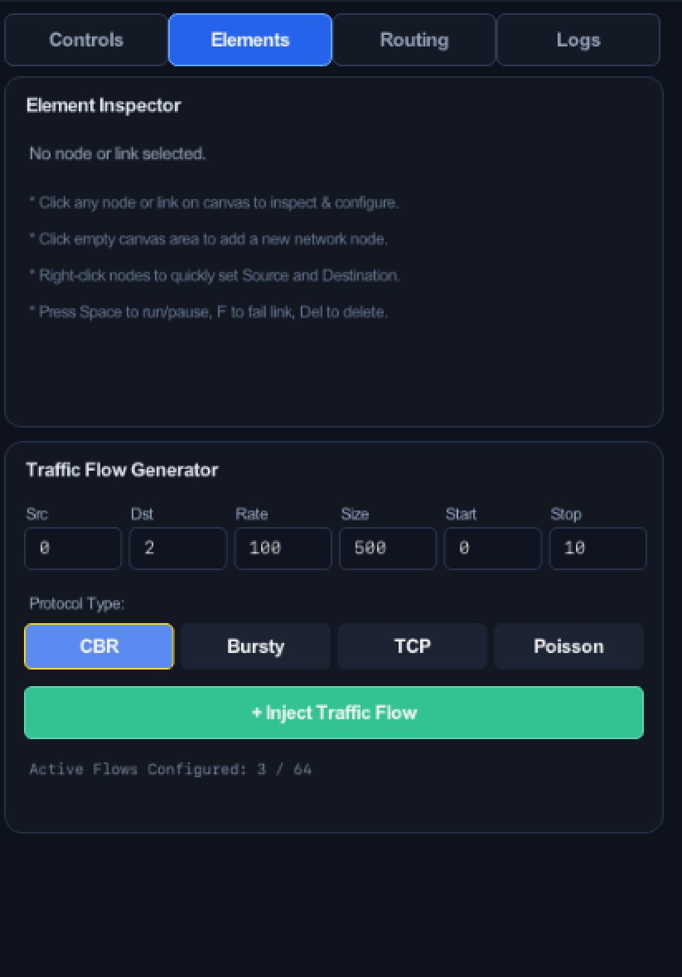
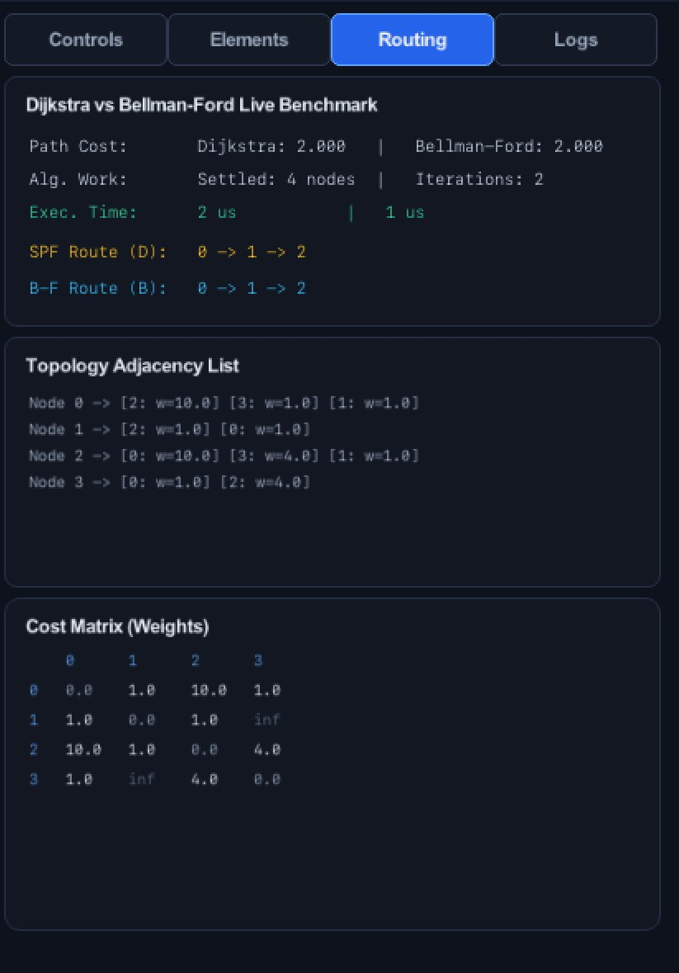
Topology Editor & Graph Model
Build any network graph, edit it live, save and reload
Click empty canvas to add a node; click two nodes to link them
Drag to move; Del removes; F fails or restores a link
Inspector edits weight, bandwidth, delay, loss and queue size
Adjacency list and cost matrix update live (∞ = no link)
Save Topo / Load Topo to topologies/session.topo
Sample: 4-node loop and 8-node mesh topologies
Elements tab: inspector + flow generator
Routing tab: adjacency list + cost matrix

Slide 6
Routing Engine: Link-State vs Distance-Vector
Both algorithms implemented and switchable at runtime
Dijkstra — Link-State
Global topology, priority queue, O((V+E) log V). Settled 4 nodes on the demo graph.
3 cost modes
Weight — administrative link weights
Hop Count — fewest hops
Dynamic — queue backlog + latency
Bellman-Ford — Distance-Vector
Iterative edge relaxation, O(VE), negative-cycle detection. Converged in 2 iterations.
Automatic recompute
Any weight edit, link failure or mode change triggers a new route, highlighted in orange on the canvas.
Live benchmark panel

Slide 7
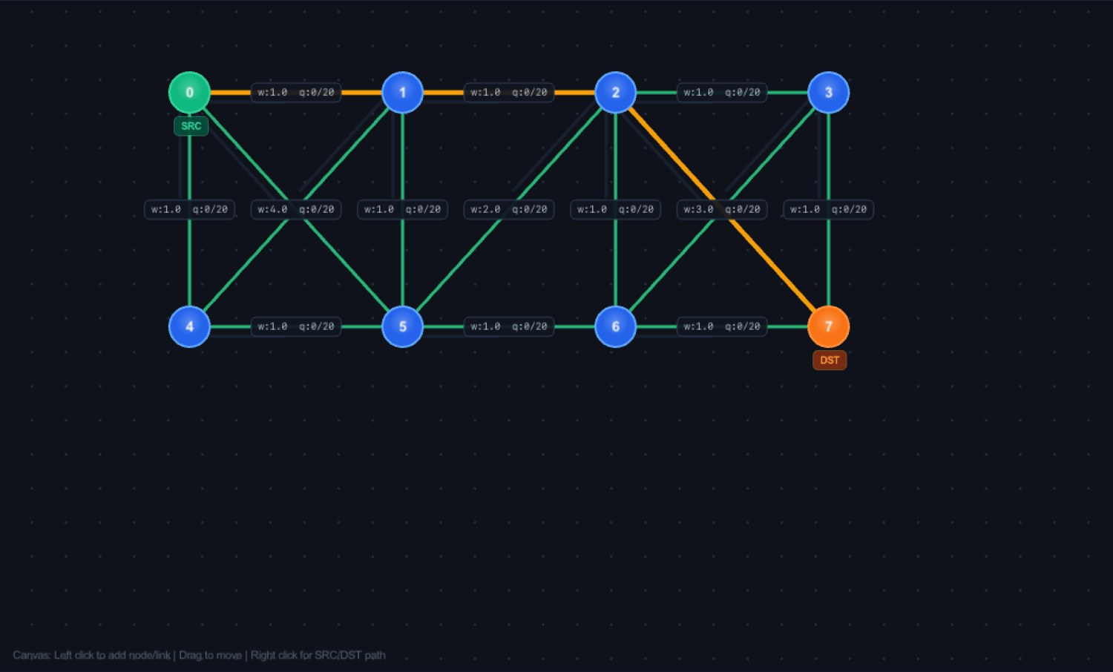
Dijkstra vs Bellman-Ford: Measured Results
4-node topology, source 0 → destination 2, Weight mode
Metric | Dijkstra | Bellman-Ford
Path cost | 2.000 | 2.000
Route | 0 → 1 → 2 | 0 → 1 → 2
Algorithm work | 4 nodes settled | 2 iterations
Execution time | 2 µs | 1 µs
Both give identical cost and route, which cross-validates the two implementations
Cheaper path 0→1→2 (cost 2) beats the direct link (weight 10)
Timings are microseconds on a 4-node graph; differences matter only at scale
8-node mesh, Bellman-Ford, Dynamic mode: path 0→1→2→7, cost 18.0
Scales beyond the demo
The 8-node mesh with weights 1–4 shows the same engine routing across a larger graph (algorithm_compare scenario).

Slide 8
Traffic Generator
Create synthetic workloads from the GUI and run them concurrently
CBR
Constant bit rate at fixed packet size
Bursty
ON/OFF bursts that stress the queues
TCP
Window-based flow with cwnd growth
Poisson
Random arrivals; basis for M/M/1 queueing
Parameters per flow: source, destination, rate, packet size, start and stop time
Up to 64 flows configured at once (3 active in the screenshot)
Flows are injected live and appear in the per-flow PDR chart
Traffic Flow Generator (Elements tab)

Slide 9
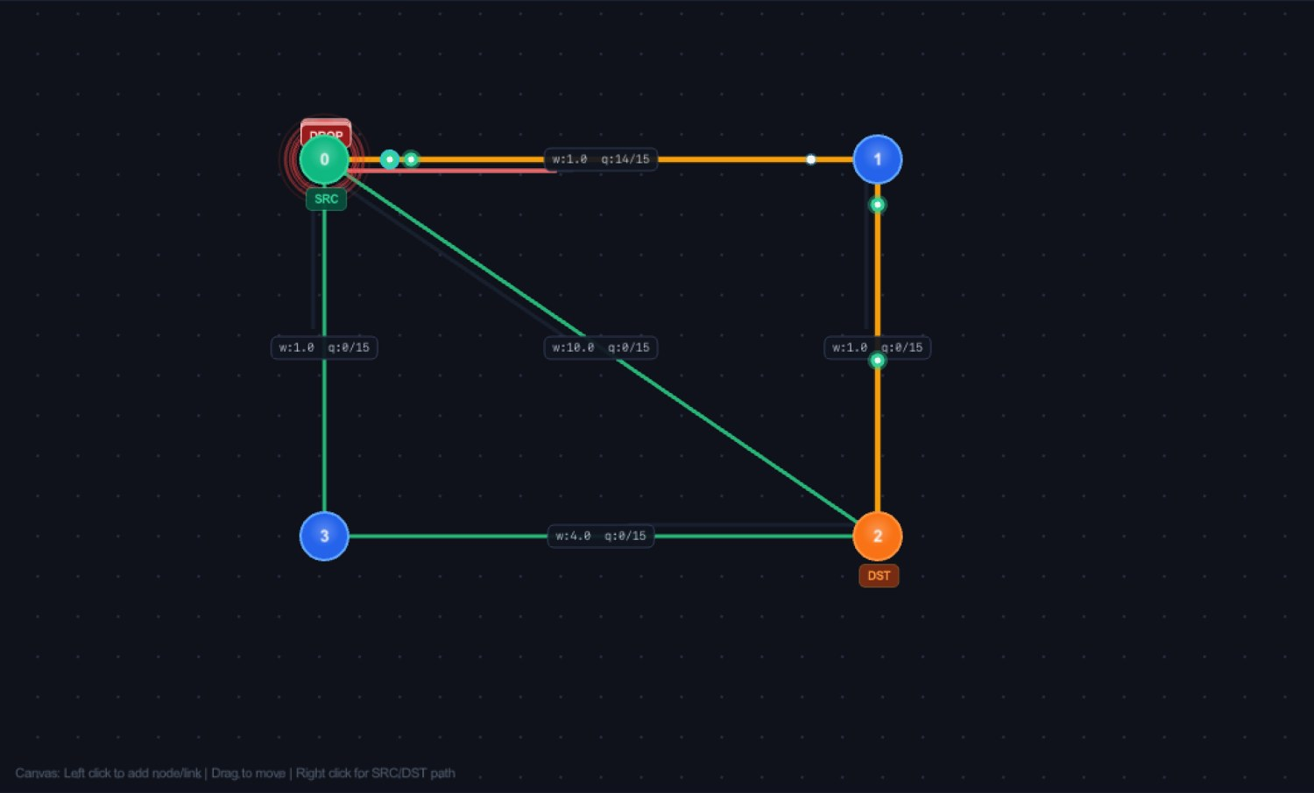
Packet Movement, Queueing and Loss
Every link has a finite FIFO buffer; congestion becomes visible
Packets animate hop by hop along the active route
Queue label q:used/K on every link (e.g. q:14/15)
Buffer full → tail-drop; node flashes DROP in red
Link loss rate adds random drops (Loss scenario)
Service time = size×8 / bandwidth, plus propagation delay
Link colour shifts from green to red as load grows
TCP vs UDP run: queue 14/15 on link 0–1, packets in flight, DROP flash at node 0

Slide 10
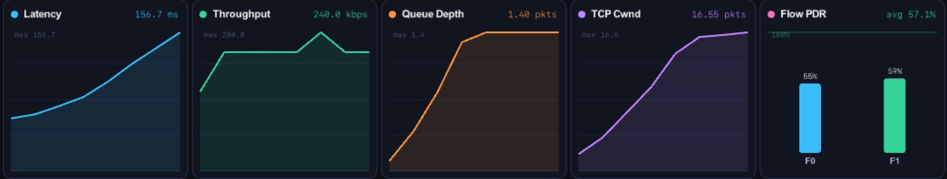
Telemetry & Live Analytics
Five real-time panels plus a status bar, all computed from the simulation
Status bar
Time · algorithm · PDR · flows · in-flight · sent · recv · drops · RTT · active path
Live charts during TCP vs UDP: latency, throughput, queue depth, cwnd, per-flow PDR
Latency
End-to-end delay (ms)
Throughput
Delivered data rate (kbps)
Queue depth
Average packets waiting
Export
Export CSV writes results_live.csv for offline analysis; Snapshot saves a screenshot.
TCP cwnd
Congestion window (pkts)
Flow PDR
Delivered ÷ sent × 100

Slide 11
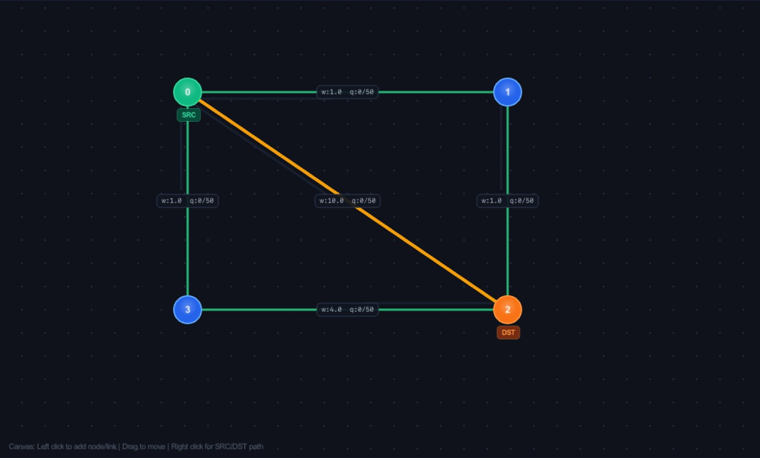
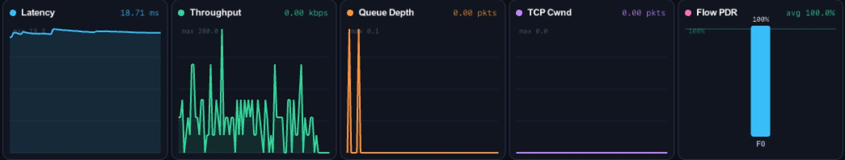
Scenario 1: Normal Traffic (Baseline)
Light load on path 0 → 2, Dijkstra, Hop Count, buffer 50
100%
140/140
PDR
received / sent
18.7 ms
0
RTT / latency
drops
Latency stays flat near 19 ms
Queue depth stays near zero
No packet loss, so this is the reference for the other scenarios
t = 8.0 s: all packets delivered

Slide 12
Scenario 2: Heavy Traffic (Congestion)
3 concurrent flows over path 0 → 2, Bellman-Ford, Hop Count, buffer 8
44.4%
149
PDR
packets dropped
226 ms
126/284
latency
received / sent
Latency rises about 12× versus the baseline (226 ms vs 18.7 ms)
Bottleneck queue is full, so excess packets are tail-dropped
Per-flow PDR: F0 31%, F1 36%, F2 100%
t = 3.1 s: link 0–2 queue at q:8/8, DROP at source

Slide 13
Scenario 3: TCP vs UDP Competing
Two flows share the 0 → 1 → 2 path, Dijkstra, Weight mode, buffer 15
57.1%
16.55
PDR
cwnd (pkts)
156.7 ms
240
latency
throughput (kbps)
TCP congestion window grows steadily while the queue fills
Per-flow PDR: F0 55%, F1 59%
Shows how competing flows share a bottleneck
t = 0.8 s: queue 14/15 on link 0–1

Slide 14
Results Summary
All numbers read from the live simulator runs shown in the previous slides
Scenario | Algorithm / cost | Sent | Recv | Drops | PDR | Latency
Normal | Dijkstra / Hop | 140 | 140 | 0 | 100% | 18.7 ms
Heavy | Bellman-Ford / Hop | 284 | 126 | 149 | 44.4% | 226 ms
TCP vs UDP | Dijkstra / Weight | 84 | 48 | 18 | 57.1% | 156.7 ms

Slide 15
Progress and Remaining Work
About 65–70% complete; the rest is validation, evidence and polish
Working now
Planned for the final review
Topology editor, graph model, save/load
Dijkstra and Bellman-Ford with live benchmark
Hop, Weight and Dynamic cost modes
CBR, Bursty, TCP and Poisson generators
Queues, tail-drop, packet animation
Live charts, status bar, CSV export
Normal, Heavy and TCP vs UDP runs demonstrated
Link-failure demo with measured rerouting time
High-loss scenario results (PDR vs loss rate)
M/M/1 queueing validation: measured vs theory
Link utilisation heatmap
Stress test on larger topologies (50+ nodes)
Full CSV analysis and final report

Slide 16
Conclusion
Routing decisions are now observable, measurable and experimentally testable.
Observable
Packets, queues and routes animate live
Measurable
Latency, throughput, PDR, queue depth, cwnd
Testable
Switch algorithms and cost modes, run 6 presets
THANK YOU Questions & Discussion

