Slide 1
EMBEDDED SYSTEMS / FINAL DA3 REVIEW
ESP32 RL
Load Balancer
Adaptive traffic routing on an ESP32
On-device Q-learning with a flash-sale demonstration
Final implementation and evaluation
Notes:
Final DA3 review. Firmware and UI reviewed at upstream commit 76d80d56532424a05b93f037408980ff52f622d2. The team confirms Q-table persistence is implemented but not pushed. Hardware results follow markdowns/05_results_and_limits.md and the user confirmation in this task.

Slide 2
FINAL DA3 REVIEW
Project team
Bhuvan Bharat Nayak
24BCE5549
Siddharth Sameer Nevgi
24BCE5550
Abhyuday Vaish
24BCE5561
Tanish Somashekhar Desai
24BCE5567
02
Notes:
Team names and registration numbers supplied directly by the user.

Slide 3
PROJECT CONTEXT
Problem and project objectives
Problem
A fixed traffic split keeps sending requests to a slow backend, increasing response time and occupying gateway sessions.
Objective
Choose a backend from observed session feedback while keeping routing decisions on the ESP32.
Evaluation
Compare Q-learning against Round Robin and EMA under controlled backend delays and changing demand.
03
Notes:
https://github.com/Tanish-Desai/Esp32LoadBal/blob/76d80d56532424a05b93f037408980ff52f622d2/esp32/MyFirstESP32/src/main.cpp
https://github.com/Tanish-Desai/Esp32LoadBal/blob/76d80d56532424a05b93f037408980ff52f622d2/server-client/server.py

Slide 4
FINAL REVIEW SCOPE
DA3 implementation status
Deliverable | DA3 status
ESP32 gateway | TCP proxy with three selectable strategies
FlashPoint UI | Flash-sale controls, routing view and event-based metrics
Hardware evaluation | Completed run with team-confirmed results
Simulation studies | Three scenarios and backend-latency sweep
Q-table persistence | Implemented by team in nonvolatile flash. Commit pending
04
Notes:
https://github.com/Tanish-Desai/Esp32LoadBal/blob/76d80d56532424a05b93f037408980ff52f622d2/ui/templates/index.html
https://github.com/Tanish-Desai/Esp32LoadBal/blob/76d80d56532424a05b93f037408980ff52f622d2/ui/static/telemetry.js
https://github.com/Tanish-Desai/Esp32LoadBal/blob/76d80d56532424a05b93f037408980ff52f622d2/benchmarks/run_benchmark.py
Team confirmation: flash persistence implemented, commit pending.

Slide 5
REQUEST AND TELEMETRY PATHS
System architecture
Stage | Responsibility
Request generators | Python clients create short-lived requests to the ESP32
ESP32 gateway, port 80 | Select a backend, forward bytes and observe session duration
Laptop backend pool | Python TCP servers on ports 8080 through 8084
Flask + Socket.IO | Manage servers and generators, publish their events
Browser dashboard | Correlate request IDs and display routing and outcomes
05
Notes:
https://github.com/Tanish-Desai/Esp32LoadBal/blob/76d80d56532424a05b93f037408980ff52f622d2/ui/app.py
https://github.com/Tanish-Desai/Esp32LoadBal/blob/76d80d56532424a05b93f037408980ff52f622d2/server-client/client.py
https://github.com/Tanish-Desai/Esp32LoadBal/blob/76d80d56532424a05b93f037408980ff52f622d2/server-client/server.py
https://github.com/Tanish-Desai/Esp32LoadBal/blob/76d80d56532424a05b93f037408980ff52f622d2/esp32/MyFirstESP32/src/main.cpp

Slide 6
EMBEDDED IMPLEMENTATION
Firmware design and resource limits
7
One frontend and one backend socket per session
The main loop services active sessions with a shared 1,024-byte buffer.
concurrent proxy sessions
WiFiManager handles setup. Preferences retains the configured laptop IP.
MAX_CLIENTS in this firmware
06
Notes:
https://github.com/Tanish-Desai/Esp32LoadBal/blob/76d80d56532424a05b93f037408980ff52f622d2/esp32/MyFirstESP32/src/main.cpp
https://github.com/Tanish-Desai/Esp32LoadBal/blob/76d80d56532424a05b93f037408980ff52f622d2/esp32/MyFirstESP32/platformio.ini

Slide 7
ROUTING ALGORITHM
Q-learning policy
Component | Firmware behavior
State and action | Active-session count (0–7), then a backend index
Selection | Epsilon-greedy exploration or highest Q-value
Reward | 1000 / (duration_ms + 1), or −50 for duration ≥ 2000 ms
Parameters | α = 0.3, γ = 0.5. ε decays from 1.0 to a 0.05 floor
Q(s,a) = Q(s,a) + α [r + γ max Q(s′,a′) − Q(s,a)]
07
Notes:
https://github.com/Tanish-Desai/Esp32LoadBal/blob/76d80d56532424a05b93f037408980ff52f622d2/esp32/MyFirstESP32/lib/LoadBalancerAlgorithms/src/QLearning.cpp
https://github.com/Tanish-Desai/Esp32LoadBal/blob/76d80d56532424a05b93f037408980ff52f622d2/esp32/MyFirstESP32/src/main.cpp
The firmware selects with the pre-admission session count and updates using the active count at completion. This is an implementation caveat for state-transition fidelity. The duration threshold is a reward rule, not a firmware timer that forcibly closes sessions at 2 seconds.

Slide 8
COMPARISON DESIGN
Baseline strategies
Strategy | Decision rule | Practical tradeoff
Round Robin | Cycle through backends | Low overhead, ignores backend delays
Q-learning | Highest learned value for a state | Learns from feedback, needs exploration
EMA response time | Highest smoothed reward | Simple adaptation without a state table
All three strategies run in the same firmware.
08
Notes:
https://github.com/Tanish-Desai/Esp32LoadBal/blob/76d80d56532424a05b93f037408980ff52f622d2/esp32/MyFirstESP32/lib/LoadBalancerAlgorithms/src/RoundRobin.cpp
https://github.com/Tanish-Desai/Esp32LoadBal/blob/76d80d56532424a05b93f037408980ff52f622d2/esp32/MyFirstESP32/lib/LoadBalancerAlgorithms/src/EmaResponseTime.cpp
https://github.com/Tanish-Desai/Esp32LoadBal/blob/76d80d56532424a05b93f037408980ff52f622d2/esp32/MyFirstESP32/lib/LoadBalancerAlgorithms/src/QLearning.cpp

Slide 9
DA3 IMPROVEMENT
Q-table persistence across restarts
Previous behavior
The committed Q-learning constructor creates a zero-filled table, so every reboot starts learning again.
Implemented change
The team now stores learned Q-values in ESP32 nonvolatile flash and restores them after restart.
Why it matters
The gateway can resume its learned policy instead of discarding the table at every power cycle.
09
Notes:
Source: user statement, confirmed implemented but not pushed. The storage API, save cadence and validation scheme are not present in the synchronized repository and are not asserted here.
Espressif Preferences documentation: https://docs.espressif.com/projects/arduino-esp32/en/latest/api/preferences.html
The ESP32 Arduino EEPROM interface is a flash-backed compatibility mechanism. Preferences uses NVS. The slide deliberately describes nonvolatile flash without guessing which API the unpushed change uses.

Slide 10
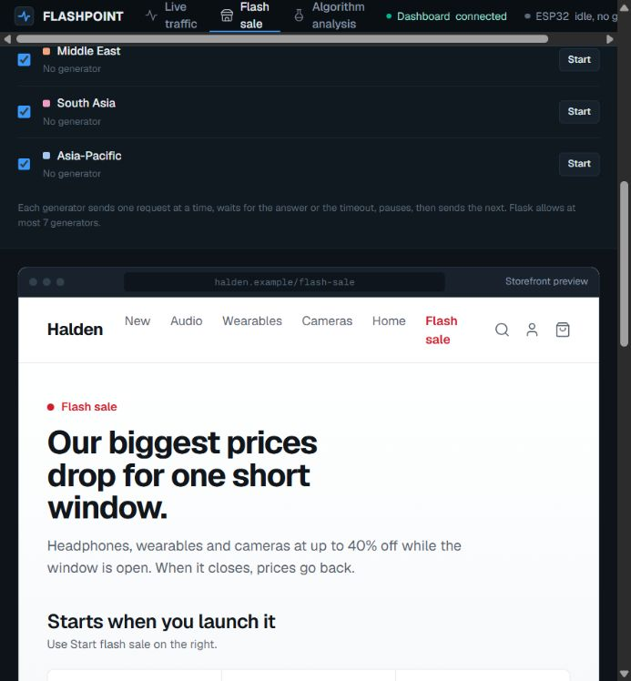
DA3 USER INTERFACE
FlashPoint flash-sale use case
Controlled demand bursts
Start one mock request generator for each selected region, up to seven in total.
Adjust the pause between requests and client timeout. The sale timer only controls the displayed countdown.
10
Notes:
https://github.com/Tanish-Desai/Esp32LoadBal/blob/76d80d56532424a05b93f037408980ff52f622d2/ui/templates/index.html
https://github.com/Tanish-Desai/Esp32LoadBal/blob/76d80d56532424a05b93f037408980ff52f622d2/ui/static/storefront.js
https://github.com/Tanish-Desai/Esp32LoadBal/blob/76d80d56532424a05b93f037408980ff52f622d2/ui/static/region-config.js
Screenshot captured from the actual local UI with no ESP32 connected and no generated traffic. Product prices and regional labels are illustrative. The storefront has no inventory or checkout service.

Slide 11
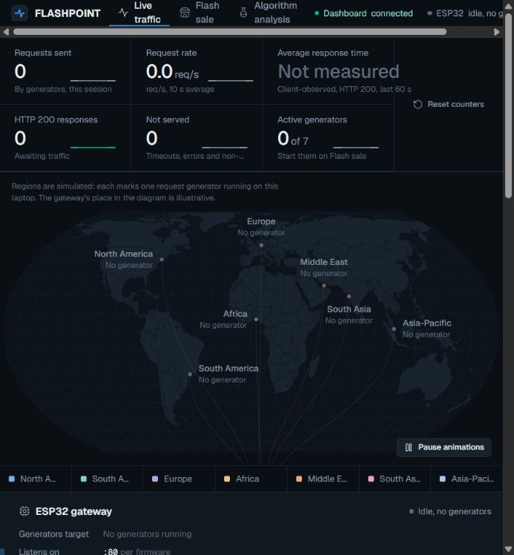
DA3 USER INTERFACE
Live routing and telemetry
Events drive the view
Request IDs connect client events to the backend that handled each request.
Charts show request rate, backend distribution and client-observed response time. The event stream exposes errors and timeouts.
11
Notes:
https://github.com/Tanish-Desai/Esp32LoadBal/blob/76d80d56532424a05b93f037408980ff52f622d2/ui/static/telemetry.js
https://github.com/Tanish-Desai/Esp32LoadBal/blob/76d80d56532424a05b93f037408980ff52f622d2/ui/static/world-map.js
https://github.com/Tanish-Desai/Esp32LoadBal/blob/76d80d56532424a05b93f037408980ff52f622d2/ui/static/charts.js
https://github.com/Tanish-Desai/Esp32LoadBal/blob/76d80d56532424a05b93f037408980ff52f622d2/ui/static/event-stream.js
Screenshot captured from the actual local UI with no traffic. Region coordinates only locate mock generators on the map. The gateway has no status endpoint and does not report its strategy.

Slide 12
REVIEW DEMONSTRATION
Flash-sale demonstration sequence
01
Configure
Start backends on 8080–8082 and select a firmware strategy at boot.
02
Route
Point generators at the ESP32 IP, port 80. Start the selected regions.
03
Degrade
Raise the delay on one backend while traffic continues.
04
Observe
Watch response time, successful responses and backend distribution.
05
Compare
Repeat with the same settings for each strategy and reset counters.
12
Notes:
https://github.com/Tanish-Desai/Esp32LoadBal/blob/76d80d56532424a05b93f037408980ff52f622d2/ui/templates/index.html
https://github.com/Tanish-Desai/Esp32LoadBal/blob/76d80d56532424a05b93f037408980ff52f622d2/ui/static/storefront.js
https://github.com/Tanish-Desai/Esp32LoadBal/blob/76d80d56532424a05b93f037408980ff52f622d2/benchmarks/run_benchmark.py
This is a demonstration protocol, not a claim that a new hardware experiment was performed during deck preparation. A direct-backend test is a connectivity check, not an ESP32 benchmark.

Slide 13
TEAM-CONFIRMED HARDWARE RUN
Hardware evaluation setup
3 backends 5 clients 120 seconds
Backend | Added delay setting | Condition
8080 | 0% of 2-second timeout | Healthy reference
8081 | 45%, approximately 900 ms | Degraded backend
8082 | 5%, approximately 100 ms | Second healthy backend
13
Notes:
https://github.com/Tanish-Desai/Esp32LoadBal/blob/76d80d56532424a05b93f037408980ff52f622d2/markdowns/05_results_and_limits.md
https://github.com/Tanish-Desai/Esp32LoadBal/blob/76d80d56532424a05b93f037408980ff52f622d2/benchmarks/run_benchmark.py
User explicitly approved use of the hardware figures. The source notes describe the run as real ESP32, 3 backends, 5 clients and 120 seconds. data/project_data.json still has null measured_results. Raw run artifacts and repeated-run intervals are not included in the repository.

Slide 14
HARDWARE RESULT
Q-learning reduced mean latency by 59.8%
310 ms
lower mean latency
than Round Robin
For the documented
120-second run
14
Notes:
https://github.com/Tanish-Desai/Esp32LoadBal/blob/76d80d56532424a05b93f037408980ff52f622d2/markdowns/05_results_and_limits.md
Team confirmation: use hardware mean latency RR=518 ms, Q-learning=208 ms, EMA=515 ms.
Calculation: (518−208)/518×100 = 59.8456%. Single documented configuration, not a universal improvement.

Slide 15
MEASURED RUN REPORTED BY THE TEAM
Hardware performance comparison
Metric | Round Robin | Q-learning | EMA
Requests served | 737 | 1,156 | 731
Mean latency | 518 ms | 208 ms | 515 ms
p95 latency | 1,186 ms | 473 ms | 1,185 ms
Throughput | 6.1 req/s | 9.6 req/s | 6.1 req/s
Timeouts | 0 | 6 | 3
Approximately 57% higher reported throughput than Round Robin
15
Notes:
https://github.com/Tanish-Desai/Esp32LoadBal/blob/76d80d56532424a05b93f037408980ff52f622d2/markdowns/05_results_and_limits.md
The team confirmed the hardware run in this task. These figures come from the results markdown, not the still-null measured_results JSON. No uncertainty interval is available. Served totals, timeout counts and throughput describe the documented run, with throughput rounded to one decimal place.
Throughput gain from rounded rates: (9.6/6.1−1)×100 = 57.38%. p95 reduction: (1186−473)/1186×100 = 60.12%.

Slide 16
SIMULATION, AVERAGES OVER 8 SEEDS
Simulation results across three scenarios
Scenario | Round Robin | Q-learning | EMA
Smart factory | 86.1% | 100.0% | 96.3%
Rural clinic | 92.0% | 100.0% | 98.7%
Retail POS outage | 84.9% | 74.5% | 97.2%
Goodput = successful answers / all offered requests
16
Notes:
https://github.com/Tanish-Desai/Esp32LoadBal/blob/76d80d56532424a05b93f037408980ff52f622d2/data/project_data.json
Section simulation_findings.scenario_results. Reproducible via benchmarks/tools/export_sim_results.mjs. This deck uses stored 8-seed aggregates, not single-seed results. Smart factory, rural clinic and retail POS are simulated scenarios, not deployments.

Slide 17
SIMULATION, AVERAGES OVER 8 SEEDS
Backend differences determine the benefit
+43.9
percentage points
QL over RR at 12×
17
Notes:
https://github.com/Tanish-Desai/Esp32LoadBal/blob/76d80d56532424a05b93f037408980ff52f622d2/data/project_data.json
Section simulation_findings.headline_finding.table. Two backends and six clients, fast backend at 60 ms, latency spread swept from 1× to 12×. Reproduce with node benchmarks/tools/exp_heterogeneity.mjs. The 8× value is specific to these settings, not a universal threshold.
At 12×: 93.7−49.8 = 43.9 percentage points.

Slide 18
SIMULATION FINDING
Known weakness under changing load
Retail POS result
Q-learning achieves 74.5% goodput, compared with 84.9% for Round Robin and 97.2% for EMA.
Cause
Nearly identical backends provide a weak initial signal. Exploration reaches its floor before the later degradation.
Experiment and remaining work
A 0.15 exploration floor lifts simulated goodput to 85.5%. Adaptive re-exploration remains future work.
18
Notes:
https://github.com/Tanish-Desai/Esp32LoadBal/blob/76d80d56532424a05b93f037408980ff52f622d2/data/project_data.json
Section simulation_findings.known_weakness. Stored aggregate results are RR=84.9%, QL=74.5%, EMA=97.2%. The narrative known_weakness.finding contains a stale RR=84.5% value, which belongs to a single-seed run. This slide consistently uses the 8-seed aggregate.
The epsilon floor experiment improves QL mean goodput to 85.5% but remains a simulation experiment. Firmware still uses 0.05. Persistence is implemented separately and does not fix stale-policy adaptation.

Slide 19
ENGINEERING ASSESSMENT
Current scope and limitations
Area | Current boundary
Capacity | Seven concurrent proxy sessions in this firmware build
Security | No TLS termination or authentication in the prototype
Workload | Local controlled tests with synthetic client traffic
Learning | A saved policy can become stale when backend conditions change
Evidence | One documented hardware run, plus separate simulations
19
Notes:
https://github.com/Tanish-Desai/Esp32LoadBal/blob/76d80d56532424a05b93f037408980ff52f622d2/esp32/MyFirstESP32/src/main.cpp
https://github.com/Tanish-Desai/Esp32LoadBal/blob/76d80d56532424a05b93f037408980ff52f622d2/ui/static/telemetry.js
https://github.com/Tanish-Desai/Esp32LoadBal/blob/76d80d56532424a05b93f037408980ff52f622d2/ui/static/region-config.js
https://github.com/Tanish-Desai/Esp32LoadBal/blob/76d80d56532424a05b93f037408980ff52f622d2/data/project_data.json
The seven-session ceiling is the current firmware configuration, not a universal immutable ESP32 silicon constraint. Retry calls may choose the same backend more than once. Feedback uses the active count at completion rather than preserving the decision-time state. No TLS code exists in this implementation.

Slide 20
CONCLUSION
Final DA3 outcome
An ESP32 gateway that learns
from session feedback
Hardware result
208 ms mean latency versus 518 ms for Round Robin in the documented run.
DA3 additions
FlashPoint makes demand and routing visible. Flash persistence preserves the learned Q-table across restarts.
20
Notes:
https://github.com/Tanish-Desai/Esp32LoadBal/blob/76d80d56532424a05b93f037408980ff52f622d2/markdowns/05_results_and_limits.md
https://github.com/Tanish-Desai/Esp32LoadBal/blob/76d80d56532424a05b93f037408980ff52f622d2/ui/templates/index.html
https://github.com/Tanish-Desai/Esp32LoadBal/blob/76d80d56532424a05b93f037408980ff52f622d2/esp32/MyFirstESP32/src/main.cpp
Q-table persistence status is based on the team statement, not the synchronized source. Mean-latency improvement is specific to the documented hardware run.

Slide 21
SUBMISSION SOURCES
References and evidence
Implementation and hardware results
github.com/Tanish-Desai/Esp32LoadBal
Firmware, FlashPoint UI and markdowns/05_results_and_limits.md
Reproducible simulation evidence
data/project_data.json and benchmarks/tools/exp_heterogeneity.mjs
Three scenario aggregates, eight seeds per experiment
Storage terminology and implementation status
Espressif Arduino-ESP32 Preferences documentation
Q-table flash persistence: team-confirmed, code commit pending
21
Notes:
Repository evidence inspected at 76d80d56532424a05b93f037408980ff52f622d2. Both GitHub main branches synchronized before creating this deck.
https://github.com/Tanish-Desai/Esp32LoadBal/blob/76d80d56532424a05b93f037408980ff52f622d2/markdowns/05_results_and_limits.md
https://github.com/Tanish-Desai/Esp32LoadBal/blob/76d80d56532424a05b93f037408980ff52f622d2/data/project_data.json
https://github.com/Tanish-Desai/Esp32LoadBal/blob/76d80d56532424a05b93f037408980ff52f622d2/esp32/MyFirstESP32/src/main.cpp
https://github.com/Tanish-Desai/Esp32LoadBal/blob/76d80d56532424a05b93f037408980ff52f622d2/esp32/MyFirstESP32/lib/LoadBalancerAlgorithms/src/QLearning.cpp
https://github.com/Tanish-Desai/Esp32LoadBal/blob/76d80d56532424a05b93f037408980ff52f622d2/ui/static/telemetry.js
https://github.com/Tanish-Desai/Esp32LoadBal/blob/76d80d56532424a05b93f037408980ff52f622d2/ui/static/storefront.js
https://docs.espressif.com/projects/arduino-esp32/en/latest/api/preferences.html

